Slide 1
Prefixes
Vocabulary & Language Week 5, Days 3-4

Slide 2
Prefixes
mis | wrong, bad
un | not
non | not
dis | not
trans | across

Slide 3
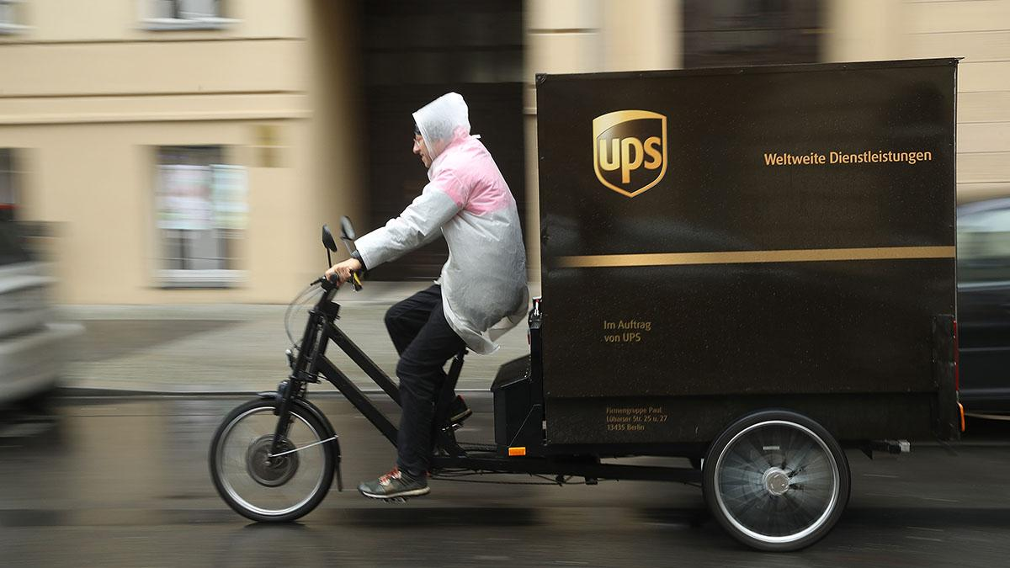
transport
verb
to carry from one place to another
Notes:
https://www.marketplace.org/2019/11/21/cities-are-piloting-e-bike-programs-in-a-bid-to-reduce-delivery-truck-traffic/

Slide 4
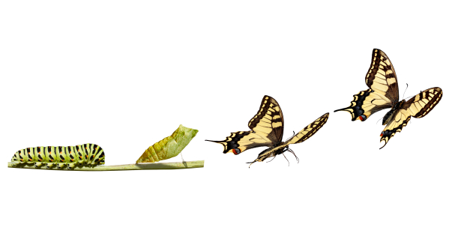
transform
verb
to change the form, look, or shape of something
Notes:
https://greattransitionstories.org/patterns-of-change/the-metaphor-of-metamorphosis/

Slide 5

suitable
adjective
right for the situation,
appropriate
Notes:
https://www.publicdomainpictures.net/en/view-image.php?image=29819&picture=child-in-a-raincoat

Slide 6
unsuitable

Slide 7

judge
verb
to form an opinion about
Notes:
https://www.houstonchronicle.com/opinion/editorials/article/Thumbs-up-thumbs-down-12295067.php

Slide 8
misjudge

Slide 9

decompose
verb
to decay,
to break down into smaller parts
Notes:
https://steemit.com/steepshot/@keephy/20180309t094850680z-post

Slide 10
compose

Slide 11
Your turn!
Choose one set of words below.
Write a sentence that demonstrates the meaning of the first word.
Write a sentence that demonstrates the meaning of the second word.
suitable | unsuitable
judge | misjudge
compose | decompose

