Slide 1
Weekly Words
Unit 2, Week 2
Notes:
decompose: to decay
layer: a section of something that alternates with a different material from top to bottom
nutrient: something that helps people, animals, and plants live and grow
organic: having to do with or coming from living things
prevent: to stop from happening
transport: to carry from one place to another
value: to think of something as important
vital: necessary for life

Slide 2
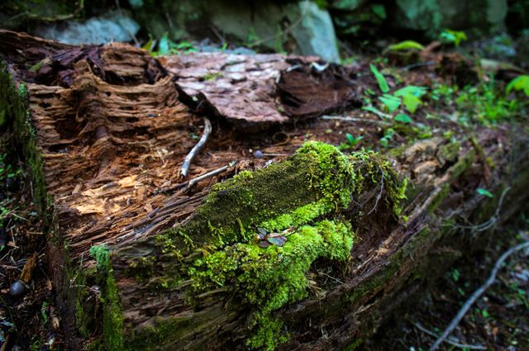
decompose
verb
to decay
Notes:
decompose (verb)
Elaboration:
When a tree falls in the forest and it’s just left there, it begins to decompose. Water, air, and small animals help this process happen. In Dirt: the Scoop on Soil you have learned about decomposers: animals that break down soil. Adding the suffix -er makes “decompose” into “decomposer”—a noun, the thing that decomposes!
Think, Pair, Share prompt:
How can you tell that this tree is decomposing? What do you notice about what’s happening to it?
https://steemit.com/steepshot/@keephy/20180309t094850680z-post

Slide 3
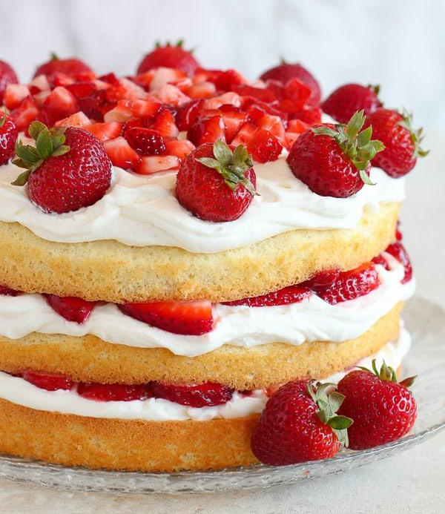
layer
noun
a section of something that alternates with a different material from top to bottom
Notes:
layer (noun)
Elaboration:
This cake has repeating layers of cake, cream, and strawberries.
Think, Pair, Share prompt:
When you get dressed to go outside on a cold day, what layers of clothing do you put on?
https://celebratingsweets.com/strawberry-shortcake-cake/

Slide 4
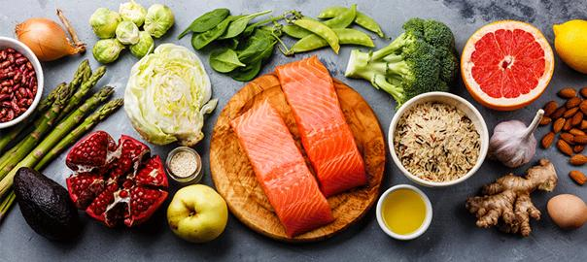
nutrient
noun
something that helps people, animals, and plants live and grow
Notes:
nutrient (noun)
Elaboration:
Plants get nutrients from the soil. People get nutrients from plants. Many people also eat meat and fish to get nutrients. Healthy foods are packed with the nutrients we need to grow and be strong!
Think, Pair, Share prompt:
What foods do you see here? Which ones remind you of foods you eat to get the nutrients you need to be healthy?
https://docs.google.com/presentation/d/1v6zpwLeCkluVNfysvTrtfOSEQnZG-5FrKKrcIwHDUS4/edit#slide=id.g9f7f33d819_0_25

Slide 5
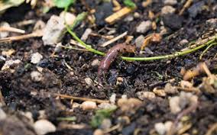
organic
adjective
having to do with or coming from living things
Notes:
organic (adjective)
Elaboration:
This is a word you might hear in different places. When we talk about something that is organic during this study, we are talking about something that is not made by people, but that comes directly from the natural world. In this photo, we see an earthworm. Earthworms are important for turning all kinds of organic material, or material from plants, into good soil for growing.
Think, Pair, Share prompt:
Why might it be important for the soil where we grow our food to be full of good, organic material?
https://hendrikusorganics.com/grow-an-indoor-vegetable-garden/healthy-soil-earthworms-organic-matter/

Slide 6
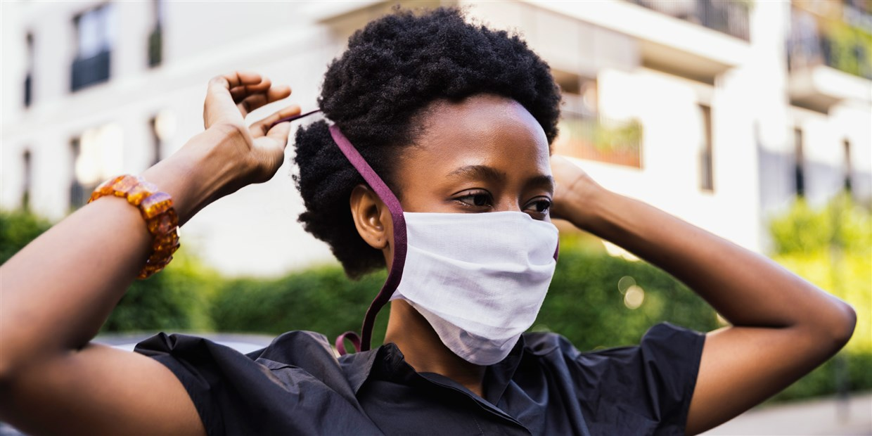
prevent
verb
to stop from happening
Notes:
prevent (verb)
Elaboration:
Wearing a mask is one thing people can do to help prevent the spread of disease.
Think, Pair, Share prompt:
Imagine you are building a tall structure with blocks. What kinds of things can you do to prevent your structure from falling down?
https://www.nbcnews.com/shopping/apparel/popular-face-masks-cdc-valves-n1236806

Slide 7
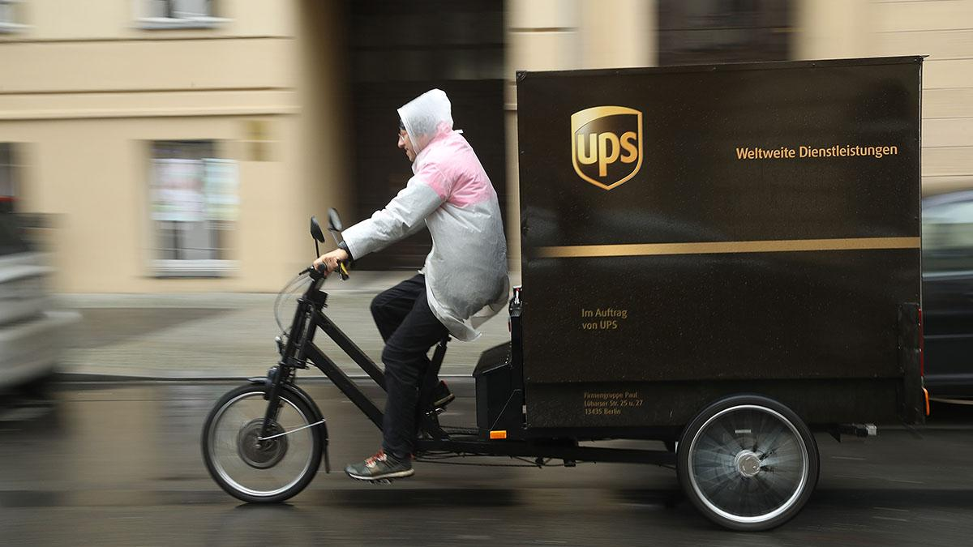
transport
verb
to carry from one place to another
Notes:
transport (verb)
Elaboration:
We are learning that water can transport bits of soil from one place to another. People often use trucks to transport. But lots of vehicles can be used to transport all kinds of things! Here is a UPS tricycle!
Think, Pair, Share prompt:
Boats are also used to transport things by water. Why might someone decide to transport something by boat?
https://www.marketplace.org/2019/11/21/cities-are-piloting-e-bike-programs-in-a-bid-to-reduce-delivery-truck-traffic/

Slide 8
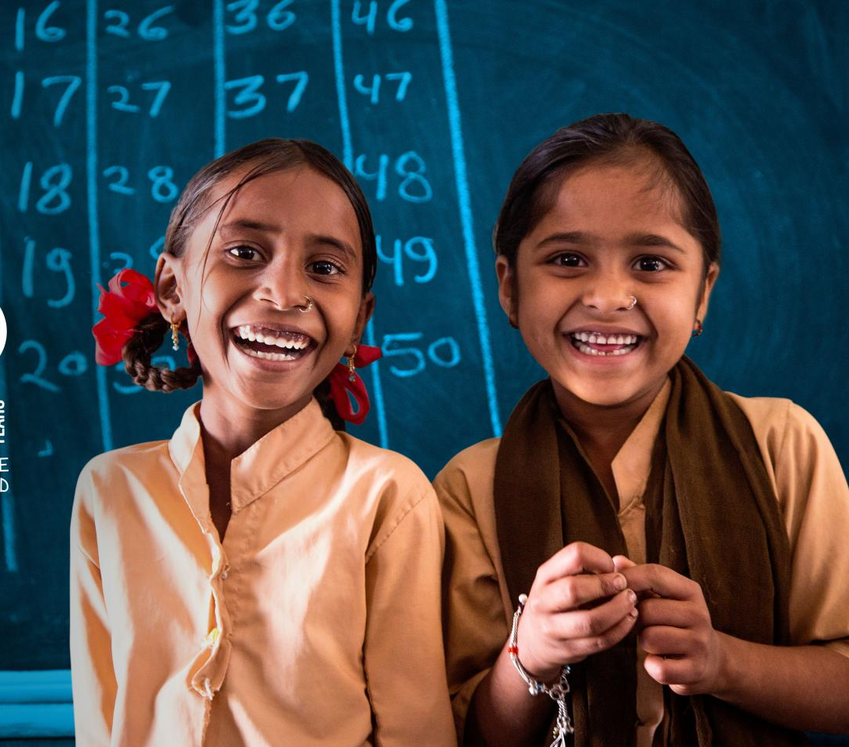
value
verb
to think of something as important
Notes:
value (verb)
Elaboration:
The UN Convention on the Rights of the Child is an official statement by countries to show that they value children’s health, education, and happiness.
Think, Pair, Share prompt:
What is very, very important to you? What do you value?
https://www.unicef.org/child-rights-convention

Slide 9

vital
adjective
necessary for life
Notes:
vital (adjective)
Elaboration:
Water is vital to life: it’s needed for plants, people, and other animals to live.
Think, Pair, Share prompt:
What else is vital for people and other animals to live?
https://water.unl.edu/

