Slide 1

Soil Erosion and How to Prevent It
excerpt, pages 12-13
Text Talk Week 5, Day 2

Slide 2
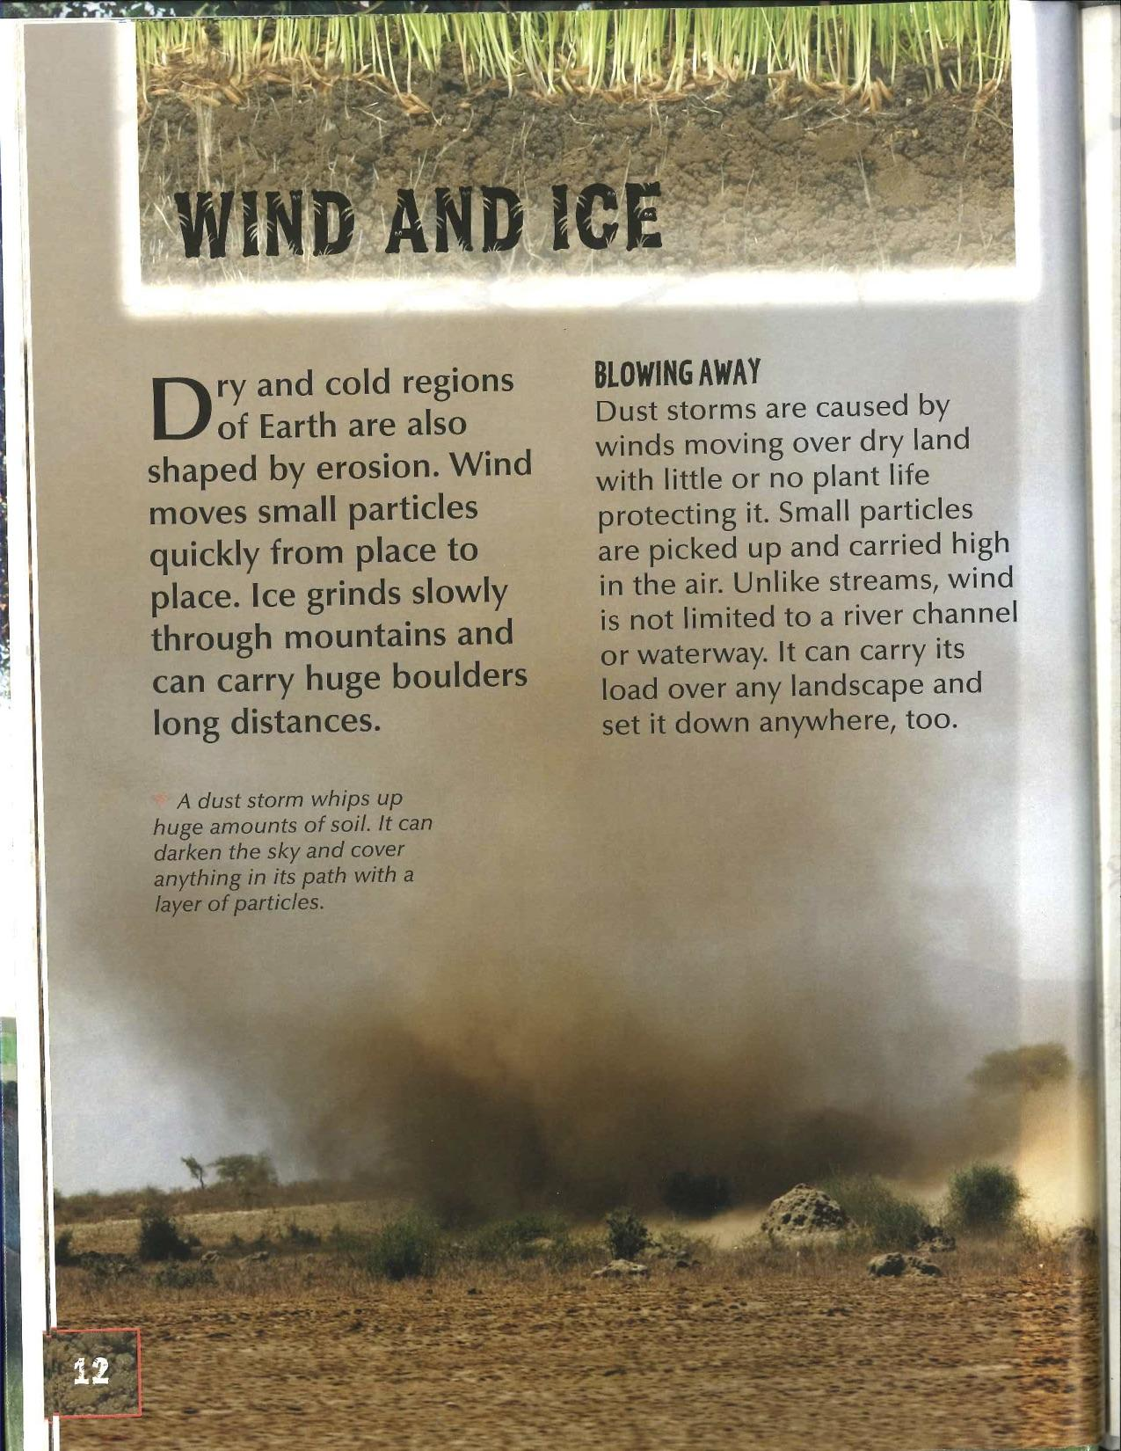
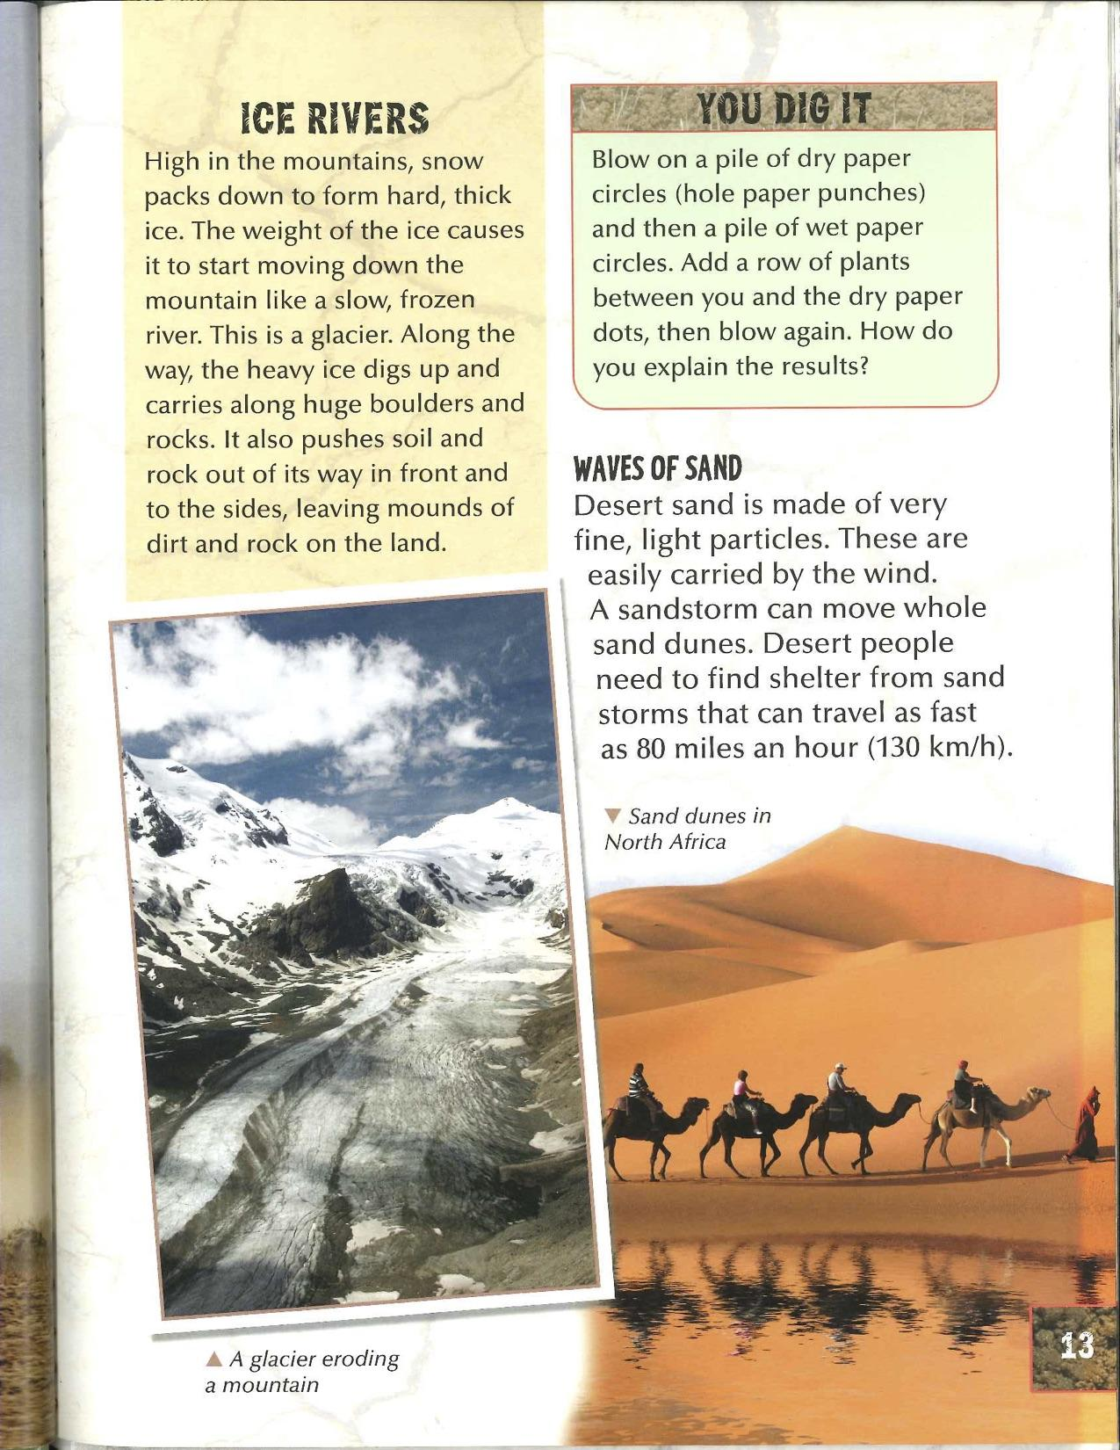

Slide 3
