Slide 1
Sample Posters
Writing Week 5, Day 2

Slide 2
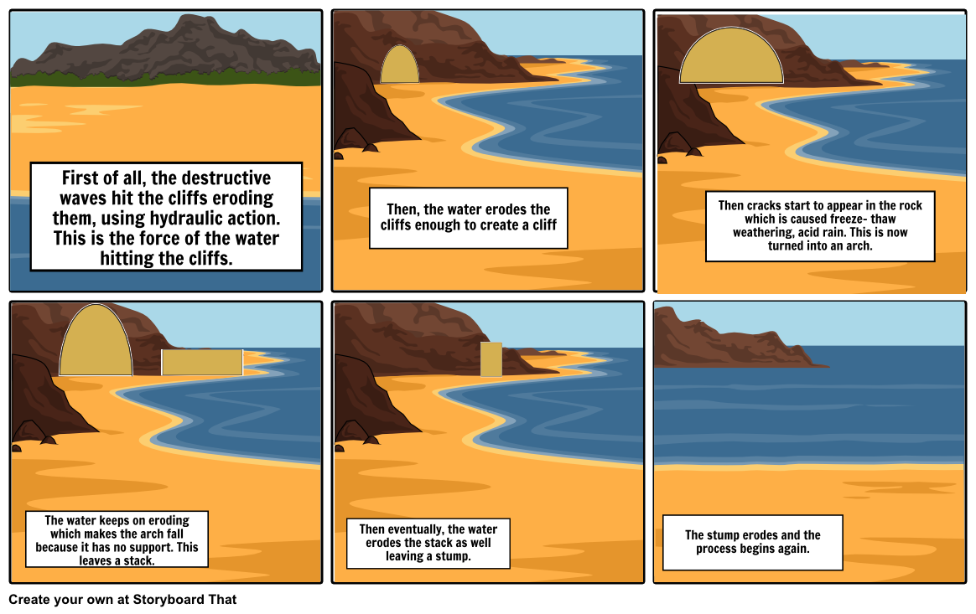
http://www.storyboardthat.com/storyboards/storyboardstar235/coastal-erosion

Slide 3
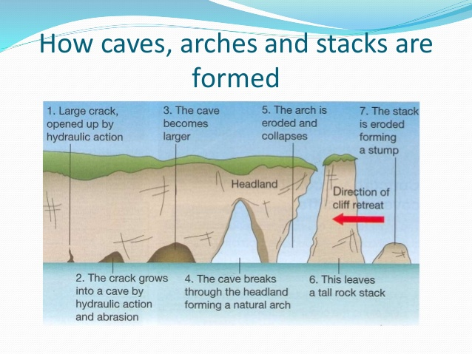
https://www.slideshare.net/brittzyxx/coasts-igcse-geography

Slide 4
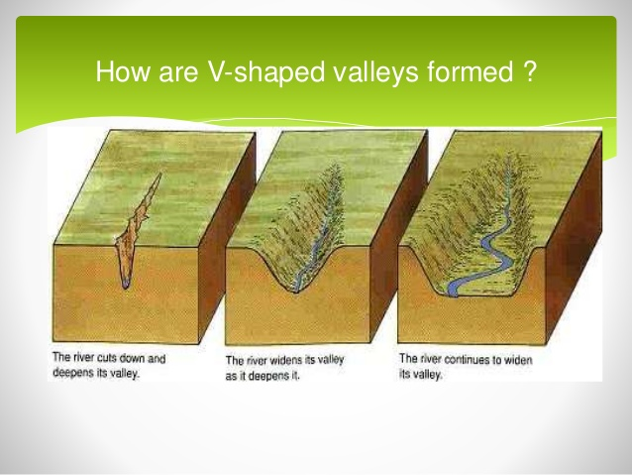
https://www.slideshare.net/stevenheath148/v-shaped-valleys-and-interlocking-spurs

Slide 5
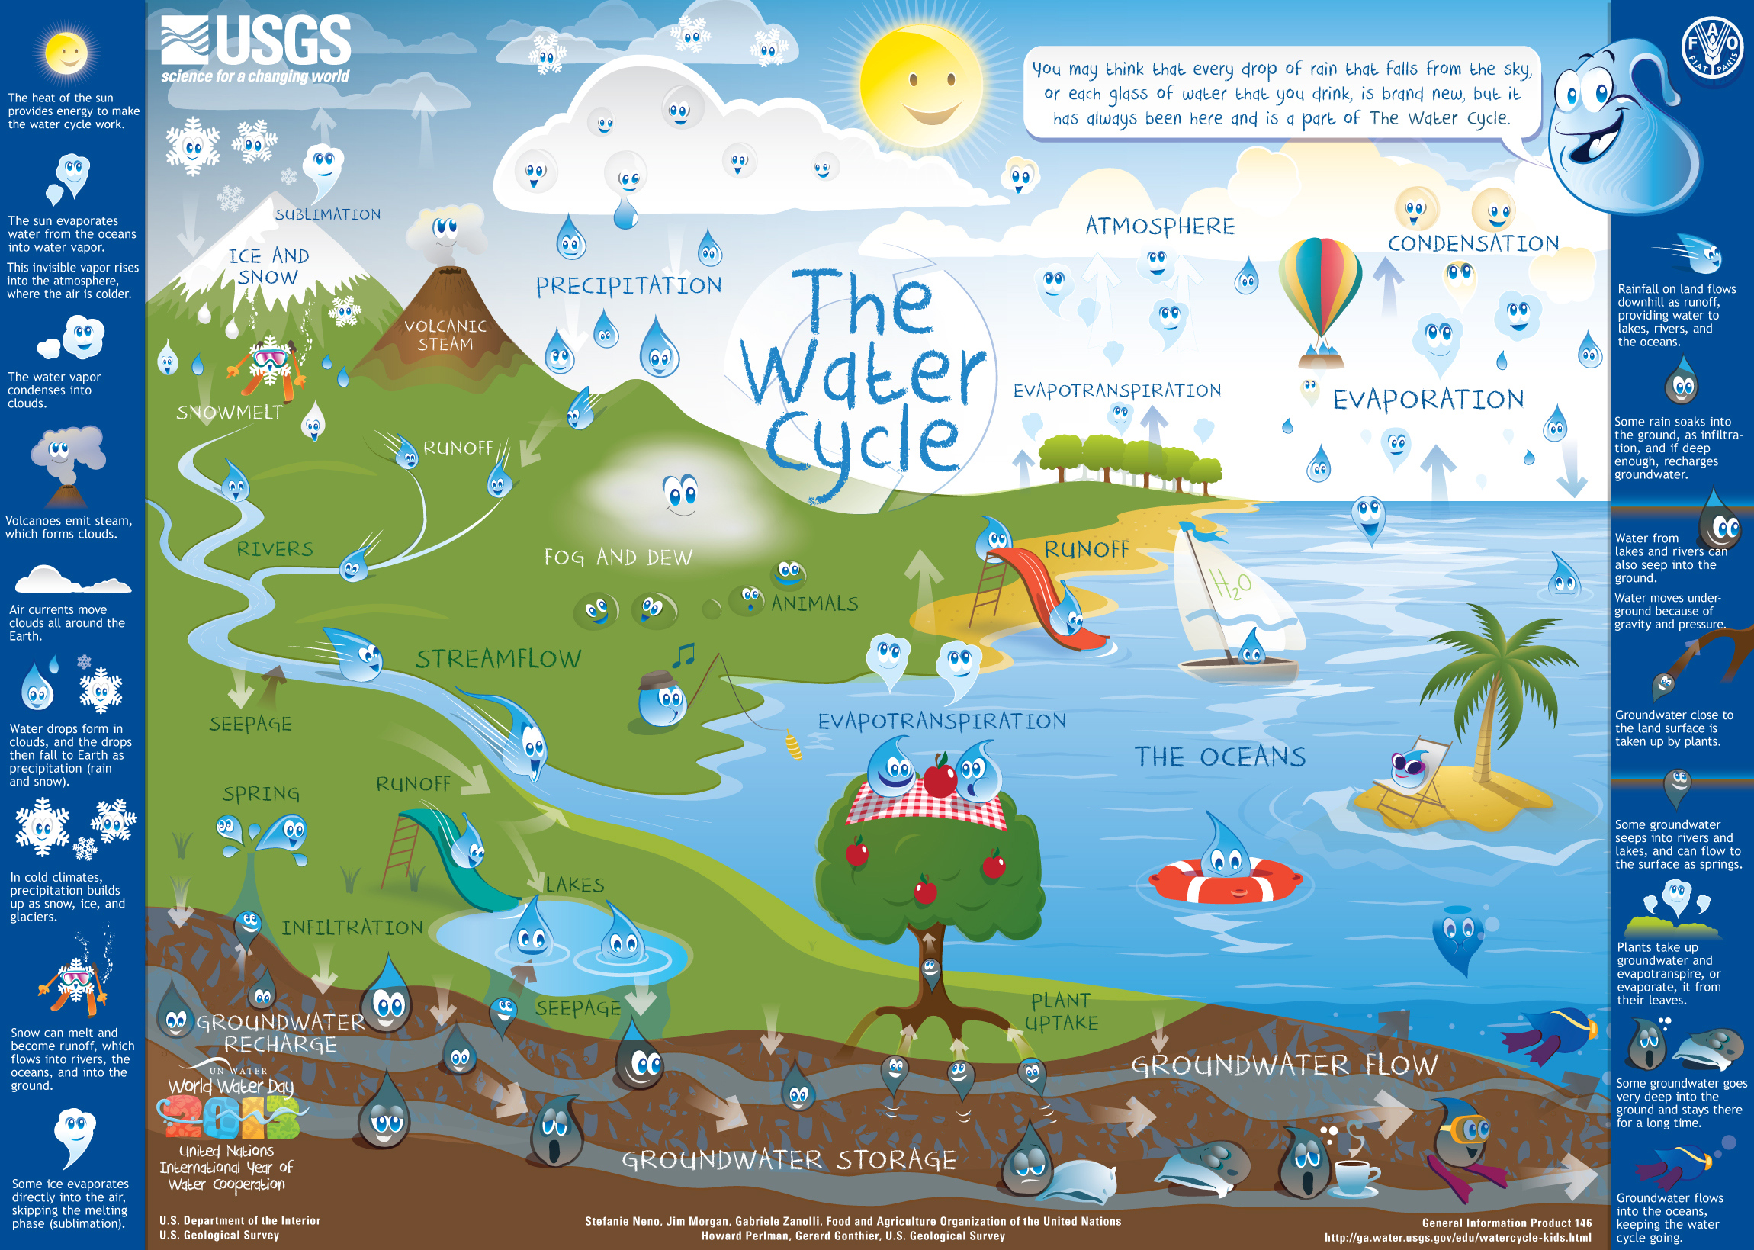
https://water.usgs.gov/edu/watercyclekids/download/watercycle-kids-poster.jpg

