Slide 1
Rio Patagonia
Writing Week 5, Day 1

Slide 2
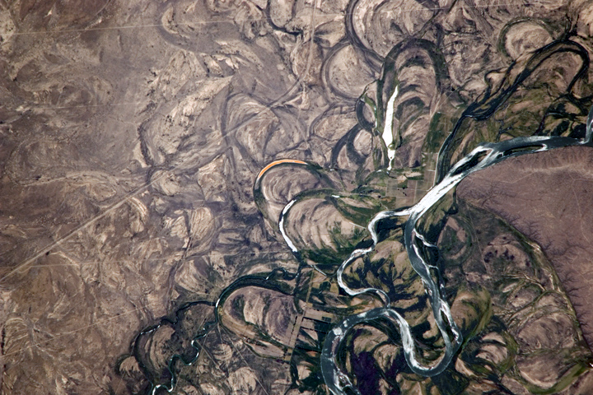
http://i.imgur.com/sX9A71I.jpg
Notes:
Rio Negro, Patagonia

