Slide 1
Popham Beach Image
Writing Week 5, Day 5

Slide 2
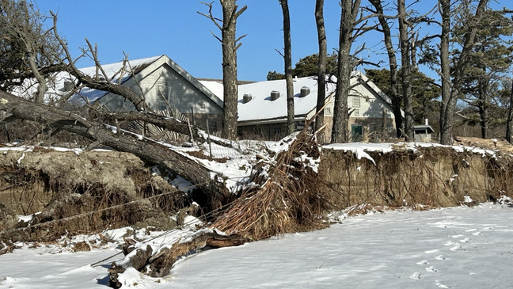
Slide 1
Photo: Theresa Vilcapoma
Notes:
Thompson Island, Boston

