Slide 1
Moving Away from the Edge
Text Talk Week 5, Day 5

Slide 2


Slide 3


Slide 4
Gay Head Lighthouse, Aquinnah, Martha’s Vineyard, Massachusetts

Slide 5
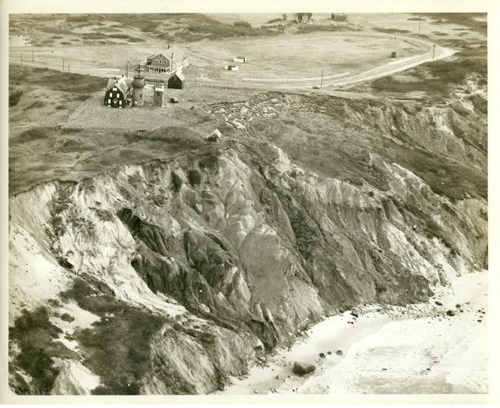

Slide 6
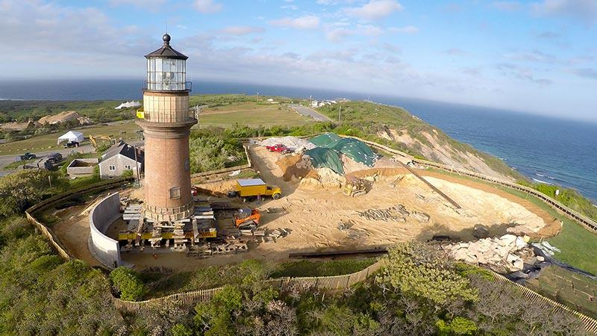

Slide 7
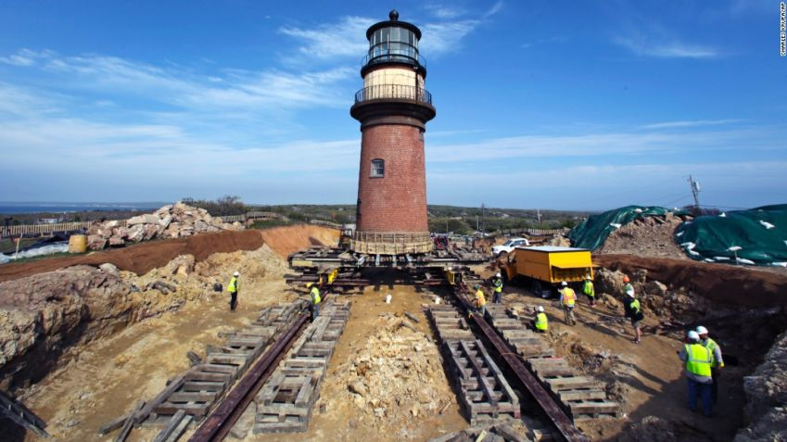

Slide 8


Slide 9

Notes:
https://www.mvtimes.com/2016/10/05/recently-relocated-gay-head-lighthouse-rough-shape/

Slide 10
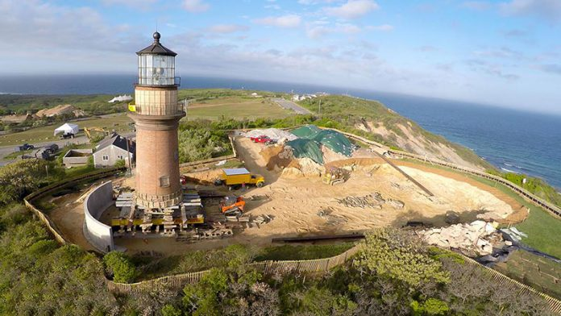
The building, which weighs in at 400 tons, traveled along metal I-beams on a path chosen for both its elevation and for the stability of the clay. Project managers said they hope the new location will be stable for another 150 years.

Slide 11
Citations
Slides 2,4 and 9: https://www.mvyvacations.com/islands-smallest-town-dreams-big-for-the-future
Slide 3: Photo: Jesse Costa, WBUR http://legacy.wbur.org/2013/03/08/plum-island-home-storm
Slide 5: https://commons.wikimedia.org/wiki/File:Gay_Head_Light_-_1958_USCG_aerial_photograph.png
Slide 6 and 10: Drew Kinsman, New York Times: https://www.mvtimes.com/2015/06/03/gay-head-lighthouse-move-is-complete/
Slide 7:http://www.cnn.com/travel/article/gay-head-lighthouse-move-feat/index.html?gallery
Slide 8: http://www.cnn.com/travel/article/gay-head-lighthouse-move-feat/index.html?gallery=6
Slide 9: https://www.mvtimes.com/2016/10/05/recently-relocated-gay-head-lighthouse-rough-shape/

