Slide 1
Mid-Unit 2 Assessment
Week 5, Day 1

Slide 2
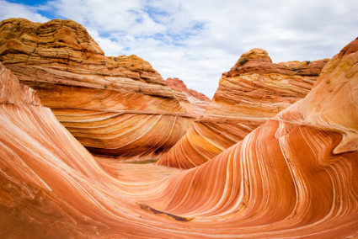
https://kidsdiscover.com/teacherresources/erosion-ever-changing-earth/

