Slide 1
Dunes
Text Talk Week 5, Day 4

Slide 2
On windy days, sand gets picked up by the wind and blows around. When the grains of sand hit something, they stop blowing and fall to the ground. This can form a dune—a heap of sand. If grass can grow there, those blades of grass can protect the sand dune from the wind by keeping the sand in place. Then the sand piles up, getting bigger and protecting the land from becoming damaged.
Notes:
NJ Sea Grant Dune Manual

Slide 3
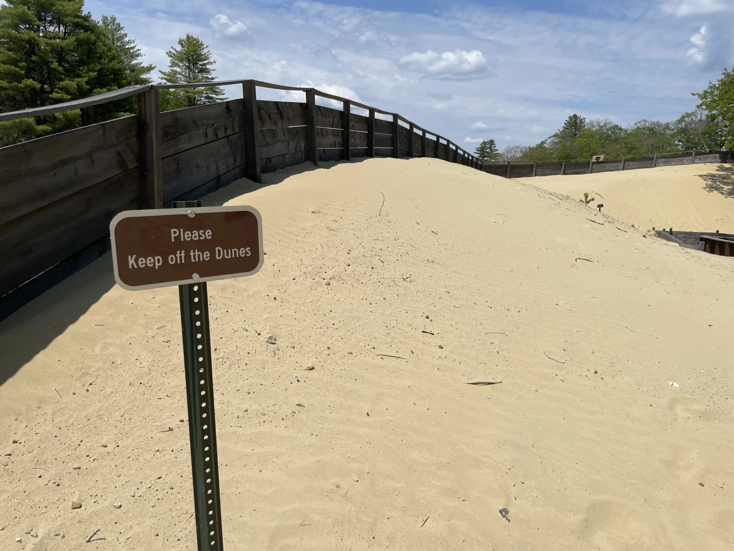
Dunes in Freeport, Maine

Slide 4
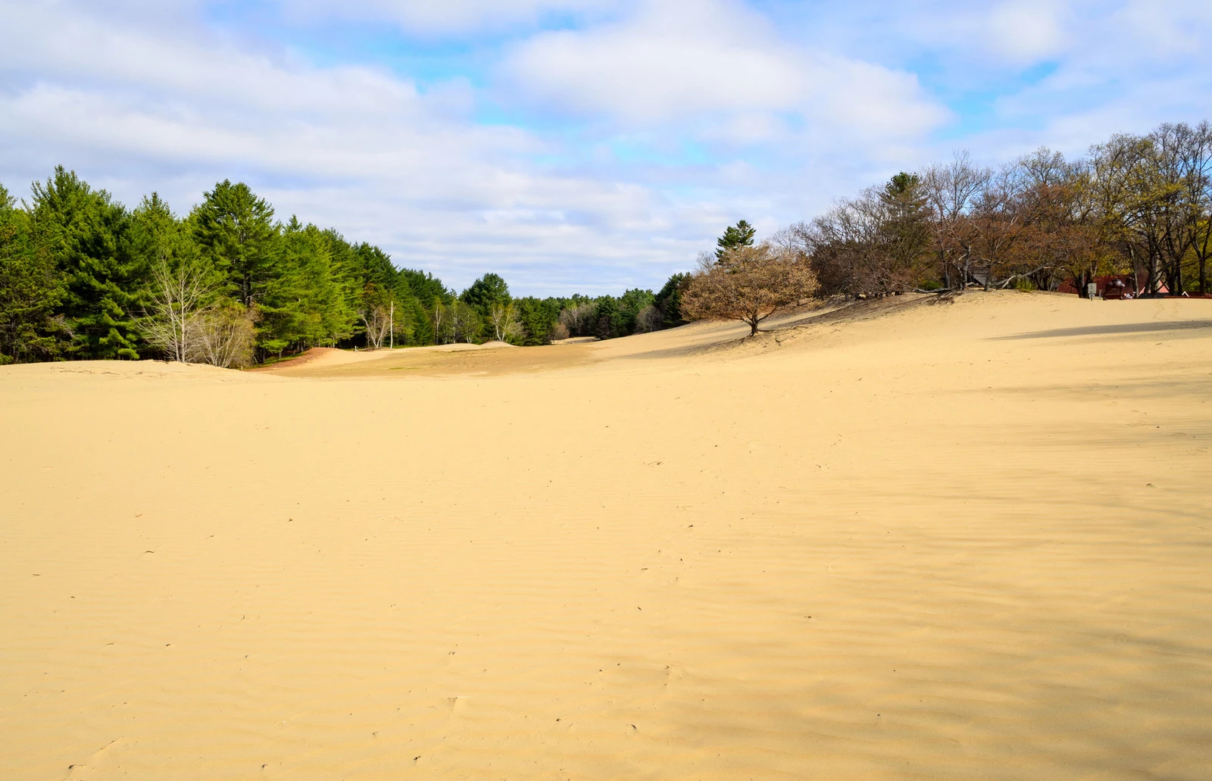
Dunes in Freeport, Maine

Slide 5
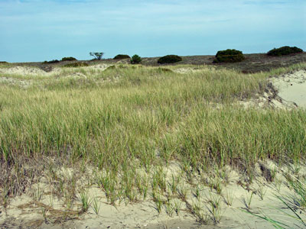
Dune Grass

Slide 6
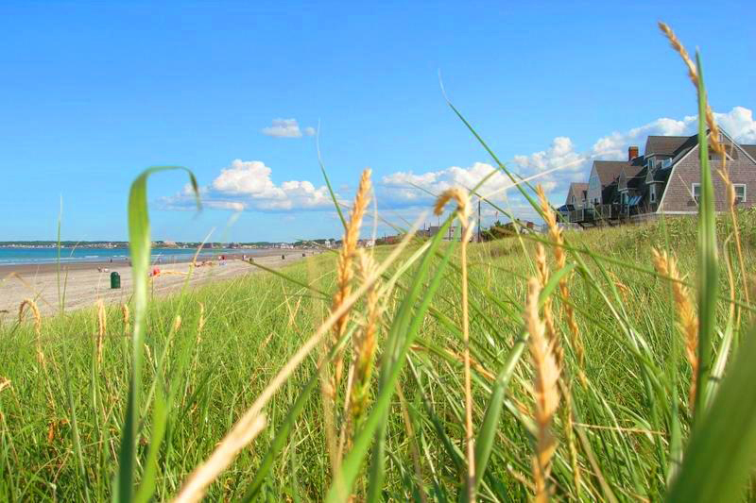
Dune Grass in Hull, Massachusetts

Slide 7
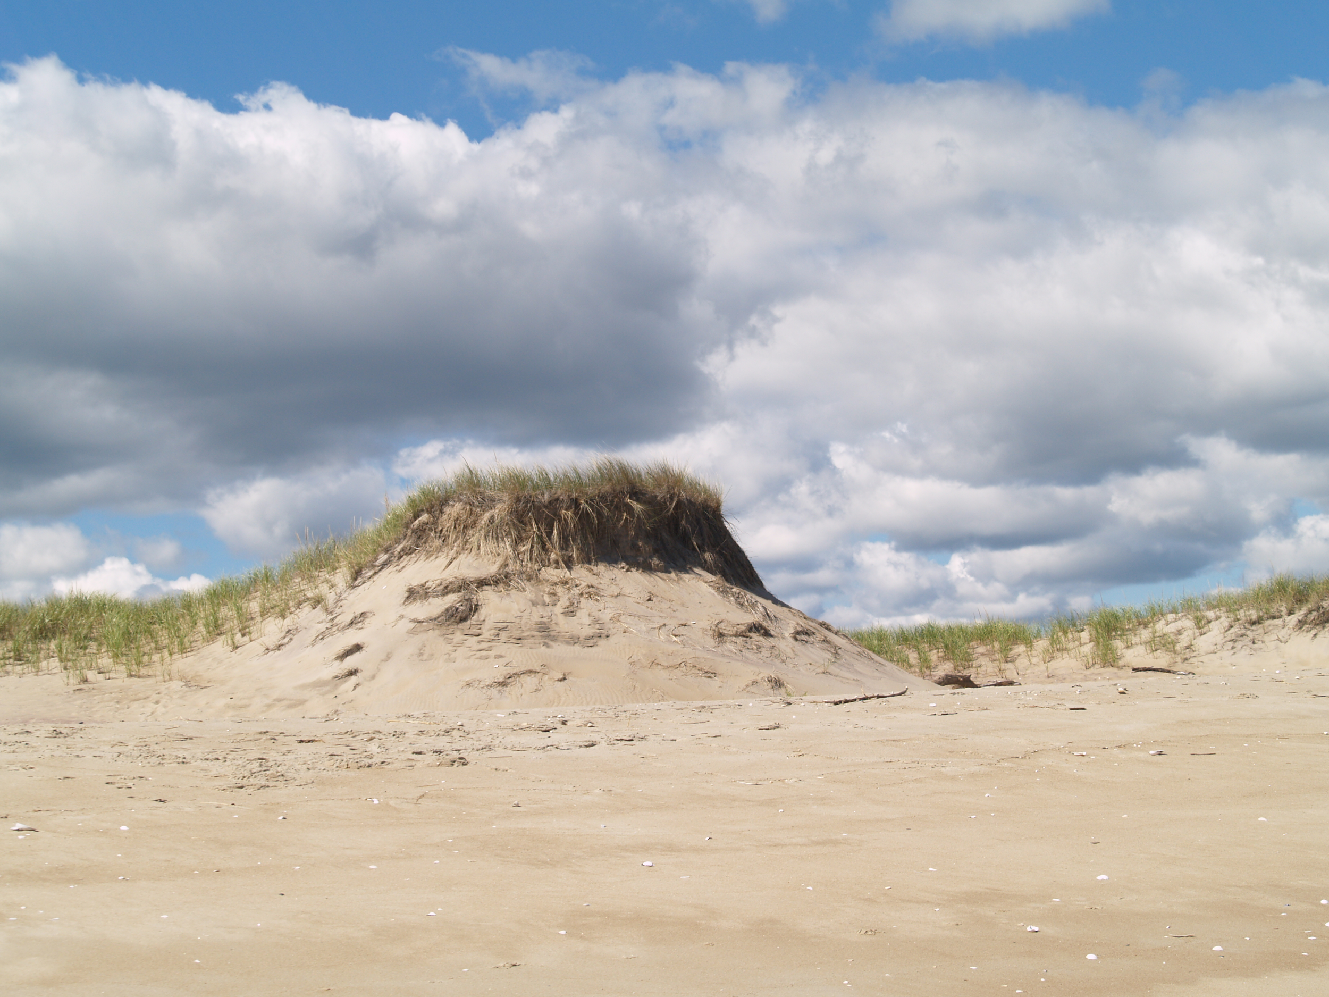
Sand dunes on Plum Island, Massachusetts

Slide 8
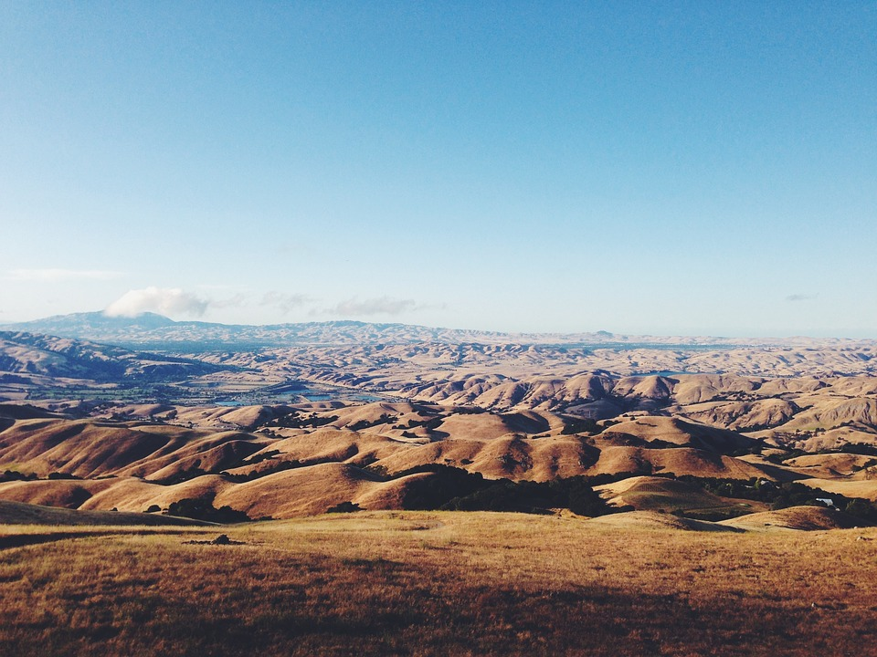
Sand dunes in the Sahara Desert

Slide 9
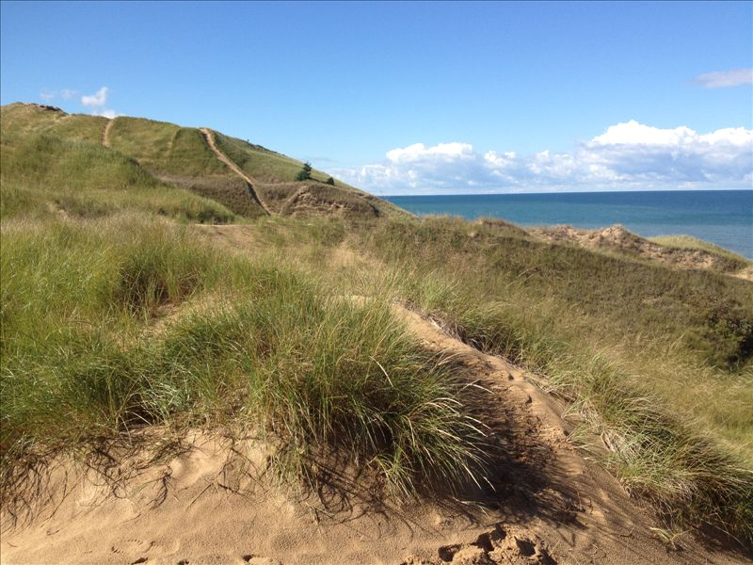
Dunes in Van Buren County, Michigan

Slide 10
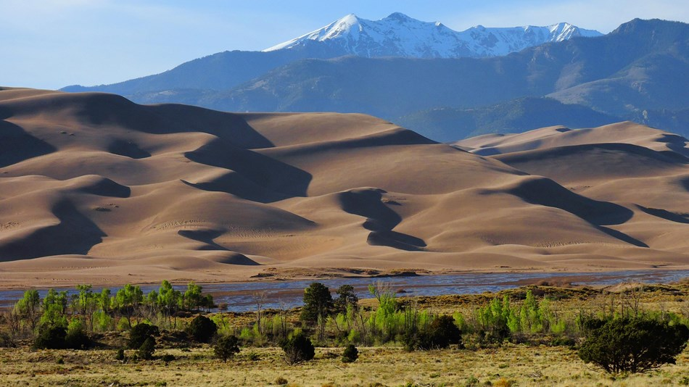
Great Sand Dunes, Colorado

Slide 11
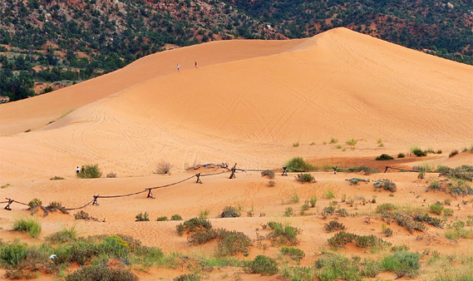
Coral Pink Sand Dunes National Park, Utah

Slide 12
Citations
Slide 3: https://www.wshu.org/podcast/off-the-path/2023-08-10/the-desert-of-maine-an-ecological-odyssey-at-a-tourist-spot
Slide 4: https://q1065.fm/desert-of-maine-history-visit/
Slide 5: https://www.maine.gov/dacf/mnap/features/communities/dunegrassland.htm
Slide 6: https://www.city-data.com/picfilesc/picc37019.php
Slide 8: https://www.nps.gov/caco/learn/nature/geologicactivity.htm
Slide 12: https://www.worldatlas.com/national-parks/great-sand-dunes-national-park-and-preserve-colorado.html

