Slide 1
Arches National Park
Text Talk Week 5, Day 3

Slide 2
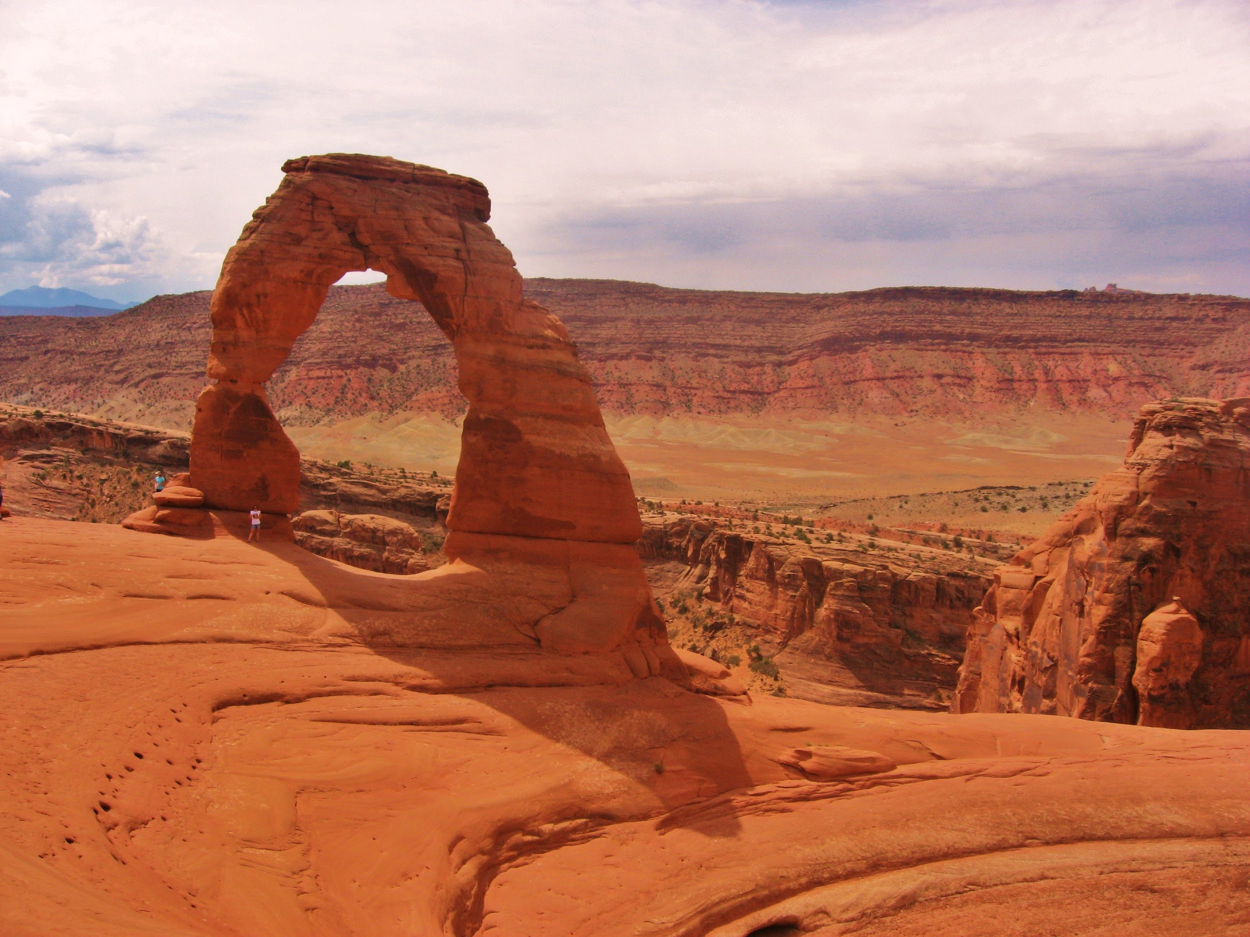
Notes:
What is happening in the photographs?
● What is erosion?
● How does wind cause erosion?
● What questions do you have about wind erosion?

Slide 3
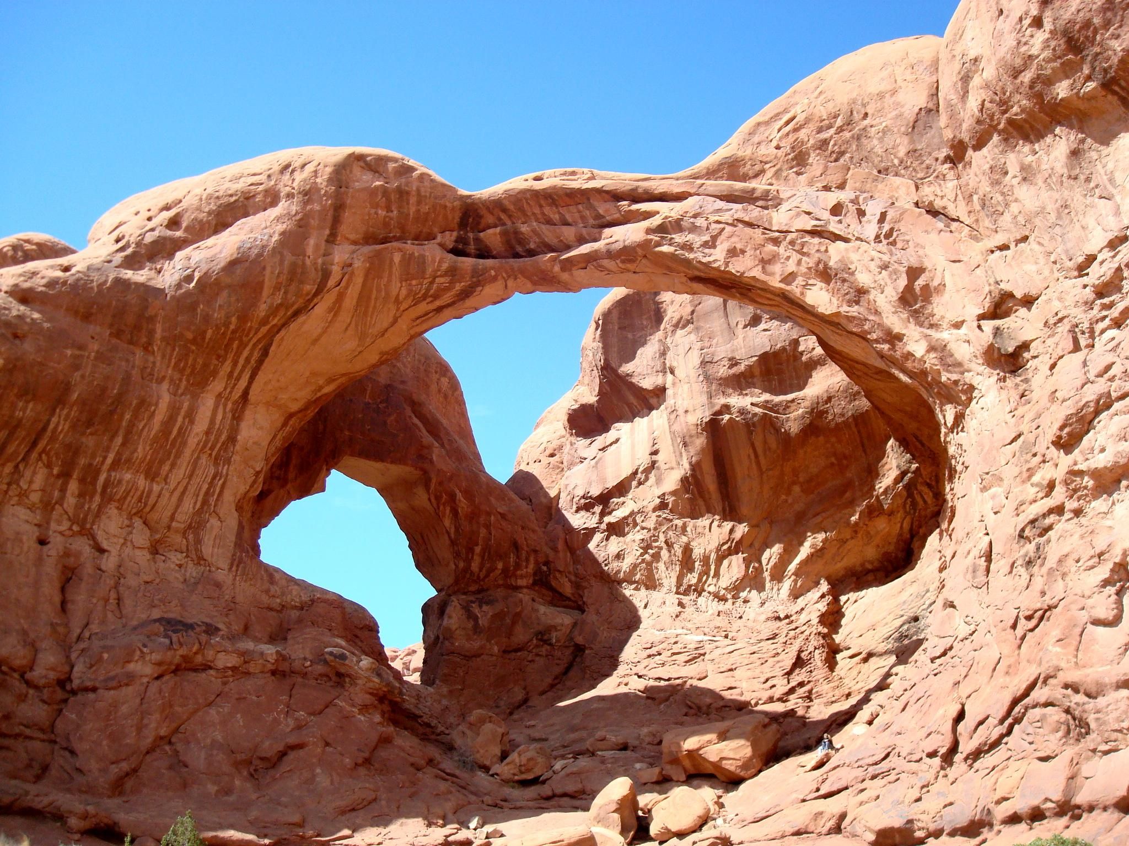
Notes:
What is happening in the photographs?
● What is erosion?
● How does wind cause erosion?
● What questions do you have about wind erosion?

Slide 4
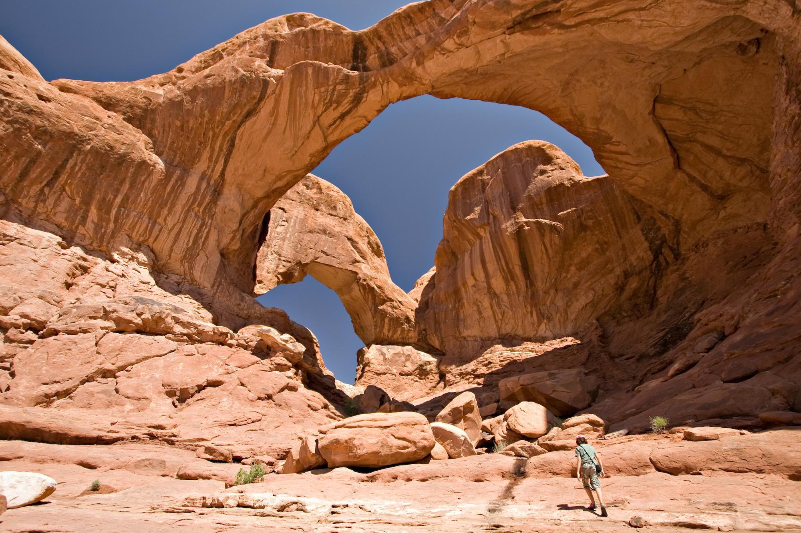
Notes:
What is happening in the photographs?
● What is erosion?
● How does wind cause erosion?
● What questions do you have about wind erosion?
We gained information from a text and from photographs. They
both helped us deepen our understanding about wind erosion.

Slide 5
Citations
Slide 2: https://commons.wikimedia.org/wiki/File:Delicate_Arch,_Arches_National_Park_Utah.jpg
Slide 3: https://commons.wikimedia.org/wiki/File:Double_Arch_Arches_National_Park_Utah_USA.JPG
Slide 4: https://commons.wikimedia.org/wiki/File:USA_10439_Arches_National_Park_Luca_Galuzzi_2007.jpg

