Slide 1
Water Images
Text Talk Week 3, Day 1

Slide 2
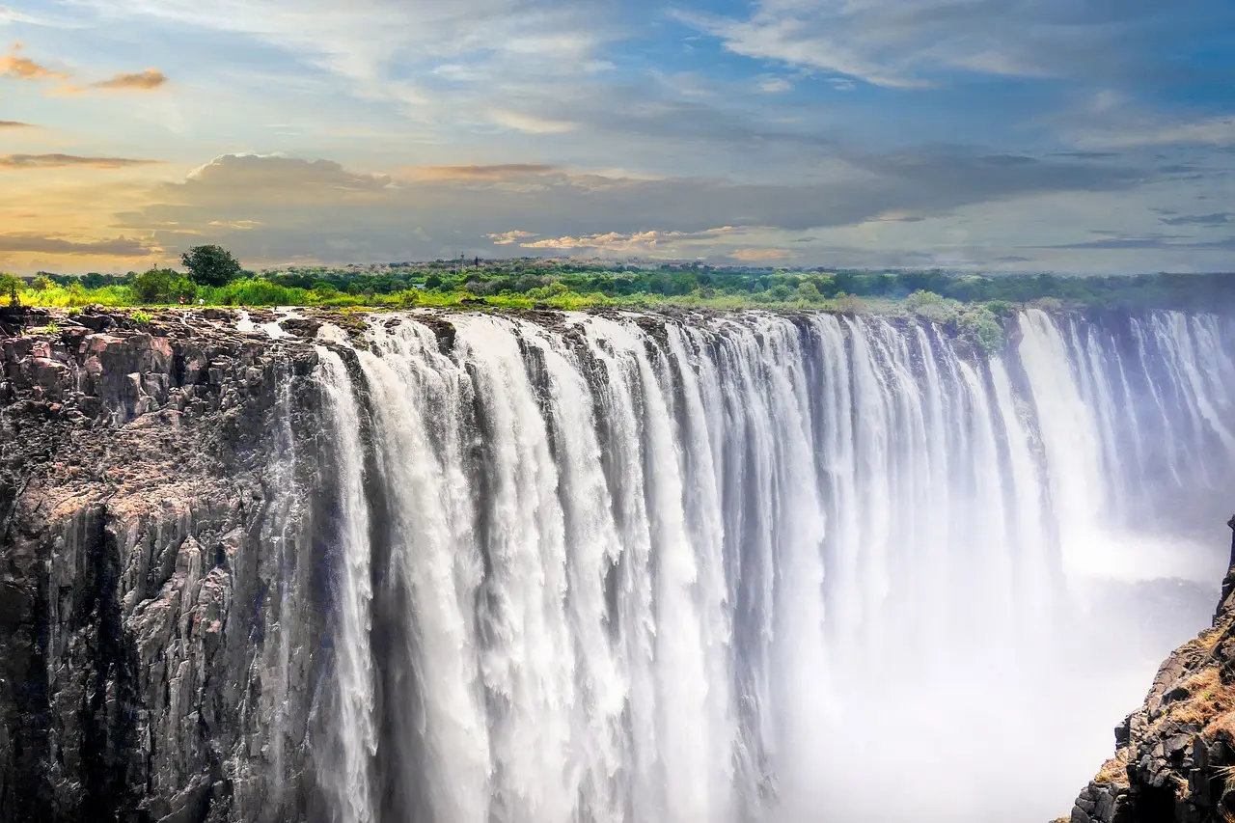
Referenced on front cover
Victoria Falls, Zambezi River at the border between Zambia and Zimbabwe
Notes:
https://www.sapeople.com/2021/03/12/british-airways-comair-to-restart-victoria-falls-route/

Slide 3
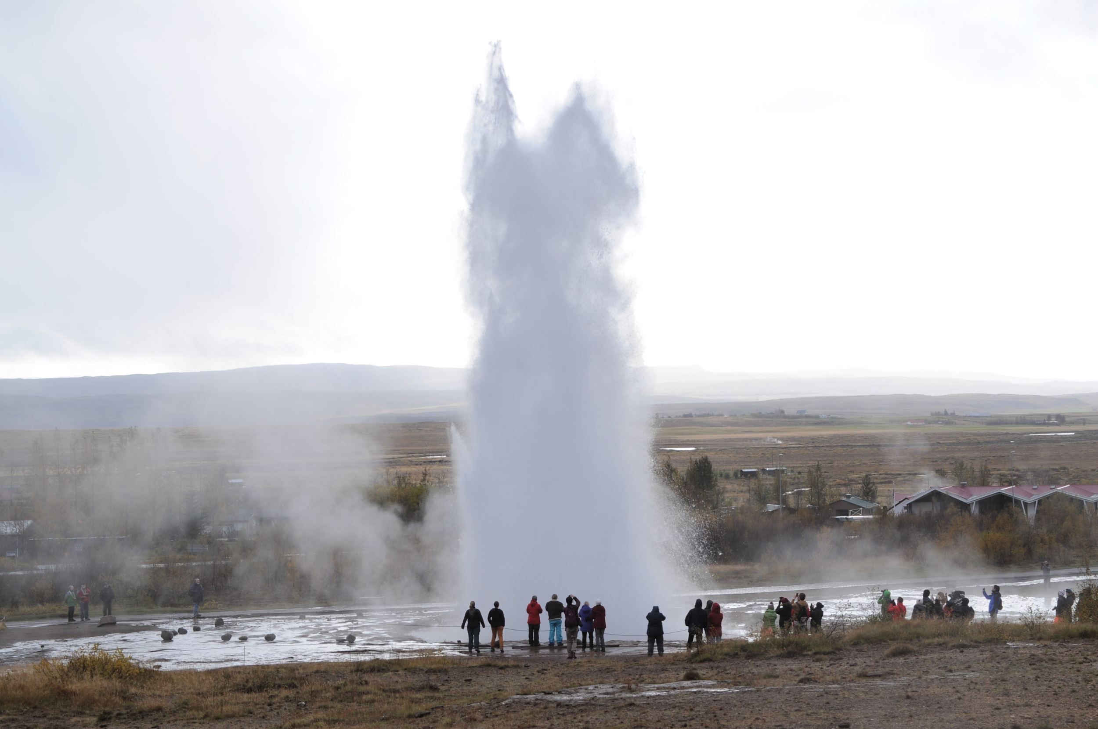
Referenced on back cover
Strokkur Geyser, beside the Hvítá River in Iceland
Notes:
https://commons.wikimedia.org/wiki/File:Geyser_Strokkur_in_Iceland.JPG

Slide 4
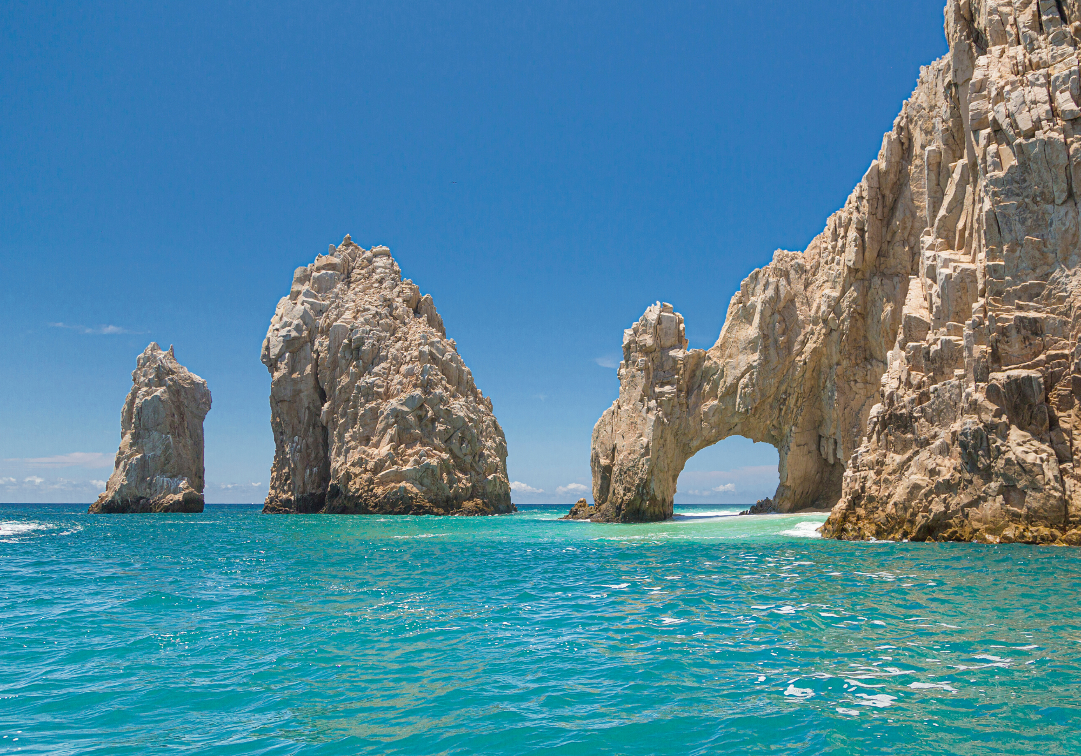
Referenced on pages 25-26
Cabo San Lucas Arch, at the southern tip of Mexico's Baja California Peninsula
Notes:
https://www.shorelinedestinations.com/wedding-destinations/los-cabos

Slide 5
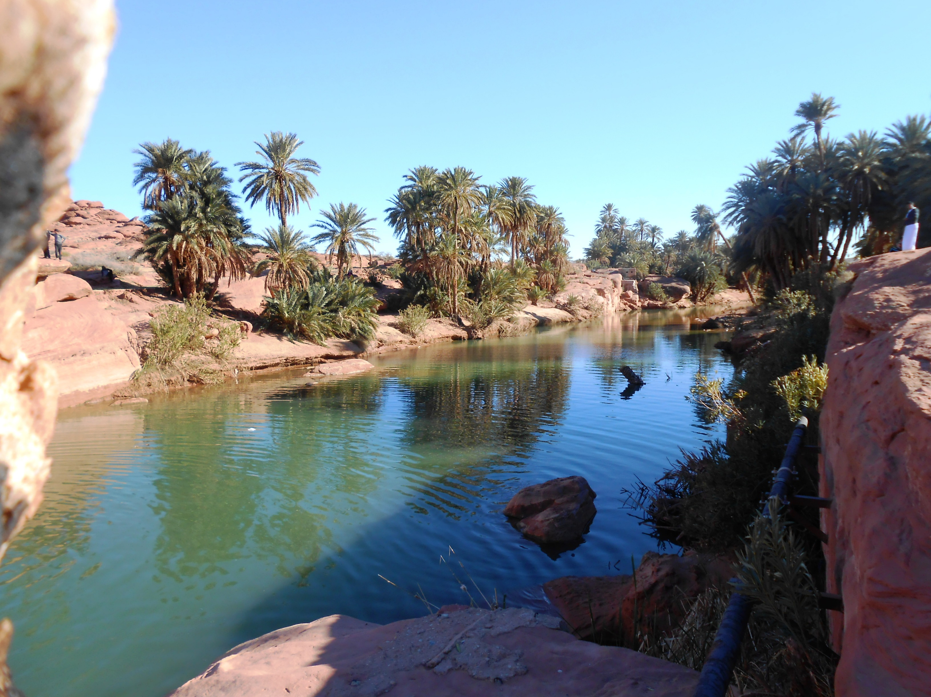
Referenced on pages 17-18
An oasis in the Sahara Desert
Notes:
https://commons.wikimedia.org/wiki/File:Oasis_Tiout.JPG

Slide 6
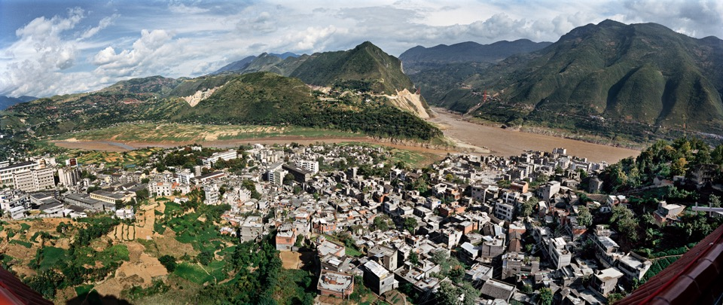
Referenced on pages 7-8
Wushan #1, Yangtze River, China, 2002
By Edward Burtynsky
Notes:
Citation: office of Edward Burtynsky

Slide 7
Citations
Slide 2: https://www.sapeople.com/2021/03/12/british-airways-comair-to-restart-victoria-falls-route/
Slide 3: https://commons.wikimedia.org/wiki/File:Geyser_Strokkur_in_Iceland.JPG
Slide 4: https://www.shorelinedestinations.com/wedding-destinations/los-cabos
Slide 5: https://commons.wikimedia.org/wiki/File:Oasis_Tiout.JPG
Slide 6: Used with special permission from the Office of Edward Burtynsky

