Slide 1
The Colorado River and Popham Beach
Science and Engineering Week 3, Lesson 2

Slide 2
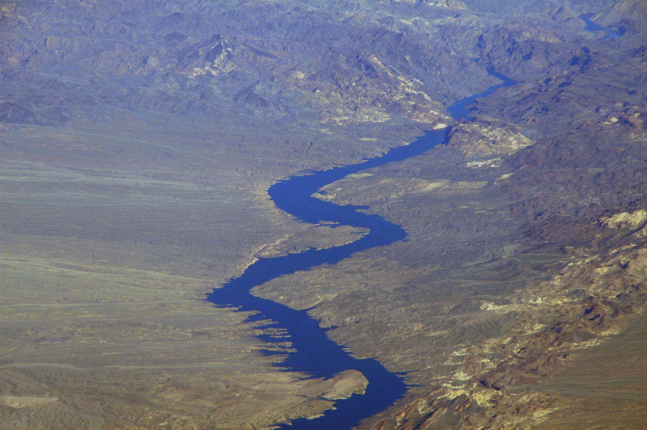

Slide 3
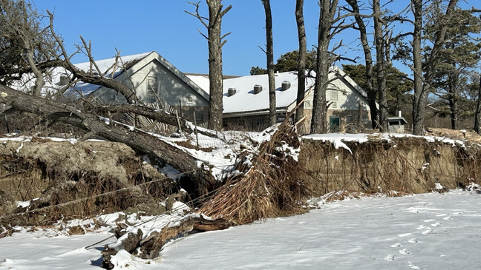

Slide 4
Citations
Slide 2: File:Aerial of the Colorado River.jpg
Slide 3: https://wgme.com/news/local/dunes-damaged-at-popham-beach-threatening-coastal-communities-and-wildlife

