Slide 1
United States Maps
Science and Engineering Week 2, Lesson 2

Slide 2
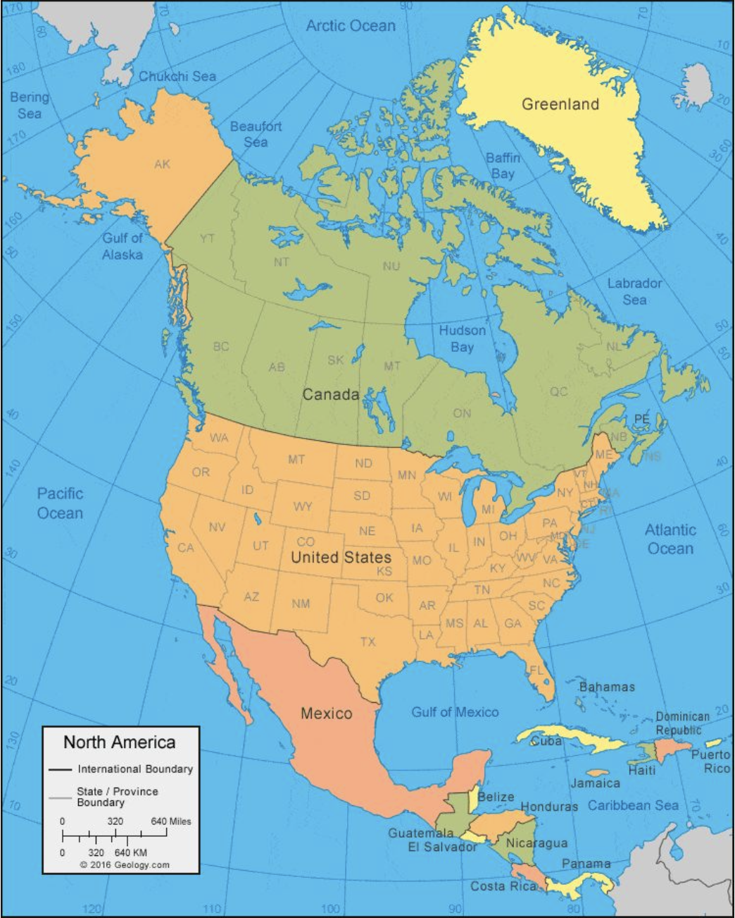
North America

Slide 3
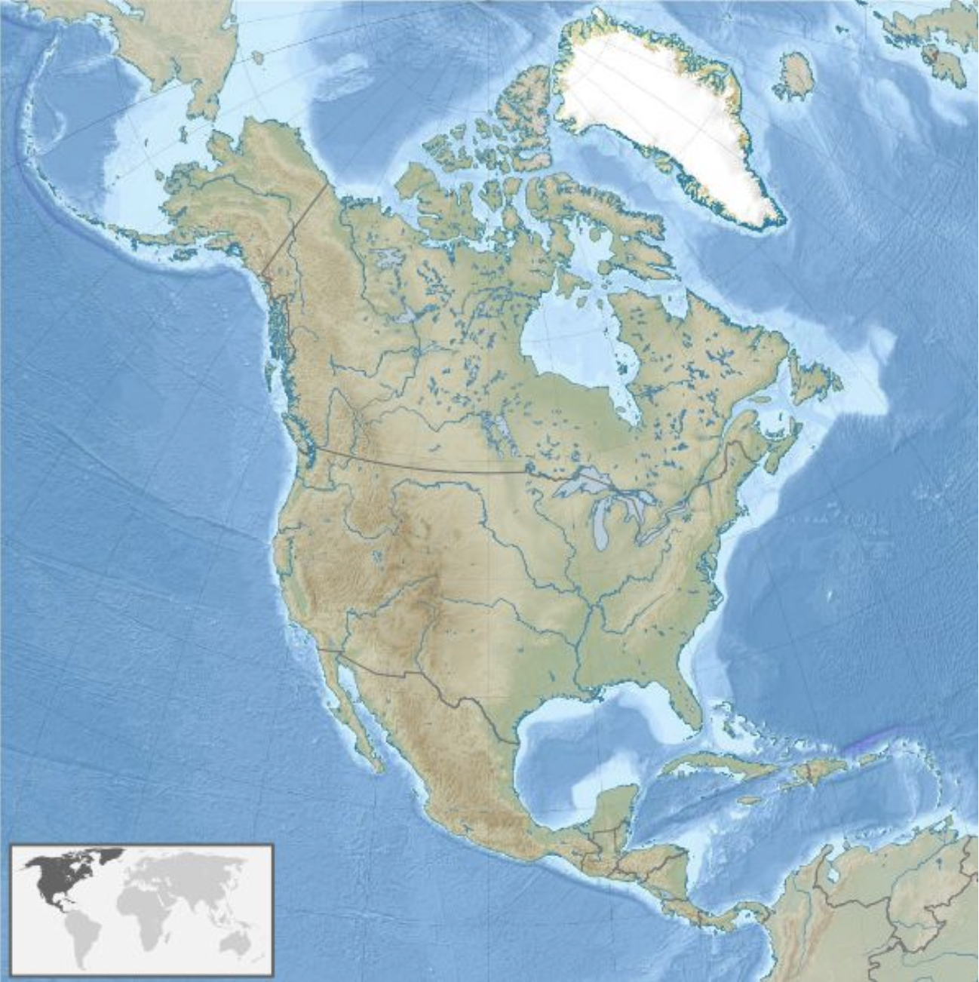
Greenland in North America

Slide 4
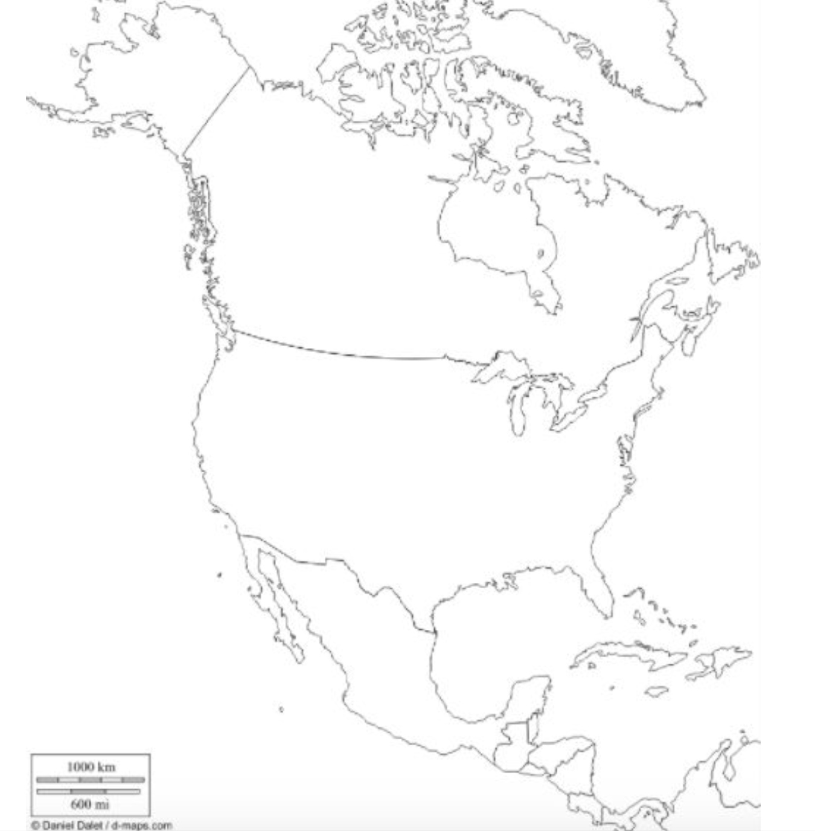
Outline of North America

Slide 5
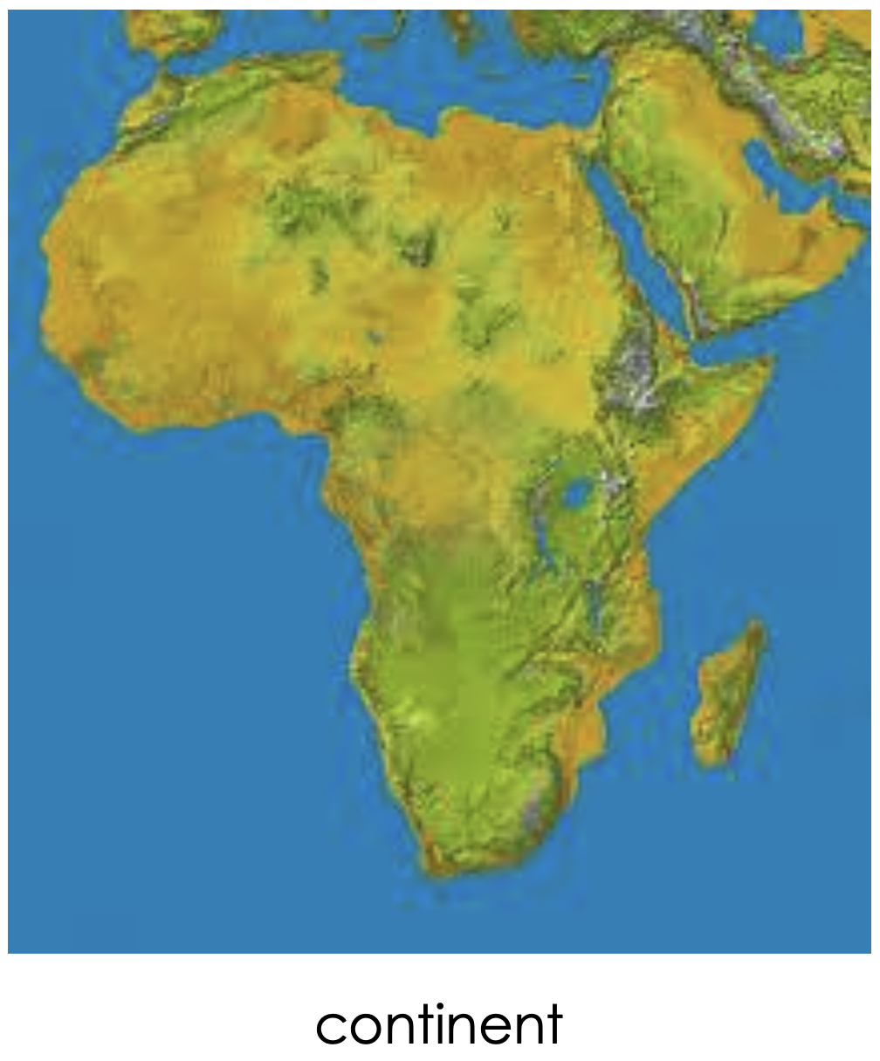


Slide 6
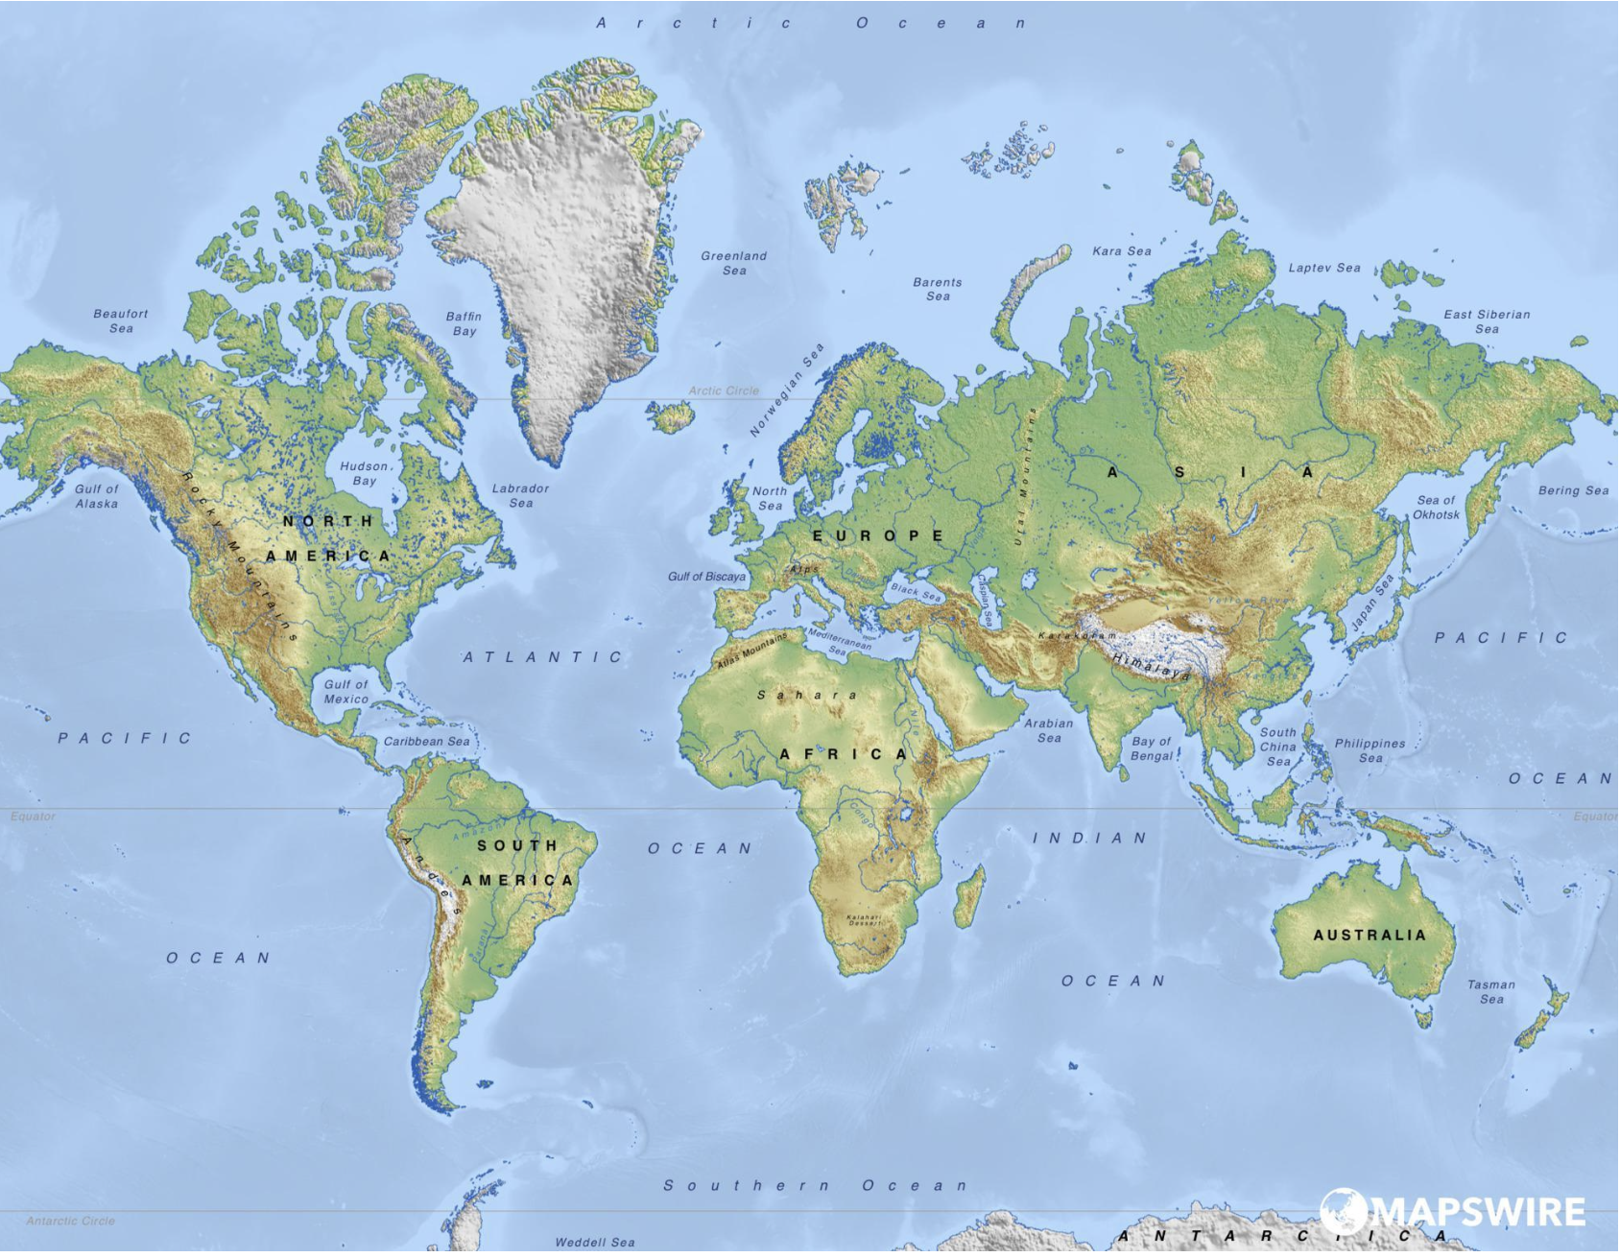
Physical Map of the World

Slide 7
Citations
Slide 2: http://geology.com/world/north-america-satellite-image.shtml
Slide3: https://commons.wikimedia.org/wiki/File:Greenland_in_North_America_(relief).svg
Slide 4: http://notesforslc.blogspot.com/2014/01/outline-map-of-north-america.html
Slide 6: https://mapswire.com/world/physical-maps/

