Slide 1

Soil Erosion and How to Prevent It
excerpt, pages 4 and 7
Text Talk Week 2, Day 3

Slide 2
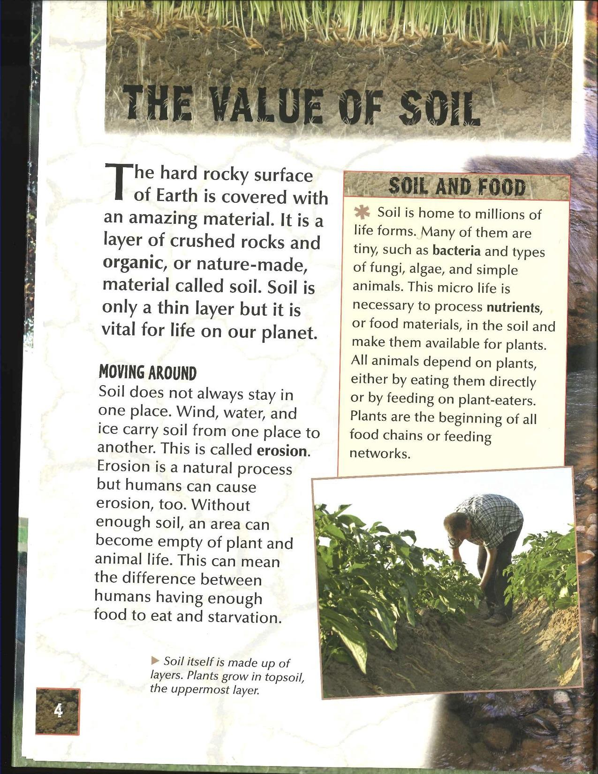


Slide 4
