Slide 1
Popham Beach
Text Talk Week 2, Day 4

Slide 2
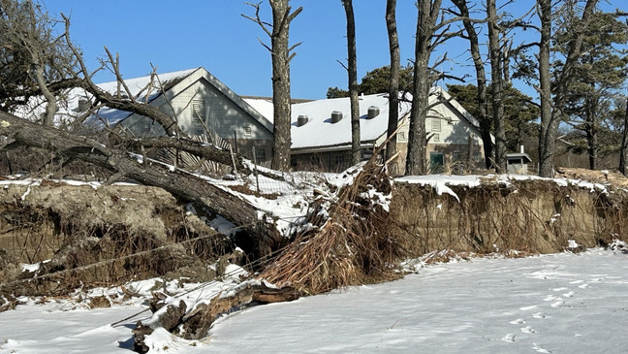

Slide 3
Popham Beach, Phippsburg, Maine

Slide 4
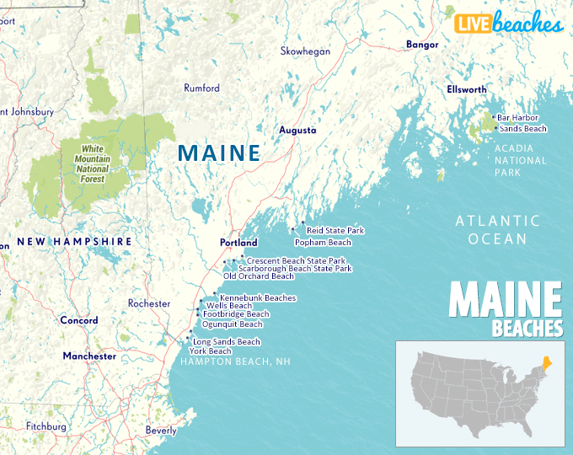

Slide 5
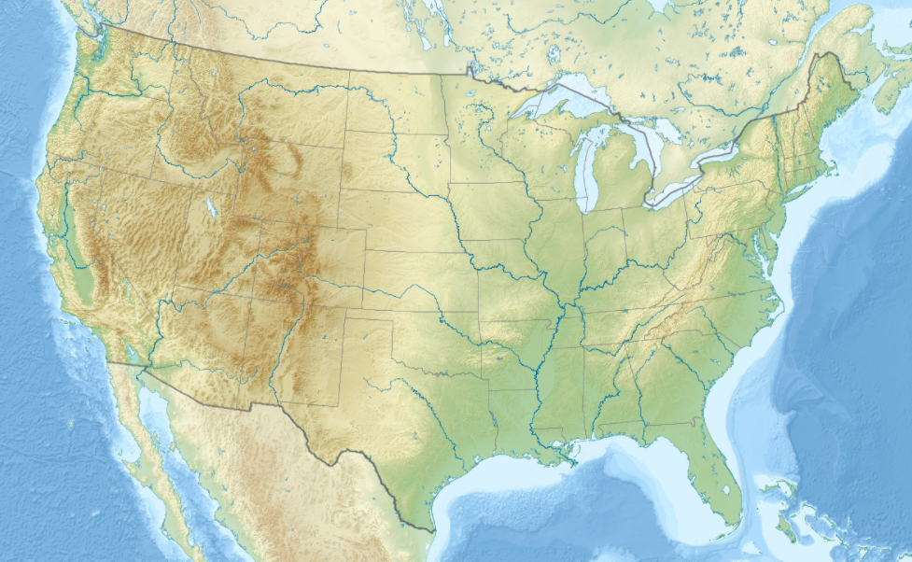
Source: Wikimedia Commons

Slide 6
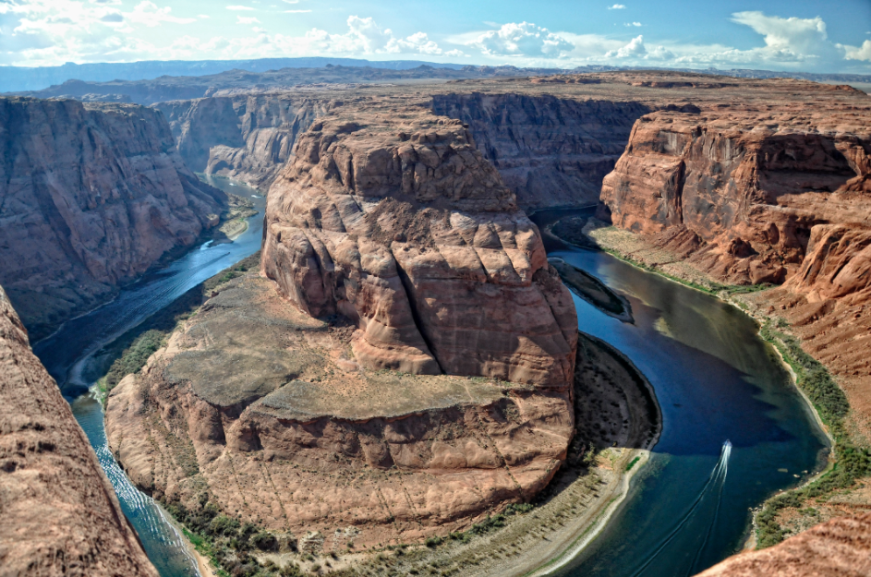
Horseshoe Bend, Colorado River, Page, Arizona
Popham Beach, Phippsburg, Maine

Slide 7
Citations
Slides 2 and 3: https://wgme.com/news/local/dunes-damaged-at-popham-beach-threatening-coastal-communities-and-wildlife
Slide 4: https://www.livebeaches.com/map-of-beaches-in-maine/
Slide 5: https://commons.wikimedia.org/wiki/File:Usa_edcp_relief_location_map.png
Slide 6: https://wgme.com/news/local/dunes-damaged-at-popham-beach-threatening-coastal-communities-and-wildlife
and https://en.wikipedia.org/wiki/Colorado_River

