Slide 1
Week 2 Maps

Slide 2
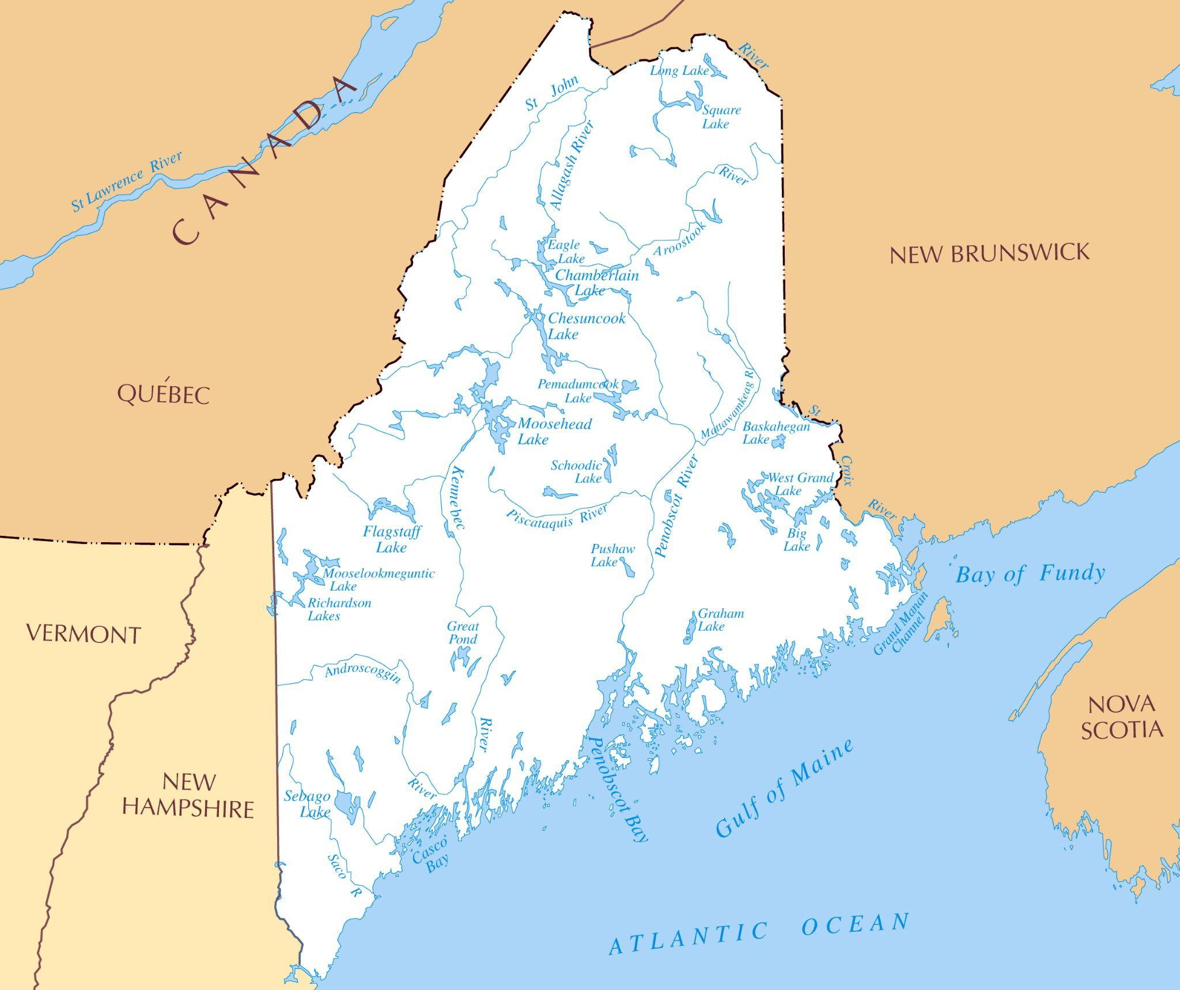

Slide 3
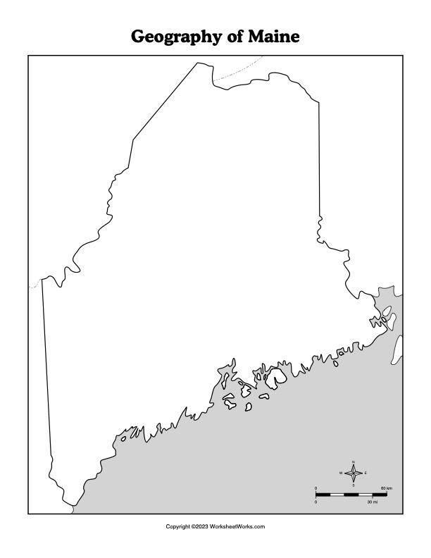
Name:_______________________________________
Directions: Color the rivers and lakes blue. Name each lake, river, and ocean.
______________ River
______________ Lake
______________ River
______________ River
______________ River
______________ River
______________ River
______________ Lake
______________ Ocean
______________ River

Slide 4
St.John River
Aroostook River
Moosehead Lake
Piscataquis River
Kennebec River
Penobscot River
Androscoggin River
Sebago Lake
Atlantic Ocean
Saco River

