Slide 1
Procedure Adjectives
Writing Week 2, Day 1

Slide 2
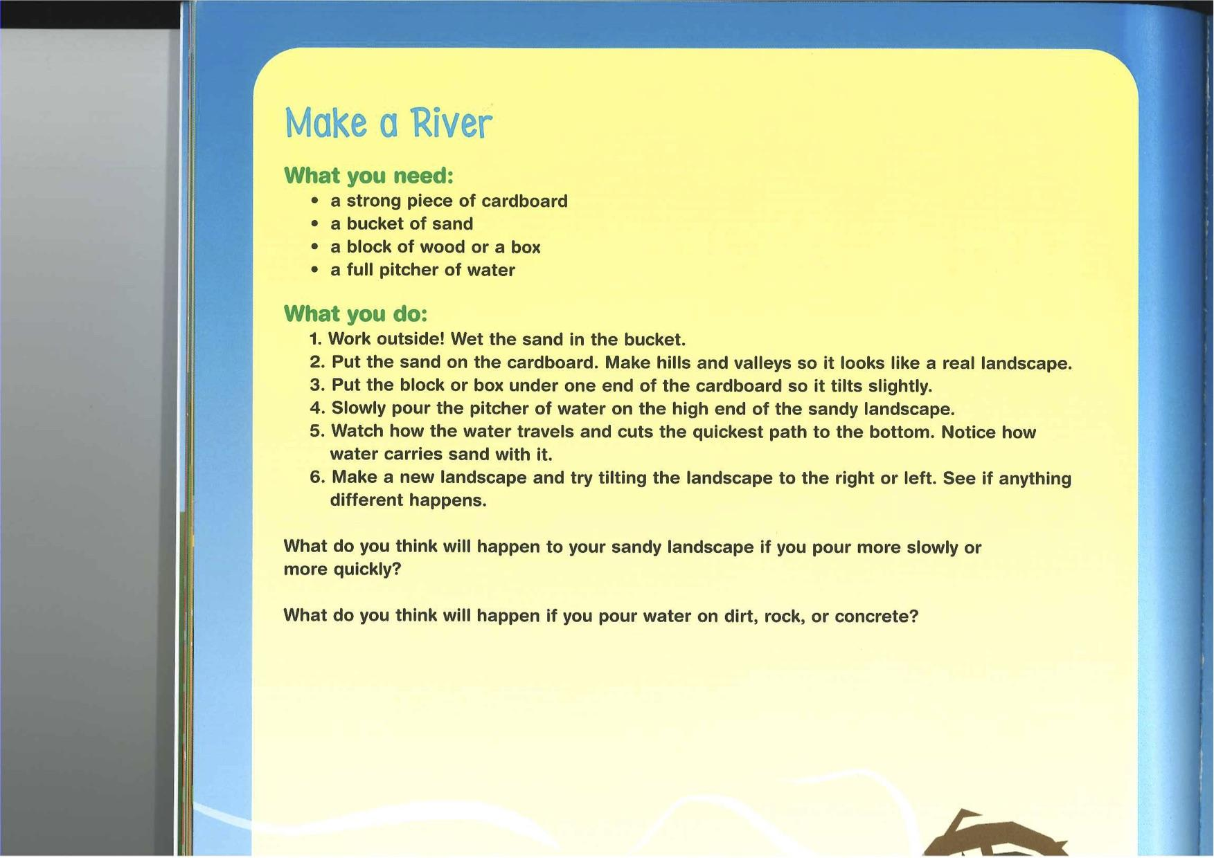
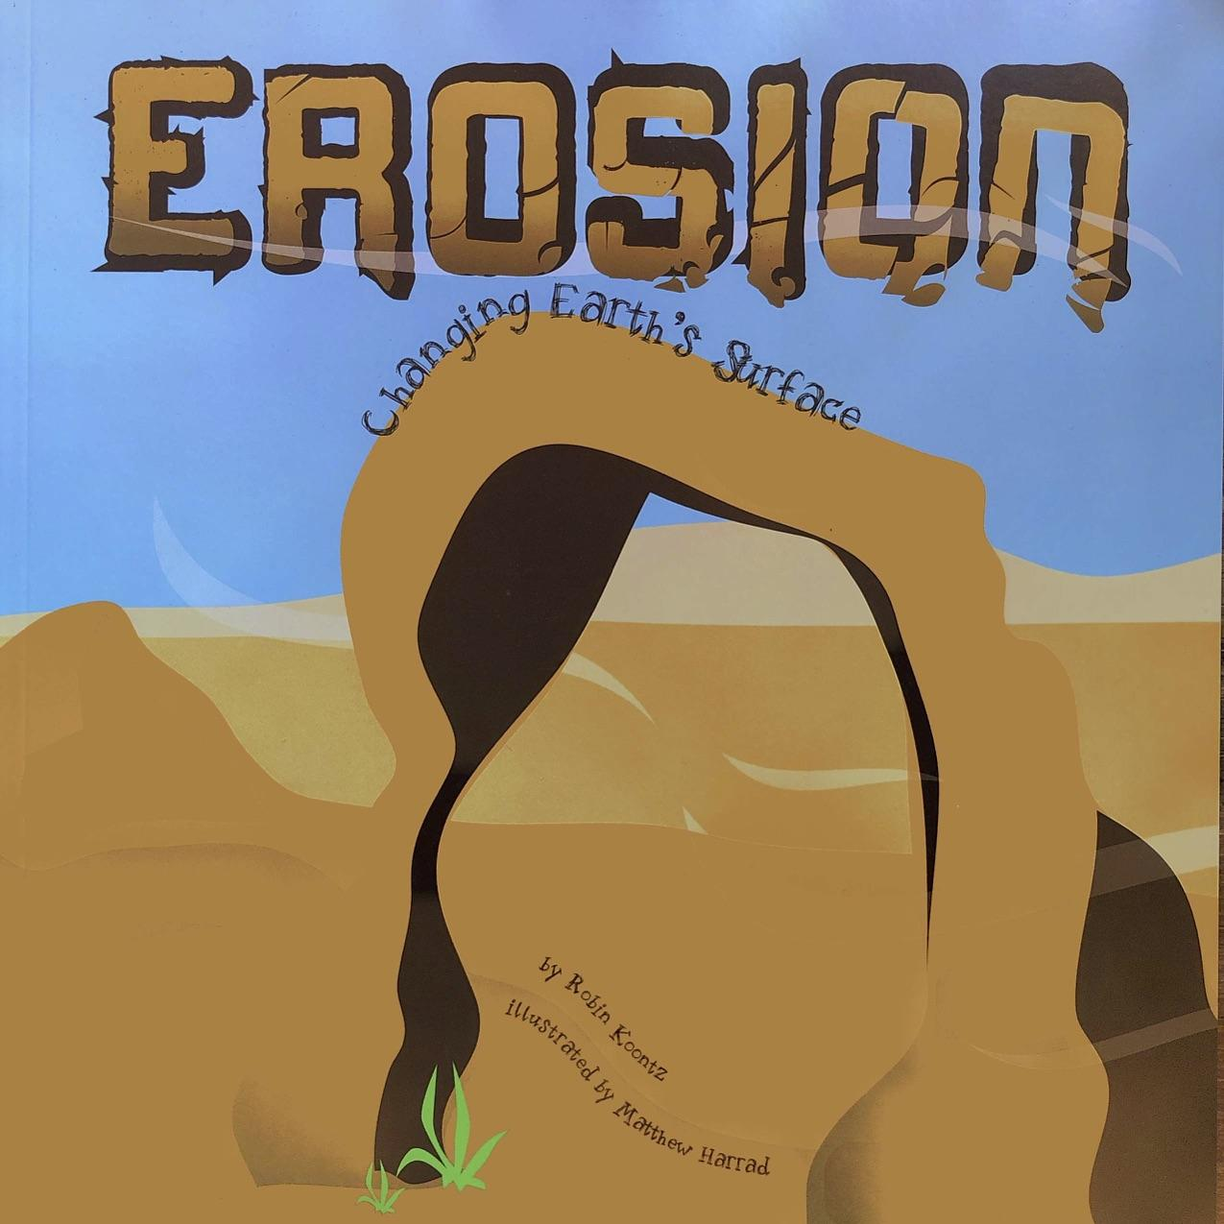

Slide 4
Remember, adjectives describe the nouns. They answer these questions:
How many/much?
What kind?
What like?
Which ones? Whose?

Slide 5
Let’s focus on the cardboard.
How many?
a (one) piece
What like?
strong

Slide 6
Let’s try one more: water.
How much?
a full pitcher

