Slide 1
Procedure Verbs
Writing Week 1, Day 4

Slide 2
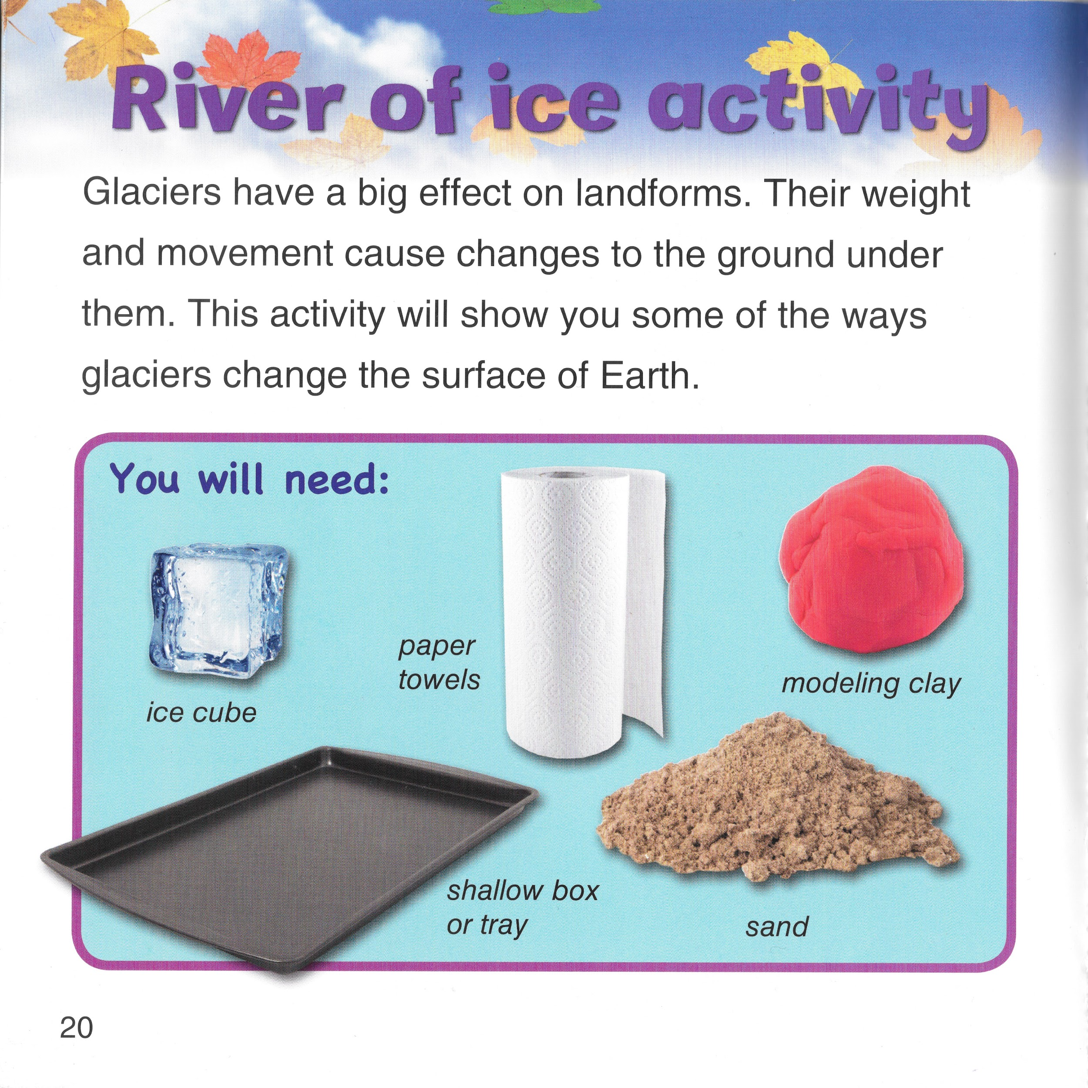
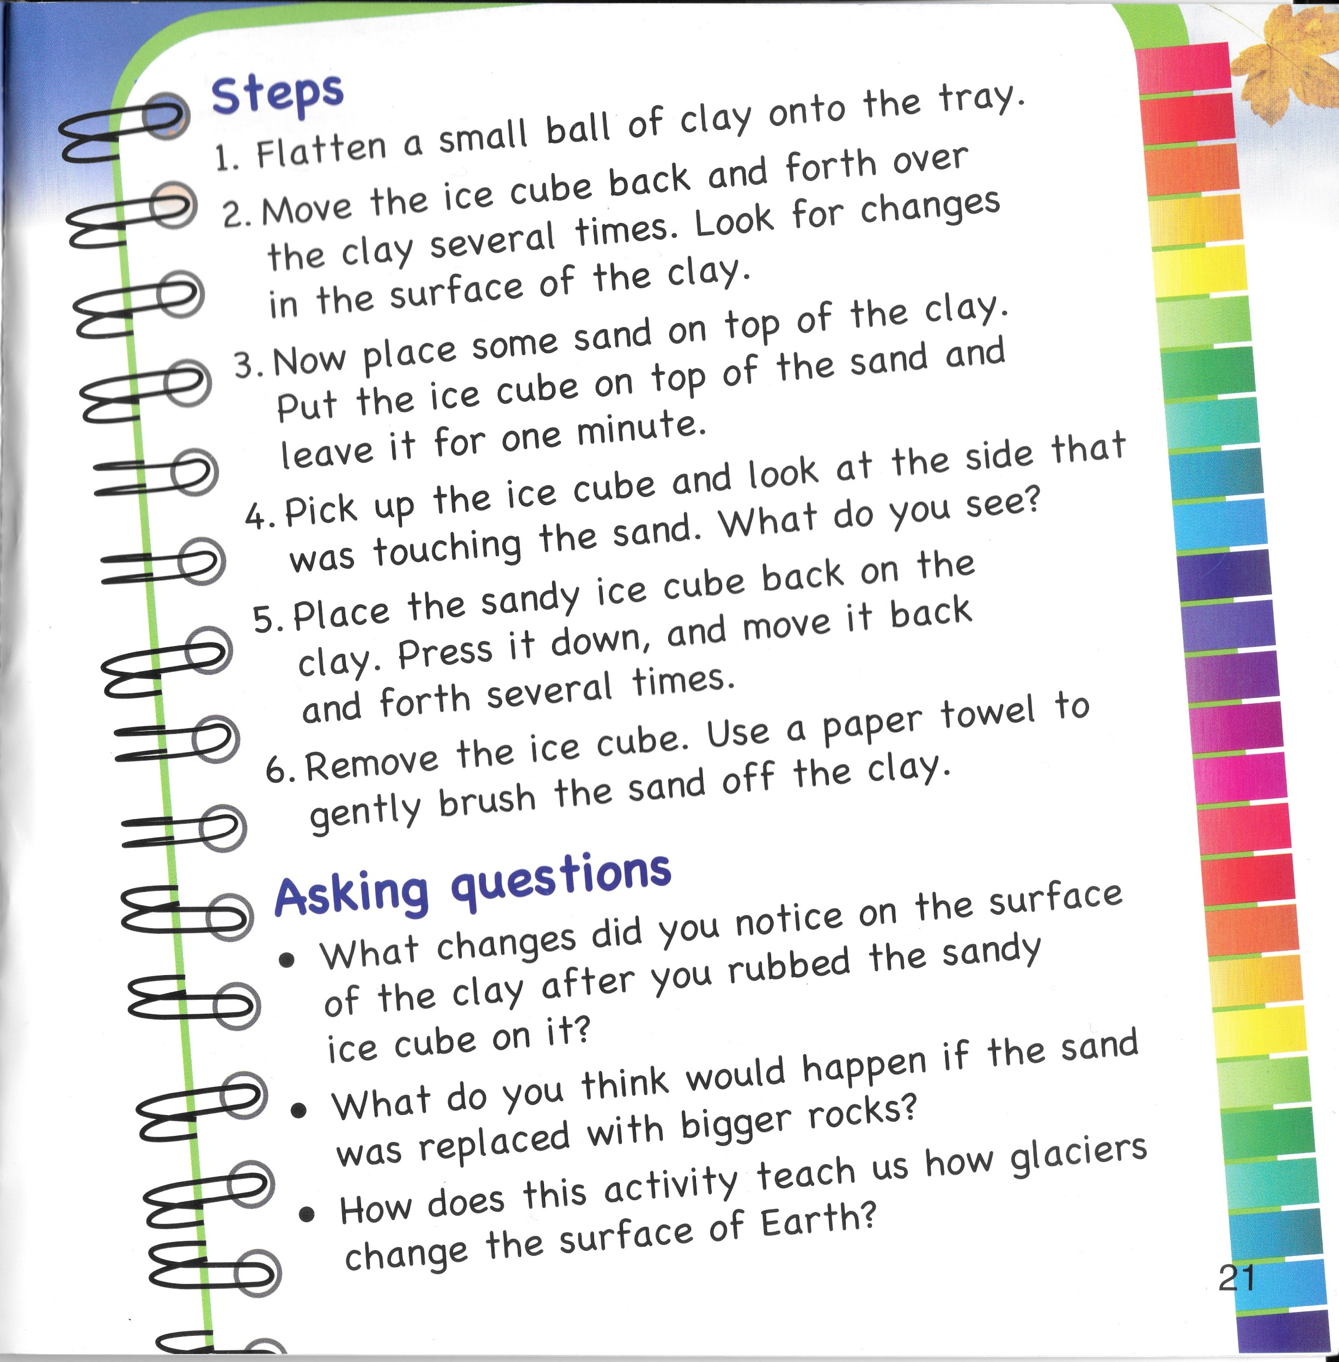

Slide 4
