Slide 1
Maps of
Maine
and the United States
Science & Engineering Week 1, Lesson 2

Slide 2
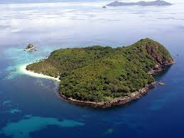
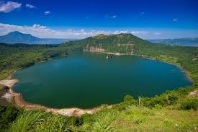
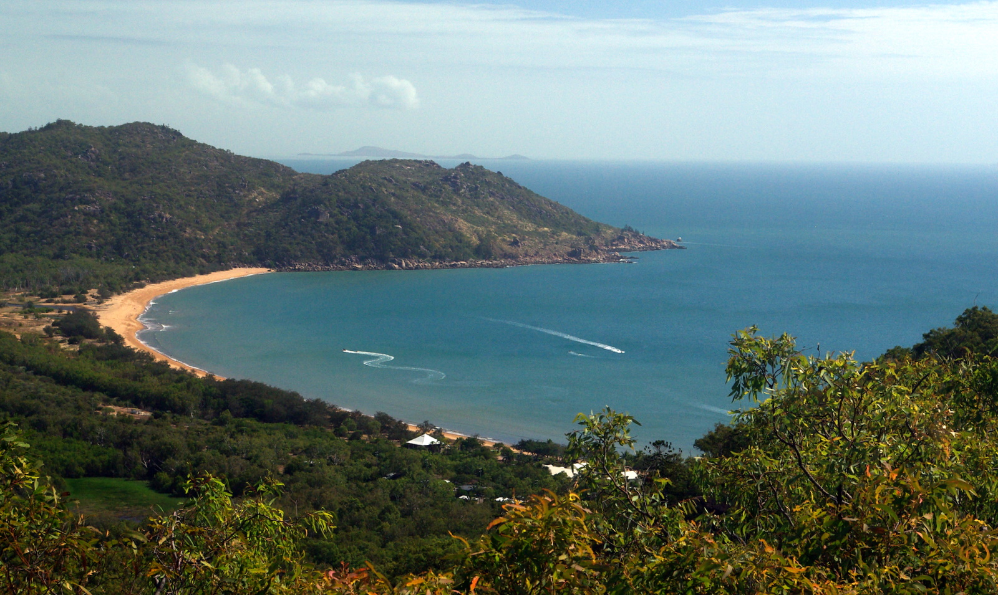

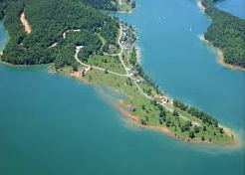

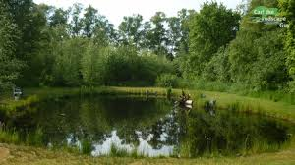
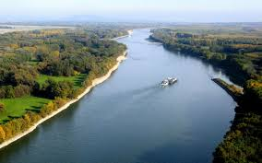
bay
hill
island
lake
peninsula
pond
river
sea

Slide 3
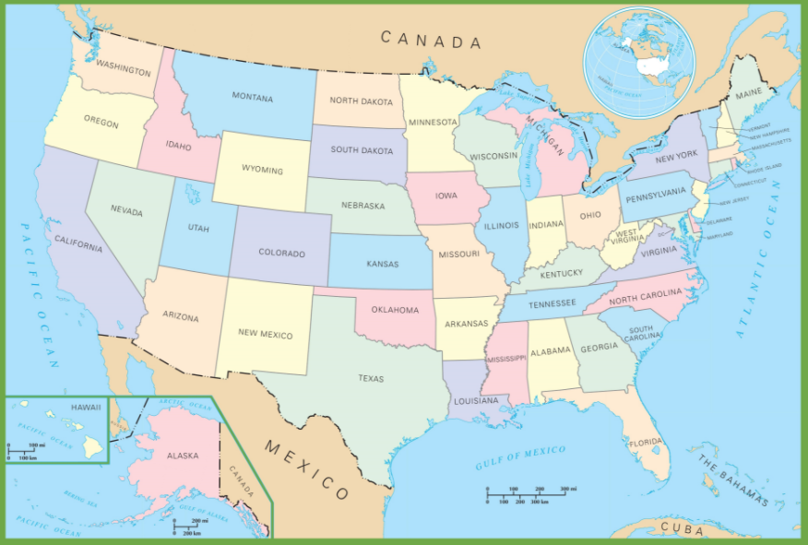
United States
Political Map
What do you think the mapmaker wants us to learn about and think about the United States by looking at this map?

Slide 4
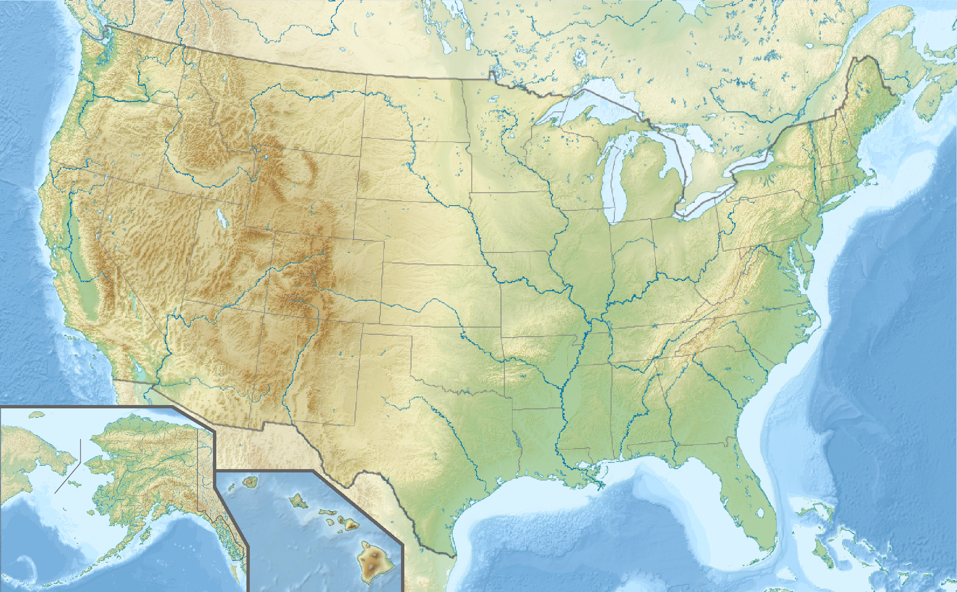
United States Physical Map

Slide 5
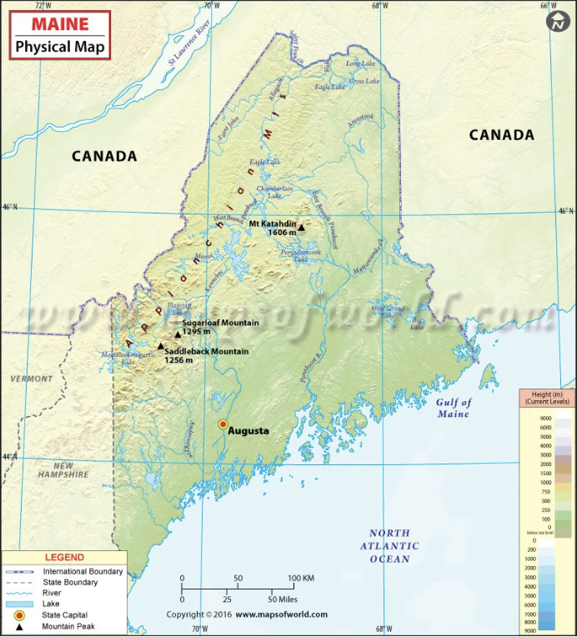
What do you think the mapmaker wants us
to learn and think about Maine by looking at this map?

Slide 6
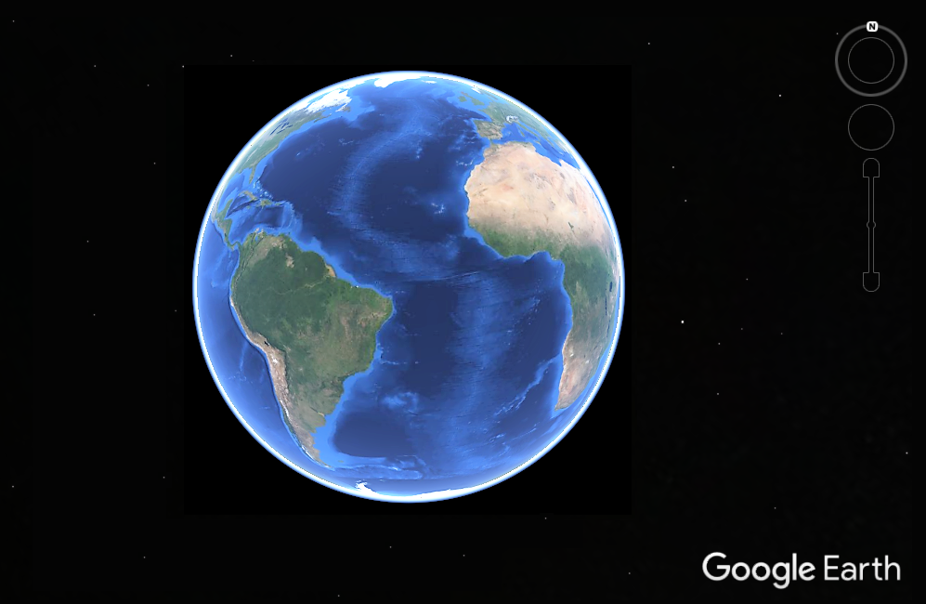
Explore more of Maine’s features using Google Earth. Click the Earth to begin exploring.

Slide 7
Citations
Slide 2: https://www.mapsofworld.com/usa/states/maine/physical-map-of-maine.html
Slide 3: http://ontheworldmap.com/usa/usa-political-map.html
Slide 5: https://upload.wikimedia.org/wikipedia/commons/2/2a/Usa_edcp_%28%2BHI_%2BAL%29_relief_location_map.png

