Slide 1
Mary Kingsley
and
World Map
Text Talk Week 1, Day 1

Slide 2
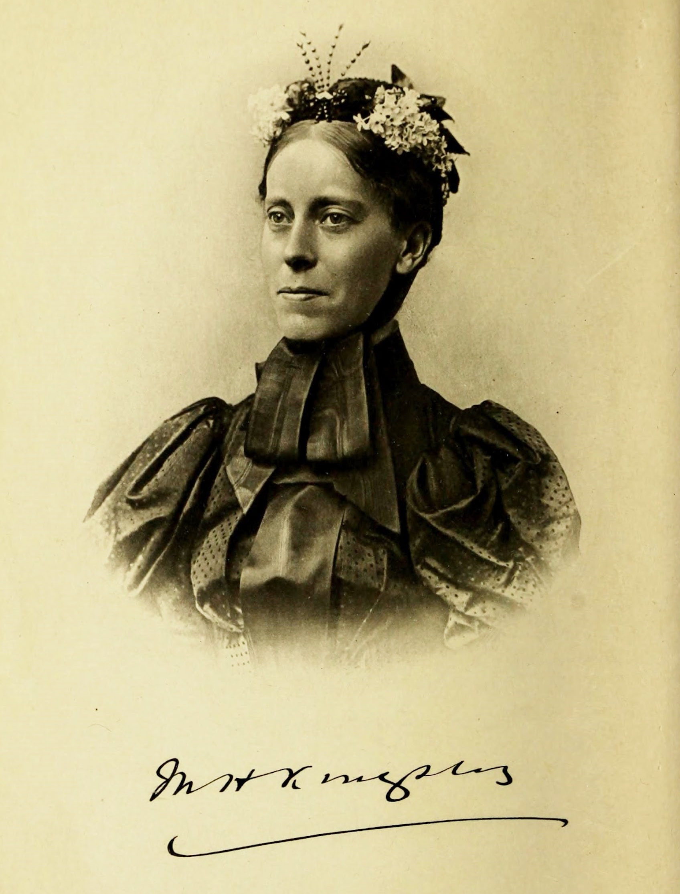
Slide 1

Slide 3
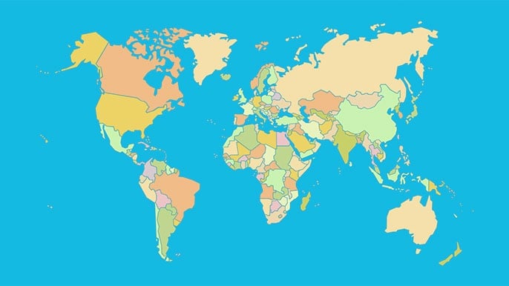
Notes:
https://www.playgeography.com/games/countries-of-the-world/

