Slide 1
Concept for Competitive Federal Grant Application: Strategic Energy Investments in Maine PK-12 Schools
Presented to Maine Dept. of Education and School Leaders
10-6-2022

Slide 2
Infrastructure Investment and Jobs Act ------- a.k.a. the “Bipartisan Infrastructure Law” (BIL)
EMT internal summary of Relevant Funding Opportunities under H.R. 3684
September 2022
Bill text (as enacted)

Slide 3
IIJA Sec 40501: Grants for EE & RE Improvements at Public School Facilities – DOE Overview
Description: Competitive grants to make energy efficiency, renewable energy, and alternative fueled vehicle upgrades and improvements at public schools.
Nationally Available Funding: $500,000,000 (42 U.S. Code § 18831)
Next Milestone: Estimated application opening date 4th quarter 2022.
Period of Availability: Available until expended
Funding Mechanism: Competitive Grant
Recipients: Consortium of 1 Local Education Agency AND 1 or more Schools, Non-Profits, For-Profits, and Community Partners
Eligible Uses:
Energy efficiency (envelope, HVAC, lighting, controls, etc.), ventilation, renewable energy, alternative vehicles, and alternative fuel vehicle infrastructure improvements.
Notes:
Board members (Joan, Ken) supportive of pursuing this opportunity
Questions of scope/size? Narrative hook to lift Maine above? Niche to target?
Problem: dirty existing systems
Solution: Heatpumps cleaner cheaper , national leader on space heating, replicability in videos to share broadly

Slide 4
The Opportunity for Electrification of HVAC in Maine Schools

Slide 5
Switching to high-efficiency, electrified HVAC systems will benefit Maine schools
There are 600-700 school buildings in Maine
The cost to heat, cool and ventilate these spaces:
Constitutes a significant cost to property taxpayers;
Significantly impacts performance of employees;
Significantly impacts performance of students;
Is among the largest sources of carbon pollution from local government
By switching from oil to heat pump technology, and/or recycling waste energy in ventilation systems, schools can improve the productivity in the classroom while reducing pollution and the annual operating costs borne by Maine taxpayers.

Slide 6
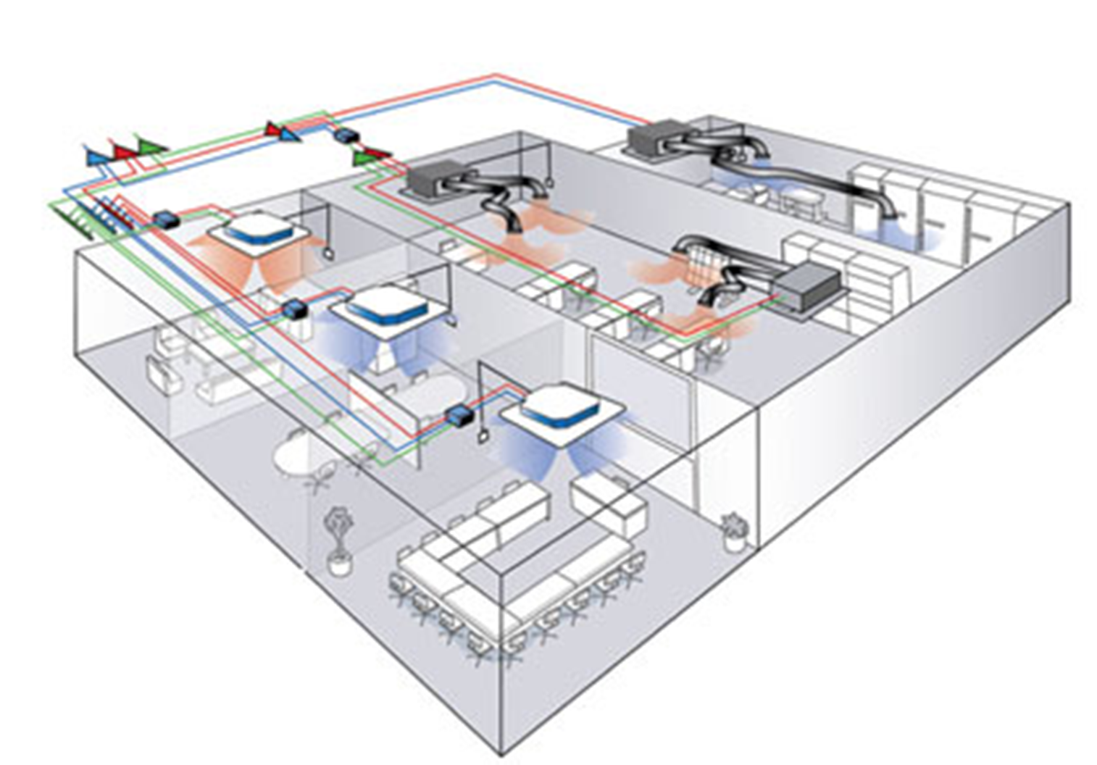
Using Heat Pump Technology to Heat & Cool Schools
VRF (Variable Refrigerant Flow) is a type of heat pump-based system used in commercial and institutional buildings
a single outdoor compressor serves multiple indoor heating/cooling units
VRF employs refrigerant flow modulation, sophisticated controls, and optional internal heat recovery
Highly energy-efficient
Provides excellent comfort, adjustable temperatures by room
No on-site fossil fuel combustion, emissions or storage
Capable of using ducted or ductless distribution system(s)

Slide 7
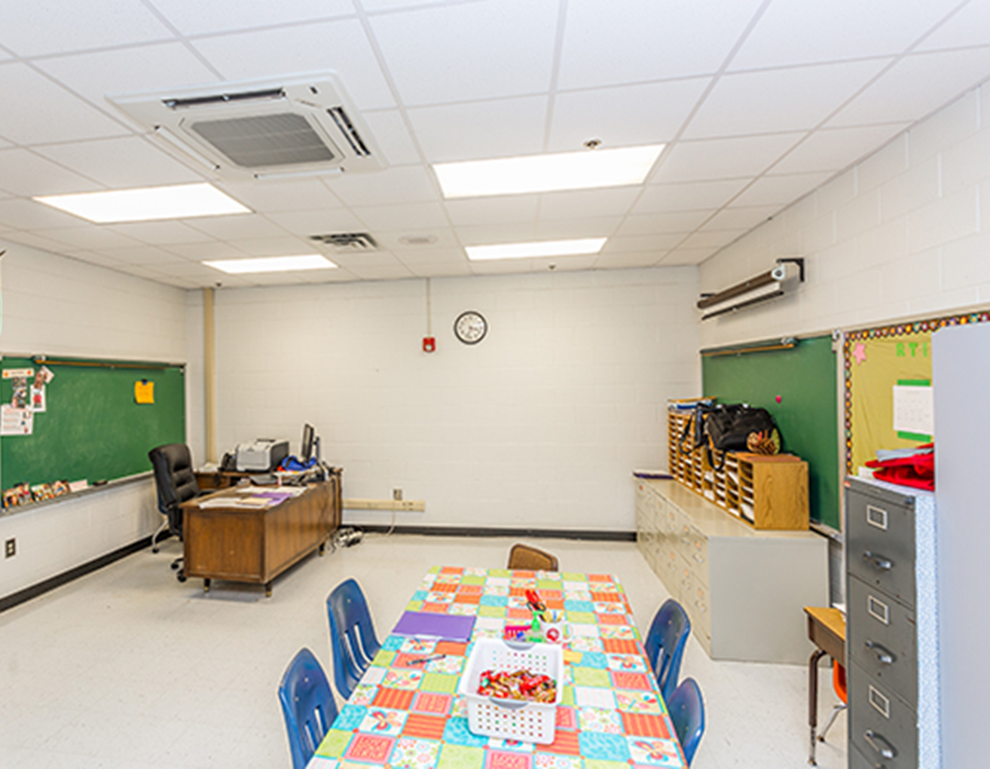
VRFs – Costs and Benefits
Costs
Typical installed cost is approximately $10-13 per square foot for new construction or a major renovation.
It may be slightly higher for a retrofit.
A hypothetical 30,000 square foot school might cost about $300-400k for a complete VRF system.
Benefits
For schools that are heating with oil, a VRF system will reduce annual operating costs significantly
Note that at this time the economics of displacing natural gas with a VRF system are not favorable and should not be pursued.
VRFs significantly reduce carbon emissions by reducing oil consumption (even after factoring in the carbon emissions from the grid)
Advances the MCC recommendations to decarbonize heating load
Improved teaching environment – ability to control temperature and manage comfort for each room, individually.

Slide 8
School HVAC Upgrades are “Shovel Ready”
Immediate opportunities can be implemented as soon as 3 months
Demand is so extensive it will not be exhausted for the next 5 years
The technologies are all commercially available, off the shelf, and can be purchased in volume at any of Maine’s many distributors (“supply houses”)
The contractor community in Maine is experienced in these installations and likely to be available for the work as new construction slows down (due to economic disruptions)

Slide 9
ERVs
ERVs – Energy Recovery Ventilation systems could be an attractive “add-on” to a school retrofit project. ERVs recover heat from the air that is exhausted from a central ventilation system and recycle it to keep the building warm. It also works in reverse for air conditioning.
ERVs would be appropriate as a “retrofit” onto existing central air handling systems that have consolidated exhaust air streams
Estimated to apply to 10% of Maine schools
Not appropriate for systems that lack consolidated exhaust streams
To introduce new central air handling systems in Maine schools could add $50 million - $100 million in costs and could not be done quickly or without disruption.
Costs -- ERVs range from $3-$6 per CFM. Rough estimates are that these systems would cost from $20,000 for a very small school to $200,000 for a large school building.

Slide 10
Funding & Financing
Funding – The above proposal assumes that new, incremental funding is available to supplement the current budgets of Efficiency Maine and the local school districts.
In the current economic environment, public schools may be unable to appropriate any contribution to the types of energy upgrades described in this presentation
Therefore, this initiative may require sufficient funding to enable projects to proceed with “no money down.”
This could be accomplished by using federal funds to provide:
a grant for a significant portion of the project cost
Financing, such as through a municipal lease or an energy services performance contract (ESPC)
Repayments of financed project costs would replenish a revolving fund to be used to extend the program benefits to more schools

Slide 11
Other Possible Program Elements
Independent 3rd Party Evaluation
Sharing the Results
Make several case studies of successfully completed projects
Prepare final report
describing the measures installed,
forecasted and actual energy savings,
actual cost/savings,
estimated carbon savings,
user satisfaction (facility managers, administrators, teachers, students)
Disseminate the report and case studies to school districts in Maine
Disseminate the report and case studies to Departments of Education in 50 states, US DOE, and US Dept of Education

Slide 12
Takeaway
There is a large, cost-effective and immediate opportunity to develop energy upgrades at Maine’s PK-12 schools
This opportunity has prospects of standing out in a competitive grant process due to Maine’s leadership in heat pumps
Where appropriate, this opportunity consists of:
installing the latest generation of heat pumps, called “VRFs”, designed for non-residential space heating and cooling; and/or
installing Energy Recovery Ventilator (ERV) systems to recycle energy before it exits a building’s central ventilation system
$10-15 million could be soundly invested over several years using existing administration at Efficiency Maine and local workforce capacity;
The opportunity could easily rise to $50 million the financing element is added

Slide 13
For More Information, contact:
Michael D. Stoddard
Executive Director
Efficiency Maine Trust
Michael.Stoddard@efficiencymaine.com
Rick Meinking
Senior Program Manager
Efficiency Maine Trust
Richard.Meinking@efficiencymaine.com

