Slide 1
Essential Topics in ELA
How does the text work?

Slide 2
For this session
Relax. Turn off your camera.
Use the chat at will.
Mute your microphone.
We will use stamp annotation during this session.
We will use the waterfall strategy in this session.
We will use a Google doc.

Slide 3
Why “essential” topics?
Updated standards are very similar to last version
BUT
The subtle changes made are significant and purposeful.
These changes help us identify the essential topics to focus our professional practice and set some priorities.
The language standards are now front and center, for good reason.

Slide 4
Look at the text
Don’t read it!
Notes:
Today we are going to talk about how the text works. Here is how we might begin.

Slide 5
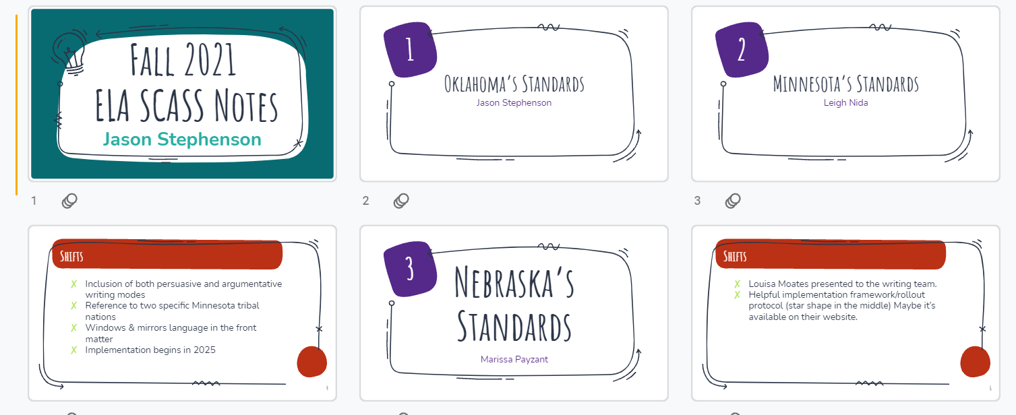
Notes:
What do you notice? What can you tell before you read the contents?

Slide 6
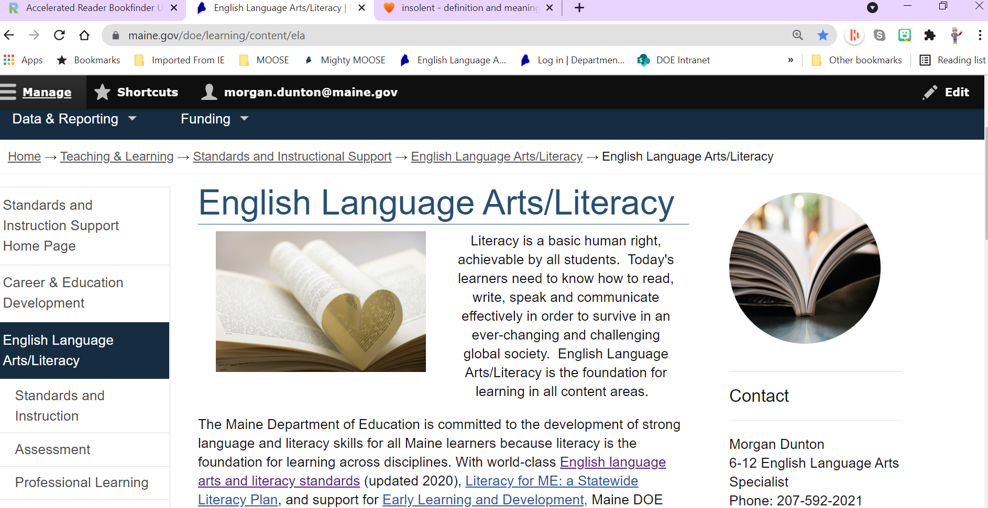
Notes:
What do you know about this text just from looking at it? Previous guidance has indicated a need to teach text structures. This may have been interpreted as features such as headings and foot notes or organization methods such as chronological or cause-and-effect. There is much more that we can teach when we consider how the “text” works, especially when the text is not literature.

Slide 7
Why ask how the text works?
Fisher and Frey: greatest acceleration of literacy growth
Impacts reading, viewing, writing, and speaking
Is most often overlooked or misunderstood
Aligns very nicely to the language standards:
Conventions
Knowledge of language
Vocabulary acquisition and use

Slide 8
What does the text say? What does the text mean?
Notes:
These are two questions we often ask when students are reading. The first reveals comprehension and is a lower order thinking question. The second requires interpretation and is a higher or thinking question. There is a question that falls between and supports interpretation.
https://img.wallpapersafari.com/tablet/768/1024/31/99/q1Ct5K.jpg

Slide 9
Structure, Vocabulary, and Author’s Craft
Notes:
In their book Text-Dependent Questions, Doug Fisher and Nancy Frey provide a structure for developing text-dependent questions.

Slide 10
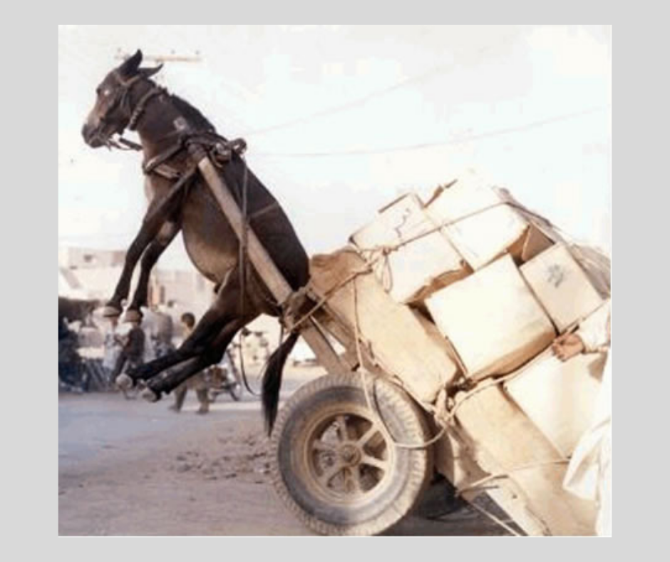
Learning acceleration and transfer
Current concern: making the most of what we have
Continuing concern: transferring learning from one context to another
Notes:
Does this photo represent you or your students? Let’s think about where we are right now. We’re worried about helping our kids make all our goals. We need to do as much as we can with the opportunities in front of us. Ultimately, we want our students to transfer their learning to other contexts, whether that’s our next unit, their next class, or an application in the wider world. To meet these goals without overwhelming ourselves or our students, we need to let go of what doesn’t get us where we want to go and hold on to what works best.

Slide 11
2020 Maine ELA Standards
Standard L.3:
Apply knowledge of language to understand how language functions in different contexts, to make effective choices for meaning or style, and to comprehend more fully when reading or listening.
L.3.6-8
Vary sentence patterns for meaning, reader/listener interest, and style.
Maintain consistency in style and tone.
Choose language that expresses ideas precisely and concisely, recognizing and eliminating wordiness and redundancy.
Use verbs in the active and passive voice and in the conditional and subjunctive mood to achieve particular effects (e.g., emphasizing the actor or the action; expressing uncertainty or describing a state contrary to fact).
Notes:
The standard is in bold and the performance indicator is below. Place a stamp on elements of the 6-8 performance indicators that need to be taught with deliberate and direct instruction.

Slide 12
2020 Maine ELA Standards
Standard L.3:
Apply knowledge of language to understand how language functions in different contexts, to make effective choices for meaning or style, and to comprehend more fully when reading or listening.
L.3.6-8
Vary sentence patterns for meaning, reader/listener interest, and style.
Maintain consistency in style and tone.
Choose language that expresses ideas precisely and concisely, recognizing and eliminating wordiness and redundancy.
Use verbs in the active and passive voice and in the conditional and subjunctive mood to achieve particular effects (e.g., emphasizing the actor or the action; expressing uncertainty or describing a state contrary to fact).
Notes:
These learning goals are often taught when revising text. But they are critical elements for understanding complex texts. Notice that the standard includes listening and must be considered when determining how context impacts language function. The Pis include both

Slide 13
2020 Maine ELA Standards
Standard SL.4:
Adapt speech to a variety of contexts, audiences, and communicative tasks.
SL.4.6-8 Adapt speech to a variety of contexts, demonstrating command of language in the appropriate register.
Standard R.7:
Interpret words and phrases as they are used in various texts, including determining technical, connotative, and figurative meanings, and analyze how specific word choices shape meaning or tone.
R.7.6-8 Determine the meaning of figurative, connotative, and technical word meanings and phrases as they are used in various texts; analyze the impact of specific word choices and techniques on meaning and tone.
Notes:
The two standards are from the reading and the speaking & listening strands. What is the relationship to the previous standard?

Slide 14
How does the text work?
Sentence patterns
Style
Tone
Precise language
Concise language
Active voice
Passive voice
Conditional
Subjunctive
Notes:
Fisher and Frey suggest that exploring how a text works addresses vocabulary, text structures, and author’s craft. Vocabulary study isn’t simply about whether the students knows the meaning of the words, but also why those words are used exactly as they are and what they suggest about the author, the audience, the purpose or the content. The text structure student isn’t simply about determining the story telling style but examining how the source is constructed or how the story is told, right down to the sentence level. Author’s craft examines the relationship between the author and the audience, the purpose of the “text” and the method of achieving that purpose, and the genre specifications with all of those things.

Slide 15
Sentence Patterns
Wheatley was a talented poet who engaged with the poetic tastes of her time. But she was also a black woman at a time when black people had very little power in America: “she died in 1784 in abject poverty, preceded in death by her three children, surrounded by filth, and abandoned, apparently, by her husband, John Peters,” Gates writes.
Wheatley was a talented poet. She met with the poetic tastes of her time. But she was also a black woman at a time when black people had very little power in America. “She died in 1784 in abject poverty. Preceded in death by her three children. Surrounded by filth. And abandoned, apparently, by her husband, John Peters,” Gates writes.
How does the text work?
Notes:
From Smithsonian Tween Tribune: The most notorious poet in 18th century American was an enslaved teenager you’ve never heard of. https://www.tweentribune.com/article/junior/most-notorious-poet-18th-century-america-was-enslaved-teenager-youve-never-heard/

Slide 16
Sentence Patterns: end marks
Wheatley was a talented poet who engaged with the poetic tastes of her time. But she was also a black woman at a time when black people had very little power in America: “she died in 1784 in abject poverty, preceded in death by her three children, surrounded by filth, and abandoned, apparently, by her husband, John Peters,” Gates writes.
Wheatley was a talented poet. She met with the poetic tastes of her time. But she was also a black woman at a time when black people had very little power in America. “She died in 1784 in abject poverty. Preceded in death by her three children. Surrounded by filth. And abandoned, apparently, by her husband, John Peters,” Gates writes.
How does the text work?
Notes:
Notice the end marks. These are two versions of the same article. What is the difference?

Slide 17
Sentence Patterns: internal punctuation
Wheatley was a talented poet who engaged with the poetic tastes of her time. But she was also a black woman at a time when black people had very little power in America: “she died in 1784 in abject poverty, preceded in death by her three children, surrounded by filth, and abandoned, apparently, by her husband, John Peters,” Gates writes.
Wheatley was a talented poet. She met with the poetic tastes of her time. But she was also a black woman at a time when black people had very little power in America. “She died in 1784 in abject poverty. Preceded in death by her three children. Surrounded by filth. And abandoned, apparently, by her husband, John Peters,” Gates writes.
How does the text work?
Notes:
Here we look at the internal punctual. There is much more going on in the first one than the second. Some argue that struggling readers cannot hold onto ideas in a long sentence. How might you help them?

Slide 18
Sentence Patterns: relationship words
Wheatley was a talented poet who engaged with the poetic tastes of her time. But she was also a black woman at a time when black people had very little power in America: “she died in 1784 in abject poverty, preceded in death by her three children, surrounded by filth, and abandoned, apparently, by her husband, John Peters,” Gates writes.
Wheatley was a talented poet. She met with the poetic tastes of her time. But she was also a black woman at a time when black people had very little power in America. “She died in 1784 in abject poverty. Preceded in death by her three children. Surrounded by filth. And abandoned, apparently, by her husband, John Peters,” Gates writes.
Notes:
Who, when, but, with are words that indicate a relationship between and among ideas. By eliminating these words in the “simplified” version, the cognitive load for understanding those relationships and making the connections is left to the student.

Slide 19
Sentence Patterns: structures
Wheatley was a talented poet who engaged with the poetic tastes of her time. But she was also a black woman at a time when black people had very little power in America: “she died in 1784 in abject poverty, preceded in death by her three children, surrounded by filth, and abandoned, apparently, by her husband, John Peters,” Gates writes.
Wheatley was a talented poet. She met with the poetic tastes of her time. But she was also a black woman at a time when black people had very little power in America. “She died in 1784 in abject poverty. Preceded in death by her three children. Surrounded by filth. And abandoned, apparently, by her husband, John Peters,” Gates writes.
How does the text work?
Notes:
Here we look at the internal punctual. There is much more going on in the first one than the second. Some argue that struggling readers cannot hold onto ideas in a long sentence. How might you help them? Notice that the words are the same. The punctuation and sentence construction helps the reader understand that the ideas are related.

Slide 20
Instructional Strategy
Find the longest sentence in a text you are reading as a whole class.
Unpack that juicy sentence to help all students understand how it is written.
Learn more about juicy sentences here:
https://achievethecore.org/search?q=juicy+sentences
Notes:
Helping students grapple with juicy sentences aligns to our standards and provides an opportunity to teach grammar, usage, and mechanics without a drill and kill process.

Slide 21
How does the text work?
Sentence patterns
Style
Tone
Precise language
Notes:
Now we are going to look at style and tone.

Slide 22
Style and Tone
The leftists writing your child’s social studies lessons
It’s hard to know what’s worse—brainwashing kids or lying about it.
Parents worried their kids are being indoctrinated with critical race theory can’t get straight answers. Local school boards and principals lie to them, claiming children are merely being taught to be “critical thinkers.”
On Saturday June 12, 2021, the truth came out. Teachers unions and activists held rallies in 22 cities to support critical race theory. What they said was eye-popping. They unabashedly declared that their goal is indoctrinating students in far-left causes.
https://docs.google.com/document/d/19YklbtPeI88gBYwftRomkMIN1eXV4IDuOEmSfo0H8bc/copy
Notes:
This is an excerpt from an email that landed in my box recently. Take a moment to read this passage and note the use of language. What words might you use to describe the tone? Use this Google doc to make some notes https://docs.google.com/document/d/19YklbtPeI88gBYwftRomkMIN1eXV4IDuOEmSfo0H8bc/copy

Slide 23
Style, Tone, and Precise Vocabulary
Instructional strategy

Slide 24
Vocabulary
Use the words and phrases that were identified from the piece to create a word wall or walk-around
For each word or phrase, brainstorm other words that are similar in meaning but have a different connotation
Use a source to look up the words for more synonyms or other ways of expressing the idea
Rewrite the passage using alternative words. How much can you change the tone?

Slide 25
Vocabulary
Violet in Teen Disciples is insolent because she constantly sasses her mother, talks trash about her friends behind their backs, and refuses to do what her teachers tell her, always stepping just a little outside of the expectations like when she refuses to face the front the of the class or stands in hallway until after the bell rings.
Create a word wall using the words you brainstormed about how you would describe the passage.
Determine definitions of the words and some synonyms
Identify passages (or characters or events, etc.) from reading that provide examples of the words you used
insolent
Showing a rude and arrogant lack of respect
insulting
contemptuous
cheeky
disparaging
Notes:
A word wall of the kinds of words you would like students to use can remain for multiple units of study. The context is determine by what you are reading.

Slide 26
How Does the Text Work? Slow reading for faster progress
Make sure what you are reading for instruction has juicy sentences
Teach the juicy sentences
Keep relationship words at the ready
Make a list of precise vocabulary to use when talking about what you are reading
Recognize shades of meaning

Slide 27
Let’s talk
Notes:
https://www.freepik.com/free-photo/business-brain-storming_11428383.htm#page=1&query=discussion&position=0&from_view=keyword

Slide 28
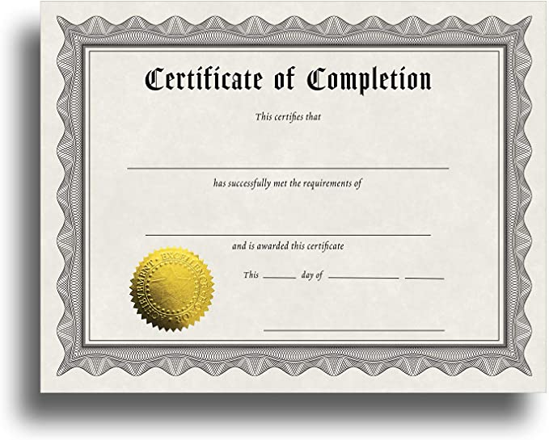
Contact certificate
Complete the feedback form to get the link for the certificate. Remember to download and save the certificate.
https://forms.office.com/g/GEg60AwBQd

