Slide 2
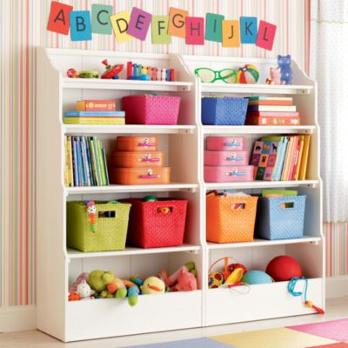
perfect
Notes:
A word in the story is perfect.
In Spanish it is perfecto (pehr-fehk-toh).
When something is perfect, it is really, really great; it is as good as possible.
Let’s say the word perfect together. Ready? ”Perfect.”
When you say perfect, I hear the /p/ sound at the beginning of the word.
Look, perfect begins with the letter p.
Here is a picture that shows perfect. All of the materials are put away in their perfect place, or perfectly. Everything is where it should be.

Slide 3
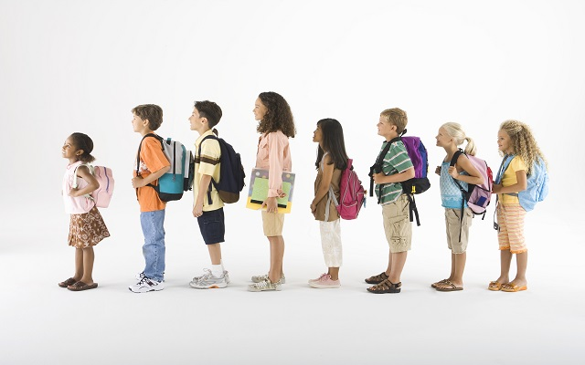
perfect
Notes:
Here is another picture of perfect.
How does this picture show the meaning of perfect? Turn and talk to your partner.
These students are in a perfect line. Everyone is facing forward, hands to themselves, looking as good as they can be.
How many syllables are in the word perfect? Let’s find out by clapping. Ready?
“Per-fect.” 2 syllables.
Now, let’s say perfect three times by clapping the syllables. Ready?
“Per-fect, per-fect, per-fect.”

Slide 4
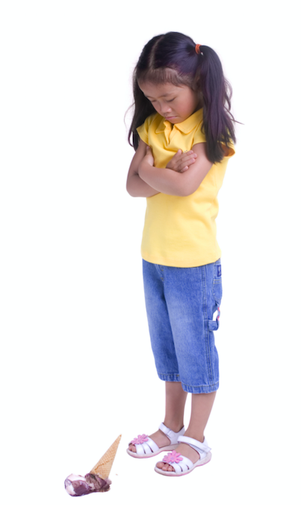
dreadful
Notes:
Another word in the story is dreadful.
In Spanish it is espantoso (ehs-pahn-toh-soh).
If something is dreadful, it is really really bad; it’s terrible.
Let’s say the word dreadful together. Ready? ”Dreadful.”
When you say dreadful, I hear the /d/ sound at the beginning of the word.
Look, dreadful begins with the letter d.
Here is a picture that shows something dreadful. This child is feeling dreadful because her ice cream fell on the ground, and she feels like it’s just terrible.

Slide 5
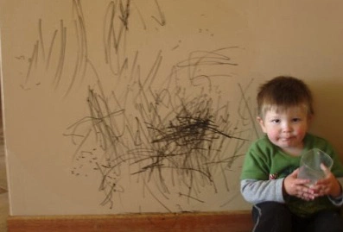
dreadful
Notes:
Here is another picture of dreadful.
How does this picture show the meaning of dreadful? Turn and talk to your partner.
This child drew all over the wall; that is dreadful, or really, really bad.
How many syllables are in the word dreadful? Let’s find out by clapping. Ready?
“Dread-ful.” 2 syllables.
Now, let’s say dreadful three times while clapping the syllables. Ready?
“Dread-ful, dread-ful, dread-ful.”

Slide 6
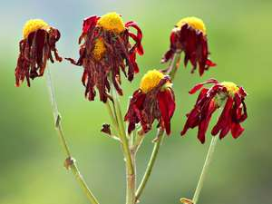
wilt
Notes:
A word in the story is wilt.
In Spanish it is marchitarse (mahr-chee-tahr-seh).
Wilt means to droop, to be without energy.
Let’s say the word wilt together. Ready? ”Wilt.”
When you say wilt, I hear the /w/ sound at the beginning of the word.
Look, wilt begins with the letter w.
Here is a picture that shows wilt. See these flowers, as they die they are wilting or drooping.

Slide 7
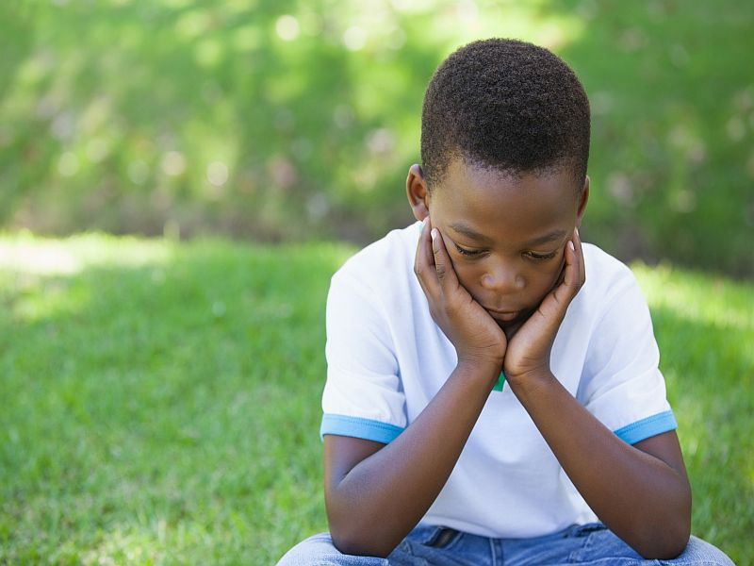
wilt
Notes:
Here is another picture of wilt.
How does this picture show the meaning of wilt? Turn and talk to your partner.
This child’s head is down, and he looks like he is wilting, or drooping. Maybe he feels sad.
How many syllables are in the word wilt? Let’s find out by clapping. Ready?
“Wilt.” 1 syllable.
Now, let’s say wilt three times by clapping the syllables. Ready?
“Wilt, wilt, wilt.”

Slide 8
miserable
Notes:
Another word in the story is miserable.
In Spanish it is miserable (mihz-ruh-buhl).
Miserable means sad and upset.
Let’s say the word miserable together. Ready? ”Miserable.”
When you say miserable, I hear the /m/ sound at the beginning of the word.
Look, miserable begins with the letter m.
Here is a picture that shows miserable. This woman is miserable, maybe because she doesn’t want to be in front of her laptop anymore! Or maybe she is reading upsetting news.

Slide 9
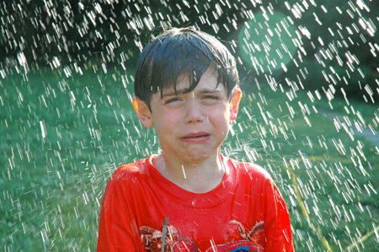
miserable
Notes:
Here is another picture of miserable.
How does this picture show the meaning of miserable? Turn and talk to your partner.
This boy is miserable because he is stuck in the rain.
How many syllables are in the word miserable? Let’s find out by clapping. Ready?
“Mis-er-a-ble.” 4 syllables.
Now, let’s say miserable three times by clapping the syllables. Ready?
“Mis-er-a-ble, mis-er-a-ble, mis-er-a-ble.”

