Slide 1
What can you build with dirt?
Focus on K2
Read Aloud Unit 3, Week 8, Day 1

Slide 2
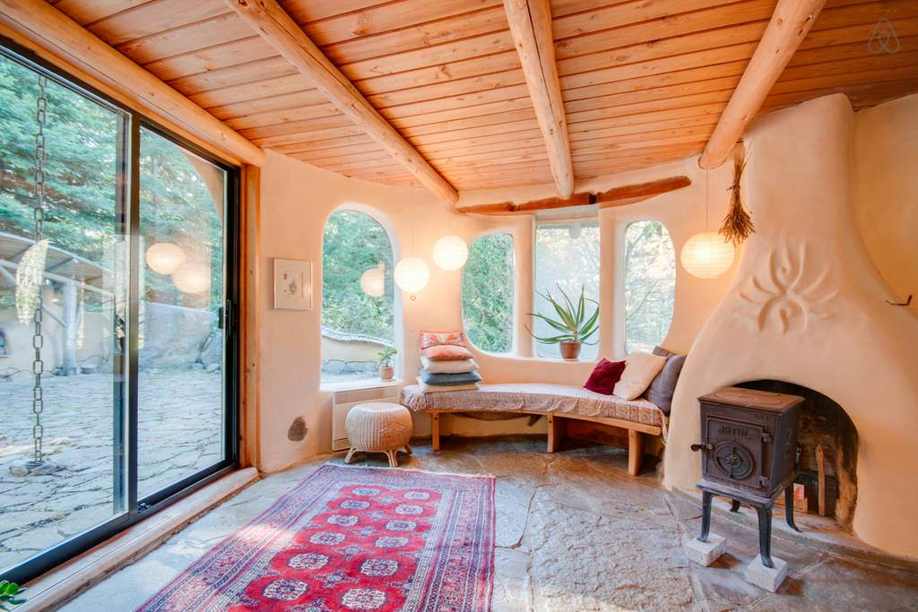
Which part of this house comes from dirt?

Slide 3
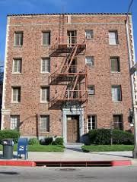
Which part of this apartment building comes from dirt?

Slide 4
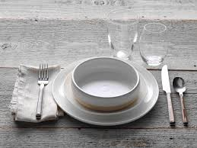
Which parts of this table setting come from dirt?

Slide 5
Dirt is another word for soil. Inside soil is clay!
Adobe walls are made from clay.
Ceramic plates and bowls are made from clay.
Brick walls are made from clay.

