Slide 1
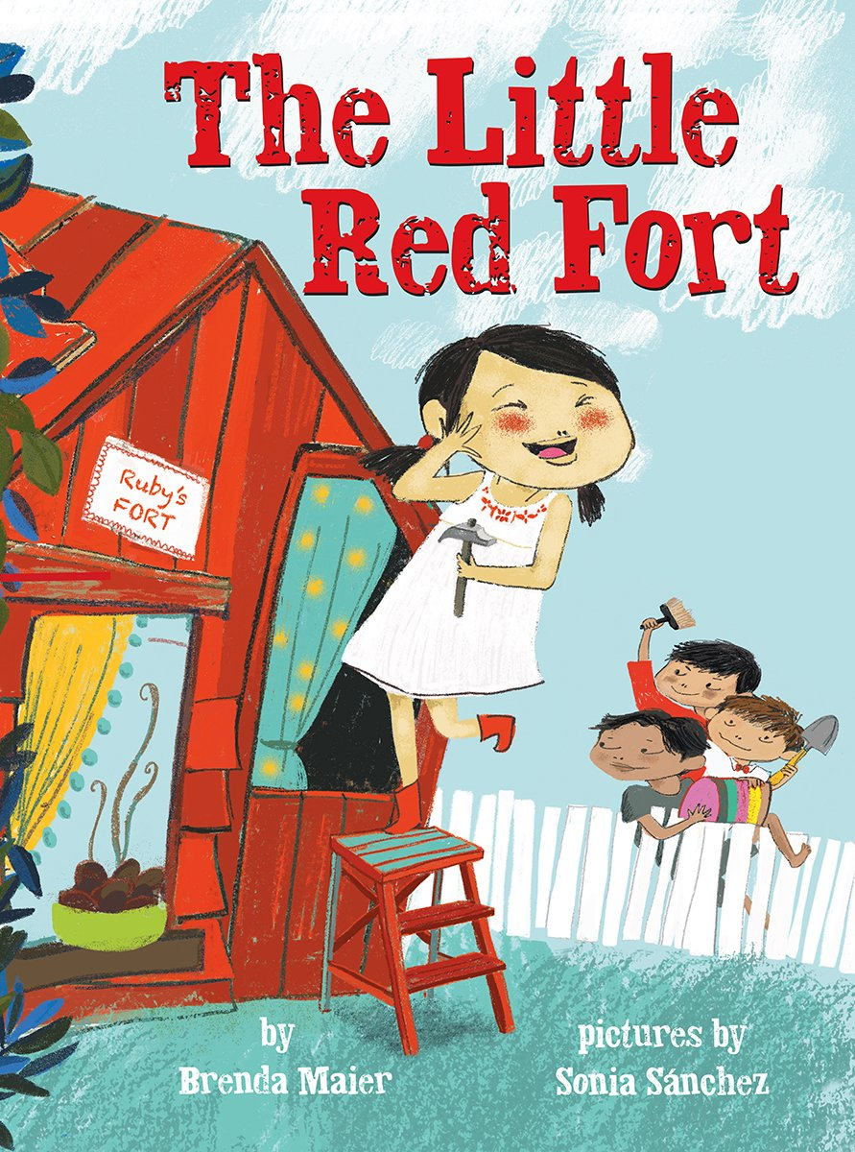
Notes:
fort: a building protected with a strong wall around it
satisfied: pleased, contented
huddle: get together to have a conversation or make a plan
gather: collect

Slide 2
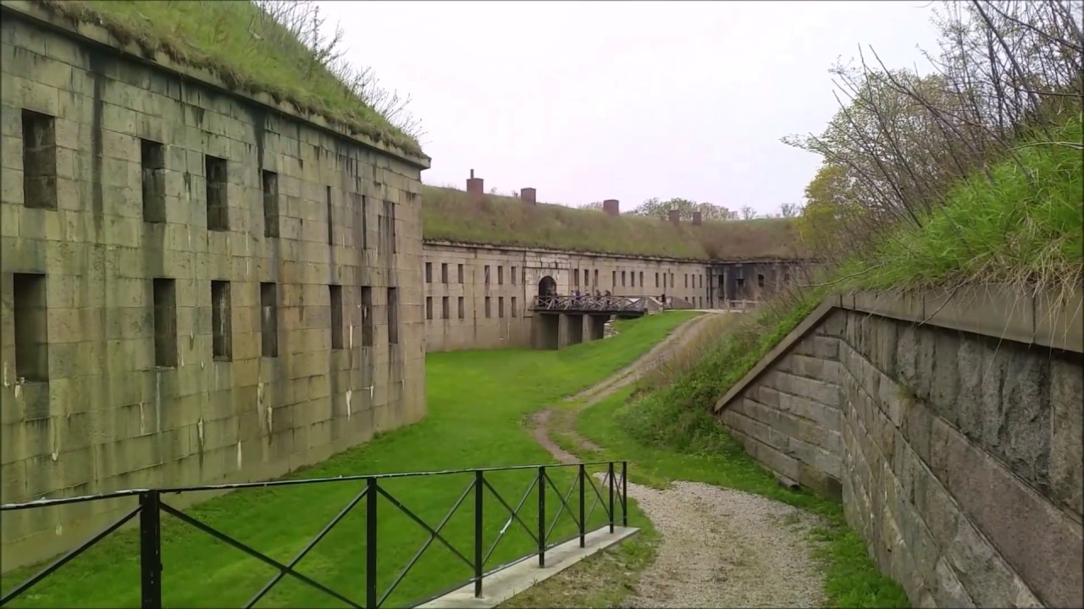
fort
https://www.youtube.com/watch?v=3orOY_CRFKk
Notes:
A word in the story is fort.
In Spanish it is fuerte (fwehr-teh).
A fort is a strong building, often surrounded and protected by a wall.
Let’s say the word fort together. Ready?
”Fort.” When you say fort, I hear the /f/ sound at the beginning of the word.
Look, fort begins with the letter f.
Here is a picture that shows fort. This is Fort Warren on Georges Island, one of the islands in the Boston Harbor. We can see the main building and the wall that surrounds and protects it.

Slide 3
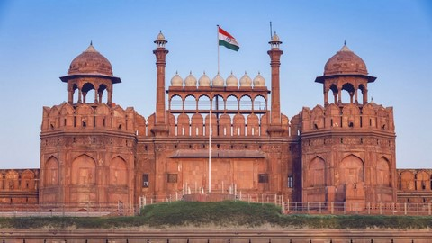
fort
https://www.incredibleindia.org/content/incredibleindia/en/popular-in-india/forts-and-palaces/all-forts-and-palaces.html
Notes:
Here is another picture of fort.
How does this picture show the meaning of fort? Turn and talk to your partner.
The image shows an old fort in India.
How many syllables are in the word fort? Let’s find out by clapping. Ready?
“Fort.” 1 syllable.
Now, let’s say fort three times while clapping the syllables. Ready?
“Fort, fort, fort.”

Slide 4
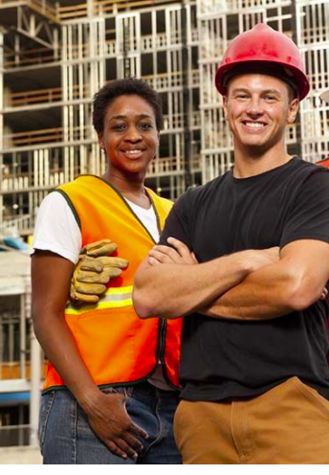
satisfied
https://mici.com/want-to-be-happy-at-work-take-a-job-in-construction/
Notes:
Another word in the story is satisfied.
In Spanish it is satisfecha/o (sah-tees-feh-chah/choh).
Satisfied is pleased, contented.
Let’s say the word satisfied together. Ready?
”Satisfied.” When you say satisfied, I hear the /s/ sound at the beginning of the word.
Look, satisfied begins with the letter s.
This picture shows satisfied. The workers are pleased with the work they did. They are satisfied with the structure they put together. You can tell by their expressions and can see the structure in the back.

Slide 5
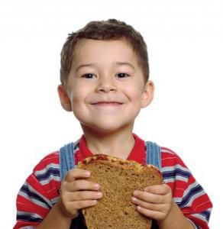
satisfied
https://www.pinterest.com/pin/140737557075553096/
Notes:
Here is another picture of satisfied.
How does this picture show the meaning of satisfied? Turn and talk to your partner.
The boy is satisfied with himself because he made this peanut butter and jelly sandwich all by himself.
How many syllables are in the word satisfied? Let’s find out by clapping. Ready?
“Sa-tis-fied.” 2 syllables.
Now, let’s say satisfied three times by clapping the syllables. Ready?
“Sa-tis-fied, sa-tis-fied, csa-tis-fied.”

Slide 6
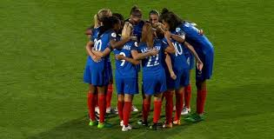
huddle
https://www.womenssoccerunited.com/report-france-iceland/france-huddle/
Notes:
A word in the story is huddle.
In Spanish it is apiñarse (ah-pee-nyahr-seh).
Huddle is to get together to have a conversation or make a plan.
Let’s say the word huddle together. Ready?
”Huddle.” When you say huddle, I hear the /h/ sound at the beginning of the word.
Look, huddle begins with the letter h.
Here is a picture that shows huddle. This team of soccer players is huddling before the beginning of the game to cheer for the team.

Slide 7
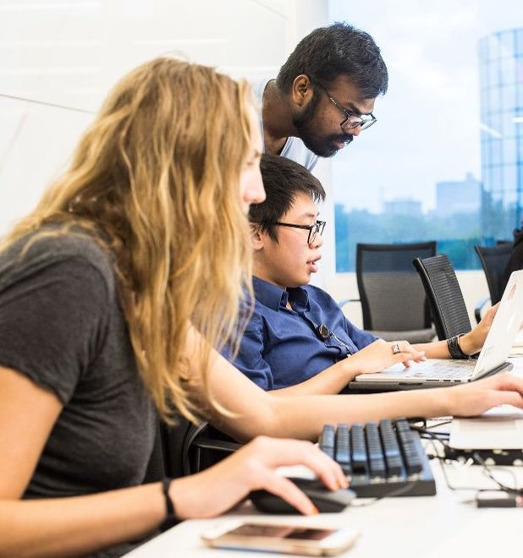
huddle
https://www.glassdoor.co.in/Photos/Bridgewater-Associates-Office-Photos-IMG7023967.htm
Notes:
Here is another picture of huddle.
How does this picture show the meaning of huddle? Turn and talk to your partner.
In this picture workers in an office huddle together to solve a problem.
How many syllables are in the word huddle? Let’s find out by clapping. Ready?
“Hud-dle.” 2 syllables.
Now, let’s say huddle three times by clapping the syllables. Ready?
“Hud-dle, hud-dle, hud-dle.”

Slide 8
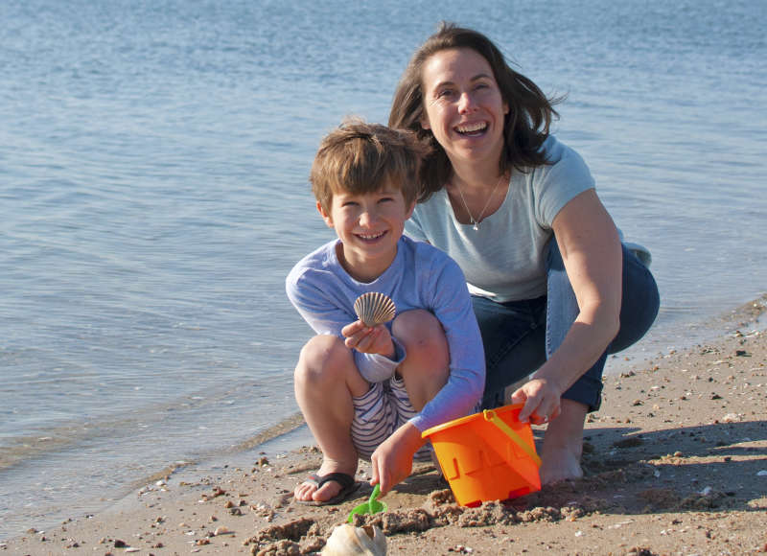
gather
hhttps://www.savebuzzardsbay.org/places-to-go/silvershell-beach/
Notes:
A word in the story is gather.
In Spanish it is recoger (rreh-koh-hehr).
Gather in this text means to collect, to bring a collection of things together.
We can also gather ourselves on the rug, get together to read a book. In this text, gather means to collect objects.
Let’s say the word gather together. Ready?
”Gather.” When you say gather, I hear the /g/ sound at the beginning of the word.
Look, gather begins with the letter g.
Here is a picture that shows gather. The child and his adult gather shells on the beach and put them into a bucket.

Slide 9
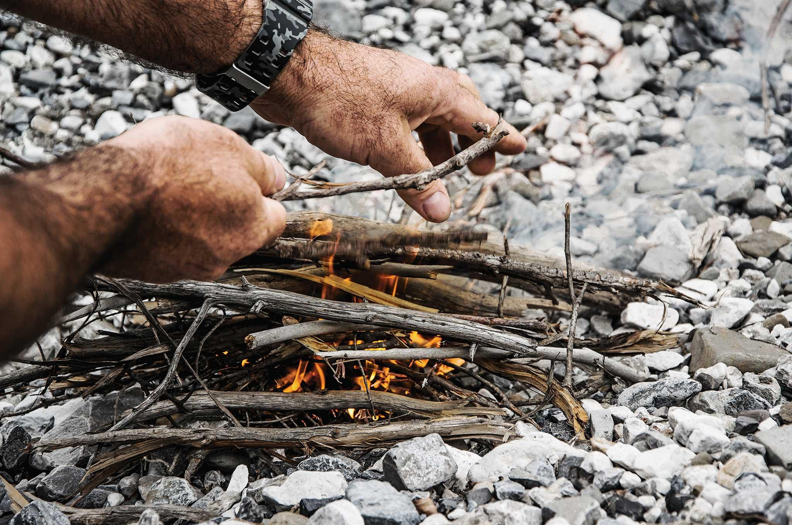
gather
https://www.offgridweb.com/survival/advanced-fire-starting-techniques-in-cold-weather/attachment/advanced-fire-starting-techniques-kindling/
Notes:
Here is another picture of gather.
How does this picture show the meaning of gather? Turn and talk to your partner.
This person gathered sticks to start a fire.
How many syllables are in the word gather? Let’s find out by clapping. Ready?
“Gath-er.” 2 syllables.
Now, let’s say gather three times by clapping the syllables. Ready?
“Gath-er, gath-er, gath-er.”

