Slide 1

Notes:
stack: to arrange things in a pile
shifting: changing
anchor: secure firmly

Slide 2
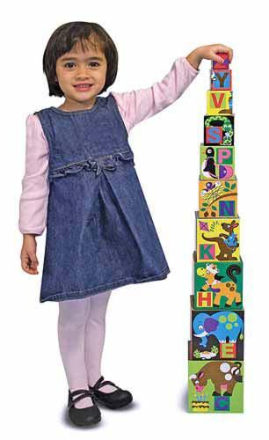
stack
https://store.redhentoys.com/alphabet-nesting-stacking-blocks-p14.aspx
Notes:
A word in the book is stacking. It comes from the word stack.
In Spanish it is apilar (ah-pee-lahr).
To stack means to arrange things in a pile. Stacking is what a person does when he or she arranges things in a pile.
Let’s say the word stacking together. Ready?
”Stacking.” When you say stacking, I hear the /s/ sound at the beginning of the word.
Look, stacking begins with the letter s.
Here is a picture that shows stack. The girl is stacking alphabet blocks to make a tall tower.

Slide 3
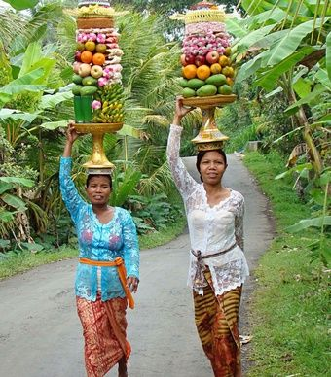
stack
https://www.pinterest.com/pin/216595063302496121/
Notes:
Here is another picture of stack.
How does this picture show the meaning of stack? Turn and talk to your partner.
The two women stack up fruit on a plate to carry on their heads.
How many syllables are in the word stack? Let’s find out by clapping. Ready?
“Stack.” 1 syllable.
Now, let’s say stack three times by clapping the syllables. Ready?
“Stack, stack, stack.”

Slide 4
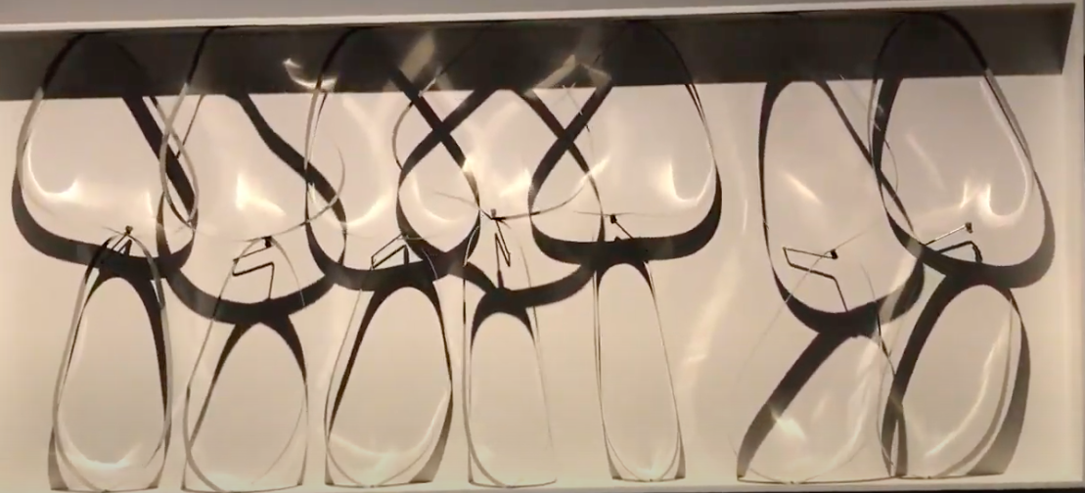
shifting
Click on the image to watch the video.
https://drive.google.com/drive/u/0/folders/1w8Yv9y6iLip03G4hsRonUbN4NVaH9Q1R, video Ana Vaisenstein
Notes:
A word in the book is shifting.
In Spanish it is cambiante (kahm-byahn-teh).
Shifting describes something that is changing.
Let’s say the word shifting together. Ready?
”Shifting.” When you say shifting, I hear the /sh/ sound at the beginning of the word.
Look, shifting begins with the letters sh, and together they make the /sh/ sound.
Here is a picture and a movie that shows shifting. The sculptor Julio LeParc created many moving sculptures in which shifting shapes surprise and attract people who are watching them.

Slide 5
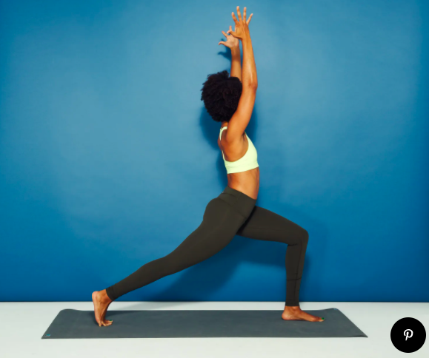
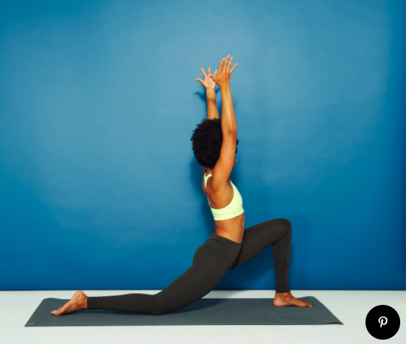
shifting
https://www.self.com/gallery/yoga-poses-for-tight-hips
Notes:
Here are two photos for shifting.
How do these photos show the meaning of shifting? Turn and talk to your partner.
The shifting yoga pose allows the woman to stretch the muscles in her legs and hips. She doesn’t stay in one position; the pose is changing. Let’s try some shifting poses to stretch our bodies.
How many syllables are in the word shifting? Let’s find out by clapping. Ready?
“Shift-ing.” 2 syllables.
Now, let’s say shifting three times by clapping the syllables. Ready?
“Shift-ing, shift-ing, shift-ing.”

Slide 6
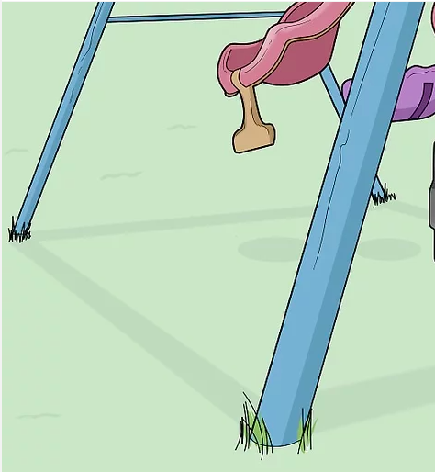
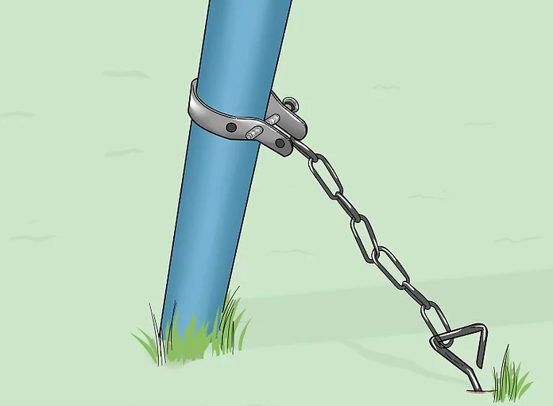
anchor
https://www.wikihow.com/Anchor-a-Swing-Set
Notes:
A word in the story is anchor.
In Spanish it is anclar (ahn-klahr).
To anchor is to secure firmly in place.
Let’s say the word anchor together. Ready?
”Anchor.” When you say anchor, I hear the /a/ sound at the beginning of the word.
Look, anchor begins with the letter a.
Here is a picture that shows anchor. This swing set is anchored to the ground to make it very safe for all children.

Slide 7

anchor
https://www.bestboatreport.com/how-long-can-you-leave-a-boat-anchored-in-one-place/
Notes:
Here is another picture of anchor.
How does this picture show the meaning of anchor? Turn and talk to your partner.
The man anchors the boat so it stay in one place in the water and not drift.
How many syllables are in the word anchor? Let’s find out by clapping. Ready?
“An-chor.” 2 syllables.
Now, let’s say anchor three times by clapping the syllables. Ready?
“An-chor, an-chor, an-chor.”

