Slide 1
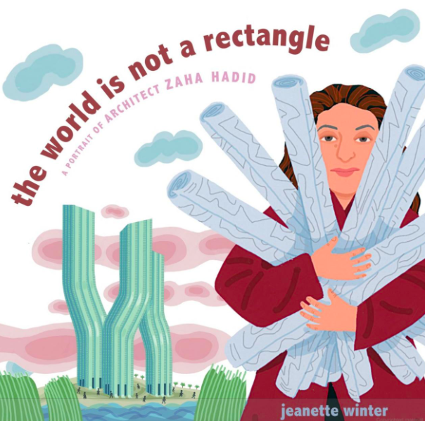
Notes:
ancient: something that is extremely old or doesn’t exist any more
unusual: strange or uncommon
ruins: what is left of a structure after it was damaged or not taken care of
to design: to make or draw plans for structures
to arrange: to put in some order or pattern

Slide 2
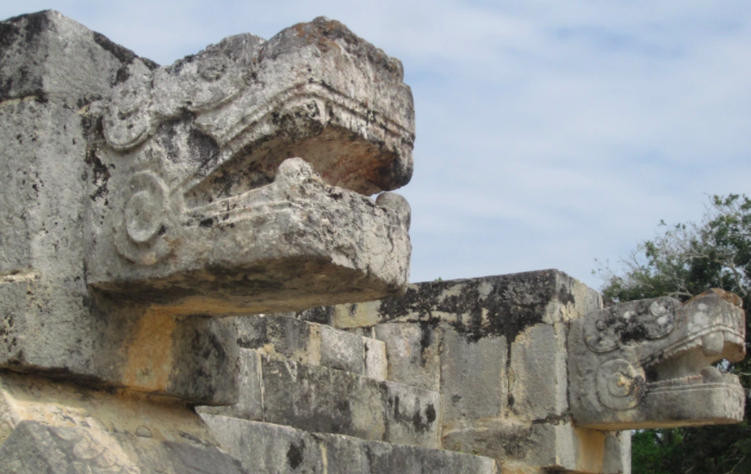
ancient
https://clausitosfootprints.wordpress.com/2013/03/27/chichen-itza-mexico-march-2012/img_0249/
Notes:
A word in the story is ancient.
In Spanish it is antiguo (ahn-tee-gwoh).
Ancient is something that is extremely old or doesn’t exist any more.
Let’s say the word ancient together. Ready? ”Ancient.”
When you say ancient, I hear the long a sound, /ā/, at the beginning of the word.
Look, ancient begins with the letter a.
Here is a picture that shows ancient. These serpent heads were built by the Mayas in México almost 2,000 years ago! They are very, very old.

Slide 3
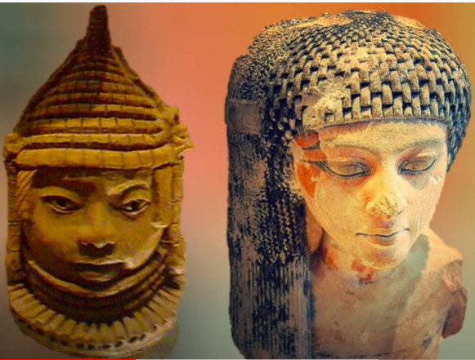
ancient
https://www.youtube.com/watch?app=desktop&v=55tSkRqhmYc
Notes:
Here is another picture of ancient.
How does this picture show the meaning of ancient? Turn and talk to your partner.
These are very old sculptures of women; they come from two different ancient kingdoms in Africa. The kingdoms don’t exist anymore, but the sculptures do, and they are ancient.
How many syllables are in the word ancient? Let’s find out by clapping. Ready?
“An-cient.” 2 syllables.
Now, let’s say ancient three times by clapping the syllables. Ready?
“An-cient, an-cient, an-cient.”

Slide 4
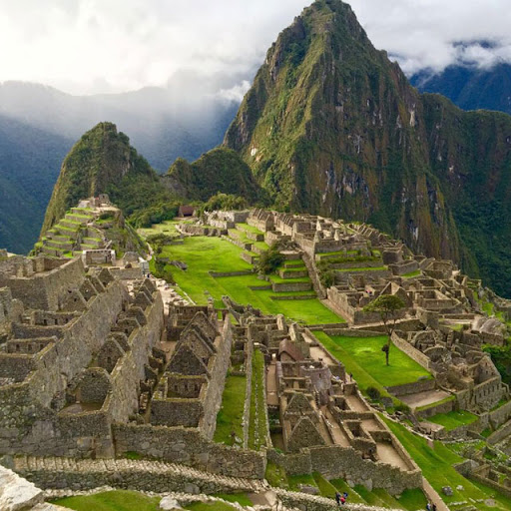
ruins
https://earth.google.com/web/@0,0,0a,22251752.77375655d,35y,0h,0t,0r
Notes:
A word in the story is ruins.
In Spanish it is ruinas (rrwee-nahs).
Ruins are what is left of a structure after it was damaged or not taken care of. We can also say “a ruin” when we are talking about just one structure.
Let’s say the word ruins together. Ready?
”Ruins.” When you say ruins, I hear the /r/ sound at the beginning of the word.
Look, ruins begins with the letter r.
Here is a picture that shows the ruins of an ancient city in Perú called Machu Picchu. It was built by the Incas, a group of American Indian people in South America.

Slide 5
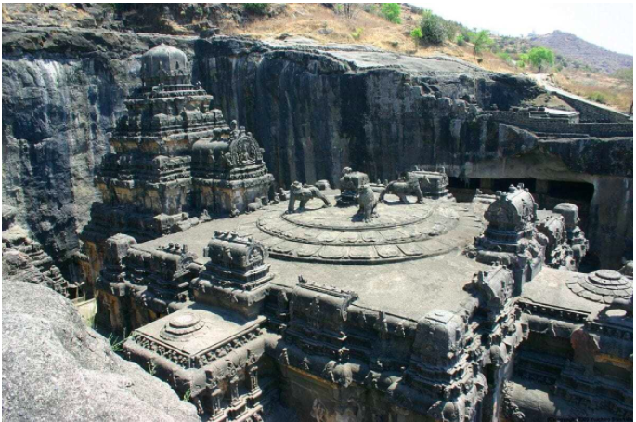
ruins
https://www.heritagedaily.com/2020/07/50-ancient-ruins-around-the-world/134292
Notes:
Here is another picture of ruins.
How does this picture show the meaning of ruins? Turn and talk to your partner.
The picture shows the Ellora Caves, a large temple complex built between 1,500 and 1,000 years ago in India. These are ancient ruins!
How many syllables are in the word ruins? Let’s find out by clapping. Ready?
“Ru-ins.” 2 syllables.
Now, let’s say ruins three times by clapping the syllables. Ready?
“Ru-ins, ru-ins, ru-ins.”

Slide 6
design
https://www.thinktankhome.com/design-laundry-room/
Notes:
Another word in the story is design, as a verb, or action.
In Spanish it is diseñar (dee-seh-nyahr).
To design is to make or draw plans. People can design buildings, clothes, furniture, tools, sculptures, and more.
Let’s say the word design together. Ready?
”Design.” When you say design I hear the /d/ sound at the beginning of the word.
Look, design begins with the letter d.
Here is a picture that shows design. These architects are designing a home; they are making decisions and drawing the plans for the structure that other people will build.

Slide 7
design
https://venturewell.org/black-women-engineers/
Notes:
Here is another picture of design.
How does this picture show the meaning of the verb design? Turn and talk to your partner.
This engineer is designing a structure, to analyze whether it will work well for people to use.
How many syllables are in the word design? Let’s find out by clapping. Ready?
“De-sign.” 2 syllables.
Now, let’s say design three times by clapping the syllables. Ready?
“De-sign, de-sign, de-sign.”

Slide 8
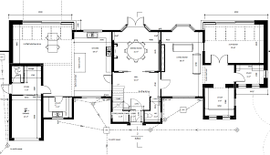
plan
https://www.houseplanshelper.com/architectural-floor-plans.html
Notes:
Another word in the story is plan.
In Spanish it is plano (plah-noh).
A plan is a drawing that shows how something will be built.
Let’s say the word plan together. Ready?
”Plan.” When you say plan I hear the /p/ sound at the beginning of the word.
Look, plan begins with the letter p.
Here is a picture that shows plan. This is the kind of drawing an architect makes to show how to build a house.

Slide 9
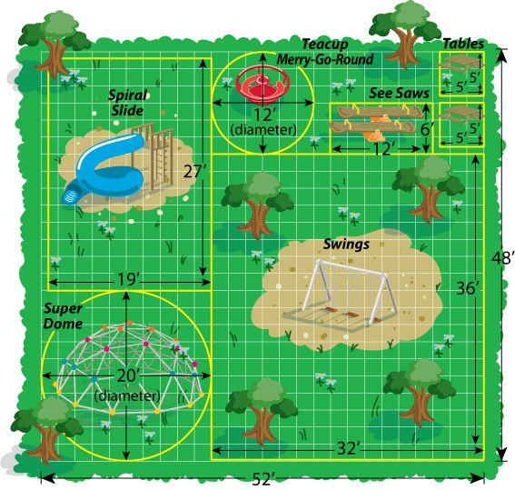
plan
https://www.pinterest.com/pin/147633694007665185/
Notes:
Here is another picture of plan.
How does this picture show the meaning of plan? Turn and talk to your partner.
This is a plan for a playground. It shows where the different play structures should be built.
How many syllables are in the word plan? Let’s find out by clapping. Ready?
“Plan.” 1 syllable.
Now, let’s say plan three times by clapping the syllables. Ready?
“Plan, plan, plan.”

Slide 10
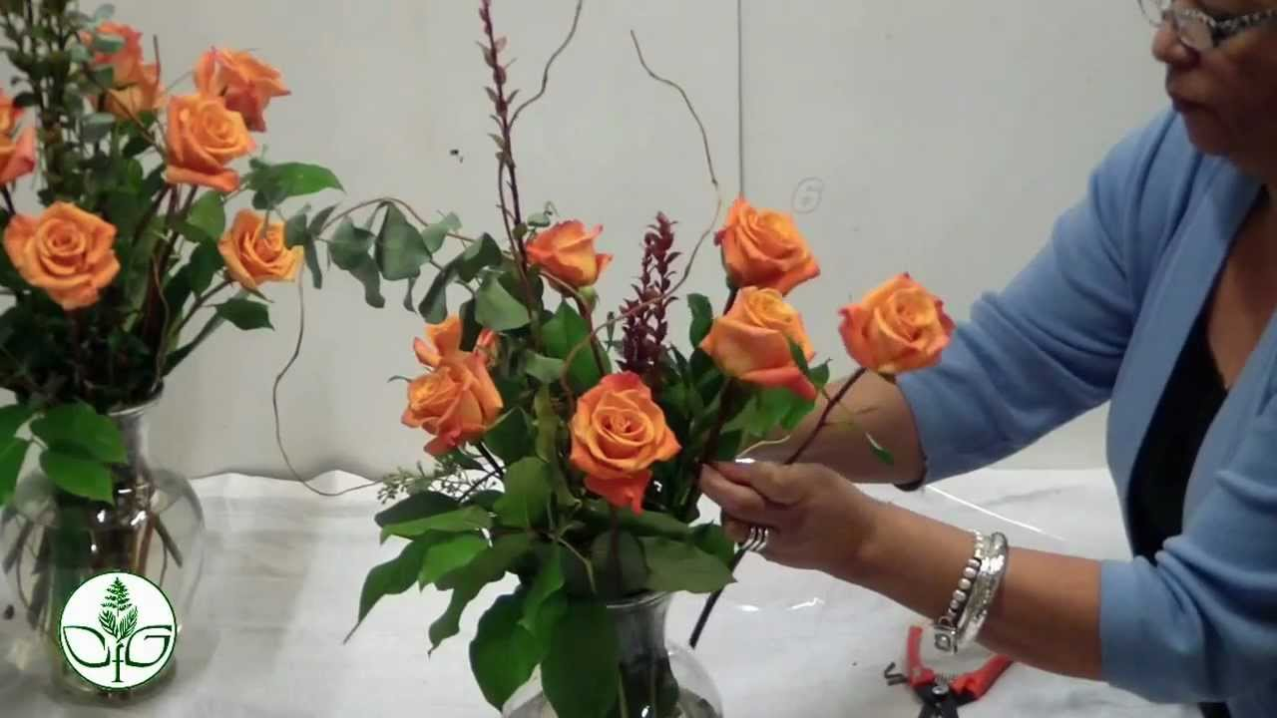
arrange
https://www.youtube.com/watch?v=jYL9puz6nIE
Notes:
Another word in the story is arrange.
In Spanish it is ordenar (ohr-deh-nahr).
To arrange is to put in some order or pattern.
Let’s say the word arrange together. Ready?
”Arrange.” When you say arrange, I hear the /a/ sound at the beginning of the word.
Look, arrange begins with the letter a.
Here is a picture that shows arrange. This person is arranging the flowers, putting them in a certain way or order so they look interesting.

Slide 11
arrange
https://www.wellandgood.com/feng-shui-with-plants/
Notes:
Here is another picture of arrange.
How does this picture show the meaning of arrange? Turn and talk to your partner.
This couple is arranging the furniture in their living room. They are organizing it so that they can have the right amount space to move around, so they are comfortable, and so they have what they need in the right place.
How many syllables are in the word arrange? Let’s find out by clapping. Ready?
“Ar-range.” 2 syllables.
Now, let’s say arrange three times by clapping the syllables. Ready?
“Ar-range, ar-range, ar-range.”

