Slide 2
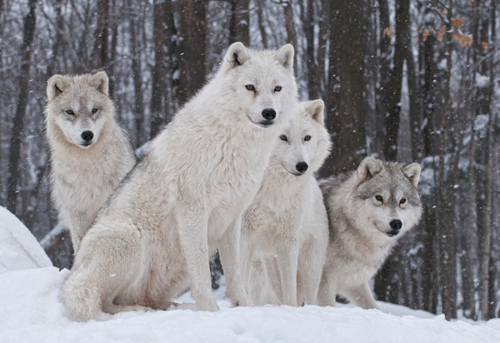
pack
https://www.fursforus.com/what-pack-animals-can-teach-you-about-leadership/
Notes:
A word in the story is pack.
In Spanish it is manada (mah-nah-dah).
In the text we are reading, pack means a group of wild animals, especially wolves.
You may have heard the word pack to refer to a small paper box or container. That’s another definition, but it does not make sense in this text. We have to pay attention to the context where we find a word so we don’t misunderstand what the author wants to communicate.
Let’s say the word pack together. Ready?
“Pack.” When you say pack, I hear a /p/ sound at the beginning of the word.
Look, pack begins with the letter p.
Here is a picture that shows pack. This pack of wolves is standing over a snow-covered rock overlooking the territory, the land.

Slide 3
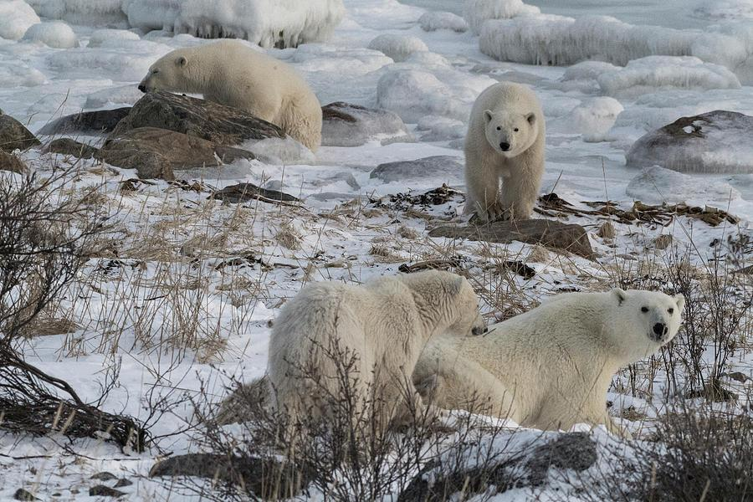
pack
https://fineartamerica.com/featured/large-group-of-polar-bears-lynn-starnes.html
Notes:
Here is another picture that shows pack.
How does this picture show pack? Turn and talk to your partner.
This is a pack of polar bears. It is a group of polar bears resting on the snow.
How many syllables are in the word pack? Let’s find out by clapping. Ready?
“Pack.” One syllable.
Now, let’s say pack three times by clapping the syllables. Ready?
“Pack, pack, pack.”

Slide 4
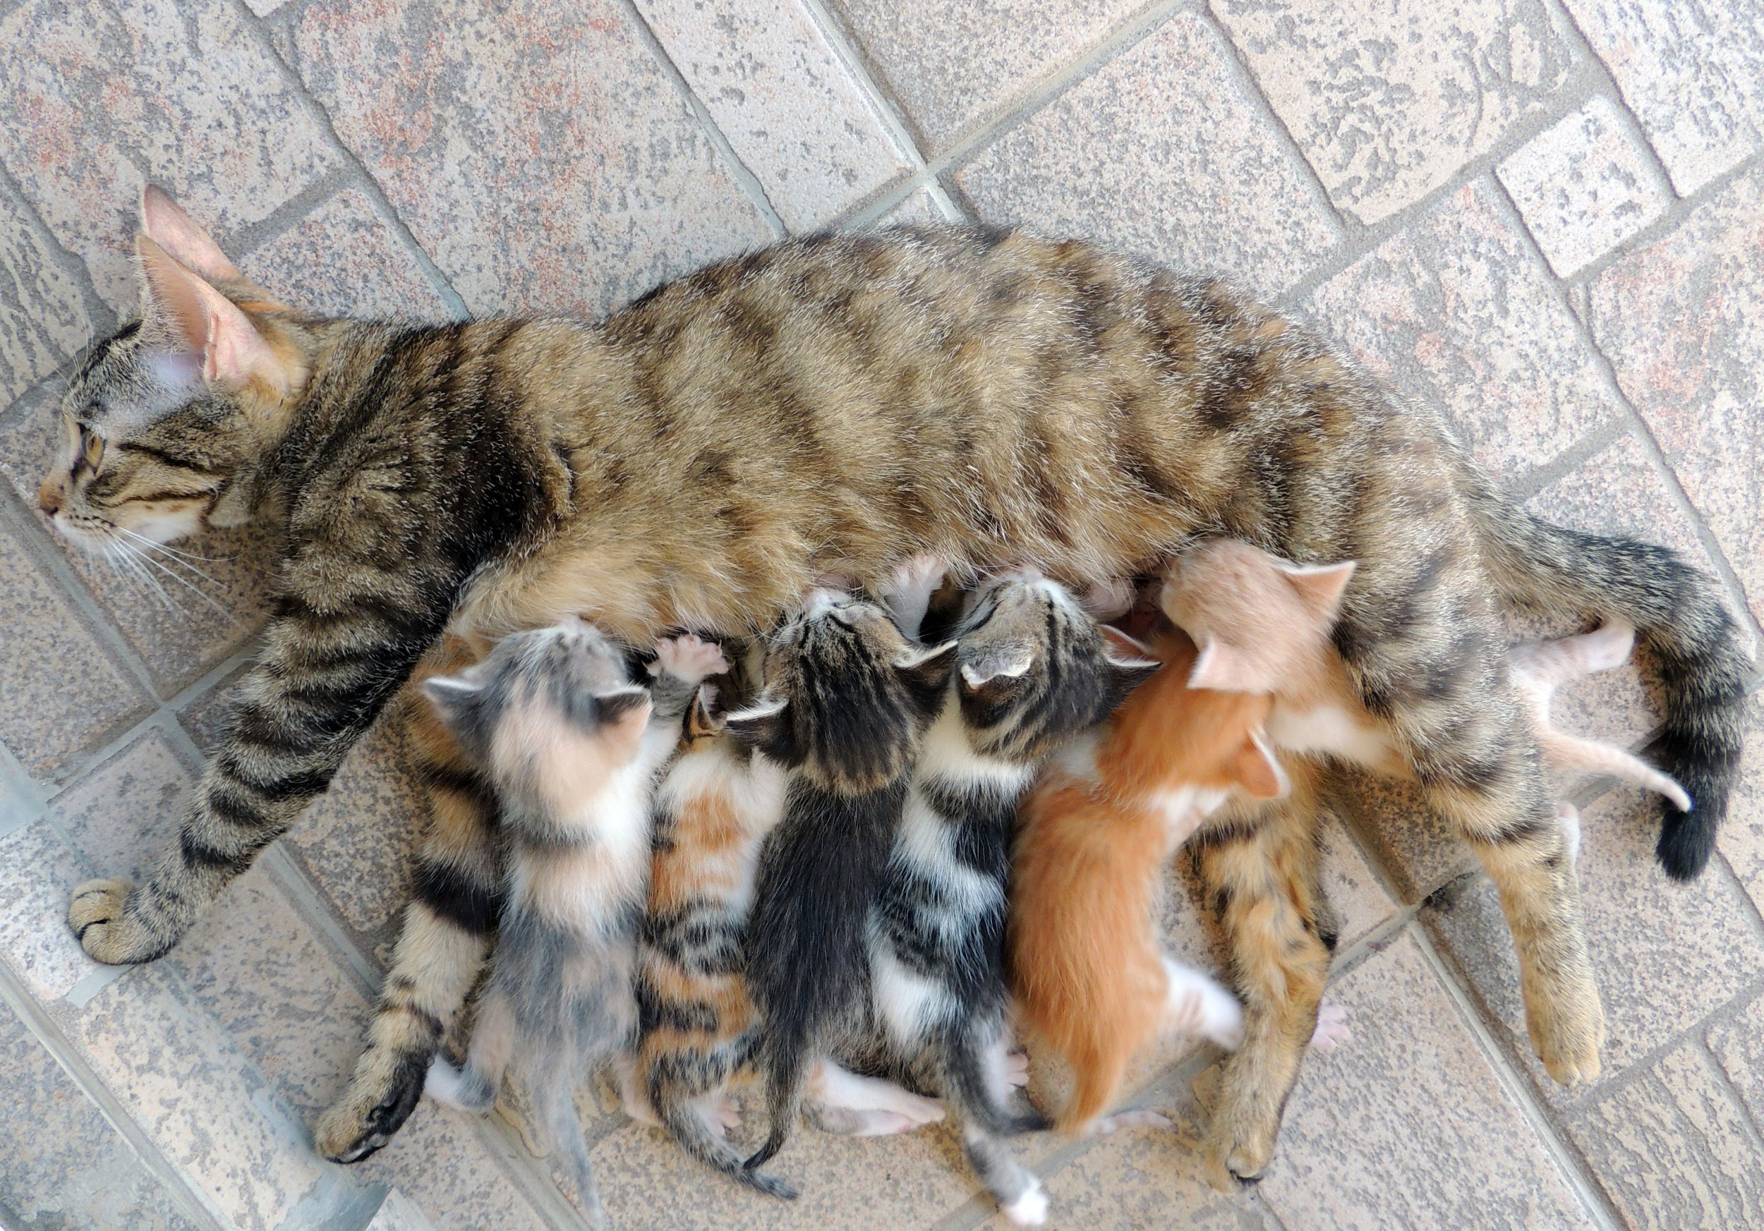
litter
https://www.pinterest.com/pin/561331541029915074/?nic_v2=1a18YqhJw
Notes:
A word in the story is litter.
In Spanish it is cría (kree-ah).
In the text we are reading, litter means a group of animals born at the same time to a mother animal.
You may have heard the word litter to refer to trash. That’s another definition, but it does not make sense in this text. We have to pay attention to the context where we find a word so we don’t misunderstand what the author wants to communicate.
Let’s say the word litter together. Ready?
“Litter.” When you say litter, I hear a /l/ sound at the beginning of the word.
Look, litter begins with the letter l.
Here is a picture that shows litter. There are six kittens in this litter. They are all drinking milk from their mother.

Slide 5
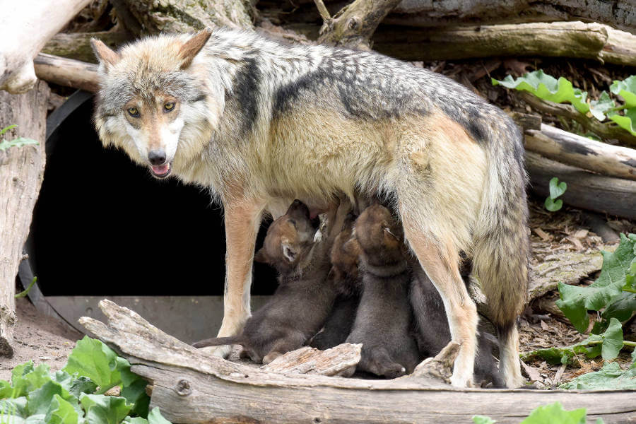
litter
https://aboutzoos.info/news/news-zoos/1185-mexican-wolf-conservation-success-story-and-captive-population-contribution
Notes:
Here is another picture that shows litter.
How does this picture show litter? Turn and talk to your partner.
This is a litter of wolves. It looks like there are four puppies in this litter. They are also drinking milk from their mother, or nursing.
How many syllables are in the word litter? Let’s find out by clapping. Ready?
“Lit-ter.” Two syllables.
Now, let’s say litter three times by clapping the syllables. Ready?
“Lit-ter, lit-ter, lit-ter.”

Slide 6
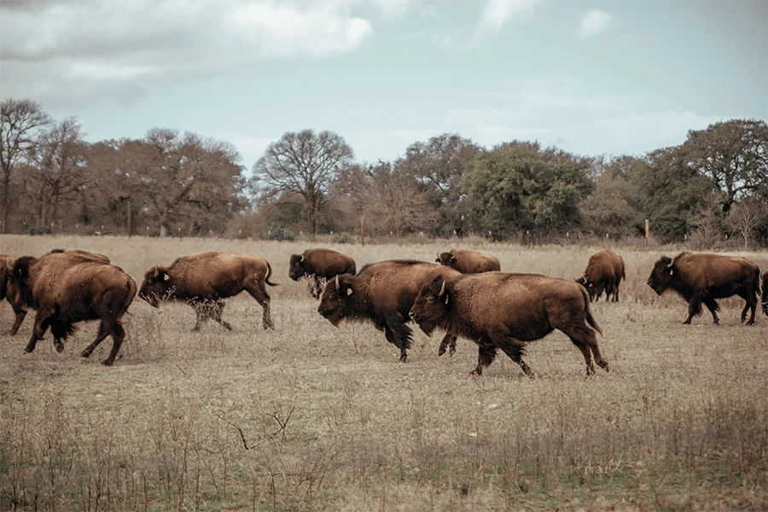
roam
https://epicprovisions.com/blogs/land-livestock/reflections-from-the-first-bison-harvest-at-roam-ranch
Notes:
A word in the story is roam.
In Spanish it is vagar (bah-gahr).
Roam means to move around over a large area.
Let’s say the word roam together. Ready?
“Roam.” When you say roam, I hear a /r/ sound at the beginning of the word.
Look, roam begins with the letter r.
Here is a picture that shows roam. These North American bison are roaming freely in the clearing and eating grass.

Slide 7
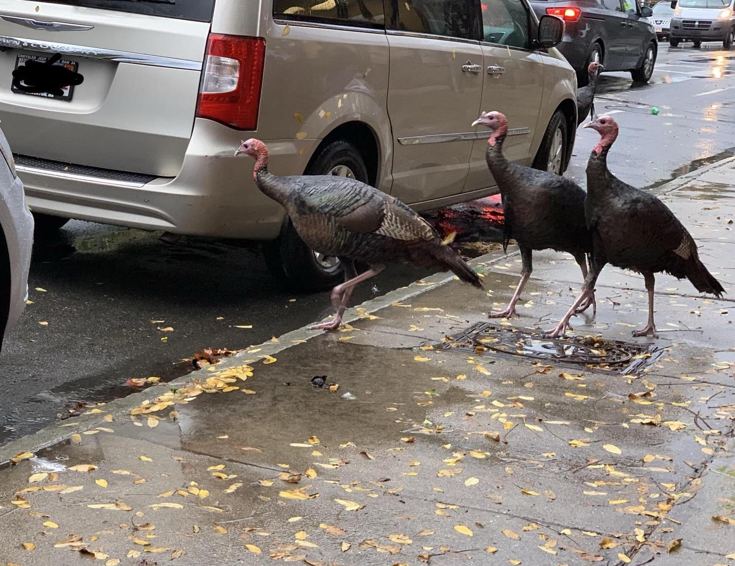
roam
https://www.reddit.com/r/boston/comments/9ne38i/the_turkeys_are_out_in_jp/
Notes:
Here is another picture that shows roam.
How does this picture show roam? Turn and talk to your partner.
Over the last months we are seeing turkeys roaming the streets of Boston. This photo was taken in Jamaica Plain.
How many syllables are in the word roam? Let’s find out by clapping. Ready?
“Roam.” One syllable.
Now, let’s say roam three times by clapping the syllables. Ready?
“Roam, roam, roam.”

