Slide 1
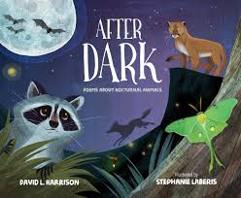
“The Rehearsal” (Gray Wolf Poem)
By David L. Harrison
From After Dark: Poems about Nocturnal Animals

Slide 2
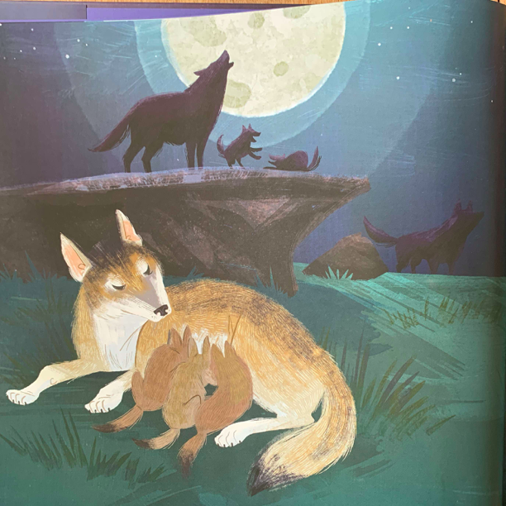
You wild thing.
You bouncy pup.
roughhousing
with your siblings
Let the grown-ups
howl in the night,
keep your belly full
hide you from eagles.

Slide 3
Play rambunctious games--
growly, pouncy, bitey games.
Time will come soon enough
to grow up, fight for life.
Time will come
when you and your mate
run the pack,
decide where to hunt,
hide your pups from eagles.

Slide 4
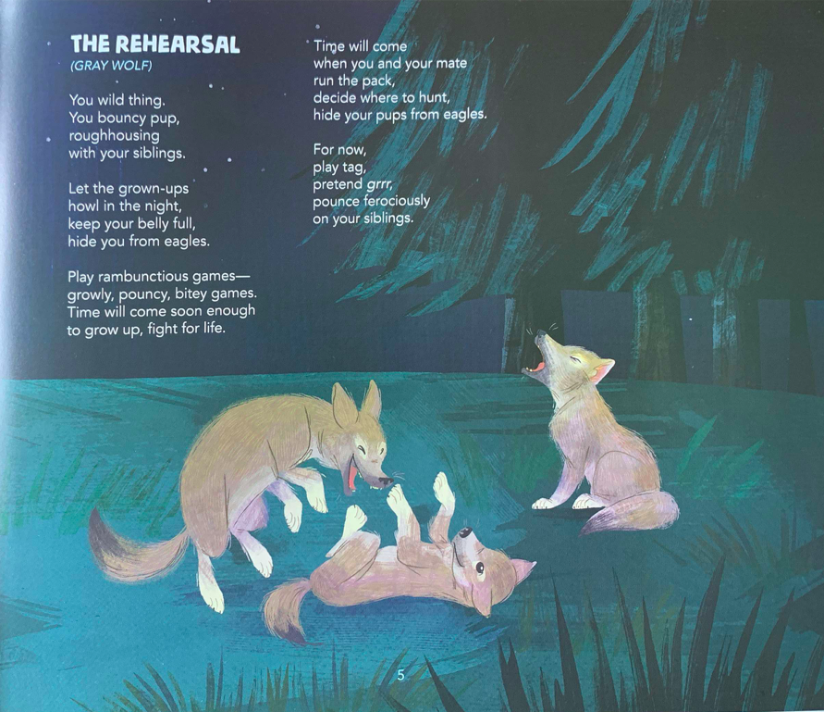
For now,
play tag,
pretend grrr
pounce ferociously
on your siblings.

