Slide 1
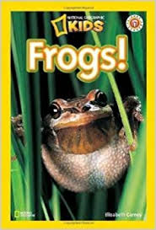
Notes:
habitat: the place where animals live
warn: to let someone know about possible danger
survive: to stay alive
poison: something that can kill or hurt living things
gills: body parts used for breathing underwater

Slide 2
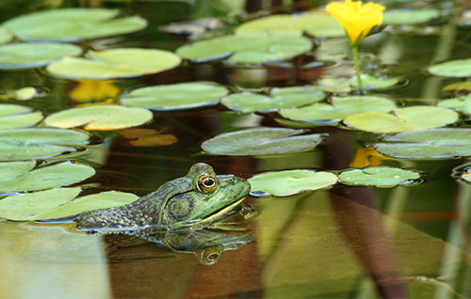
habitat
https://animalsake.com/frog-habitat
Notes:
A word in the story is habitat.
In Spanish it is el hábitat (el ah-bee-taht).
Habitat means the place where animals live.
Let’s say the word habitat together. Ready? ”Habitat.”
When you say habitat, I hear the /h/ sound at the beginning of the word.
Look, habitat begins with the letter h.
Here is a picture that shows habitat. We learned that frogs live in ponds. Ponds are their habitat. Here is a picture of a frog in its habitat.

Slide 3
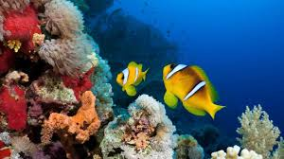
habitat
Notes:
Here is another picture of habitat.
How does this picture show the meaning of habitat? Turn and talk to your partner.
These fish live in the ocean. The ocean is their habitat.
How many syllables are in the word habitat? Let’s find out by clapping. Ready?
“Hab-i-tat.” Three syllables.
Now, let’s say habitat three times by clapping the syllables. Ready?
“Hab-i-tat, hab-i-tat, hab-i-tat.”

Slide 4
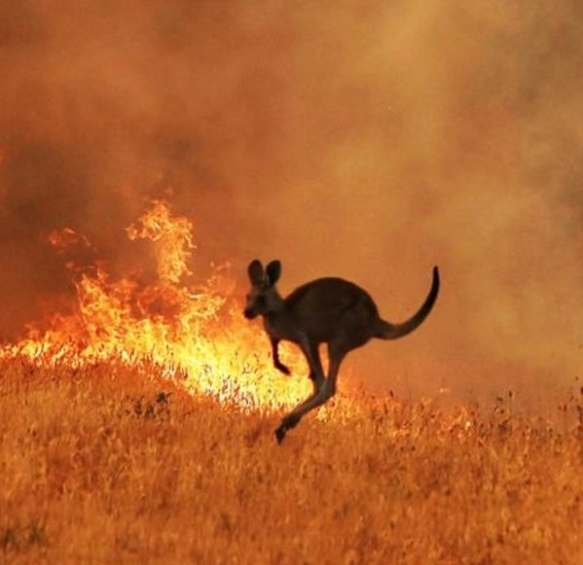
survive
http://news925.com/australia-forest-fires-kill-or-displace-nearly-3-billion-animals
Notes:
A word in the story is survive.
In Spanish it is sobrevivir (soh-breh-bee-beer).
Survive means to stay alive.
Let’s say the word survive together. Ready? ”Survive.”
When you say survive, I hear the /s/ sound at the beginning of the word.
Look, survive begins with the letter s.
Here is a picture that shows survive. There was a big fire in Australia. This kangaroo survived the fire. It ran away to escape the area where fires were burning. It was able to stay alive.

Slide 5
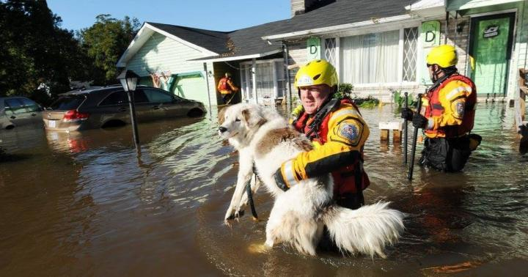
survive
https://www.almanac.com/content/flood-safety-and-survival-tips
Notes:
Here is another picture of survive.
How does this picture show the meaning of survive? Turn and talk to your partner.
The dog survived the flooding. Workers rescued it. They took it to a safe place so it could get what it needed to stay alive.
How many syllables are in the word survive? Let’s find out by clapping. Ready?
“Sur-vive.” Two syllables.
Now, let’s say survive three times by clapping the syllables. Ready?
“Sur-vive, sur-vive, sur-vive.”

Slide 6
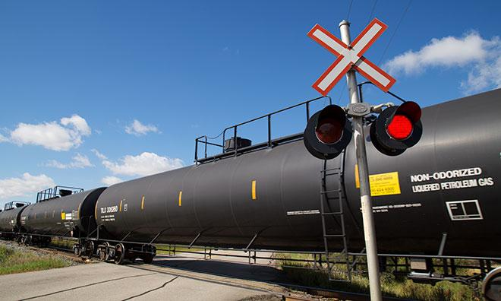
warn
https://www.strathcona.ca/transportation-roads/traffic/traffic-management/railways/
Notes:
Another word in the story is warn.
In Spanish it is advertir (ahd-behr-teer).
Warn means to let someone know about possible danger.
Let’s say the word warn together. Ready? ”Warn.”
When you say warn, I hear the /w/ sound at the beginning of the word.
Look, warn begins with the letter w.
Here is a picture that shows the word warn. This red light warns that it is not safe to cross the train trucks at that time. It also warn us that a train is coming and we should stay in place.

Slide 7
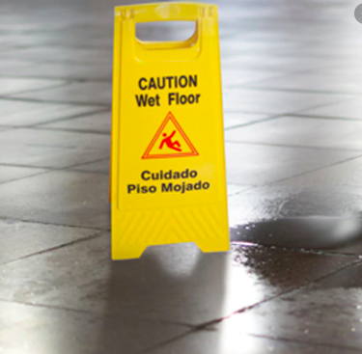
warn
https://www.creativesafetysupply.com/signs/caution-hazard-signs/wet-floor-signs/
Notes:
Here is another picture of warn.
How does this picture show the meaning of warn ? Turn and talk to your partner.
This sign is to warn people that the floor is wet and it could be slippery.
How many syllables are in the word warn? Let’s find out by clapping. Ready?
“Warn.” One syllable.
Now, let’s say warn three times by clapping the syllables. Ready?
“Warn, warn, warn.”
Can you think of a time when someone warned you about something?

Slide 8
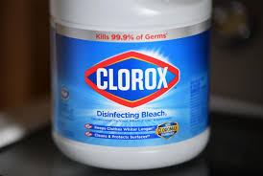
poison
https://www.forbes.com/sites/robertglatter/2020/04/25/calls-to-poison-centers-spike--after-the-presidents-comments-about-using-disinfectants-to-treat-coronavirus/#
Notes:
Another word in the story is poison.
In Spanish it is veneno (beh-neh-noh).
Poison means something that can kill or hurt living things.
Clorox is a very strong cleaning product for the house, but it is poison for living things. It can make us very sick if we put it in our mouths.
Let’s say the word poison together. Ready?
”Poison.” When you say poison, I hear the /p/ sound at the beginning of the word.
Look, poison begins with the letter p.

Slide 9
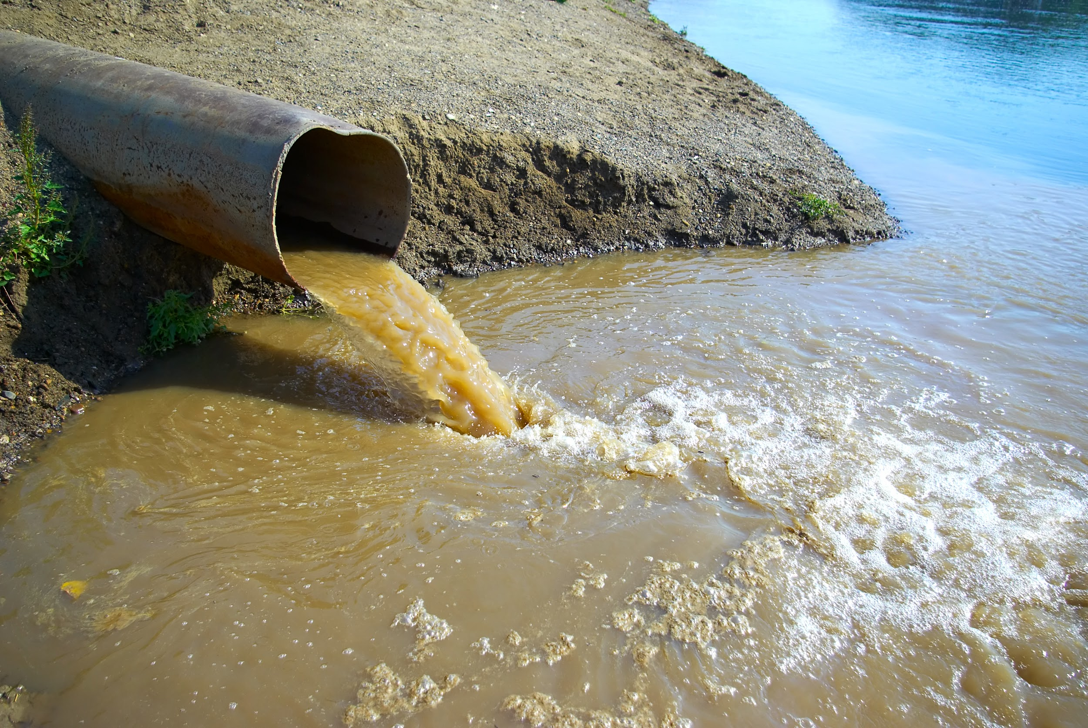
poison
https://environmentamerica.org/programs/ame/clean-water-america-1
Notes:
Here is another picture of poison.
How does this picture show the meaning of poison? Turn and talk to your partner.
The dirty water is like poison for the river and the animals that live in it. It will make them sick.
How many syllables are in the word poison? Let’s find out by clapping. Ready?
“Poi-son.” Two syllables.
Now, let’s say poison three times by clapping the syllables. Ready?
“Poi-son, poi-son, poi-son.”

Slide 10
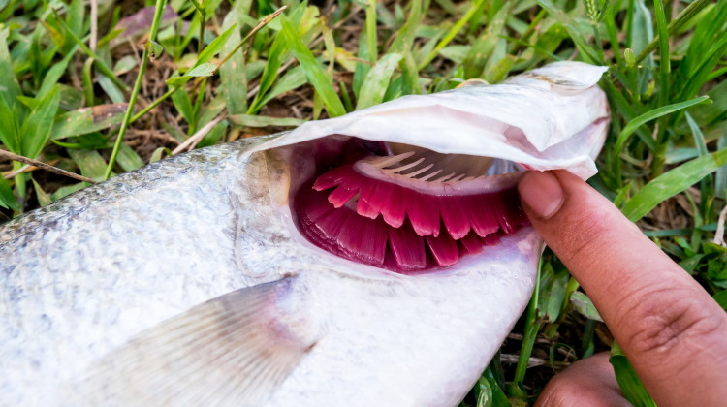
gill
https://www.earthlife.net/fish/gills.html
Notes:
Another word in the story is gill.
In Spanish it is branquia (brahn-kyah).
Gill is a body part some animals have for breathing underwater.
This person is showing the gills of a fish. The gills help the fish get rid of water and keep the oxygen it needs to survive.
Let’s say the word gill together. Ready?
”Gill .” When you say gill, I hear a /g/ sound at the beginning of the word.
Look, gill begins with the letter g.

Slide 11
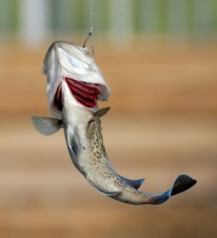
gills
https://www.yourdictionary.com/gill
Notes:
Here is another picture of gills. The base word is gill; because there is an s at the end, there is more than one gill.
How does this picture show the meaning of gills ? Turn and talk to your partner.
Fish have two sets of gills, one on each side of their bodies. Gills allow fish to breathe.
How many syllables are in the word gills? Let’s find out by clapping. Ready?
“Gills.” One syllable.
Now, let’s say gills three times by clapping the syllables. Ready?
“Gills, gills, gills.”

