Slide 1
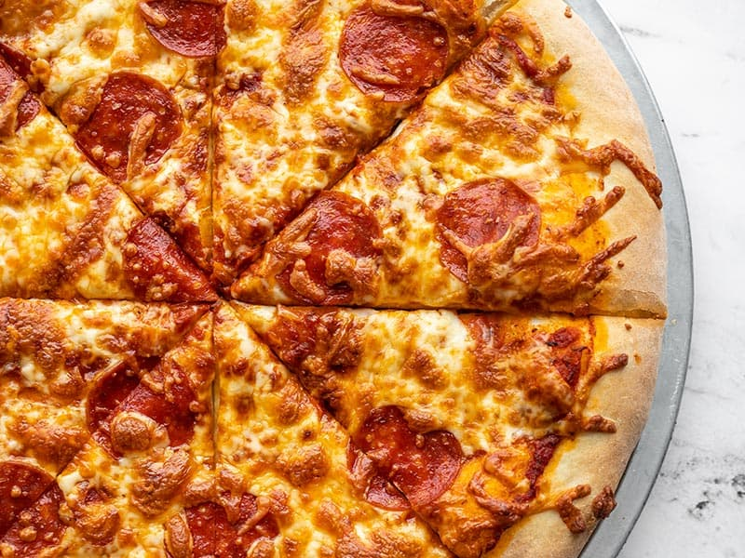
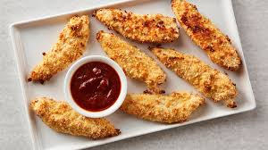
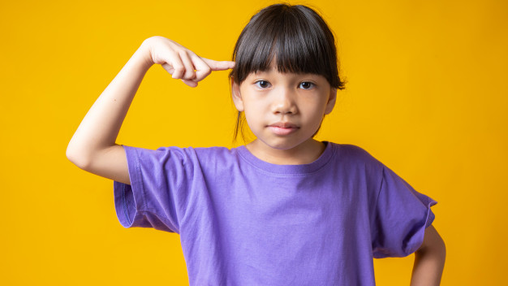
rather
https://www.budgetbytes.com/pizza-dough/, https://www.bettycrocker.com/recipes/oven-fried-chicken-tenders/46a69e4d-4c31-485b-9d43-67d40b353f2e, https://www.pinterest.com/pin/create/button/?media=https://image.freepik.com/free-photo/young-asian-girl-violet-shirt-thinking-pointing-head-get-idea_
Notes:
A word in the story is rather.
In Spanish it is preferir (preh-feh-reer).
Rather means to prefer or choose one thing over another.
Let’s say the word rather together. Ready?
”Rather.”
When you say rather, I hear the /r/ sound at the beginning of the word.
Look, rather begins with the letter r.
Here is a picture that shows rather. This girl is thinking about what she would rather have for lunch. Would she rather have pizza or chicken nuggets? What would you rather have for lunch?

Slide 2
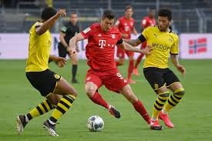
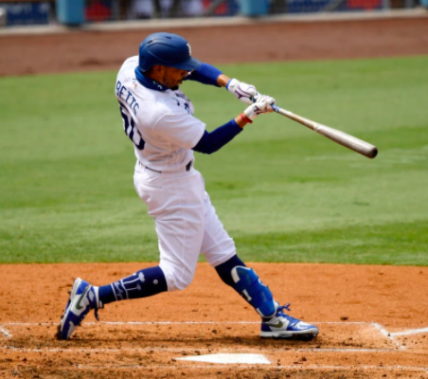
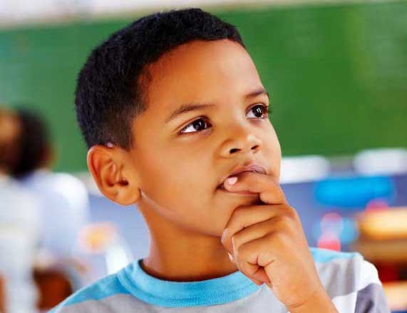
rather
https://vocal.media/theSwamp/we-need-a-new-black-education-system-nationwide, https://www.nytimes.com/2020/08/24/sports/baseball/Dodgers-halfway-season.html, https://slate.com/culture/2020/05/bundesliga-social-distancing-rules-pointless-germany-soccer-coronavirus.html
Notes:
Here is another picture of rather.
How does this picture show the meaning of rather? Turn and talk to your partner.
How many syllables are in the word rather? Let’s find out by clapping. Ready?
“Rather.” Two syllables.
Now, let’s say rather three times by clapping the syllables. Ready?
“Ra-ther, ra-ther, ra-ther.”

Slide 3
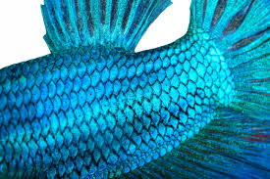
scale
https://animals.mom.com/what-are-fish-scales-used-for-3010814.html
Notes:
A word in the story is scale.
In Spanish it is escama (ehs-kah-mah).
A scale is a small, hard, thin part of a fish’s covering. Fish have many scales, so we add an s to the base word scale. You might have heard the word scale before when you go to the doctor and get your weight measured. There are different meanings for the word scale.
Let’s say the word scale together. Ready?
”Scale.”
When you say scale, I hear the /s/ sound at the beginning of the word.
Look, scale begins with the letter s.
Here is a picture that shows scale. This fish has beautiful blue scales. Can you see how many scales cover its body?

Slide 4
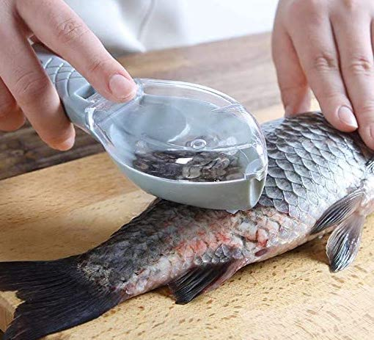
scale
https://www.amazon.com/Plastic-Graters-Scraper-Cleaning-Scraping/dp/B08358GGDK
Notes:
Here is another picture of scale.
How does this picture show the meaning of scale? Turn and talk to your partner.
The person is scraping the scales off the fish. He or she will cook the fish, and we don’t eat the scales.
How many syllables are in the word scale? Let’s find out by clapping. Ready?
“Scale.” One syllable.
Now, let’s say scale three times by clapping the syllables. Ready?
“Scale, scale, scale.”

