Slide 1
Assessment Lunch & Learn / Office Hours
December 14^{th,} 2022
Please post questions you may have in the chat box – we will work to answer them during the session and add them to a Q & A document.
We will begin shortly.
Notes:
As always, we are glad you are able to join us today and are hopeful the information provided in these sessions is helpful and beneficial to your work.
We have our assessment team members, Jodi Bossio-Smith, Cheryl Brackett, Krista Averill, Regina Lewis, Varun Motay, consultant Andy Wallace, to ensure we are able to answer all questions in a timely, efficient and detailed manner.
Some general reminders before we get started today:
Feel free to place questions in the chat – we will respond to them during the Q & A session
In the Q & A session, if asking a question please raise your hand and we will call on you.
Please ensure you are muted – we will be muting all participants shortly to ensure limited distractions

Slide 2
General Reminders & Forthcoming Updates in Today’s Office Hour:
The December Monthly Update was shared via email to DACs 12/2/22
Pre-administration tasks for ACCESS for ELLs are underway!
Maine Through Year Assessment professional learning workshops are kicking off in January!
Notes:
We hope the 2022-23 school year is off to a great start!
We are excited to share that over the summer and more recently there are some changes to the assessment team. We welcome Krista Averill, a former science and social studies educator from China Middle School to the assessment team. Krista is coordinating the math, reading (NWEA) and Maine science assessments.
More recently and within the coming weeks, Jodi Bossio-Smith will be transitioning to the role of Director for Assessment. This is effective September 19. During this period of transition, both Janette and Jodi will serve as points of contact for assessment related items as we work to back fill the vacancy created by Jodi’s transition.
The assessment calendar for the 2022/23 school year is posted on the DOE website. The winter administration of the NWEA MAP growth remains optional as in prior years but Krista will be sharing additional information related to NWEA next.
Some general reminders:
With transitions that transpire within districts, please ensure if there are changes to the DAC role in the SAU, these changes are also reflected in NEO. By doing so, we can maintain communication of important assessment related information. Please note NEO log in credentials are required to make these changes and the directions(https://www.maine.gov/doe/sites/maine.gov.doe/files/inline-files/Updating_DACs_NEO_1.pdf) are located on the assessment homepage.
September monthly update is now available. Sent to DACs and tech coordinators/integrators
Feel free to reach out with future topics for consideration for inclusion.

Slide 3
Future NWEA Assessment Administrations
Reading & Math
Winter Optional Assessment NWEA MAP Growth Window: January 9 – February 3
Maine Through Year Assessment: May 1st – 26th
Notes:
From January 9th to February 3rd, 2023, the winter MAP Growth assessment window will be open. This administration is optional.
In the spring from May 1st through the 26th, we will have the first administration of the new Maine Through Year Assessment.

Slide 4
Maine Through Year Assessment
Professional Learning Opportunities
January 4 – April 26
Using Multiple Data Sources to Support Student Growth
Using Achievement Level Descriptors to Ensure Rigor
Benefits of the Through Year Assessment
Getting Your Teachers Ready
Getting Your Students Ready
Notes:
Starting in January, the Maine Department of Education will be collaborating to offer professional learning opportunities in using multiple data sources to support student growth, using achievement level descriptors to ensure rigor, the benefits of the through year assessment, and getting your teachers and students ready for the assessment.
Using Multiple Data Sources & Using Achievement Level Descriptors are workshops that allow for up to 40 participants in an interactive environment including small group work and discussions in breakout rooms.
In the Using Multiple Data Sources session, participants will strengthen their understanding and use of RIT scores in achievement and growth data. Participants will use RIT scores as one of multiple sources to inform instruction that supports student growth, with an emphasis on formative assessment practices.
In the Using Achievement Level Descriptors session, participants will learn what achievement level descriptors (or ALDs) are, how to use information from the ALDs to inform teaching and learning actions that support students’ success, and how to use ALDs to ensure rigor in instruction.
The benefits of the through year assessment and getting your teachers and your students ready sessions are webinars that will begin in February Hundreds of individuals can attend those sessions, and they will be recorded and posted online.
Please note that these sessions are in addition to our pre-administration and administration trainings which focus on the technical aspects such as the platform and registration. I will release the times for those trainings as soon as I have them.

Slide 5
Maine Through Year Assessment
Professional Learning Opportunities
January 2023
Notes:
*UPDATE SCREENSHOT AND NOTES AS NECESSARY TO REFLECT NEW REGISTRATIONS AND LINK UPDATES*
In January we will begin our workshop sessions for Using Multiple Data Sources and Using Achievement Level Descriptors. Unfortunately, I am unable to record these sessions or share the information in a different format as the content is considered NWEA’s intellectual property. We can, however, adjust the workshop length to accommodate your needs by starting late or ending early. Please contact me directly by email if adjusting the overall session length is necessary in order for your educators and staff to attend.

Slide 6
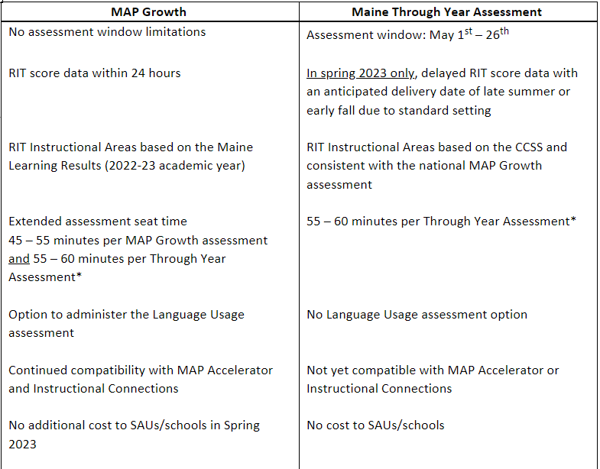
Maine Through Year Assessment
FAQ: Can I choose to give BOTH MAP Growth & MTYA in spring 2023?
Notes:
Please note that all students are required to take the Maine Through Year Assessment in spring 2023. The table displayed here is meant to provide guidance to SAUs and schools when deciding whether or not to administer the MAP Growth assessment in addition to the Maine Through Year Assessment.
Some considerations that I would like to highlight from the table are the following:
If an SAU or school chooses to administer MAP Growth this spring, it does not need to be within the same assessment window as the Through Year Assessment.
Due to standard setting, RIT scores from the Through Year Assessment will be delayed until late summer or early fall. If a school or SAU is seeking immediate RIT score data, they can still receive this by taking the MAP Growth assessment.
Extended assessment seat time is one consideration as well. Please note that the average seat time for the Maine Through Year Assessment is 55 to 60 minutes per content area (Reading and Math). Individual students will take varying amounts of time to complete the assessments.
Lastly, in spring 2023 there will be no additional cost to SAUs and schools if you choose to administer MAP Growth in addition to the Through Year Assessment. The Department has already paid for MAP Growth for the remainder of this school year.
More Questions & Answers can be found on our Reading & Math Assessments webpage: https://www.maine.gov/doe/Testing_Accountability/MECAS/NWEA

Slide 7
Maine Science Assessment
Grades 5, 8, and third year of high school
Assessment Window: May 15 – 26, 2023
Data from Spring 2022 will be available later this month
FAQ: When will the manuals and guides be available online?
Resources available on our Maine Science Assessment webpage:
Assessment Blueprints
Practice Assessments
Notes:
In spring 2023, the Maine Science Assessment will be administered to students in grades 5, 8, and third year of high school. The assessment window for the Maine Science Assessment is May 15 through 26.
Spring 2022 student results reports will be released this month with educators able to review within Maine’s Assessment & Accountability Reporting System (MAARS).
A frequently asked question in the past several weeks has been "When will the manuals and guides be available online?"
We are working on updating handbooks and manuals in preparation for the Spring 2023 administration. The support site, ME Science Zendesk, is to be restored to full functionality by March 2023, with the Lockdown Browser, ADAM Platform User, Proctor User, and Accessibility Guides being released at the end of January.
On our website under Resources, you can currently find our assessment blueprints and practice assessments.
All items on the Maine Science Assessment are aligned to a science topic and to a specific performance expectation. To ensure ample coverage of all grade-level science topics, assessment blueprints specify targets for the minimum and maximum number of score points aligned to each topic.
Lastly, practice assessments are available for each grade level and can be found at the link in the slides. This link is also available on the Maine Science Assessment webpage: https://www.maine.gov/doe/Testing_Accountability/MECAS/Generalscience

Slide 8
National & International Assessments -
NAEP No Maine Schools selected for NAEP 2023 Field Test
PISA 2022 administration
Complete. Thank you for participating.
TIMSS 2023 administration
March 1 to May 31, 2023
Notes:
The 2022 NAEP Mathematics and Reading results was officially released on Monday, October 24, 2022 by NCES Commissioner Dr. Peggy Carr. National and state results will be presented for more information please visit https://www.nagb.gov/news-and-events/calendar/naep-day-2022.html.
There are a multitude of classroom tools as well as data analysis tools available on the Nations Report Card website. https://nces.ed.gov/nationsreportcard/ Check out the release items from NAEP 2022 as well as items from previous years.
They include the :
NAEP Questions Tool https://www.nationsreportcard.gov/nqt/
NAEP Item Maps https://www.nationsreportcard.gov/itemmaps/?subj=MAT&grade=4&year=2022
Take NAEP Now https://www.nationsreportcard.gov/takenaepnow/home
NAEP Data Explorer https://www.nationsreportcard.gov/ndecore/landing
State Profiles Tool https://www.nationsreportcard.gov/profiles/stateprofile?chort=1&sub=MAT&sj=&sfj=NP&st=MN&year=2022R3
Release information from the September NAEP 2022 LTT age 9 https://www.nationsreportcard.gov/highlights/ltt/2022/
More information from the National Assessment Governing Board about the release https://www.nagb.gov/naep-subject-areas/long-term-trend/2022-NAEP-Long-Term-Trend-Release.html
No Maine Schools selected for NAEP 2023 Field Test - March 20 to April 14, 2023 Enjoy the year off
PIRLS - Analysis and reporting (release date in December 2022 tentatively) https://timssandpirls.bc.edu/
PISA 2022 –
15 year olds
Fall 2022 administration window 10/03 - 11/30/2022
Reading, Mathematics, Science, and Financial literacy
Focus topic is Mathematics for 2022
PISA 2022 will focus on mathematics, with an additional test of creative thinking.
The new PISA 2022 mathematics framework was recently launched and is located at https://pisa2022-maths.oecd.org/
Since 2000, PISA has involved more than 90 countries and economies and around 3, 000, 000 students worldwide
TIMSS 2023
4th/8thgrade: about 576,000 students in 64education systems
TIMSS 2023 focuses on how well students have learned the mathematics and science curricula in participating countries. Has been conducted every 4 years since 1995.
Assesses 4th-and 8th-graders in: Mathematics, and Science achievement
TIMSS 2023 Assessment dates: March 1-May 31, 2023
ICILS 2023 (No Maine Schools)
8thgrade: about 90,000 students in 30 education systems
ICILS 2023 compares U.S. students’ skills and experience using technology with that of their peers in countries around the world. The United States participated in ICILS in 2018 along with 13 other education systems and will participate again in 2023.
Assesses 8th-graders in:Computer & Information Literacy (CIL), and Computational Thinking (CT)
ICILS 2023 Assessment dates: March 1-May 31, 2023
4

Slide 9
ACCESS for ELLs and Alternate ACCESS for ELLs
Webinars | Date | Time | Connect
Navigating WIDA AMS for New Test Coordinators/Administrators (Maine DOE) | 12/13/22 | 8-9am | Register Here
Organizing for ACCESS: Scheduling, Materials, Accessibility (Maine DOE) | 12/15/22 | 8-9am | Register Here
Open Office Hours during ACCESS Administration Window (Maine DOE) | Weekly on Mondays 1/9/23 - 2/14/23 | 3-4pm | Register Here
Notes:
https://networkmaine.zoom.us/meeting/register/tZAlfuGrqTouHNUNL87pEGKXbMskKVYuB_OJ
https://networkmaine.zoom.us/meeting/register/tZ0rf-irrDopEtL_WC9epirfIuUNFM4Lx5Mf
https://networkmaine.zoom.us/meeting/register/tZIucu2uqjwvE9z_bcwm2lkF74zRFpdEDyNS

Slide 10
ACCESS for ELLs and Alternate ACCESS for ELLs
As of November 29th, student records have populated in WIDA AMS for SAUs to view. Learn more about student management (p.57) and test session management (p.84) in the WIDA AMS User Guide:
-Review rosters to ensure all multilingual learners have been included
-Confirm student demographic information
-Assign accommodations to students as outlined in the IEP, if applicable
-Create and manage test sessions
Notes:
https://www.wida-ams.us/Documents/Unsecure/Doc.aspx?id=e7823e23-661f-4435-aaef-bdb89e382ed6

Slide 11
ACCESS for ELLs and Alternate ACCESS for ELLs
Initial materials are schedule to arrive at SAU central offices by today, December 14th.
The window to order additional materials, which is facilitated by SAUs, opens on December 15th.
If a student is not appearing in WIDA AMS, SAUs should reach out directly to jodi.bossio-smith@maine.gov to troubleshoot. SAUs should not be manually adding students in WIDA AMS.
Notes:
https://portal.wida.us/resource/detail/c1ce6e03-2276-eb11-a2dd-0050568beee8

Slide 12
ACCESS for ELLs and Alternate ACCESS for ELLs

Slide 13
MSAA and MSAA Science
Alternate assessment dates for 2023: March 13th – April 28th
Pre-Administration Activities for alternate assessments, beginning January 2023:
Identification of SAU alternate assessment coordinators, TCs, and TAs
Trainings offered by Maine DOE
Platform goes live to SAU users (end of February)
Participation in mandatory online training modules within platform

Slide 14
Questions & Answers
Notes:
Review of Q from the chat

Slide 15
Questions or Support? @maine.gov
Jodi Bossio-Smith
Director of Assessment
MSAA Math & ELA/Literacy, MSAA Science
ACCESS for ELLs & Alternate ACCESS for ELLs
Krista Averill
NWEA Math & Reading
Maine Science
Regina Lewis
NAEP & International Assessments
Cheryl Brackett, Management Analyst
Varun Motay, Data Analyst
Notes:
Please don’t hesitate to reach out to the team with any questions or concerns.

