Slide 1
Module 1
Take Care
of Yourself

Slide 2
WELCOME
Session norms
Mute yourself
Turn off camera in general session
Use chat box
Listen with an open mind
Engage in collaborative discussion
Notes:
I will monitor the chat box and manage the breakout rooms.

Slide 3
SERIES DETAILS
Playbook - not handbook
Play organization considered by teacher leaders
Consider the reset - what we have learned so far and when we can rest our practice
Pause between sessions is to do “homework”
Each session ends with a feedback form which must be completed for contact hours
Notes:
A playbook is a set, not a series, of actions to take in response to the current situation. Our teacher leaders have considered what we did in the spring, how we have started this school year, and what we can do to continue to improve. Our study of the plays is influenced by a belief that many of us will be starting a new semester in late January and can “reset” some of our practices. Please keep this in mind as you study. We have a syllabus to reflect this planning. Also, if you need contact hour documentation, please make sure to complete the feedback form at the end of each session and save your contact hour form.

Slide 4
morgan.dunton@maine.gov
Contact me for questions about zoom, contact hours, or other “housekeeping” topics
Notes:
Now I am happy to turn over this session to Patti Forster who will tell you more about herself.

Slide 5
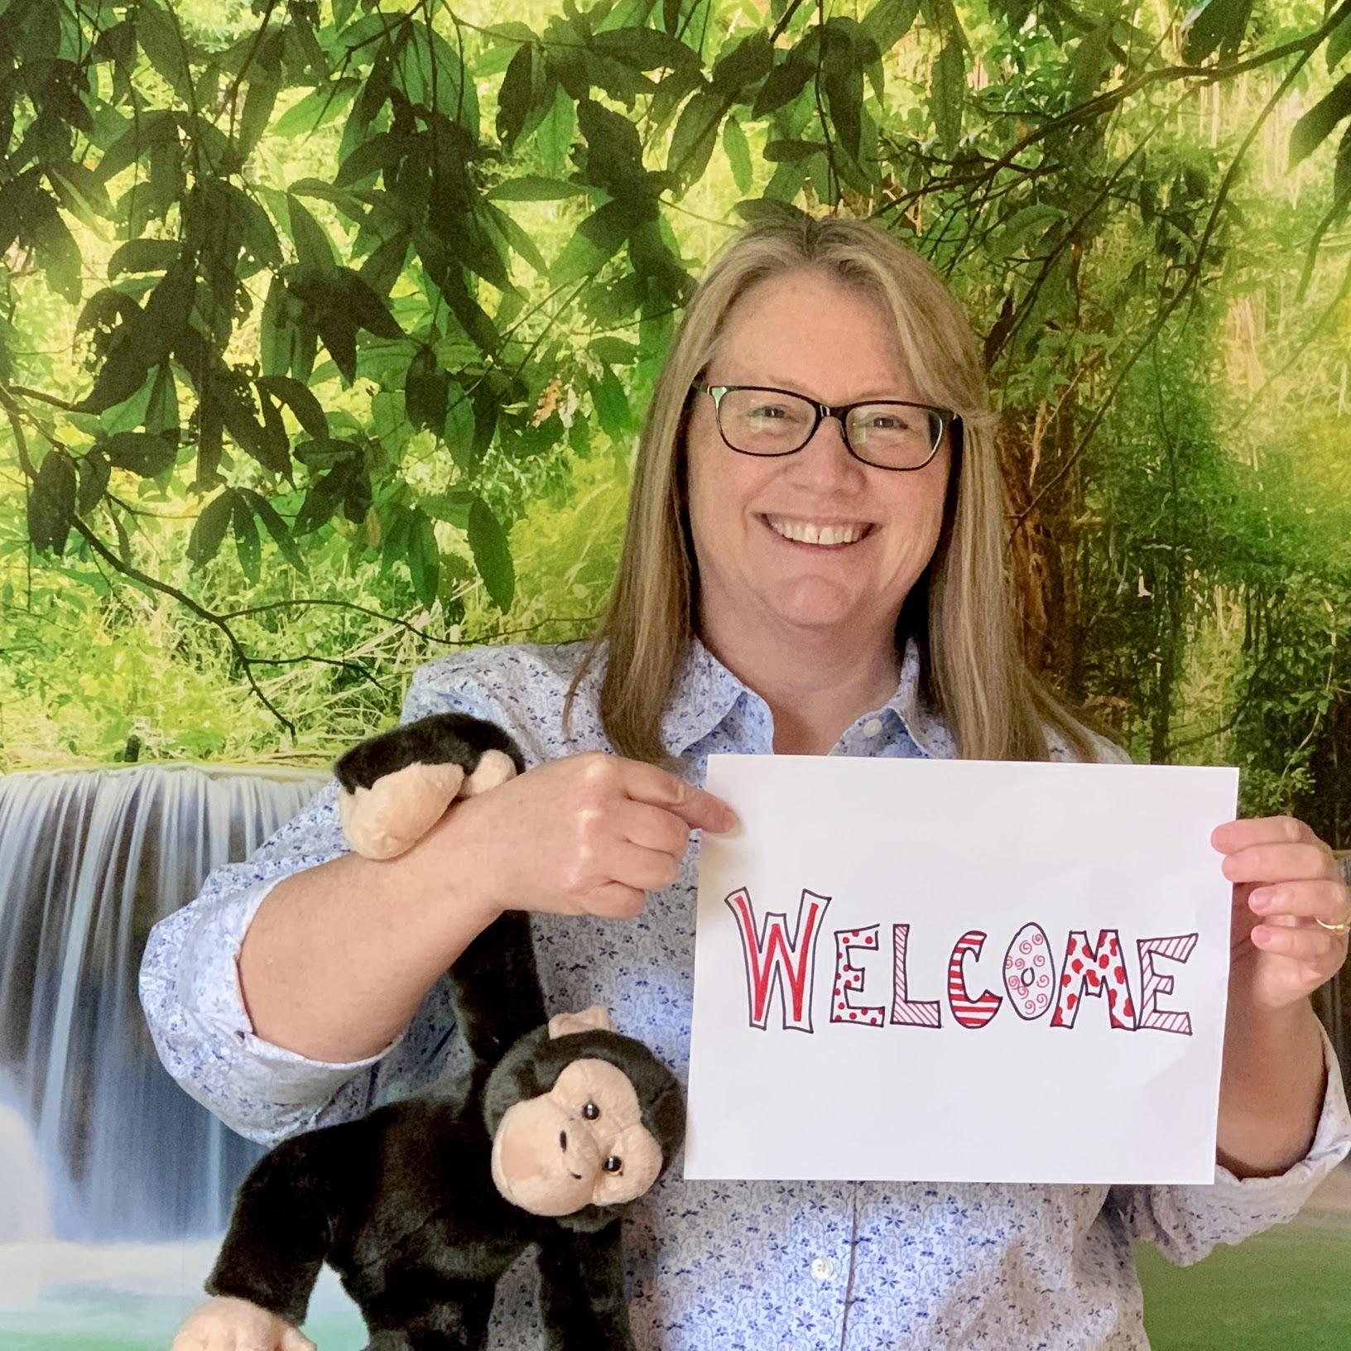
Hello!
I am Patti Forster
I am here because I believe this year, more than ever, educators must
take care of themselves.
You can find me at on Twitter @pforster25
or email patti.forster@fivetowns.net

Slide 6
Module 1
Learning Intentions
I am learning about the impact of trauma on educators.
I am learning to take care of myself as I engage with my students.

Slide 7
Webinar Intentions...

Slide 8
Slow Down

Slide 9
Connect
& Support

Slide 10
Hurry Slowly
Latin:
festina lente

Slide 11
Recover a rhythm of time that allows you to attend with consciousness and attention.”~Maryanne Wolf
from Reader, Come Come

Slide 12
Pandemic Fatigue
We are all exhausted!

Slide 13
Pandemic Support 1
Compassion Fatigue
Surge Depletion
Burnout

Slide 14
Pandemic Support 22
Compassion Fatigue
Surge Depletion
Burnout
Check out this resource:
Tackling COVID-19 Fatigue as a Teacher

Slide 15
The fundamental trap that causes compassion fatigue is a focus on other people and their needs before focusing on your own self-care needs.”~Terri Bogue, Is It Compassion Fatigue or Burnout?

Slide 16
Pandemic Support 3
Compassion Fatigue
Surge Depletion
Burnout
Check out this resource:
What is Surge Capacity? It Might Explain Why You are Feeling So Depleted

Slide 17
Surge capacity is a collection of adaptive systems — mental and physical — that humans draw on for short-term survival in acutely stressful situations, such as natural disasters. But natural disasters occur over a short period, even if recovery is long. Pandemics are different — the disaster itself stretches out indefinitely..~Tara Haelle, Your ‘Surge Capacity’ Is Depleted — It’s Why You Feel Awful

Slide 18
Pandemic Support 4
Compassion Fatigue
Surge Depletion
Burnout
Check out this resource:
Brené with Emily and Amelia Nagoski on Burnout and How to Complete the Stress Cycle

Slide 19
Activity #1
What is your current level of COMPASSION FATIGUE?
I have nothing
Left to give.
I am plenty in my reserves to help others!
What is your current level of SURGE DEPLETION?
I can barely
function.
I am ready to run a marathon!
What is your current level of BURNOUT?
I’m done!.
I love my job!

Slide 20
“The goal isn’t to live in a state of perpetual balance and peace and calm; the goal is to move through stress to calm, so that you’re ready for the next stressor, and to move from effort to rest and back again.”~Amelia Nagoski, The Key to Avoiding Burnout

Slide 21
Supporting Ourselves
How do we move through the pandemic, stress, and trauma to calm, rest, and back again?

Slide 22
Personal Support
How do you
rest, recover, rejuvenate?

Slide 23
Personal Support 22
Workspace
Routines
Connections

Slide 24
Personal Support 3 3
Workspace
Routines
Connections

Slide 25
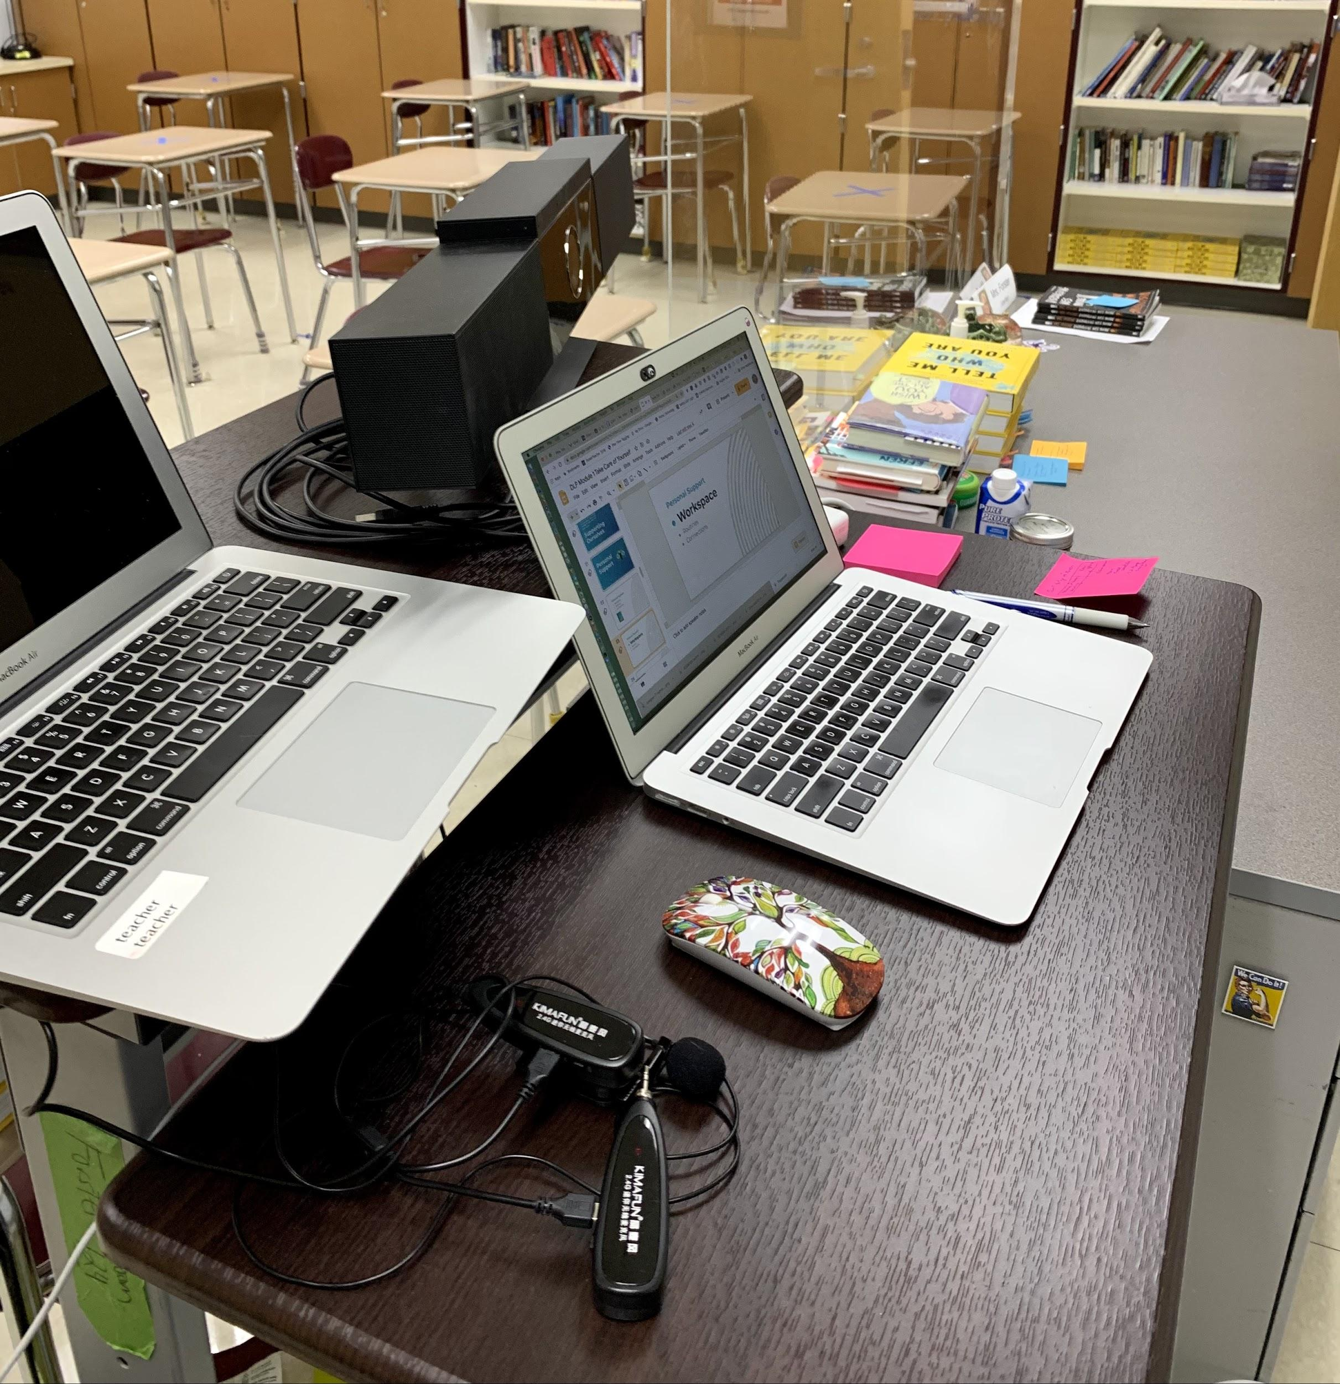
Personal Support 3 3
Workspace
Routines
Connections

Slide 26
Personal Support 4
Workspace
Routines
Connections
Reset the room!

Slide 27
Personal Support 5
Workspace
Routines
Connections

Slide 28
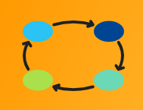
Breakout Group Discussion #1
3 people
6 minutes
2 minutes each
Routines Discussion Prompts: 1) Share your current morning routine at home and/or at school.
2) Brainstorm 1 thing you could do to make each better for you.
3) Jot down what you hope to change for next week.

Slide 29
In the Chat #1
Share your
morning routine
improvement idea.

Slide 30
Breakout Group Discussion #2
3 people
6 minutes
2 minutes each
Routines Discussion Prompts: 1) Share your end of the day routine both at school & at home
2) Brainstorm 1 thing you could do to make it better. 3) Jot down what you hope to change for next week.

Slide 31
In the Chat #2
Share your
end of day routine
improvement idea.

Slide 32
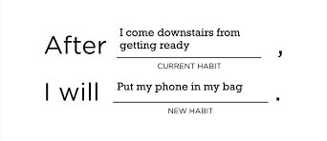
Personal Support 6
Workspace
Routines
Connections
Habit Stacking

Slide 33
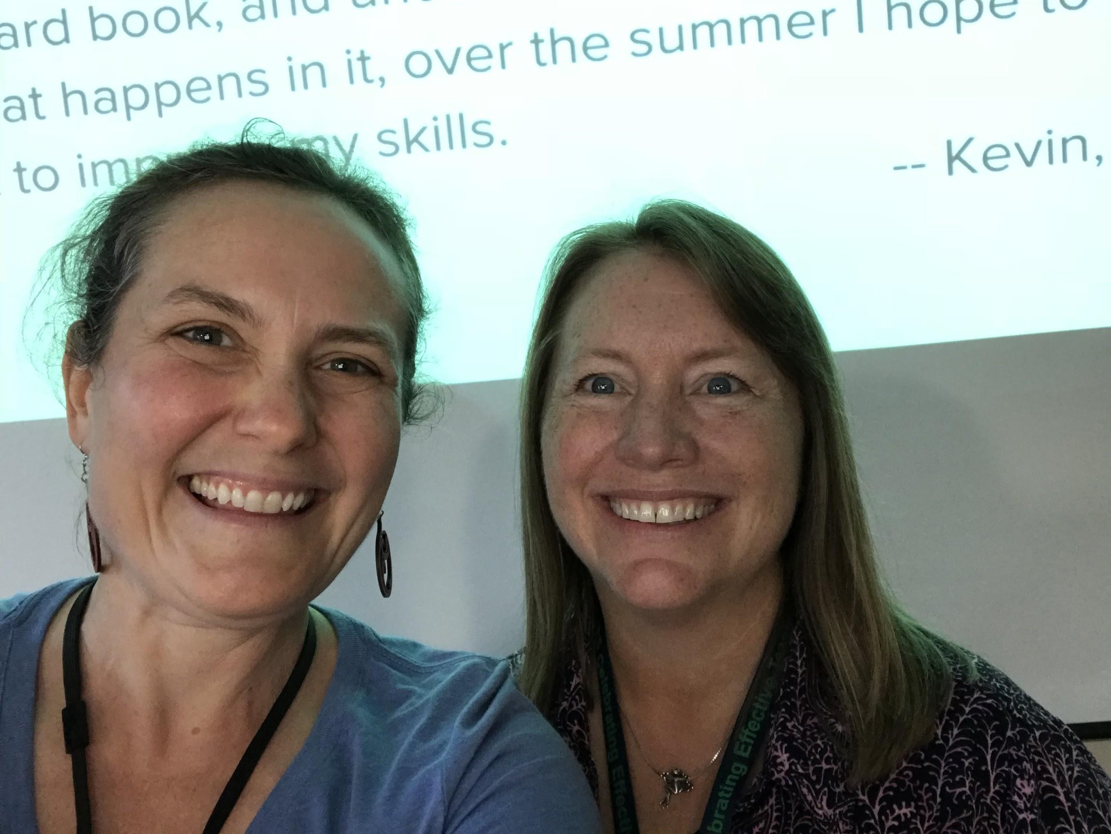
Personal Support 7
Workspace
Routines
Connections

Slide 34
Breakout Group Discussion #3
3 people
6 minutes
2 minutes each
Connections Discussion Prompts: 1) Share who you have in your life as a connection outside your home plus how often you currently connect.
2) Brainstorm how you can increase your connection opportunity.
3) Jot down what you hope to change for next week.

Slide 35
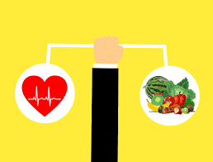
Physical Support
How are you helping
yourself physically?

Slide 36
Physical Support 2
Stress Management
Healthy Eating
Sleep
Exercise

Slide 37
Physical Support 3
Stress Management
Healthy Eating
Sleep
Exercise

Slide 38
Activity #2
TO DO vs. TO BE

Slide 39
Physical Support 4
Stress Management
Healthy Eating
Sleep
Exercise

Slide 40
In the Chat #3
What is one change
you can make
to eat more healthy?

Slide 41
Physical Support 5
Stress Management
Healthy Eating
Sleep
Exercise

Slide 42
In the Chat #4
What is one change
you can make
to sleep better?

Slide 43
Physical Support 6
Stress Management
Healthy Eating
Sleep
Exercise

Slide 44
In the Chat #5
What is one change
you can make
to exercise?

Slide 45
Implementation Intention
I will [BEHAVIOR] at [TIME] in [LOCATION].
I will eat a salad at lunchtime in my classroom.
I will make my partner a cup of coffee at 6 a.m. in the kitchen
I will exercise for one hour at 5 p.m. in my local gym.
I will meditate for one minute at 7 a.m. in my kitchen.
Want to read more on implementation intentions? Click here!

Slide 46
Breakout Group Discussion #4
3 people
6 minutes
2 minutes each
Physical Support Discussion Prompts: 1) Share an area of physical support you can work on in the coming weeks: healthy eating, sleep, exercise? Why did you select this area?
2) Brainstorm/discuss one thing you can implement in this area.
3) Create an implementation intention and jot it down for yourself: I will [BEHAVIOR] at [TIME] in [LOCATION].

Slide 47
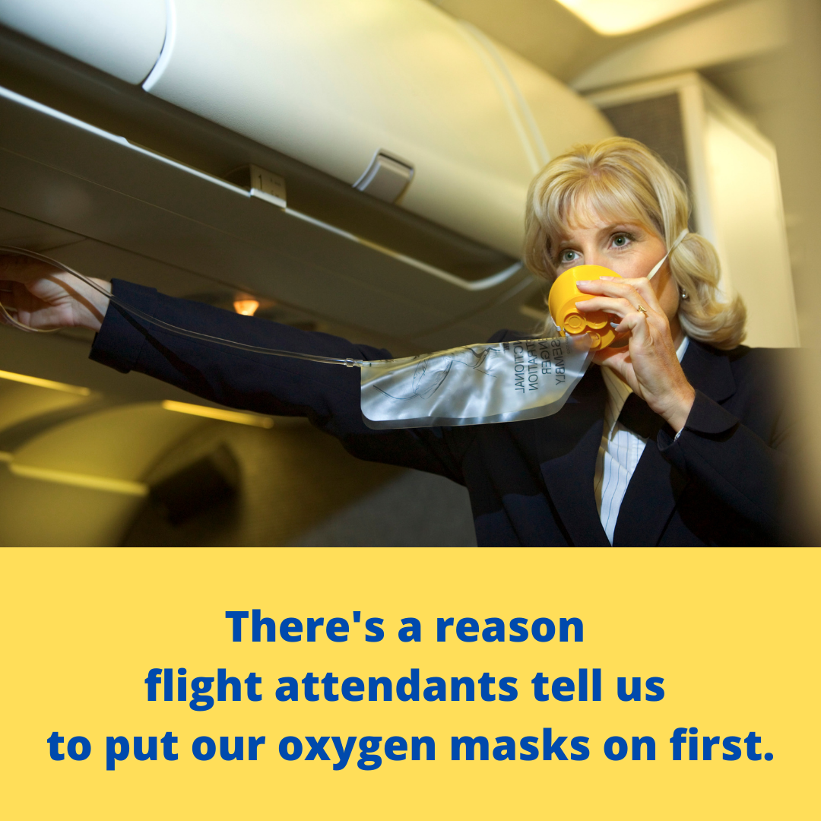

Slide 48
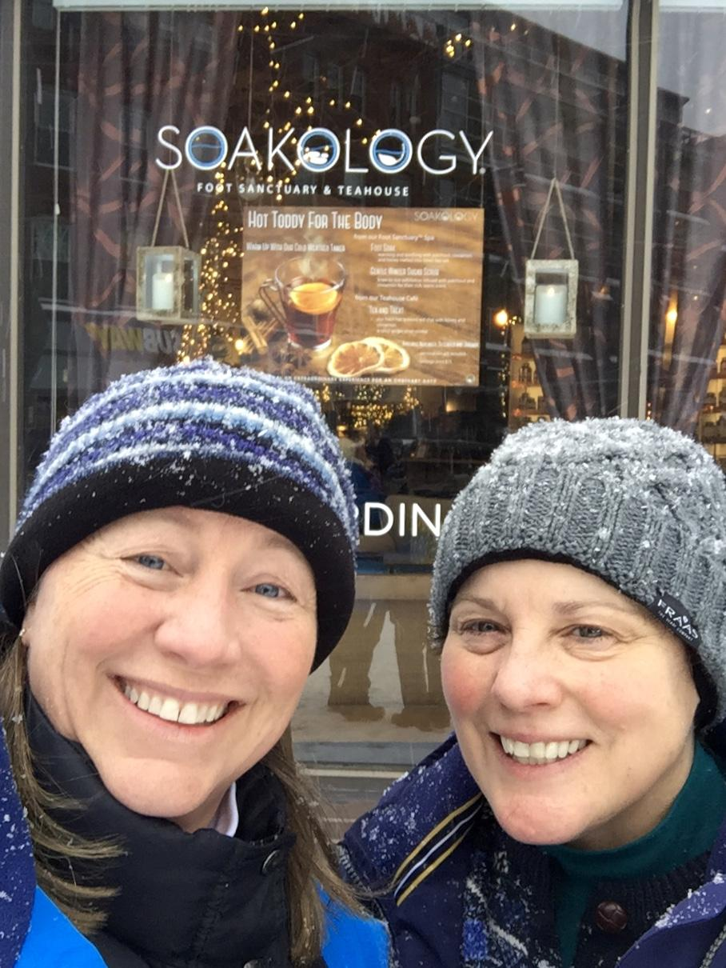
How will you take care of yourself first this winter?

Slide 49
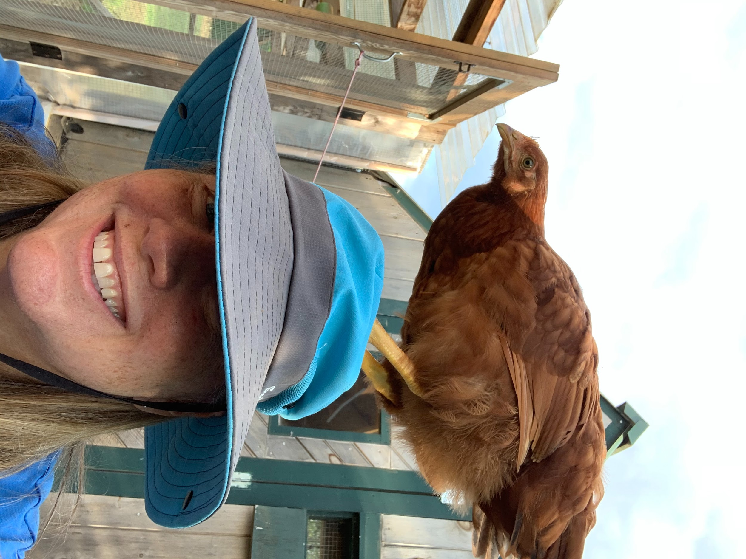
Thanks!
Any questions?
You can find me at:
@pforster25
patti.forster@fivetowns.net
Or at Grateful Heart Farm

Slide 50
Next Session
Tuesday, December 1, 3:30 - 5:00
Teacher Clarity
Feedback
Assessment
Grading
Patti Forster
Brandon Terrill
Notes:
Our ensuing sessions will be 90 minutes to provide time for conversation in breakout rooms and explore the plays presented.

