Slide 1
The Little Red Hen
Notes:
mill: a place that grinds grains into flour

Slide 2
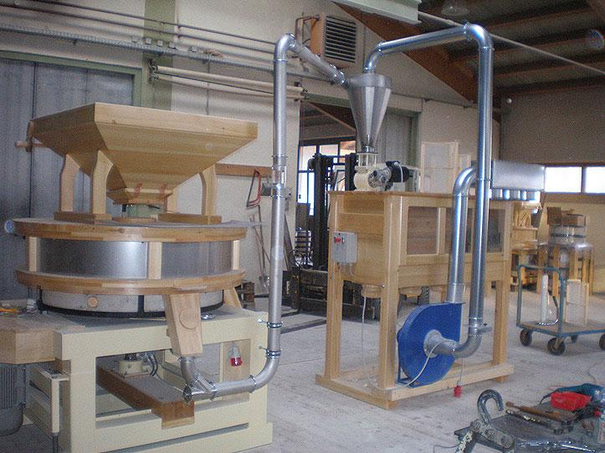
mill
https://www.moulins-cereales.com/moulins-cereales-osttiroler/installations-de-moulins-professionnels/installations-de-moulins-professionnels.php
Notes:
A word in the story is mill.
In Spanish it is molino (moh-lee-noh).
A mill is a machine that grinds grains into flour.
Let’s say the word mill together. Ready?
”Mill.” When you say mill, I hear the /m/ sound at the beginning of the word.
Look, mill begins with the letter m.
Here is a picture that shows mill.

Slide 3
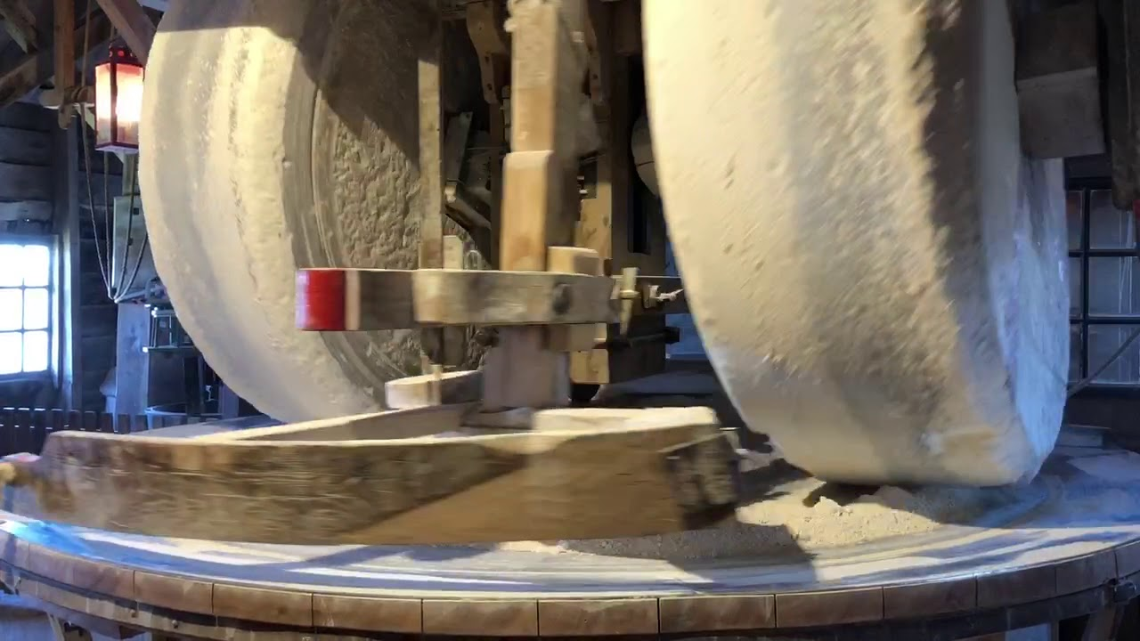
mill
https://www.youtube.com/watch?app=desktop&v=uLeiaHFcZGU
Notes:
Here is another picture of mill.
How does this picture show the meaning of mill? Turn and talk to your partner.
This is a stone mill. We can see how the stone wheels grind the grains. Let’s watch how it works. [Click on link or image.]
How many syllables are in the word mill? Let’s find out by clapping. Ready?
“Mill.” 1 syllable.
Now, let’s say mill three times while clapping the syllables. Ready?
“Mill, mill, mill.”

