Slide 2
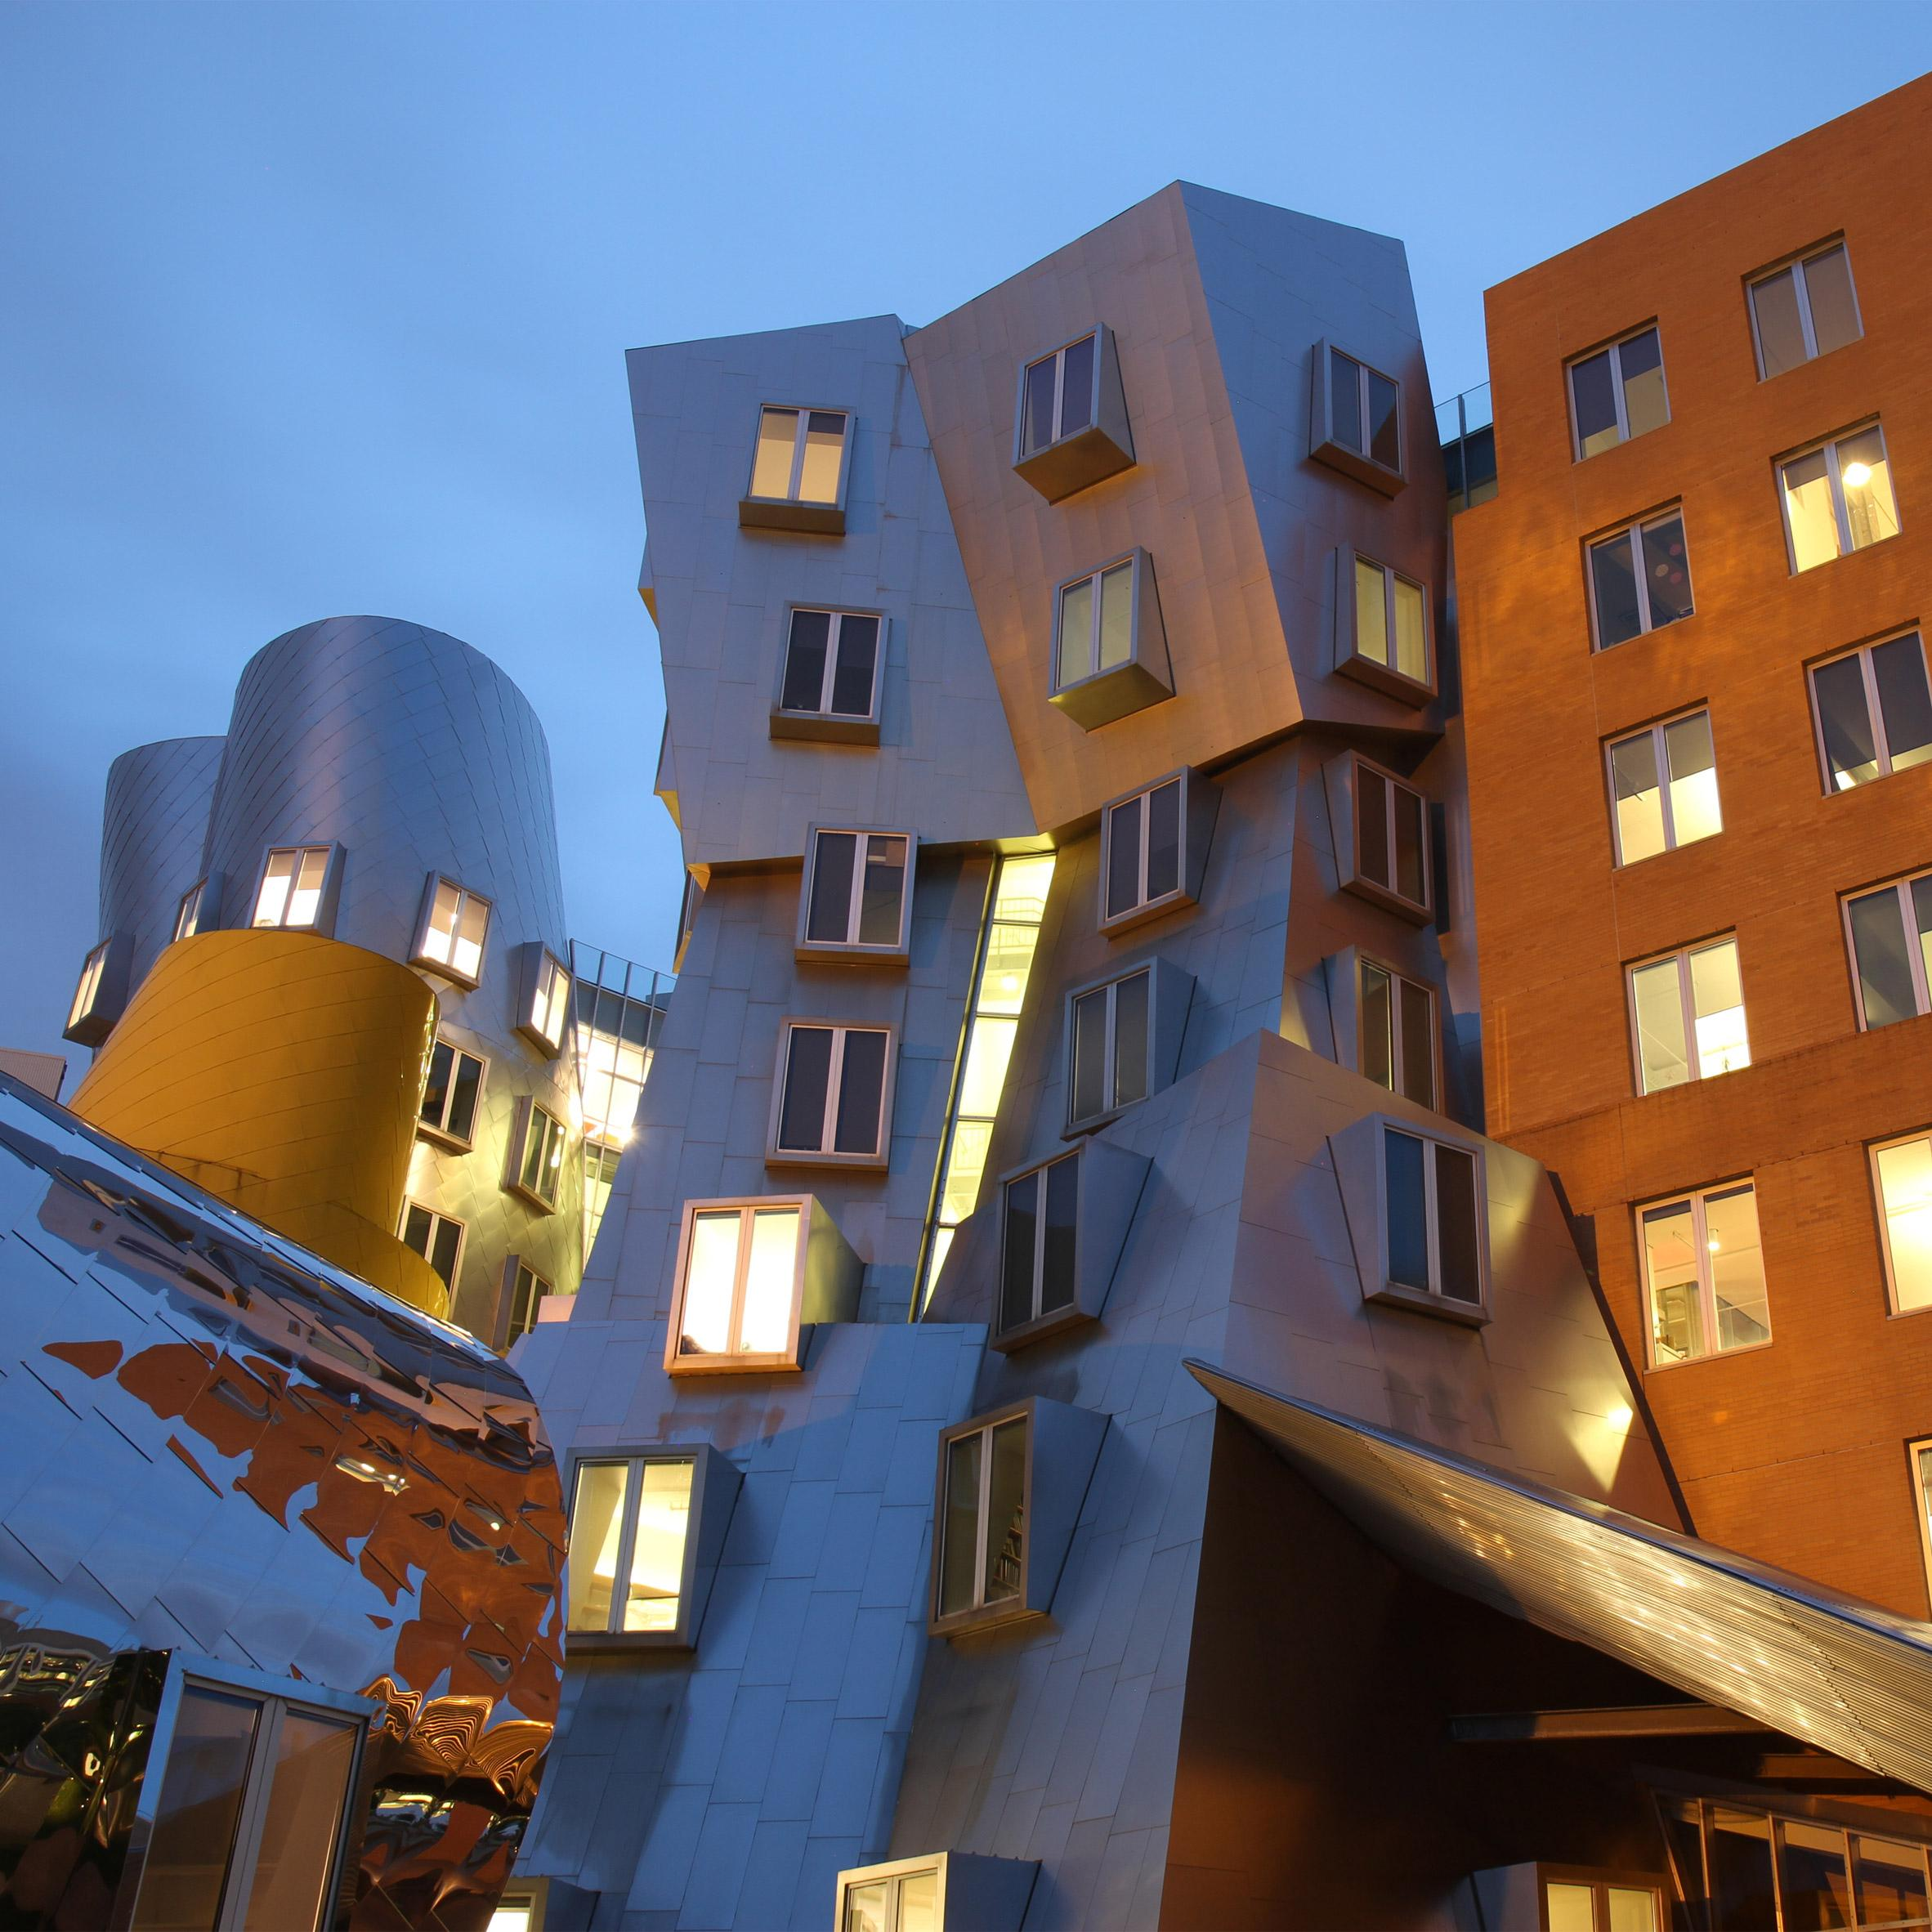
unusual
https://www.dezeen.com/2017/04/21/architecture-mit-massachusetts-institute-technology-10-impressive-campus-buildings/
Notes:
Another word in the story is unusual.
In Spanish it is inusual (een-oo-swahl).
Unusual means strange or uncommon, something that we don’t see often.
Let’s say the word unusual together. Ready?
”Unusual.” When you say unusual, I hear the /u/ sound at the beginning of the word.
Look, unusual begins with the letter u.
Here is a picture that shows unusual. It shows a strange, unusual building in Cambridge, just across the river from downtown Boston. It does not have the typical rectangular prism shape that we find in most buildings.

Slide 3
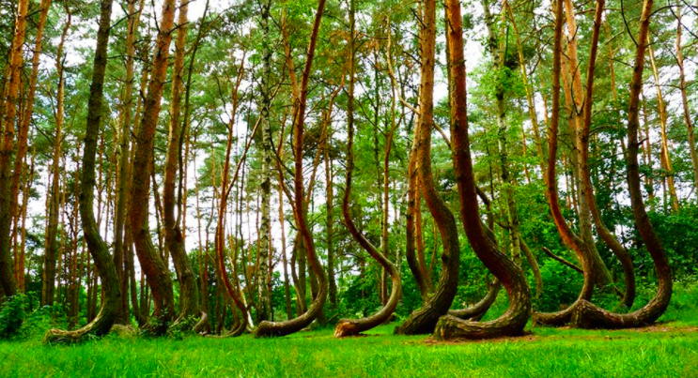
unusual
https://buzzly.info/en/photo/882/the-most-unusual-tree-pictures-in-the-world
Notes:
Here is another picture of unusual.
How does this picture show the meaning of unusual? Turn and talk to your partner.
These trees grow in an unusual way. Instead of growing straight up, their trunks make a turn and then grow up.
How many syllables are in the word unusual? Let’s find out by clapping. Ready?
“Un-u-su-al.” 4 syllables.
Now, let’s say unusual three times while clapping the syllables. Ready?
“Un-u-su-al, un-u-su-al, un-u-su-al.”

Slide 4
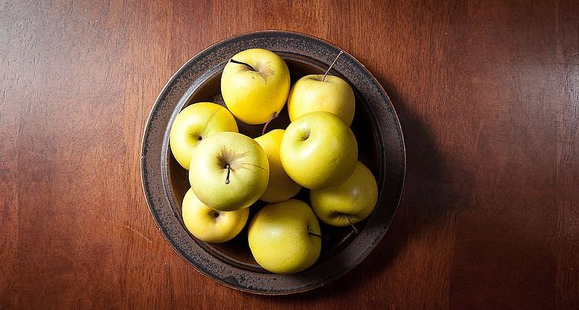
above
https://www.stockfreeimages.com/20613268/Golden-delicious-apples-on-a-table-above.html
Notes:
A word in the story is above.
In Spanish it is arriba (ah-rree-bah).
Above means high up.
Let’s say the word above together. Ready?
”Above.” When you say above, I hear the /a/ sound at the beginning of the word.
Look, above begins with the letter a.
Here is a picture that shows above. We have a view of the bowl of apples from above.

Slide 5
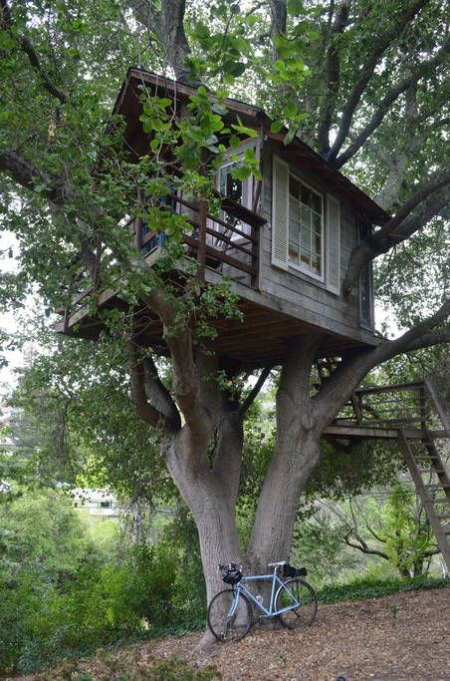
above
https://www.pinterest.com/pin/424042121144801649/
Notes:
Here is another picture of above.
How does this picture show the meaning of above? Turn and talk to your partner.
People built this tree house above the tree trunk.
How many syllables are in the word above? Let’s find out by clapping. Ready?
“A-bove.” 2 syllables.
Now, let’s say above three times by clapping the syllables. Ready?
“A-bove, a-bove, a-bove.”

Slide 6
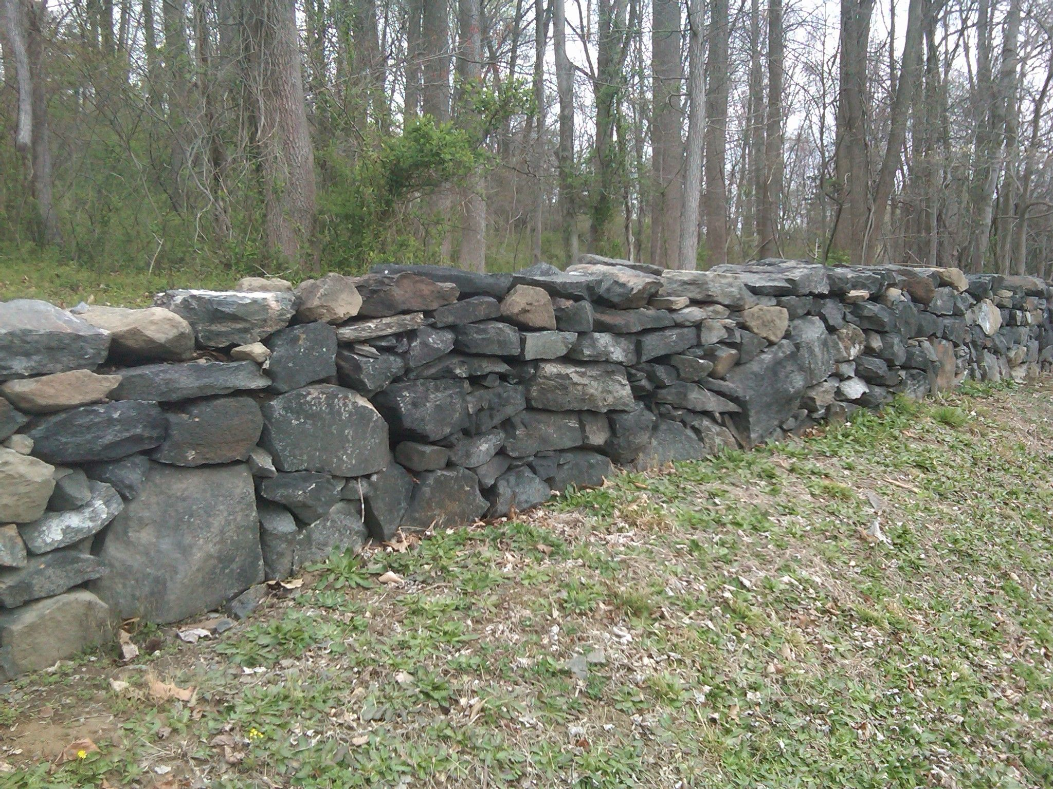
layer
https://www.pinterest.com/pin/293085888238657463/
Notes:
A word in the story is layer.
In Spanish it is capa (kah-pah).
A layer is one sheet of material on top of or under another.
Let’s say the word layer together. Ready?
”Layer.” When you say layer, I hear the /l/ sound at the beginning of the word.
Look, layer begins with the letter l.
Here is a picture that shows layer. This wall is made out of several layers of stones. The stones are piled up on top of one another.

Slide 7
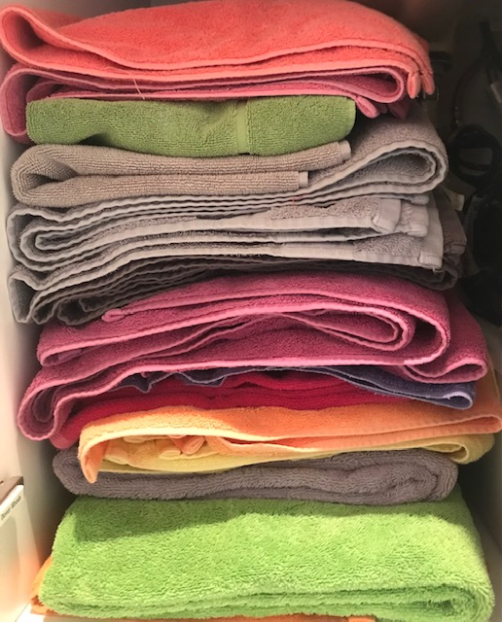
layer
Photo credit: Ana Vaisenstien
Notes:
Here is another picture of layer.
How does this picture show the meaning of layer? Turn and talk to your partner.
The picture shows layers of towels—they are piled up one on top of another.
How many syllables are in the word layer? Let’s find out by clapping. Ready?
“Lay-er.” 2 syllables.
Now, let’s say layer three times by clapping the syllables. Ready?
“Lay-er, lay-er, lay-er.”

Slide 8
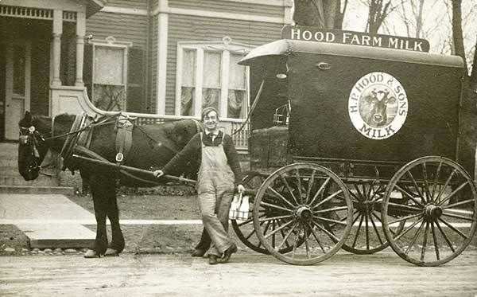
used to
https://www.pinterest.com/pin/358669557797657533/
Notes:
An expression in the story is used to.
In Spanish it is acostumbrar (ah-kohs-toom-brahr).
Used to describes something people did in the past but no longer do.
Let’s say the expression used to together. Ready?
”Used to.” When you say used to I hear the /u/ sound at the beginning of the first word, “used.”
Look, used begins with the letter u.
Here is a picture that shows used to. Long ago, people in Boston used to get milk from a someone who traveled in a horse wagon to deliver milk from home to home.

Slide 9
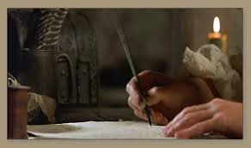
used to
http://colonialdays.pbworks.com/w/page/16140827/Writing
Notes:
Here is another picture of the expression used to.
How does this picture show the meaning of used to? Turn and talk to your partner.
In the past, people used to write with a quill that they dipped in ink. They also used to light candles, because there was no electricity.
How many syllables are in the first word of this expression, used? Let’s find out by clapping. Ready?
“Used.” 1 syllable.
Now, let’s say used three times by clapping the syllables. Ready?
“Used, used, used.”

Slide 10
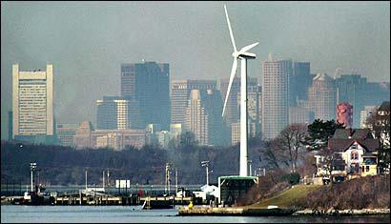
energy
http://archive.boston.com/news/local/articles/2006/02/24/wind_turbines_gaining_power/
Notes:
Another word in the story is energy.
In Spanish it is energía (eh-nehr-hee-ah).
Energy is the power needed to make something work.
Let’s say the word energy together. Ready?
”Energy.” When you say energy, I hear the /e/ sound at the beginning of the word.
Look, energy begins with the letter e.
Here is a picture that shows energy. Boston is now using more wind turbines. These are machines that help to create energy to light up homes and streets.

Slide 11
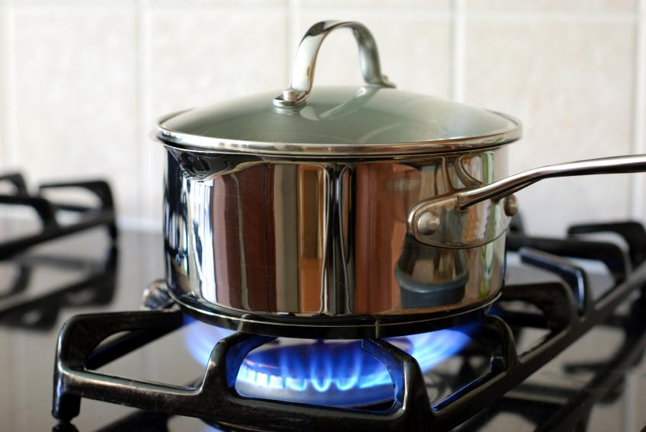
energy
https://www.cheatsheet.com/culture/mistakes-you-didnt-know-you-were-making-while-using-your-stove-top.html/
Notes:
Here is another picture of energy.
How does this picture show the meaning of energy? Turn and talk to your partner.
To cook our foods we need heat energy. We cook many foods with heat so we can eat them.
How many syllables are in the word energy? Let’s find out by clapping. Ready?
“En-er-gy.” 3 syllables.
Now, let’s say energy three times by clapping the syllables. Ready?
“En-er-gy, en-er-gy, en-er-gy.”

