Slide 1
Cultural Appropriation in World Languages Classrooms
10.21.21
3:00pm
April Perkins
World Languages & ESOL/Bilingual Programs Specialist

Slide 2
Learning Objectives
I can define and identify examples of cultural appropriation.
I can support my students in learning about cultural appropriation and how to avoid engaging in it.

Slide 3
Essential Vocabulary and Concepts
Culture (noun) - the customs, arts, social institutions, and achievements of a particular nation, people, or other social group
Cancel culture (noun) – the practice or tendency of engaging in mass canceling as a way of expressing disapproval and exerting social pressure
To appropriate (verb) - take (something) for one's own use, typically without the owner's permission
Stereotype (noun) - a widely held but fixed and oversimplified image or idea of a particular type of person or thing
Power dynamics (noun) – the way power works in a given setting
Intent vs. Impact (nouns) – the idea that a good intention does not remove a negative effect

Slide 4
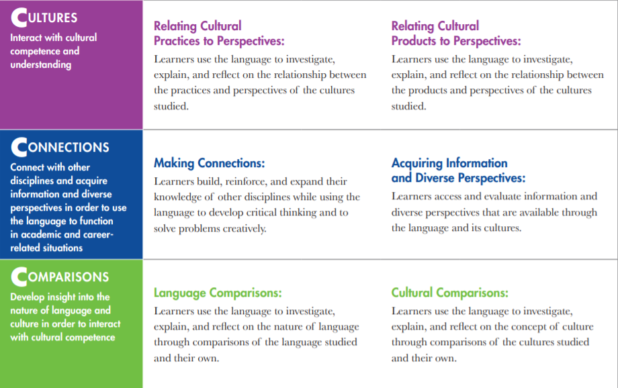
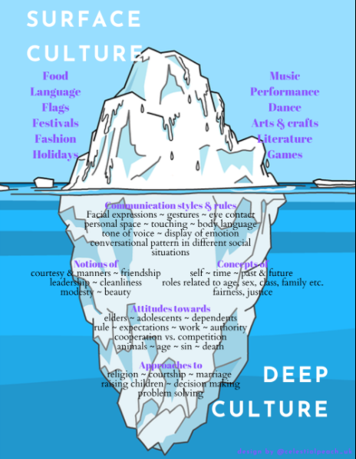
ACTFL World-Readiness Standards for Learning Languages
Notes:
The standards charge us with teaching students about culture in a variety of ways, all pointing towards the deeper, less visible aspects of culture that are often at play in cases of CA. Yet, the lowest hanging fruit, in other words the easiest aspects of culture to teach about, are often those that are outwardly observable. WL teachers may inadvertently trivialize or caricature a target culture. What possible examples of CA that have you observed in language classrooms?

Slide 5
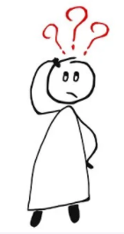
Icebreaker Activity
We will look at four images.
What’s your gut reaction as to whether they constitute cultural appropriation or not?
Vote in the Zoom poll.

Slide 6
Image 1
Image retrieved from this source.
Notes:
What do you know about the context of this image?
What do you know about the cultural element(s) represented here?

Slide 7
Image 2
Image retrieved from this source.
Notes:
What do you know about the context of this image?
What do you know about the cultural element(s) represented here?

Slide 8
Image 3
Image retrieved from this source.
Notes:
What do you know about the context of this image?
What do you know about the cultural element(s) represented here?

Slide 9
Image 4
Image retrieved from this source.
Notes:
What do you know about the context of this image?
What do you know about the cultural element(s) represented here?

Slide 10
Defining Cultural Appropriation
What words do you think a definition of cultural appropriation should include?
(Example: insensitive)
Go to menti.com and use the code 6614 6380.

Slide 11
Sample Definitions
Oxford Dictionary: the unacknowledged or inappropriate adoption of the customs, practices, ideas, etc. of one people or society by members of another and typically more dominant people or society
Oregon DOE: Cultural appropriation is the adoption of the elements of another culture (often a minority group) by members of the dominant culture. It is an unequal exchange in that the appropriators often uses these stolen elements for monetary gain or prestige, without regard for the value, respect, or importance paid to these images and traditions in the original culture (Source: Yang, R. (n.d.). A project to help teach your students about appropriation. The Art of Education University. Retrieved from https://theartofeducation.edu/2018/04/20/a-project-to-help-teach-yourstudents-about-appropriation/ )

Slide 12
Cultural Appropriation vs. Appreciation
Limited knowledge or respect for the cultural product/practice being used
Imbalance of power
Negative impact on members of the culture being appropriated
Rooted in deep understanding and respect
Recognition of one’s stance as an outsider
Appropriately crediting and benefitting the source
Not perceived as offensive by members of the culture

Slide 13
Scenarios
With your partner(s), discuss whether the scenario may be an example of cultural appropriation or not. Be prepared to justify your opinion.
Group 1: A French teacher has students choose traditionally French names for themselves to be used in class.
Group 2: A Spanish teacher comes to class in sugar skull make-up for Día de los Muertos.
Group 3: An Arabic teacher models different fashion for Muslim women, including hijab, niqab, and abaya.
Group 4: A Chinese teacher has students make red lanterns for Lunar New Year.
Notes:
What additional information would you need?
https://priorworld.com/editorial/red-lantern-chinese-new-year-prior/

Slide 14
Questions for Teachers
Is this costume or image a stereotype of a group of people?
Does this object/image hold important cultural or traditional significance?
How does removing the context of this costume/object change its meaning?
Does my usage of the costume/object trivialize a culture or group of people?
And…
Am I clear about my role as a member or non-member of the target culture community?
Is there a better way to teach about this aspect of a target culture?
Adapted from: https://www.pbs.org/education/blog/cultural-appropriation-whats-an-educators-role

Slide 15
Teaching Students to Identify Cultural Appropriation
Share examples of appropriation of the target culture with students.
Support them in reflecting on how these examples may be harmful.
Use these conversations as a springboard for developing deeper understanding of the target culture and the power dynamics at play.
Check out this resource from EdWeek that provides discussion questions to support students’ learning about cultural appropriation: Addressing Cultural Appropriation in the Classroom – Tools and Resources
Notes:
Use this presentation or adapt it to your needs!

Slide 16
Resources
ACTFL: More Than a Decade of Standards: Integrating “Cultures” in Your Language Instruction
EdWeek: Addressing Cultural Appropriation in the Classroom – Tools and Resources
National Conference for Community and Justice: What is Cultural Appropriation?
Oregon DOE: Native American Cultural Appropriation
PBS: Cultural Appropriation – What is an educator’s role?
Ted: When is it ok to wear an item from another culture and when is it appropriation?
University of Maryland: Understanding Cultural Appropriation & Halloween

