Slide 1
Comprehension & Fluency
Danielle M. Saucier
Elementary Literacy Specialist
Maine Department of Education
danielle.m.saucier@maine.gov

Slide 2
Welcome
Thank you for our continued interest and participation
Final session May 28, 2020 – Writing
Reminder – Zoom Protocols
Mute
Questions in Chat Box

Slide 3
Reading Is Key
Expand ones own learning of topics of personal interest
Develop creative thinking
Expand vocabulary and spelling
Increase success in foundational academic subjects

Slide 4
Crucial Comprehension
Weak comprehension skills come to the front in grades 3-4 when students begin to become more responsible for learning from what they read.
Less teacher framing and structure as students get older – comprehension weaknesses show up in all subjects

Slide 5
Indicators of Strong Readers
Predict what happens next in a text
Self-monitor for understanding
Self-question key text elements – main idea, message, plot, sequence, content, characters.
Clarify unclear parts of a text
Make connections between a text and personal prior knowledge and experiences

Slide 6
Places Weak Readers Struggle
Lack of organized reading strategies
Unclear purpose for reading or knowledge of approach for a certain type of text
Weak background knowledge to make authentic connections
Limited vocabulary knowledge can hinder deep comprehension
Lack of interest or engagement because reading is difficult – frustration and low self-confidence

Slide 7
Comprehension
. Thinking guided by print (Perfetti, 1995)
Challenge of comprehension is the necessity for students to combine the structures of text, the words on the page, the context of the story and their own experiences and knowledge to bring meaning to print.

Slide 8
Reading Comprehension Instruction
Be certain to keep other foundational skill instruction in mind – Phonological Awareness, Phonics, Vocabulary & Spelling foundations lead to students reading for meaning of texts.
Language and listening comprehension are also foundational skills for reading comprehension.

Slide 9
Components of Reading Comprehension Instruction
Actively engage students by varying activities, texts and supports
Teach comprehension strategies
Give students ample opportunity to practice using strategies in real texts and monitor for understanding

Slide 10
Skills vs. Strategies
Skills -
Right and Wrong Answer
Action done primarily after reading
Assesses ability to comprehend specific text
Strategies-
Values student thinking
Done before during and after reading
Can be used to better understand any text

Slide 11
Reading Comprehension Strategies
Summarizing
Questioning
Story mapping
Monitoring
Question answering
Graphic organizers
Mental imagery
Prior knowledge
-Shanahan

Slide 12
Summarizing
Students identify what is important in the text by:
retelling short parts of the text
identify crucial details
practice identifying crucial and irrelevant information in the text
locate key words and phrases that are meaningful to the summary
identify the main idea

Slide 13
Questioning
Students generate question before reading to increase interest and motivation as well as activate background knowledge and schema.
During reading students learning to ask questions to themselves and others in order to focus on meaning and important points throughout the text.
After reading questions can deepen understanding of the text and clear confusions.
Questioning can lead to deep conversations.

Slide 14
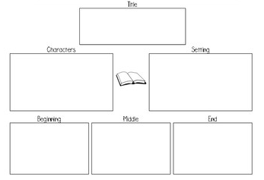
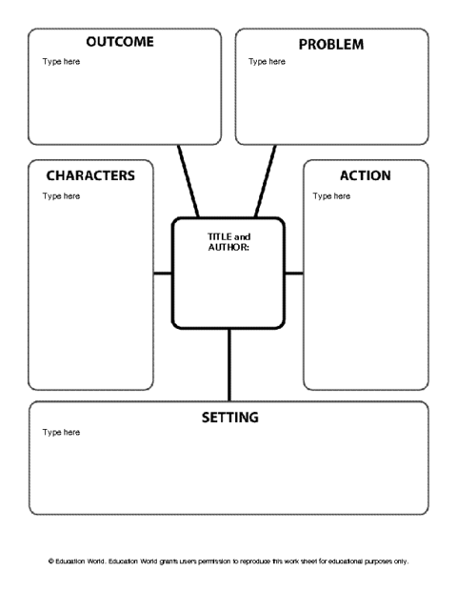
Story Mapping
In story structure instruction, students learn to identify the categories of content

Slide 15
Monitoring
Students monitor their own thinking and understanding and make actionable decisions about what to do when they don’t understand
Identify what is not understood
Stop at the end of a smaller section of text to monitor for understanding
Use fix-up strategies

Slide 16
Question Answering
Answering questions can:
Give students a purpose for reading
Focus students’ attention as they read
Help students be active thinkers
Help students self-monitor comprehension
Make connections to what students know
4 Types of Questions (Reading Rockets):
Right There
Think and Search
Author and You
On Your Own

Slide 17
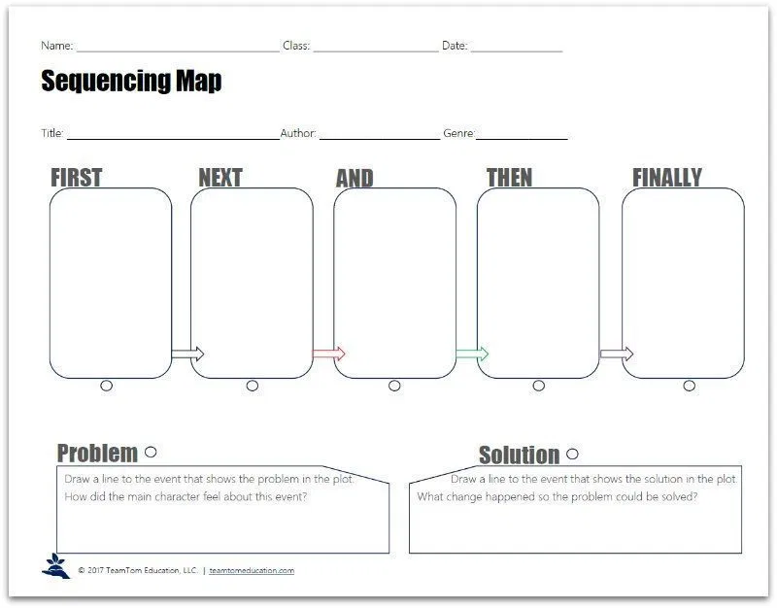
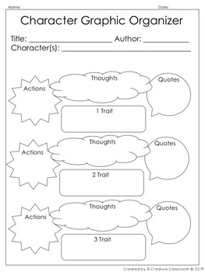
Graphic Organizers
Illustrate concepts and relationships between concepts in a text or using diagrams.

Slide 18
Mental Imagery
Visualize parts of the story in ones mind to increase understanding.
Talk about particularly descriptive information
Share the image and compare people’s images
Keep track of how images change as students continue to read
Practice and encourage students to integrate on their own

Slide 19
Prior Knowledge
All of the experiences readers have had, including information they have learned. This knowledge is used to bring texts to life and to make them more relevant to the reader – activating allows students to make more connections to the new information with connections that allow them to access their schema.
Help students “think about their thinking”

Slide 20
Fluency
Fluency is “reasonably accurate reading, at an appropriate rate, with suitable expression, that leads to accurate and deep comprehension and motivation to read” (Hasbrouck & Glaser, 2012, p. 13).
Fluency is NOT just reading words fast.

Slide 21
Building Fluency
Don’t abandon foundational instruction of phonemics, high-frequency word practice & vocabulary.
Provide extensive opportunities for students to read and reread texts – practice orally
Practice with shorter familiar passages
Read familiar poems and song lyrics
Practice short highly used phrases
Reader’s Theater

Slide 22
Building Fluency
Expand vocabulary instruction in the context of authentic reading – engage in rich discussions about words and building meaning
Provide access to media and models that allow students to hear fluent reading
Reading along with audio books and videos
Shared Reading
Echo Reading

Slide 23
Resources & Additional Information
Florida Center for Reading Research – www.fcrr.org
Resources – Student Center Activities
Reading Rockets
Intervention Central – www.interventioncentral.org
Academic Interventions

Slide 25
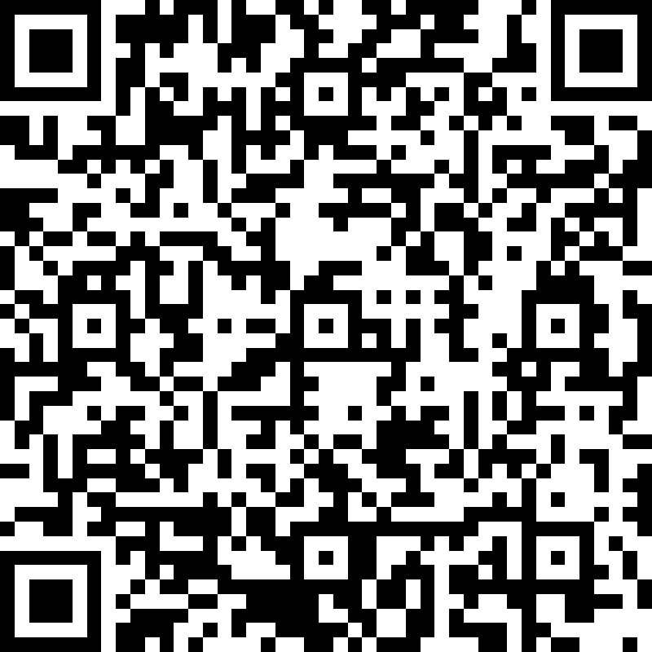
Thank You
https://bit.ly/2AGOKob
danielle.m.saucier@maine.gov

