Slide 1
MAINE DEPARTMENT OF EDUCATION
Community Schools
Presented by: Ann Hanna, Office of School and Student Supports

Slide 2
Why Community Schools?
If a child comes to school hungry….they cannot learn
If a child comes to school sick…they cannot learn
If a child comes to school worried about immigration, unemployment or violence…they cannot learn
If a child’s family does not have the information, resources and stability to support them….they cannot learn
Schools must address these obstacles so children can reach their full potential!
Notes:
If students are coming to school hungry; dealing with stress; lacking adequate mental or physical health care; or dealing with other social-emotional challenges or hardships, it makes it that much harder to focus on academics. Community schools address these barriers and support all students in holistic and integrated ways.

Slide 3
What is a Community School?
A community school is both a place and a set of partnerships between the school and other community resources. Its integrated focus on academics, health and social services, youth and community development and community engagement leads to improved student learning, stronger families and healthier communities.
EXTENDED LEARNING
Notes:
What is a community school?
A Community school is a strategy, not a program. It is both a place and a set of partnerships between the school and other community resources. It is a fundamental rethinking of how to deliver public education in a way that addresses the whole child. A community school is any public-school serving pre-Kindergarten through high school students using a “whole child” approach, with “an integrated focus on academics, health and social services, youth and community development, and community engagement.”

Slide 4
Community schools serve the whole child
Notes:
Far too many communities in Maine continue to face the enduring impacts of generational poverty and systematic racism. Plus, our schools are still recovering from the impact of COVID and, for many, the negative effects on student learning could last for years. We have an opportunity to reimagine school in ways that nurture the gifts and talents of every child and family, and that leverage community support.

Slide 5
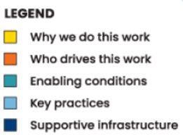
Notes:
This graphic captures the essential components of a community school transformation and is produced by several national organizations in support of the community school’s movement including Learning Policy Institute, The Brookings Institute, the National center for Community Schools and the Coalition for Community Schools. Studies in Human Development tell us that every child can learn and thrive when their full set of needs are met, which is why you see the ultimate purpose of this initiative at the center of this graphic that “All students flourish in thriving school communities” with all of the rings surrounding the center providing the supportive infrastructure that makes it possible.

Slide 6
Community Schools in Maine
2015-20-A MRSA Chapter 333
2019- Maine Community Schools Coalition
2019- Old Town Elementary
2022-Cape Cod Hill, Talbot
2024- ???
Notes:
There are approximately 10,000 schools across the country today who have adopted the community school approach as a reform strategy. In Maine, the Community School model was first recognized by Maine Legislature in 2015 through the passing of public Law 20-A MRSA Chapter 333. Under this statute, a school board may designate an existing school or establish a new school as a Community School. Currently, there are three schools in Maine who are implementing community school strategies with a small amount of financial support from the DOE; Old Town Elementary which started its transformation in 2019. Talbot in Portland, the Cape Cod Hill School in New Sharon. Talbot started this journey in 2019, through funding from JT Gorman foundation and a significant amount of support from the UW of Southern Maine who has supported Talbot’s strategies for the last three year by helping to fund the Community School Coordinator position, which I will speak more about in a minute. There are a few other schools in Maine who have joined the Maine Coalition of Community Schools, which is a nonprofit support network, as they seek to adopt targeted strategies to meet their students’ needs, including South Portland’s newest middle school. Many schools in Maine have the words Community School in their title, but may not be implementing intentional Community School Strategies. My position for the DOE is to promote awareness of the power of community schools ant to provide support and technical assistance to schools and communities who are interested in adopting the community school model.

Slide 7
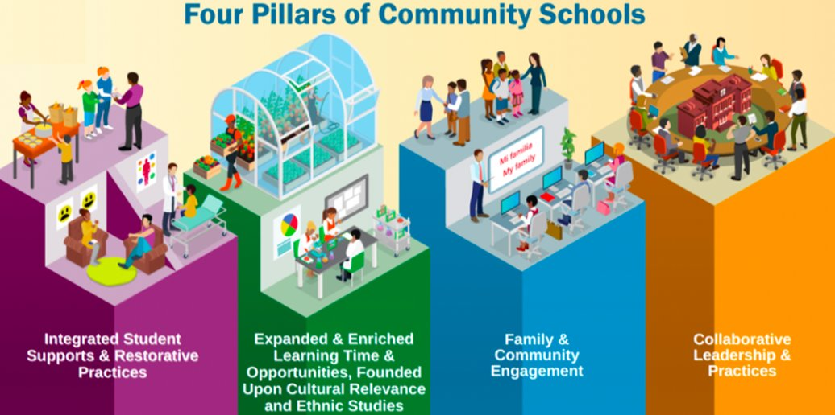
Notes:
How are Community Schools different from traditional schools?
Community schools are meant to serve the unique needs of individual students, families, and communities. While there isn’t a one-size-fits-all solution or single way to address needs, Community Schools do share common features that support student learning and are anchored in the four established pillars of the community school movement. Statute 333 aligns with and supports the four pillars you can see here.
Four Pillars of Community School
Integrated student supports, to address out of school barriers to learning that often stem from poverty and racism, and to support student success by providing coordinated social services, through practices such as school-based health centers, vision, nutrition and dental care, counseling, and restorative justice. The coordination and integration of services with support from community-based partnerships helps to ensure that children have the physical, social, and emotional well-being to come to school ready to learn.
Extended and enriched learning time and opportunities which includes before and after school programming, weekend, and summer programs, tutoring, internships, mentoring and other enrichment supports beyond school hours. This could include opportunities for students to participate in yoga classes, comic book clubs, art or STEM activities, with access provide for all students, by providing transportation and reduced or no cost to students and families.
Family and community engagement, which involves actively including family and community members to serve as true partners in supporting and educating students. Opportunities for family member collaboration include home visits, Theme nights, Homework Diners, Parent Academies, Play and Learns, adult education, workforce development, English as a second language classes, community wide arts and cultural events, health, and fitness activities- the sky is the limit.
Collaborative leadership and practices for educators and administrators that establish a culture of professional learning, collective trust, shared decision making and shared responsibility for outcomes in a manner that includes students, families, and community members. Parents and community members are viewed as assets in the work of the school and become partners in making decisions about the school and their children’s education. Community Schools implement a collaborative school governance structure, often called an Advisory Board, that involves parents, educators, community partners and youth in the older grades.
It is important to keep in mind that, while each of the four pillars contribute to a high-quality educational environment, the pillars reinforce each other, and it is this synergy that defines the essence of a comprehensive community school. Many schools may have services in these various areas but have no plan for how to integrate those services to achieve specific results. Integration and alignment is key.

Slide 8
Community School Outcomes
Increase academic achievement
Improve student health and wellness
Improve social-emotional well-being
Increase student attendance
Increase student/parent engagement
Increase access to adult education
Increase after-school opportunities
Improve school climate
Increase community engagement
Notes:
Do Community Schools work? In the report, Making the Difference: Research and Practice in Community Schools, evaluators of 20 initiatives nationwide confirm that community schools have a positive impact on what matters most to students, parents, communities, and schools. Evidence shows that schools that implement strategies based on the Four Pillars show improvements in academic performance and also school climate, student behavior, family engagement, chronic absenteeism, graduation rates, and other indicators of academic success. Everyone involved –community partners, families, school staff and administrators-shares responsibility for accountability and continuous improvement using school data to tailor programming.

Slide 9
Enabling Conditions
Collaborative school leadership
Shared vision
High Quality instruction
Data based decision making
Trusting relationships
Assets-driven and strengths focused
Strong social and emotional learning
Culture of belonging, safety, and care
Notes:
In addition to the 4 pillars, Community Schools are guided by a set of foundational values and enabling conditions that are known to support successful implementation, which include:
Strong school leadership with a clear instructional vision and high expectations for all students.
Strong instruction designed to provide quality learning opportunities to increase all students’ academic achievement.
A commitment to building trusting relationships and inclusive decision-making that is assets-driven and strengths-based.
A commitment to addressing social and emotional obstacles to learning by putting in place strong social and emotional learning (SEL) practices that are trauma informed, and promote skills, habits, and mindsets that foster a culture of belonging, safety, and care.

Slide 10
Community School Coordinator
Facilitates the strategic plan
Coordinates programs, services, and supports
Oversees before/after school programs, and family engagement opportunities
Collaborates with Admin, Staff, Families and Community-based Organizations
Notes:
You may be wondering how all this can possibly happen in a school. Principals and teachers are very busy people and have a lot on their plates. The community school infrastructure enables the coordination and integration of strategies because of the very important role of a Community School Coordinator. ​ The coordinator facilitates the development and implementation of the strategic plan in collaboration with school and community members/partners. The CSC ensures that programs, services, and supports are aligned, coordinated, and integrated with the core instructional program to avoid duplication or fragmentation of services and supports. The CSC’s work focuses on managing the integration of before and after school programs, family engagement opportunities and integrated support services in alignment with the community school’s vision of success and results. The coordinator is the glue and the anchor for the community school. They have strong relationships with school staff, parents, administrators, and the community.

Slide 11
Community School Transformation Plan
Resource Inventory
Advisory Board
Implementation Plan Goals
What is a Community School?
5
What are our strengths and areas to grow?
Theory of Change/Logic Model
Funding CSC and Extended Day Programs
Notes:
Chapter 333 guides schools in Maine through a process of adopting a community school model and includes a set of proven practices that all Maine community schools should implement when becoming a community school:
Conduct a community Needs and Assets Assessment: to identify the academic, physical, social, and emotional, health, mental health needs of students and their families. This process allows for school and community members to identify gaps in programs, services and resources that inhibit student achievement and community coherence.
Conduct a community resource inventory to identify potential resources, services, and opportunities available within or near the community that students, families, and community members may access and integrate into the community school.
Create a Strategic Plan: that incorporates the school’s vision, values and mission and articulates how assets may be used to address the identified needs with the goal of high academic, and personal outcomes for all students.
Advisory Team to guide implementation and focus on reviewing data to monitor continuous improvement and adjust course as needed.

Slide 12
Community Schools
A good investment in Maine’s students, families and communities.
Notes:
Students can only do their best in school if they have support for their basic needs. Community schools make it possible for families to access vital services that students need to thrive academically. Often such services and supports are not located nearby or they are financially out of reach for many. Community Schools recognize these challenges and provide a coordinated close-to-home solution that minimizes disruptions to important class time and helps students to attend school and be ready to learn, setting them up for academic and life success.
In an era of tight resources, Community Schools are a good investment. Research from the Children's Aid Society has shown that every dollar invested in student supports in a community schools yielded a $15 return on the investment to the community. Another study done in Albuquerque found that every dollar invested to support the salary of a community school coordinator generated over $7.00 in net benefits. The Community School strategy is an efficient and cost-effective way to maximize multiple resources and funding streams to transform a school into a hub where educators, local community members, families, and students work together to strengthen conditions for student success.
A community schools represents a vision for public schools and a way of thinking that school and community leaders can adopt and adapt to their own unique circumstances. All communities contain assets that can support a child to reach their full potential and community schools are thoughtfully organized to leverage those assets to help achieve better outcomes that allow students, families and communities to thrive.

Slide 13
For more information please contact
Ann Hanna, Community Schools Consultant- ann.c.hanna@maine.gov

