Slide 1
Clarity and Feedback
Engaging with students while learning from a distance
Recorded 4/7/2020

Slide 2
Session recording: click here
Chat box - click here

Slide 3
Agenda
Quick review
Teacher clarity – from article??
Objectives for learning Q4
Text-dependent questions
Planning is key
Ability to engage
Capacity
Purpose
scope

Slide 4
Focus, Purpose and Letting Go
Begin with purpose – how has our purpose changed?
No new learning
No grading
Don’t collect work
Review and Practice
Take attendance
Collect work
Grade for credit

Slide 5
Focus, Purpose and Letting Go
Focus - what are the big goals?
What is possible?
Consider the context
Consider the tools available
What is necessary?
Foundations for next year?
Credits?
Other requirements?
What is not possible?
Cannot be done in this environment

Slide 6
Focus, Purpose and Letting Go
How to let go:
Grieve
Commiserate
Acknowledge priorities
Do what is best for students

Slide 7
Text-Dependent Questions
Critical for this environment
Best for students - explain

Slide 8
Text-Dependent questions and the big objectives
Planning for the next steps

Slide 9
Objectives and Learning Intentions
OBJECTIVE: DEVELOP EVIDENCE-BASED RESPONSES
Learning intentions:
Analyze appropriately complex text
Summarize whole or parts
Analyze for style, purpose, effect
Prioritize value of evidence provided
Determine what may be missing or unstated
Synthesize information from multiple texts
Summarize across texts
Analyze for purpose, bias, style, effect
Account for conflicting information

Slide 10
How is this context different from your classroom approach?
What are you letting go?
What can you not do?

Slide 11
Summarize
This is hard – and becomes hard again with more complex text!
Annotating text – digital format or paper copy
Can you color code?
Main topic or theme
Claims or big ideas
Crucial details or supporting evidence
Key vocabulary or terms/phrases
Highly charged language
Irrelevant or unnecessary information

Slide 12
Summarize and get feedback
Feedback to advance learning should focus on the learning intention and success criteria.
Focus on the elements of the text
Did you notice that the text . . . ?
Why did the author . . . ?
What do these words mean . . . ?
What might be another way of saying . . .? How would that effect the text?
Notes:
Can students do this together? Do you have the ability to assign in groups? Can this be done with comments on a common document?

Slide 13
Summarize – a simple strategy
Create a 5 word summary
Represent the text in only 5 words. This does not have to be a sentence or phrases, just 5 words.
Work with 2 partners
Share your 5 words then agree on just 5 words to represent the text from the whole group
Describe the process of agreeing on 5 words
Now write a summary of the text using the 5 words as a guide
What is the added value? – when/how do students get and give feedback?

Slide 14
Summarize & Synthesize
Look across multiple texts
What is the same, what is different?
Information
Style – structure, format
Language - passive, impassioned?
Summary reflects analysis more than bare content
Summary also reflects best evidence

Slide 15
Can students reflect on their own learning? (feedback to self)
TO MAKE IT BETTER | SUCCESS CRITERIA | DONE WITH DISTINCTION
 | Shows an understanding of the text’s central idea(s) and of most important details and how they interrelate, demonstrating a comprehensive understanding of the text.
 | Is free of errors of fact or interpretation with regard to the text.
 | Offers an insightful analysis of the source text and demonstrates a sophisticated understanding of the analytical task.
 | Offers a thorough, well-considered evaluation of the author’s use of evidence, reasoning, and/or stylistic and persuasive elements, and/or other feature(s).
 | Focuses consistently on those features of the text that are most relevant to addressing the task.

Slide 16
TO MAKE IT BETTER | SUCCESS CRITERIA | DONE WITH DISTINCTION
 | Shows an understanding of the text’s central idea(s) and of most important details and how they interrelate, demonstrating a comprehensive understanding of the text.

Slide 17
TO MAKE IT BETTER | SUCCESS CRITERIA | DONE WITH DISTINCTION
 | Is free of errors of fact or interpretation with regard to the text(s).

Slide 18
TO MAKE IT BETTER | SUCCESS CRITERIA | DONE WITH DISTINCTION
 | Offers a thorough, well-considered evaluation of the author’s use of evidence, reasoning, and/or stylistic and persuasive elements, and/or other feature(s).

Slide 19
Objectives and Learning Intentions
OBJECTIVE: DEVELOP EVIDENCE-BASED RESPONSES
Learning intentions:
Analyze appropriately complex text
Summarize whole or parts
Analyze for style, purpose, effect
Prioritize value of evidence provided
Determine what may be missing or unstated
Synthesize information from multiple texts
Summarize across texts
Analyze for purpose, bias, style, effect
Account for conflicting information

Slide 20
Prompts
Explain how the author uses precise language to accomplish the purpose of the text.
Compare the information from the three sources and determine why some information may be conflicting.
Determine the essential characteristics of the author’s style. Describe how a reader would recognize a work by this author.

Slide 21
Focus, Purpose, Letting Go
What are we letting go in this approach?
How are we focusing with this approach?
What else might we do?
Notes:
What do we do in the classroom because we are in the classroom?

Slide 22
What, why, how
Know what you want to teach and assess
Know why this is what you want to teach and assess
Consider how –
what are the tools you currently use
What tools are exclusive to context (i.e. classroom or virtual)
What tools might help you and your students move between the two

Slide 23
For further exploration
https://fordhaminstitute.org/covid-19-home-learning
https://fordhaminstitute.org/national/commentary/planning-ela-age-remote-learning
https://www.cultofpedagogy.com/distance-learning/

Slide 24
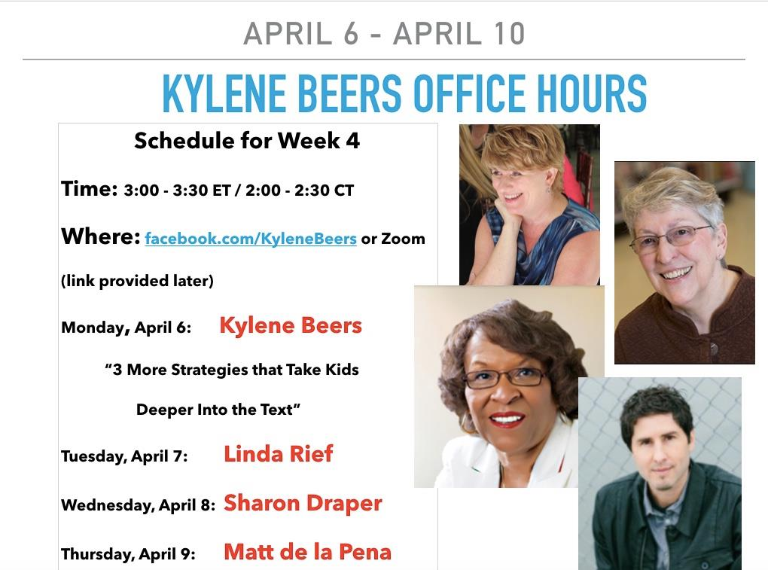

Slide 25
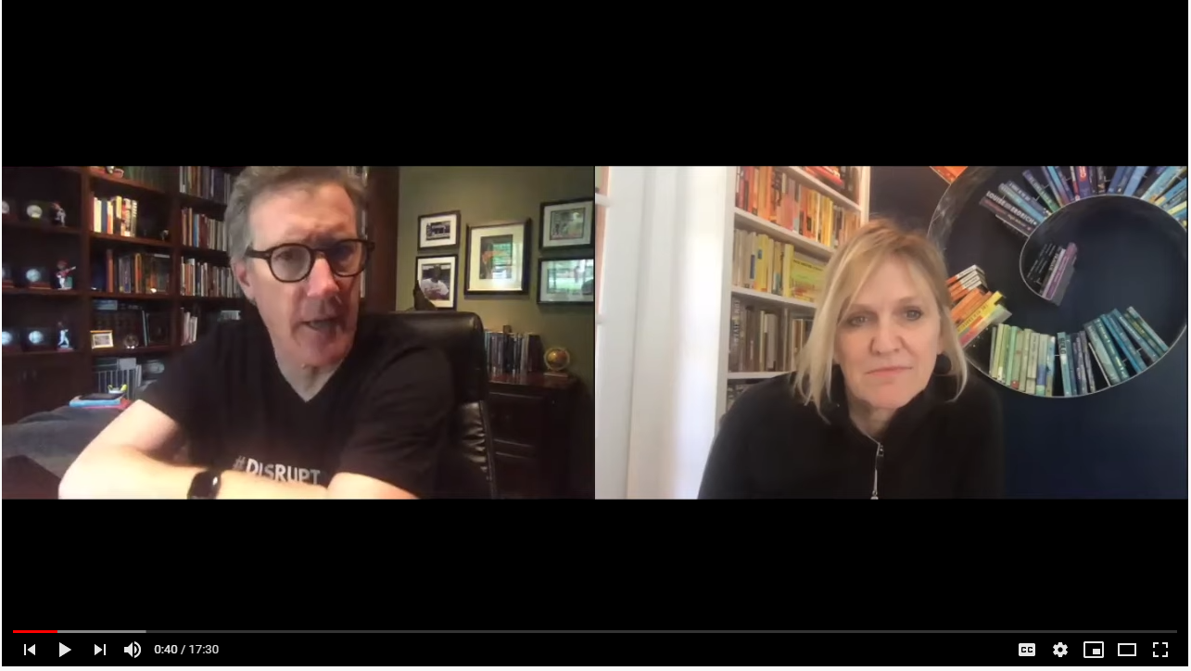

Slide 26
Next
To get certificate of one contact hour for today, complete the “quiz” and answer “yes” to the last question.
https://forms.gle/aPatGkDV5Nqq9A7q7
Take care of yourself.
Take care of your family.
Come back Thursday.

