Slide 1




MAINE DEPARTMENT
OF EDUCATION
Child Nutrition Programs
M
Meal Pattern Requirements for Offer Versus Serve

Slide 2
Offer Versus Serve at Breakfast
Offer 4 items from 3 required components
  Milk
  Fruit (or vegetable)
  Grains & MMA
Student must select at least:
  3 items
  Including ½ cup of fruit (vegetable)
Notes:
let’s review the breakfast OVS requirements.
1

Slide 3
Offer Versus Serve at Breakfast
Offer 4 items from 3 components, student must select at least:
  ½ cup of fruit (vegetable)
  2 other items
Option A
1 oz eq Grain
1 oz eq Grain
1 cup Fruit
1 cup Milk
Option B
1 oz eq Grain
1 oz eq M/MA
1 cup Fruit
1 cup Milk
Option C
1 oz eq Grain
½ cup Fruit
½ cup Fruit
1 cup Milk

Slide 4
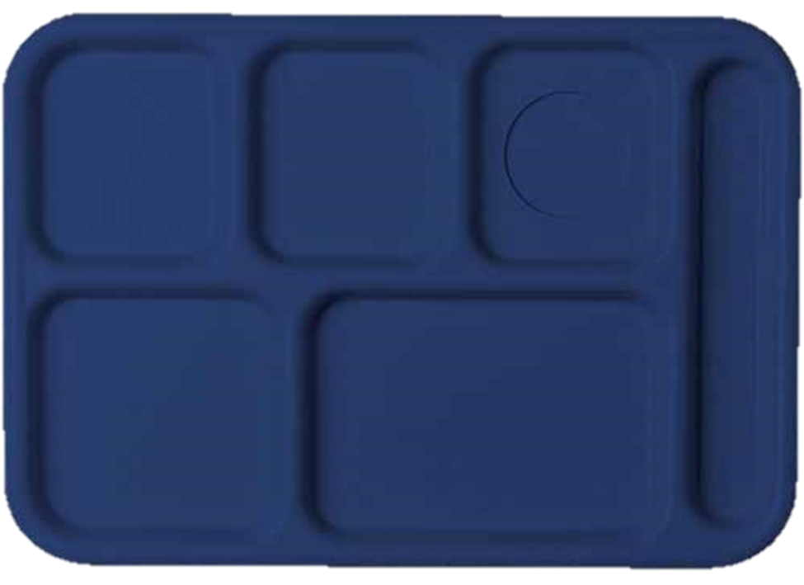
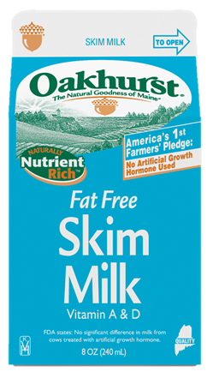


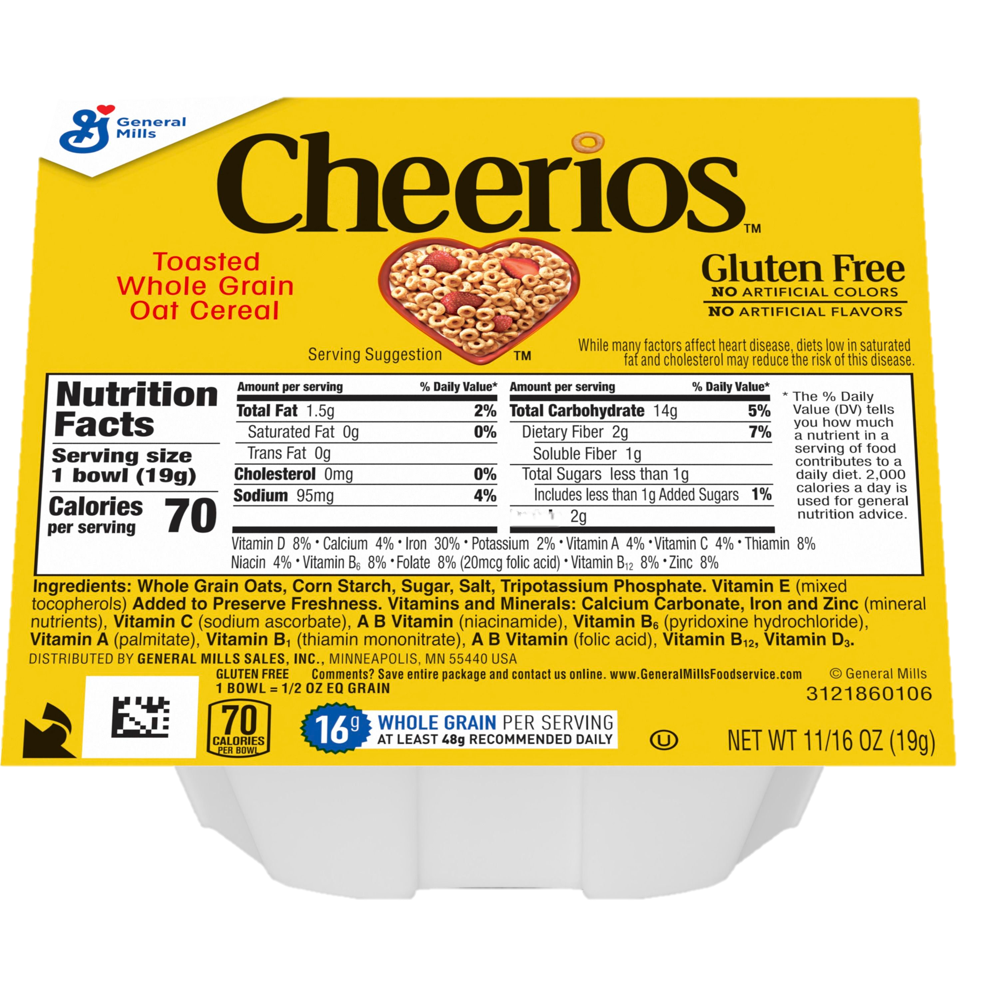
OVS: Fruit at Breakfast
1 cup of fruit must be offered daily
May offer two ½ cup servings of fruit to count as two items
The minimum quantity of fruit a student must select is ½ cup
CEREAL

Slide 5

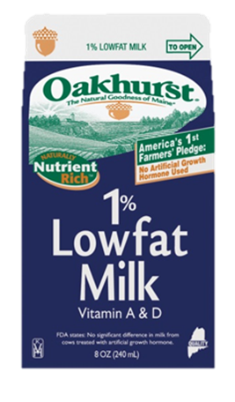



Offer Versus Serve - Breakfast
Offered
1 oz M/MA
½ cup Fruit
1 oz Grain
1 cup milk
½ cup Fruit
Notes:
4

Slide 6
Offer Versus Serve - Breakfast
What the students selects. Is this Reimbursable?
1 oz eq M/MA
1 oz eq Grain
1 cup milk
Notes:
5

Slide 7
Offer Versus Serve - Breakfast
There are 3 items but does not include ½ cup of fruit.
1 oz eq M/MA
1 cup milk
1 oz eq Grain
NO
Notes:
NOT REIMBURSABLE.
How many items on this tray? 3 items (1 oz eq MMA, 1 oz eq Grain, 8 oz milk)
-Is there a minimum of ½ cup fruit or vegetable? No
-Is this tray reimbursable? No
6

Slide 8
Offer Versus Serve - Breakfast
What the students selects. Is this Reimbursable?
½ cup Fruit
½ cup Fruit
1 cup milk
Notes:
7

Slide 9
Offer Versus Serve - Breakfast
There are 3 items including ½ cup of fruit.
½ cup Fruit
½ cup Fruit
YES
Notes:
How many items on this tray? 3 items
-Is there a minimum of ½ cup fruit or vegetable? Yes
-Is this tray reimbursable? Yes
8

Slide 10
Offer Versus Serve - Breakfast
What the students selects. Is this Reimbursable?
½ cup Fruit
1 oz eq M/MA
1 oz eq Grain
Notes:
How many items on this tray? 3 items
-Is there a minimum of ½ cup fruit or vegetable? Yes
-Is this tray reimbursable? Yes
9

Slide 11
Offer Versus Serve - Breakfast
There are 3 items including ½ cup of fruit.
½ cup Fruit
YES
1 oz eq M/MA
1 oz eq Grain
Notes:
How many items on this tray? 3 items
-Is there a minimum of ½ cup fruit or vegetable? Yes
-Is this tray reimbursable? Yes
10

Slide 12

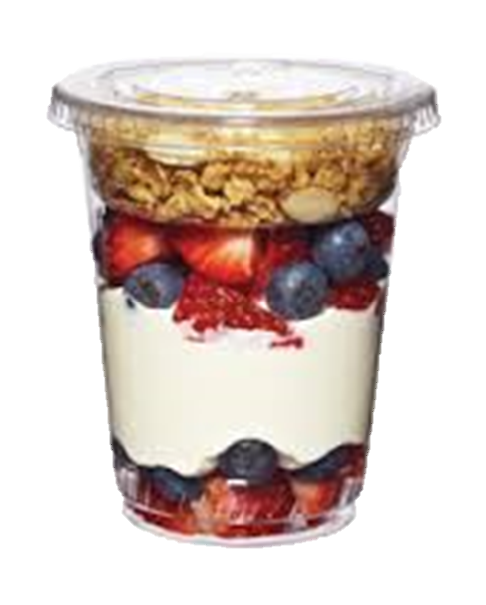
Offer Versus Serve - Breakfast
Offered
½ cup Fruit
1 oz eq Grain
1 cup milk
½ cup Fruit
1 oz eq M/MA
Notes:
11

Slide 13
Offer Versus Serve - Breakfast
What the students selects. Is this Reimbursable?
1 oz eq Grain
½ cup Fruit
1 oz eq M/MA
Notes:
12

Slide 14
Offer Versus Serve - Breakfast
There are 3 items including ½ cup of fruit.
YES
1 oz eq Grain
½ cup Fruit
1 oz eq M/MA
Notes:
How many items on this tray? 3 items
-Is there a minimum of ½ cup fruit or vegetable? Yes
-Is this tray reimbursable? Yes
13

Slide 15

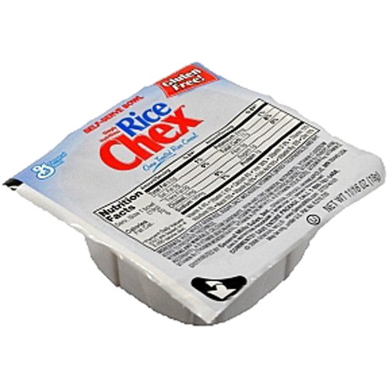

Offer Versus Serve - Breakfast
Offered
½ cup Fruit
½ cup Fruit
1 cup milk
1 oz eq Grain
1 oz eq Grain
Notes:
Here is our planned menu with 1 cup of milk, 1 oz eq of cereal, 1 oz eq of toast and ½ cup of fruit and ½ cup of fruit juice
14

Slide 16
Offer Versus Serve - Breakfast
What the students selects. Is this Reimbursable?
½ cup Fruit
1 cup milk
1 oz eq Grain
Notes:
How many items on this tray? 3 items
-Is there a minimum of ½ cup fruit or vegetable? YES
-Is this tray reimbursable? Yes
15

Slide 17
Offer Versus Serve - Breakfast
There are 3 items including ½ cup of fruit.
½ cup Fruit
1 cup milk
YES
1 oz eq Grain
Notes:
How many items on this tray? 3 items
-Is there a minimum of ½ cup fruit or vegetable? YES
-Is this tray reimbursable? Yes
16

Slide 18
Offer Versus Serve - Breakfast
What the students selects. Is this Reimbursable?
½ cup Fruit
½ cup Fruit
1 oz eq Grain
Notes:
How many items on this tray? 3 items
-Is there a minimum of ½ cup fruit or vegetable? YES
-Is this tray reimbursable? Yes
17

Slide 19
Offer Versus Serve - Breakfast
There are 3 items including ½ cup of fruit.
½ cup Fruit
½ cup Fruit
YES
1 oz eq Grain
Notes:
How many items on this tray? 3 items
-Is there a minimum of ½ cup fruit or vegetable? YES
-Is this tray reimbursable? Yes
18

Slide 20
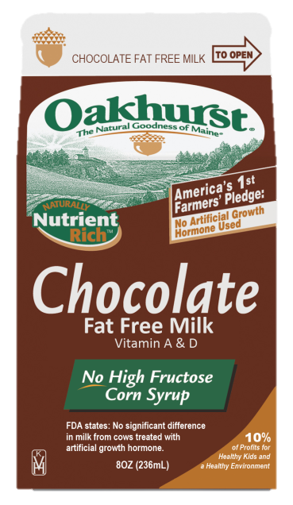


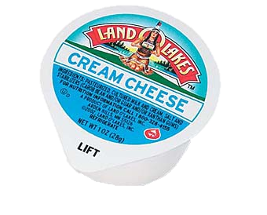
Offer Versus Serve - Breakfast
Offered
½ cup fruit
½ cup fruit
1 cup milk
1 oz eq M/MA
2 oz eq Grain
Notes:
Let’s look at several trays where we count the M/MA (yogurt) counted as a grain
So the planned menu is 1 cup of milk, a carton of yogurt that counts as a 1 oz grain, a WG bagel that is 2 oz eq of grain, ½ cup of fruit, and ½ cup juice:
The yogurt that is 1 oz equivalent of M/MA is an counted as a grain
19

Slide 21
Offer Versus Serve - Breakfast
What the students selects. Is this Reimbursable?
1 cup milk
1 oz eq M/MA
2 oz eq Grain
Notes:
How many items on this tray? 4 items
What are the items? (cc doesn’t count)
-Is there a minimum of ½ cup fruit or vegetable? No
-Is this tray reimbursable? No
20

Slide 22
Offer Versus Serve - Breakfast
There are 4 items but does not include ½ cup of fruit.
NO
1 cup milk
1 oz eq M/MA
2 oz eq Grain
Notes:
How many items on this tray? 4 items
What are the items? (cc doesn’t count)
-Is there a minimum of ½ cup fruit or vegetable? No
-Is this tray reimbursable? No
21

Slide 23
Offer Versus Serve - Breakfast
What the students selects. Is this Reimbursable?
½ cup Fruit
2 oz eq Grain
Notes:
How many items on this tray? 3 items
-Is there a minimum of ½ cup fruit or vegetable? YES
-Is this tray reimbursable? Yes
22

Slide 24
Offer Versus Serve - Breakfast
There are 3 items including ½ cup of fruit.
½ cup Fruit
YES
2 oz eq Grain
Notes:
How many items on this tray? 3 items
-Is there a minimum of ½ cup fruit or vegetable? YES
-Is this tray reimbursable? Yes
23

Slide 25


Offer Versus Serve - Breakfast
Offered
½ cup Fruit
1 cup milk
½ cup Fruit
2 oz eq Grain +
2 oz eq M/MA
Notes:
The breakfast sandwich can count as
4 ITEMS: Count both grains oz eq AND count the 2 oz M/MA as grains
2 ITEMS: Count both grains oz eq and count the 2oz M/MA as EXTRA
1 ITEM: Count the 2oz grains as 1 item and count the 2oz M/MA as EXTRA
The planned menu is 1 cup of milk, a breakfast sandwich that is 2oz eq of grain and 2 oz equivalent of M/MA and ½ cup of juice and ½ cup of fruit
24

Slide 26
Offer Versus Serve - Breakfast
What the students selects. Is this Reimbursable?
½ cup Fruit
2 oz eq Grain +
2 oz eq M/MA
Notes:
How many items on this tray? 3 items
-Is there a minimum of ½ cup fruit or vegetable? YES
-Is this tray reimbursable? Yes
25

Slide 27
Offer Versus Serve - Breakfast
There are 5 items including ½ cup of fruit.
½ cup Fruit
YES
2 oz eq Grain +
2 oz eq M/MA
Notes:
How many items on this tray? 3 items
-Is there a minimum of ½ cup fruit or vegetable? YES
-Is this tray reimbursable? Yes
26

Slide 28
Offer Versus Serve - Breakfast
What the students selects. Is this Reimbursable?
½ cup Fruit
1 cup milk
½ cup Fruit
Notes:
How many items on this tray? 3 items
-Is there a minimum of ½ cup fruit or vegetable? YES
-Is this tray reimbursable? Yes
27

Slide 29
Offer Versus Serve - Breakfast
There are 3 items including ½ cup of fruit.
½ cup Fruit
1 cup milk
YES
½ cup Fruit
Notes:
How many items on this tray? 3 items (a FULL cup of fruit/juice is considered an item)
-Is there a minimum of ½ cup fruit or vegetable? YES
-Is this tray reimbursable? Yes
28

Slide 30
Review OVS at Lunch
Offer 5 components
  Milk
  Fruit
  Vegetable
  Grains
  MMA
Student must select at least 3 different components including at least a ½ cup fruit or vegetable
Notes:
So let’s move into lunch. Remember with lunch students select meal components (or food groups) vs. items.
How many components do students have to select (at minimum)? The answer is 3! These have to be three different food components, or three different food groups if that is easier to remember.
Out of the three components, which component are they required to take?
29

Slide 31
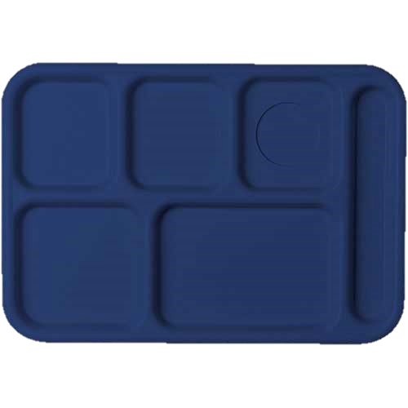


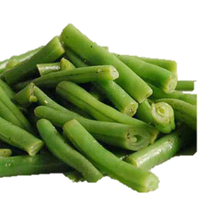
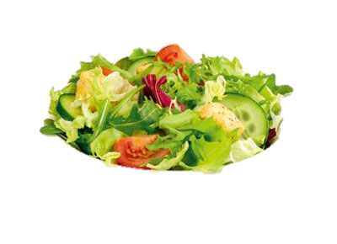
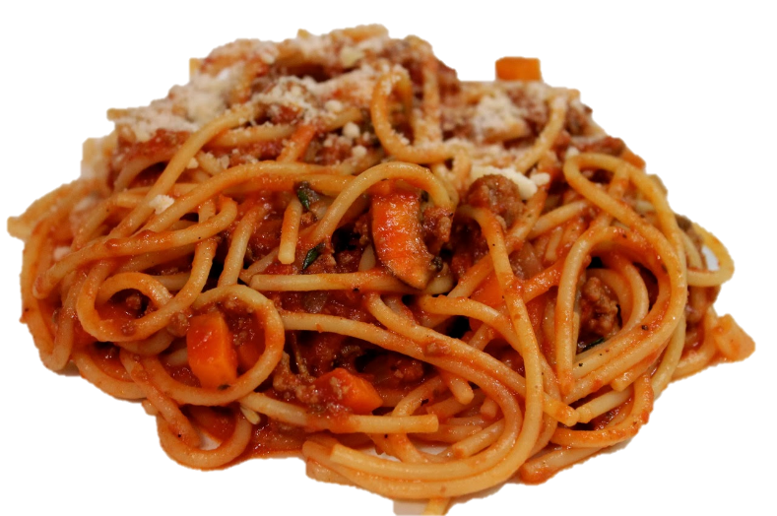
Offer Versus Serve - Lunch
Offered
1 cup fruit
½ cup Veg.
1 cup milk
1 cup Veg.
2 oz eq M/MA + 2 oz eq Grain
Notes:
Here is our planned meal: Spaghetti w/meat sauce), ½ green beans, 1 cup mixed salad (that credits as what??? ½ cup), 1 cup fresh grapes and milk.
30

Slide 32
Offer Versus Serve - Lunch
What the students selects. Is this Reimbursable?
1 cup milk
1 cup Veg.
2 oz eq M/MA + 2 oz eq Grain
Notes:
31

Slide 33
Offer Versus Serve - Lunch
There are 4 components including ½ cup of fruit or vegetable.
1 cup leafy vegetable credits as ½ cup
YES
1 cup milk
1 cup Veg.
2 M/MA + 2 Grain
Notes:
For this tray:
-How many components: 4
-Is there a minimum of ½ cup fruit or vegetable? Yes
-Is this tray reimbursable: Yes
32

Slide 34
Offer Versus Serve - Lunch
What the students selects. Is this Reimbursable?
1 cup fruit
½ cup Veg.
1 cup milk
Notes:
33

Slide 35
Offer Versus Serve - Lunch
There are 3 components including ½ cup of fruit or vegetable.
1 cup fruit
½ cup Veg.
1 cup milk
YES
Notes:
For this tray:
-How many components: 3 (1 cup F, ½ cup v, 1 milk)
-Is there a minimum of ½ cup fruit or vegetable? Yes
-Is this tray reimbursable: Yes
34

Slide 36
Offer Versus Serve - Lunch
What the students selects. Is this Reimbursable?
½ cup Veg.
1 cup milk
1 cup Veg.
Notes:
35

Slide 37
Offer Versus Serve - Lunch
There are 2 components selected: 1 cup of vegetable and 1 cup of milk
1 cup leafy vegetable credits as ½ cup
½ cup Veg.
1 cup milk
NO
1 cup Veg.
Notes:
For this tray:
-How many components: 2 (1 cup v, 1 milk)
-Is there a minimum of ½ cup fruit or vegetable? Yes
-Is this tray reimbursable: No
36

Slide 38






Offer Versus Serve - Lunch
Offered
1 cup fruit
½ cup Veg.
1 cup milk
½ cup Veg.
2 oz eq M/MA +
2 oz eq Grain
Notes:
The planned meal for the day :
37

Slide 39

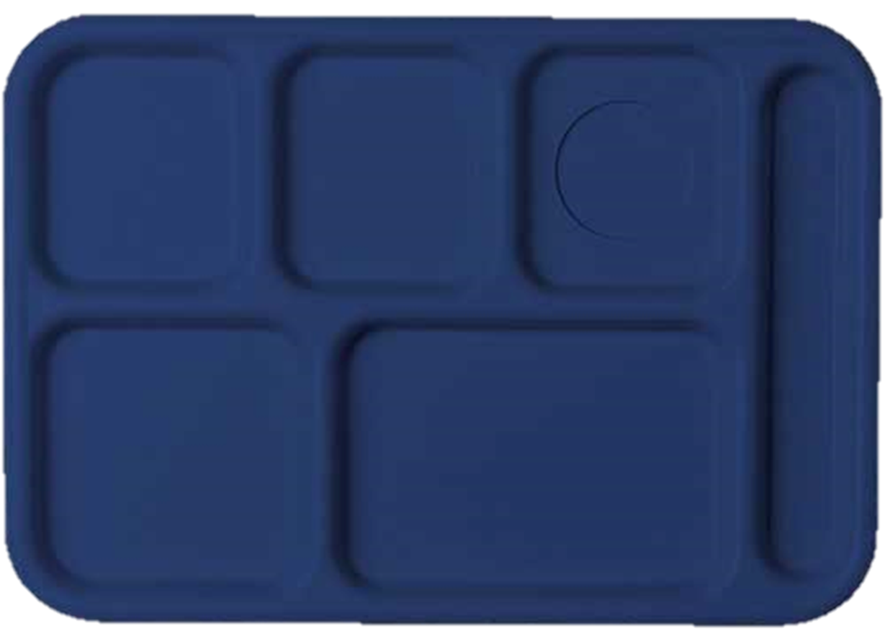


Offer Versus Serve - Lunch
What the students selects. Is this Reimbursable?
1 cup milk
2 oz eq M/MA +
2 oz eq Grain
Notes:
38

Slide 40
Offer Versus Serve - Lunch
There are 3 components but not a ½ cup of fruit or vegetable.
NO
2 oz eq M/MA +
2 oz eq Grain
Notes:
How many components: 3
Do you ever see trays like this?
-Is there a minimum of ½ cup fruit or vegetable? No
-Is this tray reimbursable: No
39

Slide 41

Offer Versus Serve - Lunch
What the students selects. Is this Reimbursable?
1 cup fruit
2 oz eq M/MA +
2 oz eq Grain
Notes:
40

Slide 42
Offer Versus Serve - Lunch
There are 3 components including ½ (or more) cup of fruit.
1 cup fruit
YES
2 oz eq M/MA +
2 oz eq Grain
Notes:
How many components: 3
-Is there a minimum of ½ cup fruit or vegetable? YES
-Is this tray reimbursable: YES
41

Slide 43


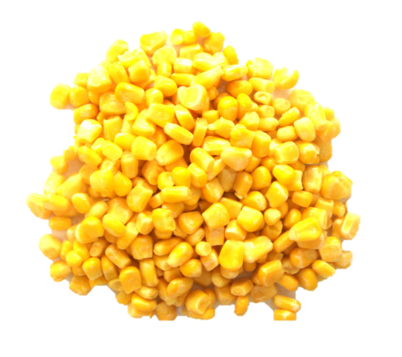
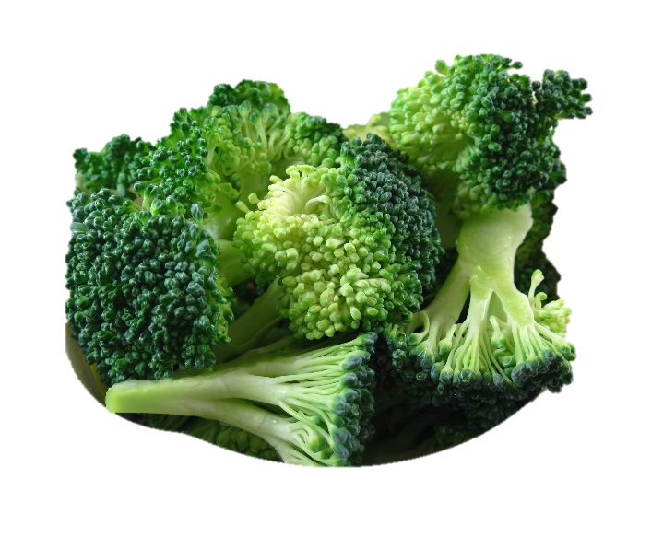
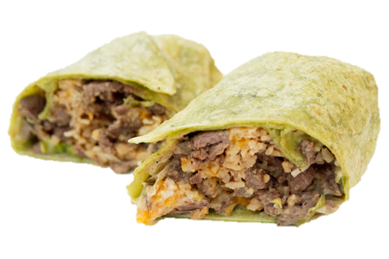
Offer Versus Serve - Lunch
Offered
1 cup fruit
½ cup Veg.
1 cup milk
½ cup Veg.
2 oz eq M/MA +
2 oz eq Grain
Notes:
The planned meal for the day : a beef and bean burrito, ½ c corn, ½ cup of broccoli florets, 1 cup of watermelon, and milk.
42

Slide 44
Offer Versus Serve - Lunch
What the students selects. Is this Reimbursable?
½ cup Veg.
2 oz eq M/MA +
2 oz eq Grain
Notes:
43

Slide 45
Offer Versus Serve - Lunch
There are 3 components including ½ cup of vegetable.
½ cup Veg.
YES
2 oz eq M/MA +
2 oz eq Grain
Notes:
How many components: 3
-Is there a minimum of ½ cup fruit or vegetable? YES
-Is this tray reimbursable: YES
44

Slide 46
Offer Versus Serve - Lunch
What the students selects. Is this Reimbursable?
1 cup milk
2 oz eq M/MA +
2 oz eq Grain
Notes:
45

Slide 47
Offer Versus Serve - Lunch
There are 3 components but not a ½ cup of fruit or vegetable.
NO
1 cup milk
2 M/MA + 2 Grain
Notes:
How many components: 3
-Is there a minimum of ½ cup fruit or vegetable? No
-Is this tray reimbursable: No
46

Slide 48
Offer Versus Serve - Lunch
What the students selects. Is this Reimbursable?
1 cup fruit
½ cup Veg.
1 cup milk
Notes:
47

Slide 49
Offer Versus Serve - Lunch
There are 3 components including ½ cup of vegetable.
Note: The fruit is in the full serving size for grades 9-12.
1 cup fruit
½ cup Veg.
1 cup milk
YES
Notes:
How many components: 3
-Is there a minimum of ½ cup fruit or vegetable? YES
-Is this tray reimbursable: YES
48

Slide 50
Offer Versus Serve - Lunch
What the students selects. Is this Reimbursable?
1/2 cup fruit
½ cup Veg.
1 cup milk
Notes:
49

Slide 51
Offer Versus Serve - Lunch
Must select 3 different components. One is a ½ cup fruit or vegetable and the other 2 components must be in the full serving size
1/2 cup fruit
½ cup Veg.
1 cup milk
YES K-8
NO 9-12
Notes:
K-8:
Milk and fruit are in full serving sizes and student also took ½ cup vegetable
9-12
Milk is in the full serving size but the ½ cup fruit or vegetable requirement can only be applied to either the fruit or the vegetable. The other one must be in the full amount of 1 cup.
50

Slide 52

Questions
207-624-6842
child.nutrition@maine.gov

Slide 53
In accordance with federal civil rights law and U.S. Department of Agriculture (USDA) civil rights regulations and policies, this institution is prohibited from discriminating on the basis of race, color, national origin, sex (including gender identity and sexual orientation), disability, age, or reprisal or retaliation for prior civil rights activity.
Program information may be made available in languages other than English. Persons with disabilities who require alternative means of communication to obtain program information (e.g., Braille, large print, audiotape, American Sign Language), should contact the responsible State or local Agency that administers the program or USDA’s TARGET Center at (202) 720-2600 (voice and TTY) or contact USDA through the Federal Relay Service at (800) 877-8339.
To file a program discrimination complaint, a Complainant should complete a Form AD-3027, USDA Program Discrimination Complaint Form which can be obtained online at: https://www.usda.gov/sites/default/files/documents/USDA-OASCR%20P-Complaint-Form-0508-0002-508-11-28-17Fax2Mail.pdf, from any USDA office, by calling (866) 632-9992, or by writing a letter addressed to USDA. The letter must contain the complainant’s name, address, telephone number, and a written description of the alleged discriminatory action in sufficient detail to inform the Assistant Secretary for Civil Rights (ASCR) about the nature and date of an alleged civil rights violation. The completed AD-3027 form or letter must be submitted to USDA by:
(1) mail:
U.S. Department of Agriculture
Office of the Assistant Secretary for Civil Rights
1400 Independence Avenue, SW
Washington, D.C. 20250-9410; or
(2) fax:
(833) 256-1665 or (202) 690-7442; or
(3) email:
program.intake@usda.gov
This institution is an equal opportunity provider.
(Federal statement updated 5/18/2022)
The Maine Human Rights Act prohibits discrimination because of race, color, sex, sexual orientation, age, physical or mental disability, genetic information, religion, ancestry or national origin.
Complaints of discrimination must be filed at the office of the Maine Human Rights Commission, 51 State House Station, Augusta, Maine 04333-0051. If you wish to file a discrimination complaint electronically, visit the Human Rights Commission website at https://www.maine.gov/mhrc/file/instructions and complete an intake questionnaire. Maine is an equal opportunity provider and employer.

