Slide 1
CTE Funding Model
Presented to the Committee on
Education and Cultural Affairs
Friday, March 26, 2021
Tyler Backus, MDOE School Finance Team Leader
Ida Batista, School Finance Coordinator

Slide 2
Because who doesn’t want to be on the beach with a flamingo!
Notes:
A pleasant musing before we delve in. Not as humorous as a cat filter lawyer but pleasant.

Slide 3
CTE Funding Model
Present since FY2019
Cost model
Evolving
Transition Period for Hold Harmless to the previous model through FY 2023
Currently under review by MEPRI – preliminary report will be submitted to the Commissioner this summer.
Notes:
Present model based on recommendations from the 2017 MEPRI report, located on our site (https://www.maine.gov/doe/sites/maine.gov.doe/files/inline-files/CTEModel_2017Final_Updated.pdf). The 2017 recommendations were based on long-term work with the CTE stakeholders group comprised CTE directors, superintendents, business managers, and State Board of Ed members, in addition to prior analytic model (a proposed model in 2010) review work done.
The present model is a Cost model, i.e. based on cost of the number & types of programs offered, and program enrollment counts within a given CTE. The change in models was made to address the challenges (expenditure basis created a 2 year lag in funding) and limitations (such as availability of resources to spend) from the prior expenditure driven model, and to increase equity. This model is more aligned with the main EPS model. And similar to the EPS model, the CTE model is used to distribute funds based on adequate resources to achieve learning standards and does not dictate how or what resource decisions are made by CTE school administration.
Given the newness of the model started in FY19, identifying gaps and misalignments, and providing opportunities to allow CTEs to converge toward model amounts, the model has been evolving. We have added components to the model, such as substitutes, legislative funds have been added, and a transition period through FY 2023 has been added to the “hold harmless” component.
To assess and address some areas of misalignment, MEPRI is reviewing the new model components as well as surveying CTE directors this winter that will inform future evolution of the current model. To determine areas of focus in this review, an ongoing CTE workgroup comprised of CTE Directors, Superintendents, MSMA, and DOE determined areas of concern which include the per pupil amount for supplies, student enrollment, teacher ratios, operations and maintenance.

Slide 4
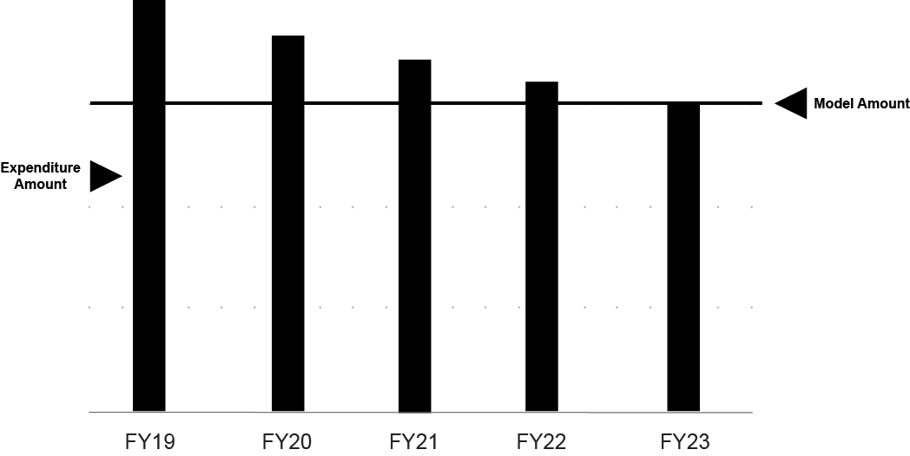
Transition Period – Hold Harmless
Model Allocation Compared to Inflated Actual Expenditures (Hold Harmless to previous model)
Ends in FY23
Provides time for CTE schools not in alignment with the model to transition
Notes:
Hold harmless provides for CTEs that are spending over the current cost model, as compared to the previous expenditure model, an allocation that recognizes expenditures over the model amount.
Some reasons why schools don’t align with the model are local only debt, and small class sizes (– i.e. aquaculture 2 students, Conservation 3 students, Hospitality 4 students, forestry 4 students as examples).
The transition period limits the amount of time that over model expenditures will be recognized and provides for a gradual decrease in the amount of over the model expenditure amounts to be allocated. This has allowed us to gradually increase the allocation amounts for CTEs with expenditures under the model from 5% to 30% up to the model amount. The transition period ends in FY23. There are three fewer schools receiving the transition adjustment in FY 2022 than in FY 2021.

Slide 5
Funding Level
FY22 - $58.1 Million for existing and new programs at Maine’s 27 CTE Centers and Regions; increase of $1.594 million over FY 2021.
State side funds only – no required local share
CTE model is blind (no recognition of or adjustments to allocations) to funds from other revenue sources (i.e. local assessments, grants, private donations, etc.)
Notes:
Current CTE funding allocations are the highest since implementation of the current model. The FY19 CTE funding allocation, first year of the present model, was $53.5 and funding has increased in total by $4.6 million since FY 2019.
These are base funds, the minimum essential amount needed, that are exclusively for CTE use, paid 100% by the State, and paid directly to the CTE regions or the SAUs that operate the CTE center for all their local and satellite programs. For CTEs that have satellite programs, programs administered on behave of the CTE school at another SAU, the CTE is responsible for sending the necessary funds needed to operate the program, as discussed between the two parties, to the hosting satellite SAU.
Given that CTEs budget needs may be greater than the State base allocation, any other source revenues that CTEs raise are not factored into the model or affect the model allocation amount. It is hard to isolate CTE revenue especially in CTE centers, however, based on FY20 expenditure data not including capital or equipment expenditures, CTEs expended $58.5M, 94.3% of which were from the GF (state ($53.7M) and local assessment & possibly carry over ($1.5M)) with the remaining 5.7% funds being from state grants, federal funds, local private funds, and enterprise funds.
With the enactment of the new model, two statutory changes were made - one requires that any GPA funds allocated to CTE must remain with CTE – this means that the SAU with a CTE Center cannot use any GPA allocation for CTE that remains unspent for any other purpose. The other change was that CTE schools may no longer charge tuition for Maine students as all SAUs support CTE schools via the mill expectation. Finally, CTE schools with cost sharing agreements between their member entities retain the ability to assess for costs “above the EPS model” – sort of like the additional local funds in the PK-12 funding formula.

Slide 6
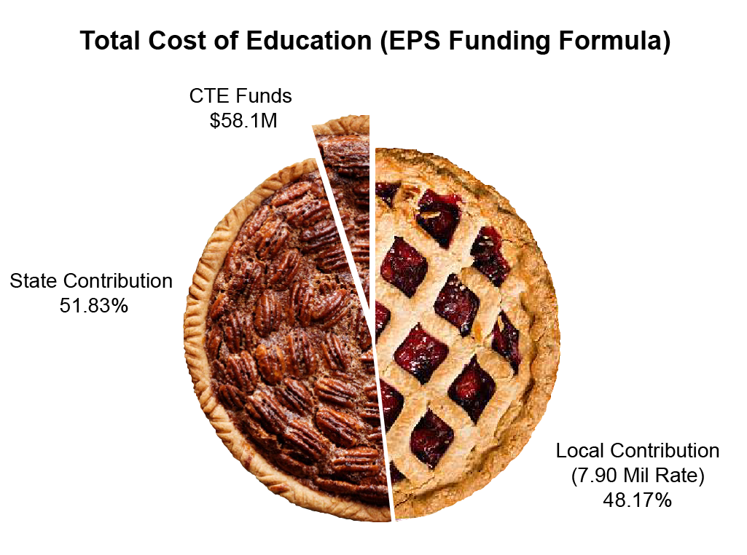
The EPS Pie - State and Local Shares
Total Cost of Education FY 22 EPS Calculation = $2,385,685,974
FY 22 State Appropriation for Education = $1,236,415,357
Notes:
For those new, this is the proverbial EPS pie which illustrates the state and local shares. For FY22, the total cost of education is $2.385B with the state share being $1.236B calculated with a 7.90 Mil Rate. Within the state share is the $58.1M (4.7%of state share) slice of pie reserved for CTEs and paid for by all tax payers.

Slide 7
CTE Funding Model – Data Inputs
Student Enrollment
School and Program
October 1 count
3 Year Average
Programs
Number & Type Approved By October 15
Sq. Footage
Self-reported by November 30
Notes:
There are three primary inputs for the CTE funding model:
Attending CTE student enrollment as of Oct. 1 for both the school and program. A 3 year average is used to smooth spikes and dips.
Any new, split, or unsuspended program applications & notifications have to be completed and submitted to Me DOE CTE by Oct 15.
And any additional or removed instructional space sq. footage measurements need to be reported to school finance by Nov.30th
These components are needed to calculate preliminary CTE funding allocations for the following fiscal year (i.e. data from fall FY21 is used for FY22 funding allocations).
The CTE model calculation is very data driven and until the model is “settled”, hopefully in FY 2024 as the transition period will have ended and the MEPRI recommendations for improvement will be available, the model is calculated manually. Once the model is finalized, DOE will be able to program and create more robust reporting for CTE schools.

Slide 8
CTE Funding Model - Five Components
Instruction
Central Administration
Operations & Maintenance
Supplies
Student and Staff Supports
Notes:
These are the 5 components that are included in the CTE funding model. The model calculates funding for instruction, central administration, operations and maintenance of plant, supplies, and student and staff supports. We will go over what is included in these components in the following slides.
First, let's mention what items are outside the model.

Slide 9
Items Not Included in the CTE Model
Equipment
Major capital and debt service
Transportation (to and from the CTE school by the CTE School)
Notes:
The shown items are out of scope for the CTE model because of the variability in choices that can be made for these items that could never be adequately reflected in a model. Federal funds provide equipment support, as do funds appropriated separately in GPA and in the Learning Systems account. CTE Schools are eligible to receive funds for capital construction under the major capital program, as well as funds for renovation under the revolving renovation fund.
For FY20, as an example, CTEs spent approximately $3.4 M on equipment, 36% from state grant funds, 23% from GF (which is excluded from hold harmless), 22% from federal funds, and the rest from a combination of Capital local or enterprise funds.

Slide 10
Instruction
Classroom Teachers
FTEs based on program enrollment
Salary & Benefits
Ed Techs
FTEs for specific programs based on program enrollment
Salary & Benefits
Clinical Supervisors
Amount per 8 students
Substitutes
Per pupil amount
Notes:
Within Instruction is included:
Teachers – teacher FTE is designated by program based on the number of students in the program. A model FTE for teachers was developed by MEPRI that designates FTE based on student counts, 12 or less students is 0.5 FTE, 13-32 is 1.0 FTE,…. Up to 80 or more students is 3 FTE. Once FTE is calculated FTE is multiplied by the model teacher salary value. For FY22, the teacher salary value is $55,725.51 per 1 FTE. This value is based on the state average EPS teacher.
MEPRI explored using the EPS salary matrix for teachers (based on education level and years of experience) with CTE teachers. However, CTE teachers educational levels were different (more skill certifications/licenses vs. degrees) and did not fit the matrix. Benefits are 19% of salary, which is consistent with PK-12 EPS model, non CTE.
2. Ed techs - ed techs were recommended for 19 specific programs and FTE is based on program enrollment, 12 or less is 0.5 FTE, or 13 or more is 1 FTE, except for diversified occupations program which gets 1 FTE ed tech per 27 students. All CTEs are guaranteed a minimum of at least 1 FTE per school. The FY22 ed tech salary is $21,756 per FTE with 36% for benefits, consistent with PK-12 EPS model, non CTE
3. Clinical supervisors are needed for 5 specific programs and are funded at a rate of $2,857 per 8 students.

Slide 11
Central Administration
Director
1 FTE per CTE, Salary and Benefits
Assistant Director
FTE based on school size, Salary and Benefits
Business Manager
1 FTE per CTE Region, Salary and Benefits
Clerical Staff
FTE per 245 students, Minimum 1 FTE per CTE school, Salary and Benefits
Other Central Administration Costs
Percentage of Central Administration Salaries and Benefits
Notes:
For Central administration, we designate 1 FTE Director per school with a salary value of $89,771 per FTE for FY22.
Asst. directors are designated based on school size for schools with 250 -349 students 0.5 FTE is allocated & for schools with 350 or more students 1 FTE is allocated with a salary value of $73,612 per FTE. Business managers are allocated at 1 FTE for only CTE regions with a salary value of $58,088 per FTE.
Clerical staff is allocated 1 FTE per 245 students with a salary value of $35,499 per FTE.
Benefits are 14% of salaries for all except clerical which is 29% - this is consistent with the EPS model for PK-12, non CTE.
All other central administration costs currently are allocated as 16% of central administration salaries and benefits.

Slide 12
Operations & Maintenance
An amount per square foot
Notes:
One of the areas highly scrutinized in the model is O&M. This is self reported data that may not be consistent across CTE schools as to what is included or not included in the measurement, such as outdoor program spaces (think playgrounds or agricultural lands as a few examples) or how space is measured, think building footprint vs. each individual room. Additionally, CTE directors have brought up other items within the management of O&M that are not factored into the sq. footage and influence O&M costs, such as the age of the building, heating system, shared spaces and utilities, or grounds care.
For FY22 the O&M value is $5.67/sq. ft.
This is one of the components on which MEPRI is focusing during its current review.

Slide 13
Supplies
Amount per program
Varies by program
A per pupil per program amount
Notes:
Supplies are allocated out in the model by program and by program students. The program supply amount in FY22 ranged from $686 in the cooperative education program to $14,015 in culinary arts program. Many programs were allocated at the general program supply amount of $6,512 per program.
Additionally, $72 per program student was added to the program supply amount.
This is one of the components on which MEPRI is focusing during its current review.

Slide 14
Student and Staff Supports
Guidance Counselor
FTE by school size, Salary and Benefits
Coordinator
1 FTE per CTE, Salary and Benefits
Technology, Per pupil amount
Co-curricular, Per pupil amount
Professional Development, Per pupil amount
Safety, Per pupil amount
Assessment, Per pupil amount
Program Transportation, Inflated actual expenditures
Notes:
Guidance FTE is allocated at 1 FTE for CTEs with 349 students or less or 1.5 FTE for CTEs with 350 or more students.
Each CTE is allocated 1 FTE coordinator . For both guidance counselors and coordinators the salary value is $57,245 per 1 FTE in FY22 with 19% benefits.
The FY22 per pupil support amounts ranged from $22 -$112:
Tech $112
Co-curricular $43
PD $22
Safety $42
Assessment $62
Program transportation (from CTE school to worksite) at present is actual expenditures inflated.
Once this last component is calculated, all components (Instruction, central admin, O&M, supplies, and student and staff support) for a CTE are added together for the total model amount. Then, hold harmless is calculated, comparing the model amount to the most current actual expenditures inflated for comparability. We do exclude tuition, equipment, school transportation, construction, debt service, food service and fund transfer from expenditures when calculating hold harmless. We add new program allocations after hold harmless since there would not be expenditures associated with them. By Feb 1st of the calendar year, a general FY CTE allocations sheet including all CTEs is made available, as well as individual CTE school sheets with more detail on the CTE allocation. These can be located at the Maine DOE School funding EPS page for the given FY. https://www.maine.gov/doe/funding/gpa/eps/resources

Slide 15
School Finance Contacts:
Tyler Backus School Finance Compliance Coordinator phone: 207-624-6635 tyler.backus@maine.gov
Ida Batista School Finance Coordinator phone: 207-624-6795 ida.batista@maine.gov
Paula Gravelle School Finance Manager phone: 207-624-6792 paula.b.gravelle@maine.gov

