Slide 2
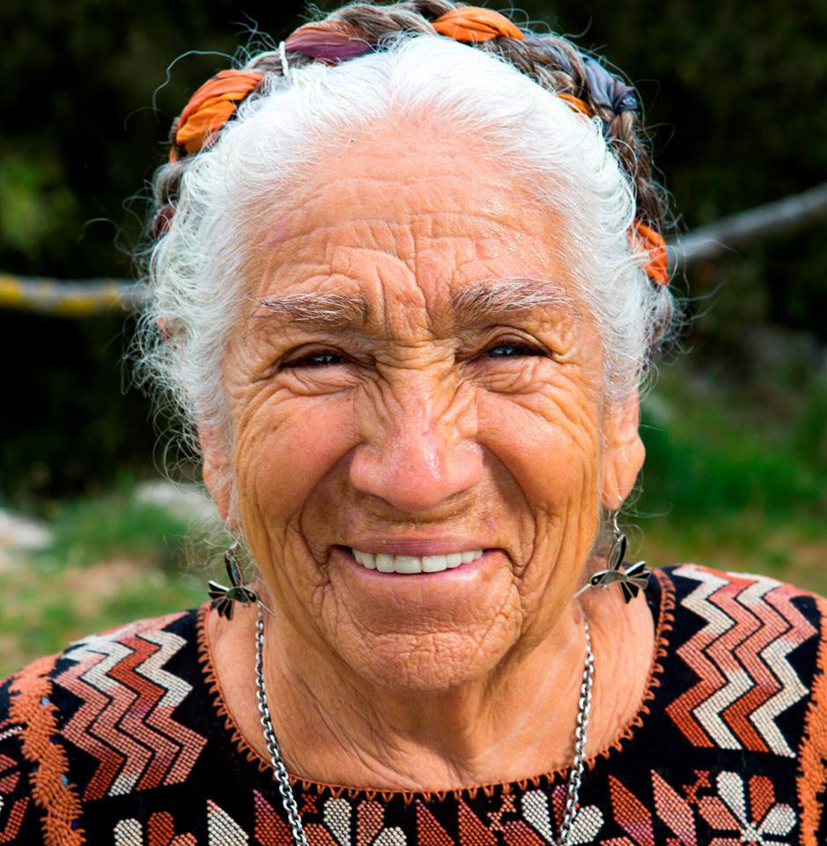
abuela
Notes:
Day 1, page 1
A word in the story is abuela.
Abuela means grandma in Spanish.
Let’s say the word abuela together. Ready…”abuela.”
Here is a picture that shows abuela. This is a picture of a grandmother, an abuela.

Slide 3
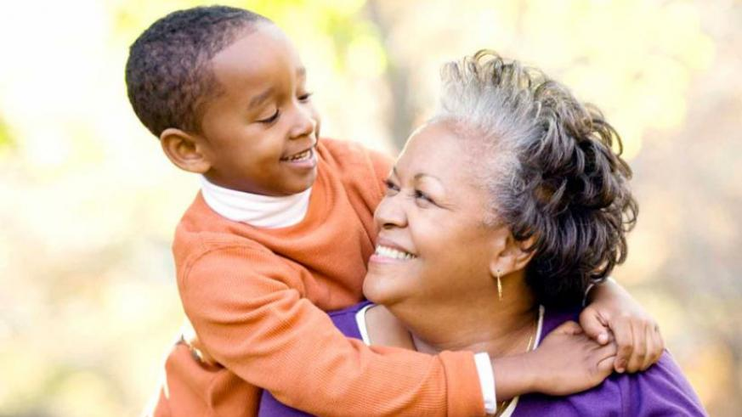
abuela
Notes:
Day 1, page 1
Here is another picture of abuela.
How does this picture show the meaning of abuela? T&T to your partner.
The little boy is hugging his abuela or grandmother.
I wonder how many syllables are in the word abuela? Let’s find out by clapping. Ready? a-bue-la. Three syllables. Now, can you say abuela three times by clapping the syllables with your hands?
Ready? a-bue-la, a-bue-la, a-bue-la

Slide 4
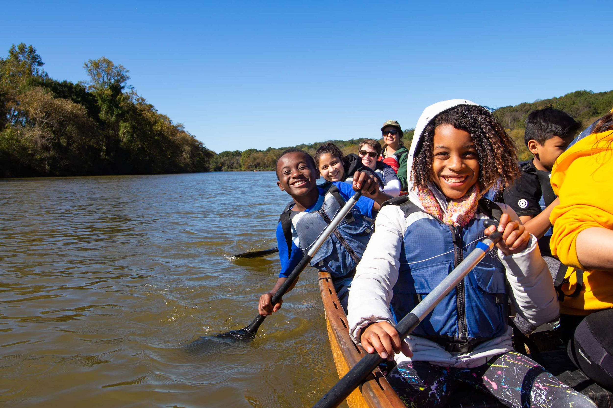
adventure
Notes:
Day 2, page 32
A word in the story is adventure.
In Spanish it is aventura (ah-behn-too-rah)
Adventure means an interesting trip or activity.
Let’s say the word adventure together. Ready…”adventure.”
Here is a picture that shows adventure. These kids are going on an interesting trip or an adventure. Look, the kids are going on an adventure in a boat.

Slide 5
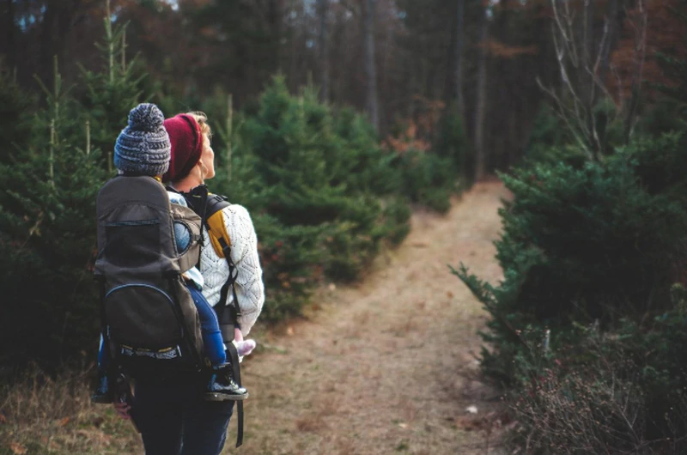
adventure
Notes:
Day 2, page 32
Here is another picture of adventure.
How does this picture show the meaning of adventure? T&T to your partner.
In this picture the baby and the mom are going on a walking adventure in the woods. I wonder what kinds of interesting things they are going to see?
I wonder how many syllables are in the word adventure? Let’s find out by clapping. Ready? ad-ven-ture. Three syllables. Now, can you say adventure three times by clapping the syllables with your hands?
Ready?
ad-ven-ture, ad-ven-ture, ad-ven-ture

Slide 6
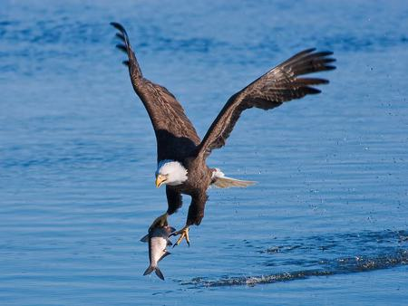
swooping
Notes:
Day 2, page 7
A word in the story is swooping.
In Spanish it is bajar en picada (bah-hahr) (ehn) (pee-kah-dah)
Swooping means to fly down quickly.
Let’s say the word swooping together. Ready...”swooping” When you say swooping, I hear a /s/ sound at the beginning of the word. Look, swooping begins with the letter s.
Here is a picture that shows swooping. This eagle is swooping down to catch a fish. It is flying down very quickly.

Slide 7
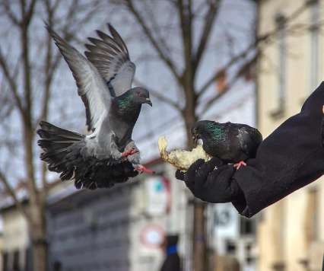
swooping
Notes:
Day 2, page 7
Here is another picture of swooping. How does this picture show the meaning of swooping? Turn and Talk to your partner.
This bird is swooping down to get the bread.
I wonder how many syllables are in the word swooping? Let’s find out by clapping. Ready? swoop-ing. 2 syllables. Now, can you say swooping three times by clapping the syllables with your hands?
Ready? swoop-ing, swoop-ing, swoop-ing

Slide 8
Day 2

Slide 9
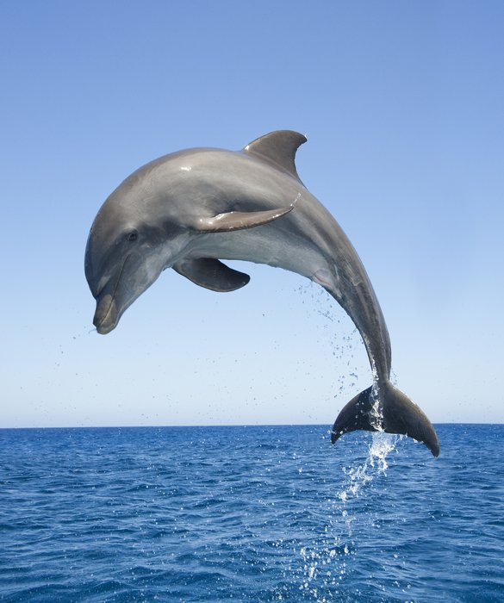
leap
Notes:
Day 2, Page 8
A word in the story is leap.
In Spanish it is saltar (sahl-tahr)
Leap means to jump.
Let’s say the word leap together. Ready...”leap” When you say leap, I hear a /l/ sound at the beginning of a word. Look, leap begins with the letter l.
Here is a picture that shows leap. This dolphin is leaping or jumping out of the water.

Slide 10
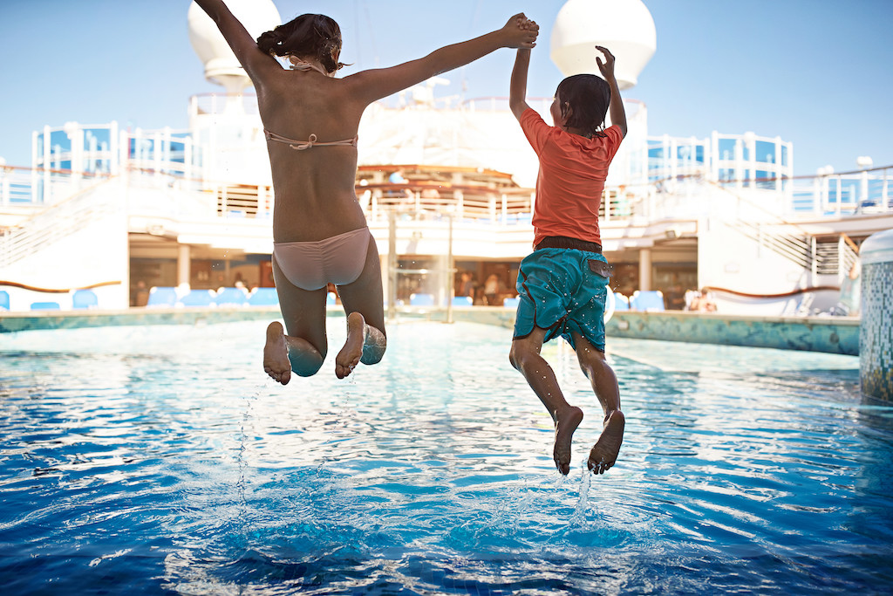
leap
Notes:
Day 2, Page 8
Here is another picture of leap. How does this picture show the meaning of leap? Turn and Talk to your partner.
These kids are leaping into the pool.
I wonder how many syllables are in the word leap? Let’s find out by clapping. Ready? leap. 1 syllable. Now, can you say leap three times while clapping the syllables with your hands?
Ready? leap, leap, leap

