Slide 1
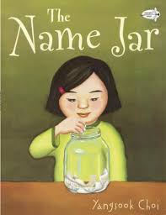

Slide 2
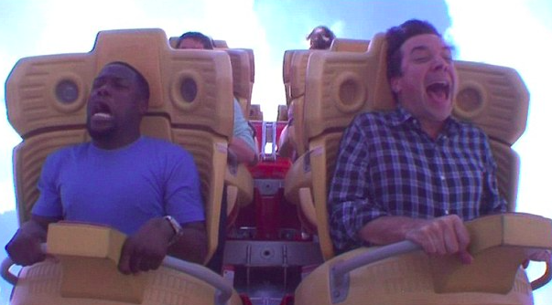
nervous
Notes:
A word in the story is nervous.
In Spanish it is nervioso (nehr-byoh-soh).
Nervous means ​worried and a little scared.
Let’s say the word nervous together. Ready? ”Nervous.”
When you say nervous, I hear the /n/ sound at the beginning of the word.
Look, nervous begins with the letter n.
Here is a picture that shows nervous. Look at the faces of the people. They are feeling a little scared and worried about riding the rollercoaster.

Slide 3
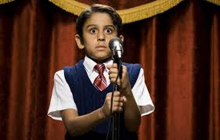
nervous
Notes:
Here is another picture of nervous.
How does this picture show the meaning of nervous? Turn and talk to your partner.
The boy is standing in front of the whole school and he is very nervous to speak.
How many syllables are in the word nervous? Let’s find out by clapping. Ready?
“Ner-vous.” Two syllables.
Now, let’s say nervous three times by clapping the syllables. Ready?
“Ner-vous, ner-vous, ner-vous.”

Slide 4
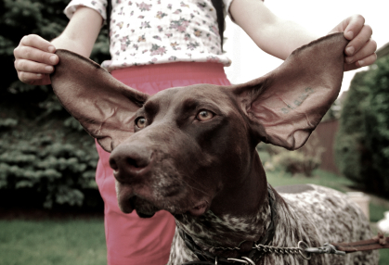
tease
Notes:
A word in the story is tease.
In Spanish it is molestar (moh-lehs-tahr).
Tease means to make fun.
Let’s say the word tease together. Ready…”Tease.”
When you say tease, I hear a /t/ sound at the beginning of the word.
Look, tease begins with the letter t.
Here is a picture that shows tease. This child is teasing the dog by pulling his ear.

Slide 5
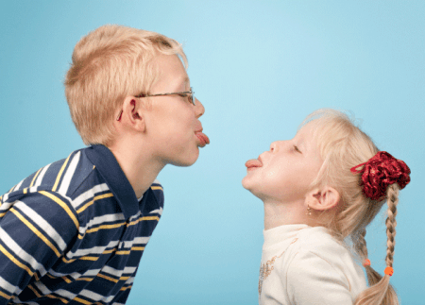
tease
Notes:
Here is another picture of tease.
How does this picture show the meaning of tease? Turn and talk to your partner.
This brother and sister are teasing, or making fun of one another, by sticking out their tongues.
How many syllables are in the word tease? Let’s find out by clapping. Ready?
“Tease.” One syllable.
Now, let’s say tease three times by clapping the syllables. Ready?
“Tease, tease, tease.”

Slide 6
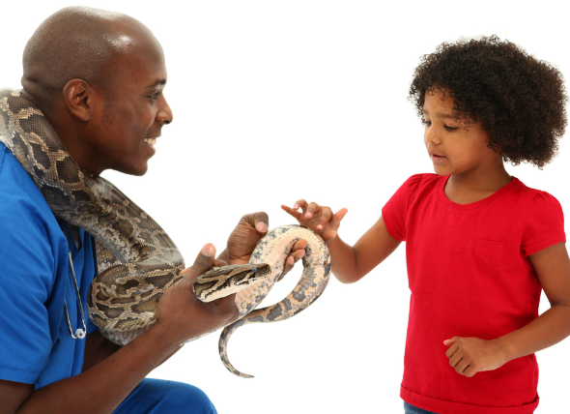
curious
Notes:
A word in the story is curious.
In Spanish it is curioso (koo-ryoh-soh).
Curious means interested and wanting to learn.
Let’s say the word curious together. Ready? ”Curious.”
When you say curious, I hear a /c/ sound at the beginning of the word.
Look, curious begins with the letter c.
Here is a picture of curious. This girl is curious about the snake. She is interested in it and wants to learn what it feels like.

Slide 7
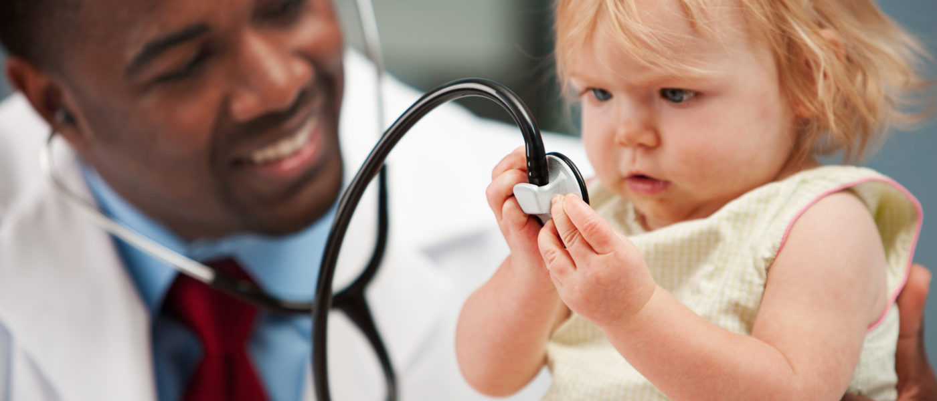
curious
Notes:
Here is another picture of curious.
How does this picture show the meaning of curious? Turn and Talk to your partner.
This baby is curious about the doctor’s stethoscope. She is interested in it and wants to learn more about it.
How many syllables are in the word curious? Let’s find out by clapping. Ready?
“Cur-i-ous.” 3 syllables.
Now, let’s say curious three times by clapping the syllables. Ready?
“Cur-i-ous, cur-i-ous, cur-i-ous.”

Slide 8
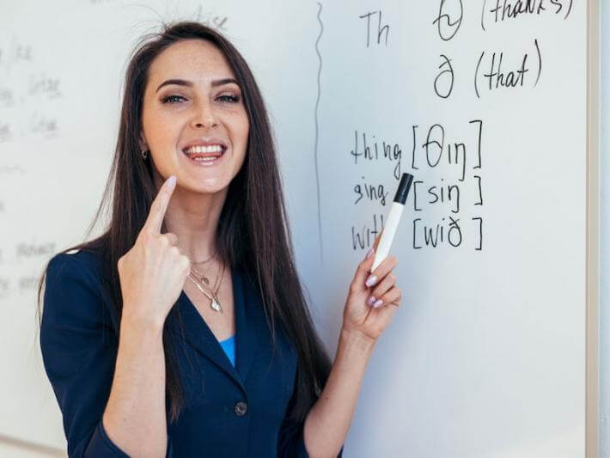
pronounce
Notes:
A word in the story is pronounce.
In Spanish it is pronunciar (proh-noon-syahr).
Pronounce means how something is said.
Let’s say the word pronounce together. Ready? ”Pronounce.”
When you say pronounce, I hear a /p/ sound at the beginning of the word.
Look, pronounce begins with the letter p.
Here is a picture that shows pronounce. This woman is teaching how to pronounce the /th/ sound. She is teaching how to say the sound.

Slide 9

pronounce
Notes:
Here is another picture of pronounce.
How does this picture show the meaning of pronounce? Turn and talk to your partner.
People are meeting each other and sharing how to pronounce their names.
How many syllables are in the word pronounce? Let’s find out by clapping. Ready?
“Pro-nounce.” Two syllables.
Now, let’s say pronounce three times by clapping the syllables. Ready?
“Pro-nounce, pro-nounce, pro-nounce.”

