Slide 1
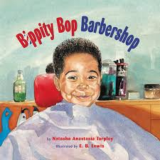

Slide 2
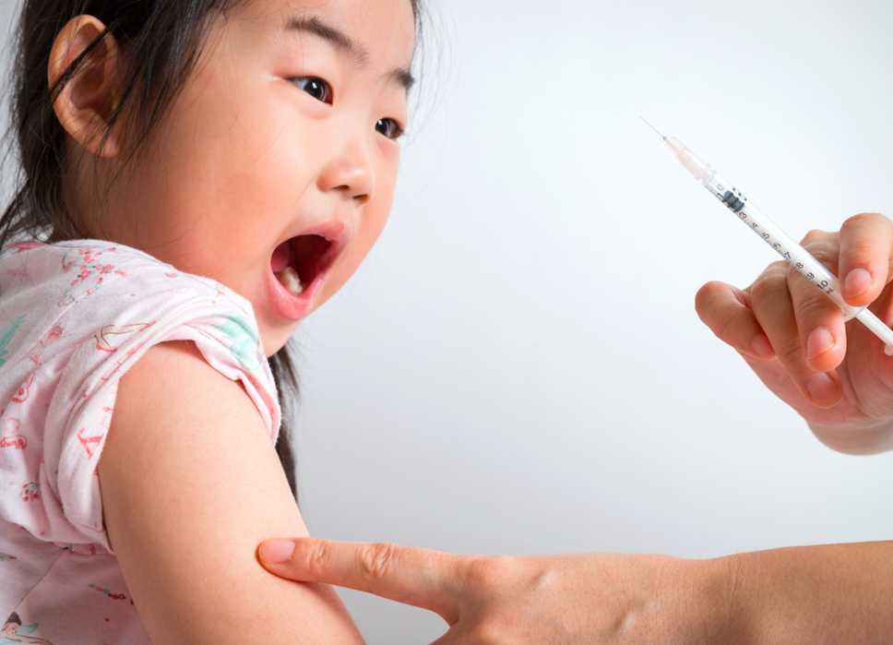
brave
Notes:
A word in the story is brave.
In Spanish it is valiente (bah-lyehn-teh).
Brave means not afraid, showing courage.
Let’s say the word brave together. Ready? ”Brave.”
When you say brave, I hear a /b/ sound at the beginning of the word.
Look, brave begins with the letter b.
Here is a picture that shows brave. This girl needs to get a shot and she is being brave. She is showing courage even though she might feel afraid.

Slide 3
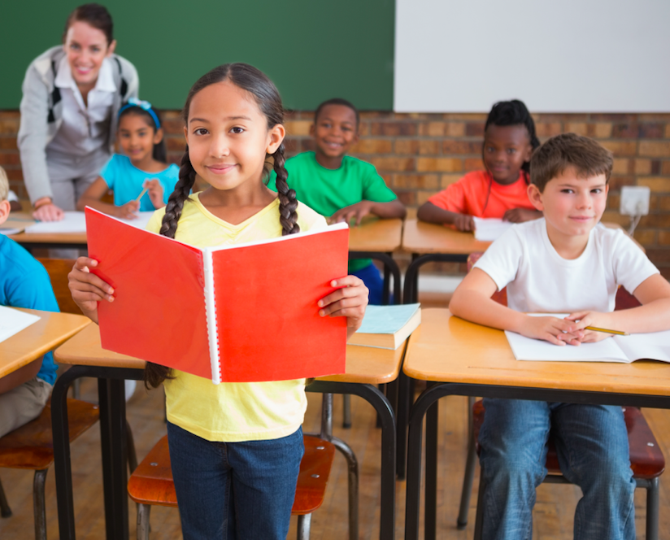
brave
Notes:
Here is another picture of brave.
How does this picture show the meaning of brave? Turn and talk to your partner.
This girl is being brave. She is reading to the whole class even though she might feel nervous.
How many syllables are in the word brave? Let’s find out by clapping. Ready?
“Brave.” One syllable.
Now, let’s say brave three times by clapping the syllables. Ready?
“Brave, brave, brave.”
Can you think of a time when you were brave?

Slide 4
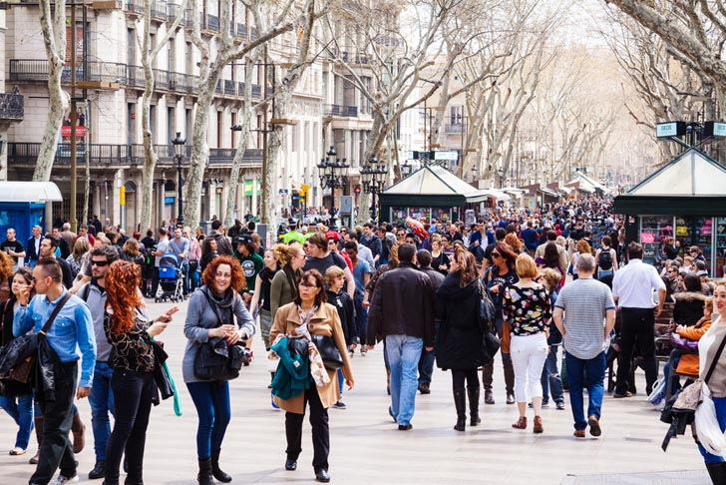
crowded
Notes:
A word in the story is crowded.
In Spanish it is lleno (yeh-noh).
Crowded means filled with too many things or too many people.
Let’s say the word crowded together. Ready…”crowded .”
When you say crowded, I hear a /c/ sound at the beginning of the word.
Look, crowded begins with the letter c.
Here is a picture that shows crowded. There are so many people on the streets of Boston. It is very crowded.

Slide 5
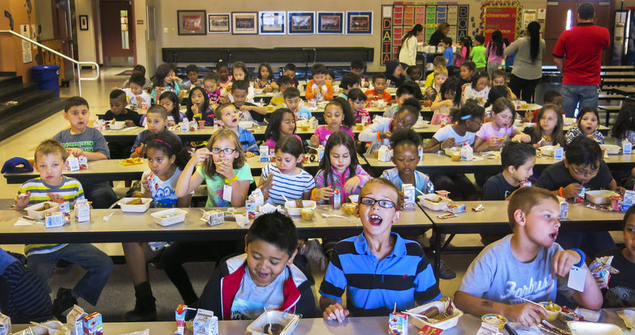
crowded
Notes:
Here is another picture of crowded.
How does this picture show the meaning of crowded? Turn and talk to your partner.
This cafeteria is very crowded. There are so many kids eating sitting and eating.
How many syllables are in the word crowded? Let’s find out by clapping. Ready?
“Crowd-ed.” Two syllables.
Now, let’s say crowded three times by clapping the syllables. Ready?
“Crowd-ed, crowd-ed, crowd-ed.”

