Slide 1
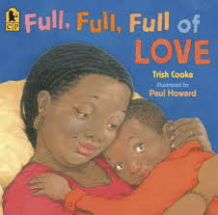

Slide 2
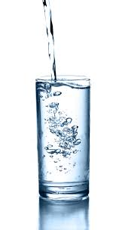
full
Notes:
A word in the story is full.
In Spanish it is lleno (yeh-noh).
Full means to have a lot of something, or to be filled up.
Let’s say the word full together. Ready? ”full.”
When you say full, I hear a /f/ sound at the beginning of the word.
Look, full begins with the letter f.
Here is a picture that shows full. This glass is full of water. There is so much water that the glass is filled up. It is full.

Slide 3
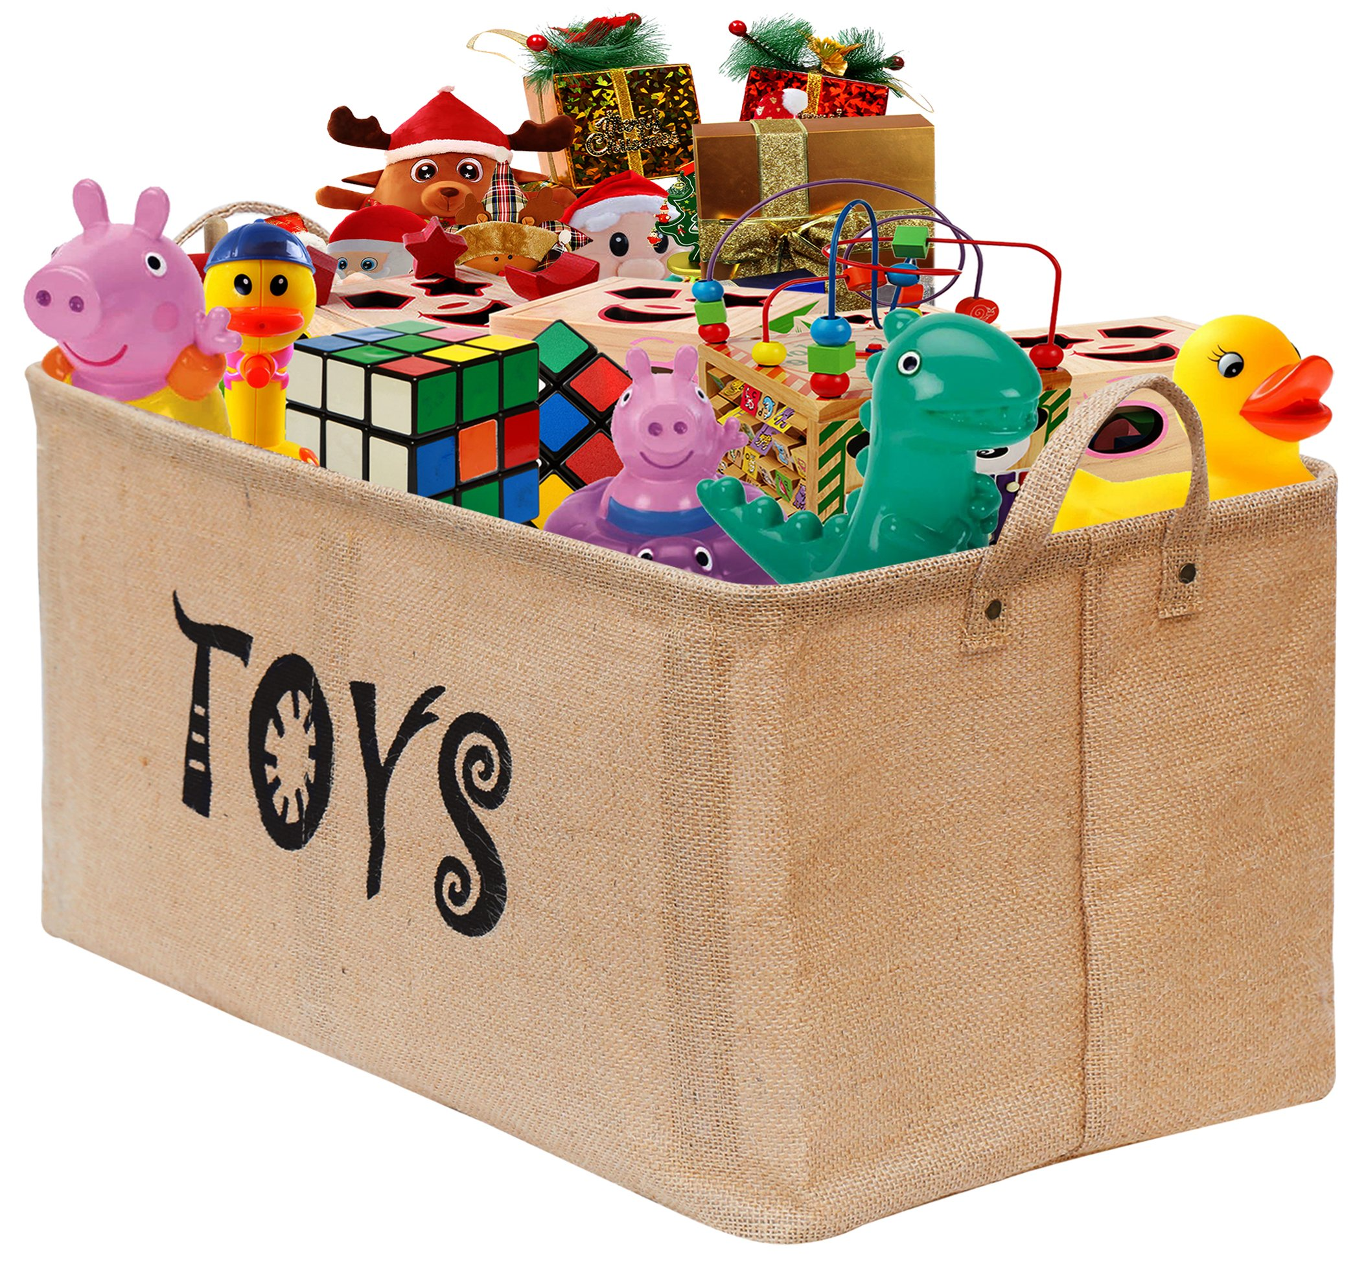
full
Notes:
Here is another picture of full.
How does this picture show the meaning of full? Turn and talk to your partner.
There are so many toys in the basket, the basket is full of toys.
How many syllables are in the word full? Let’s find out by clapping. Ready?
“Full.” One syllable.
Now, let’s say full three times by clapping the syllables. Ready?
“Full, full, full.”

Slide 4
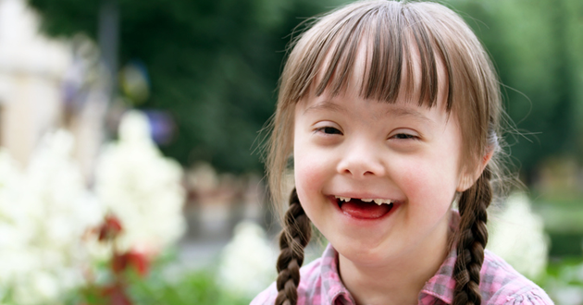
grin
Notes:
A word in the story is grin.
In Spanish it is sonrisa (sohn-ree-sah).
Grin means to smile to show you are happy.
Let’s say the word grin together. Ready? ”grin.”
When you say grin, I hear a /g/ sound at the beginning of the word.
Look, grin begins with the letter g.
Here is a picture that shows grin. The girl is so happy she has a big grin or smile on her face.

Slide 5
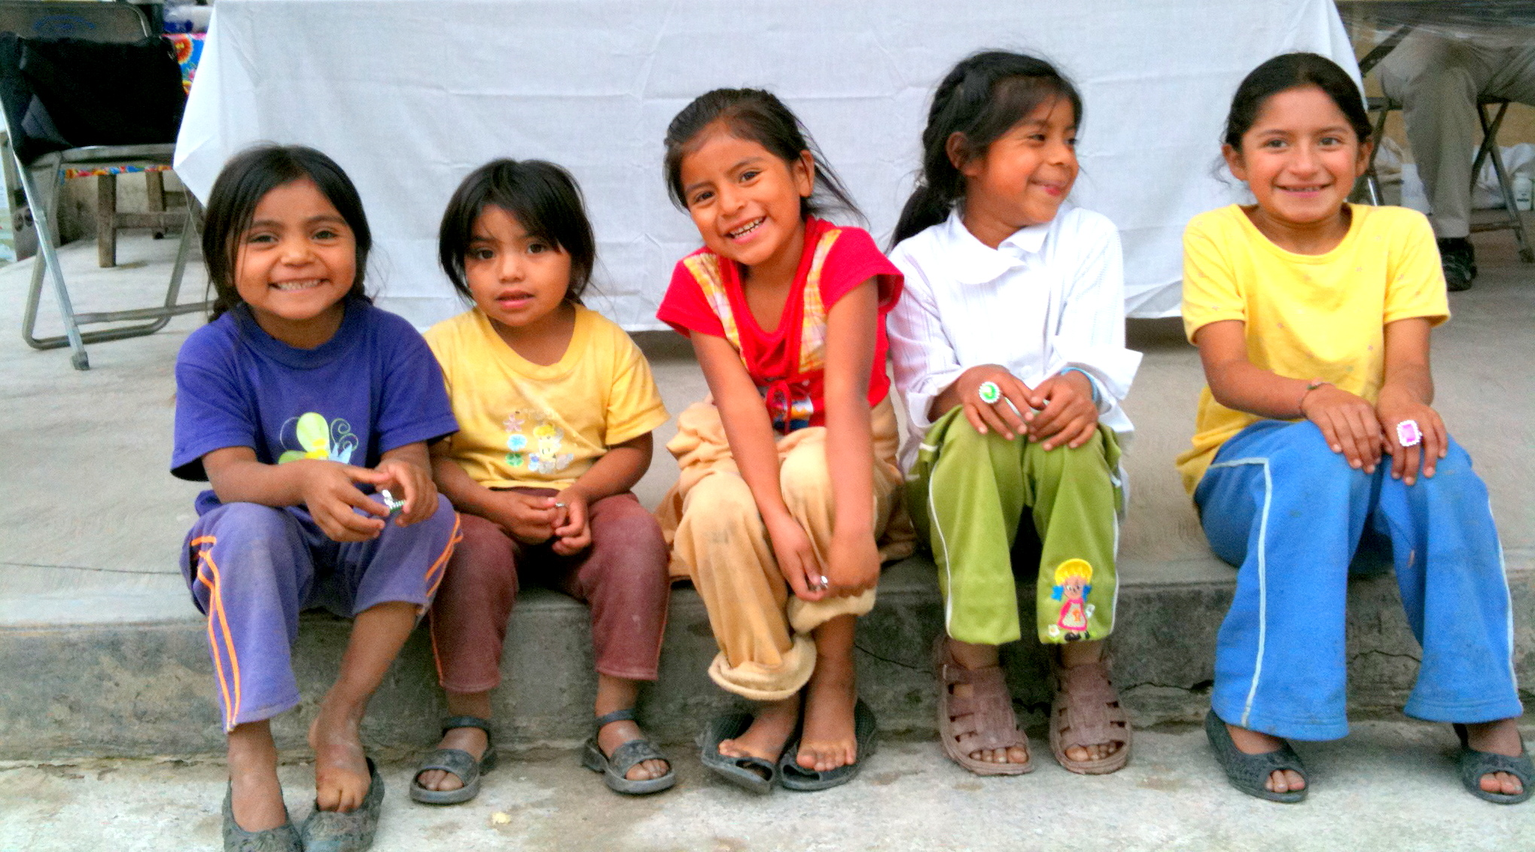
grin
Notes:
Here is another picture of grin.
How does this picture show the meaning of grin? Turn and talk to your partner.
These children all have a grin on their faces for the picture.
How many syllables are in the word grin? Let’s find out by clapping. Ready?
“grin.” One syllable.
Now, let’s say grin three times by clapping the syllables. Ready?
“Grin, grin, grin.”

