Slide 1
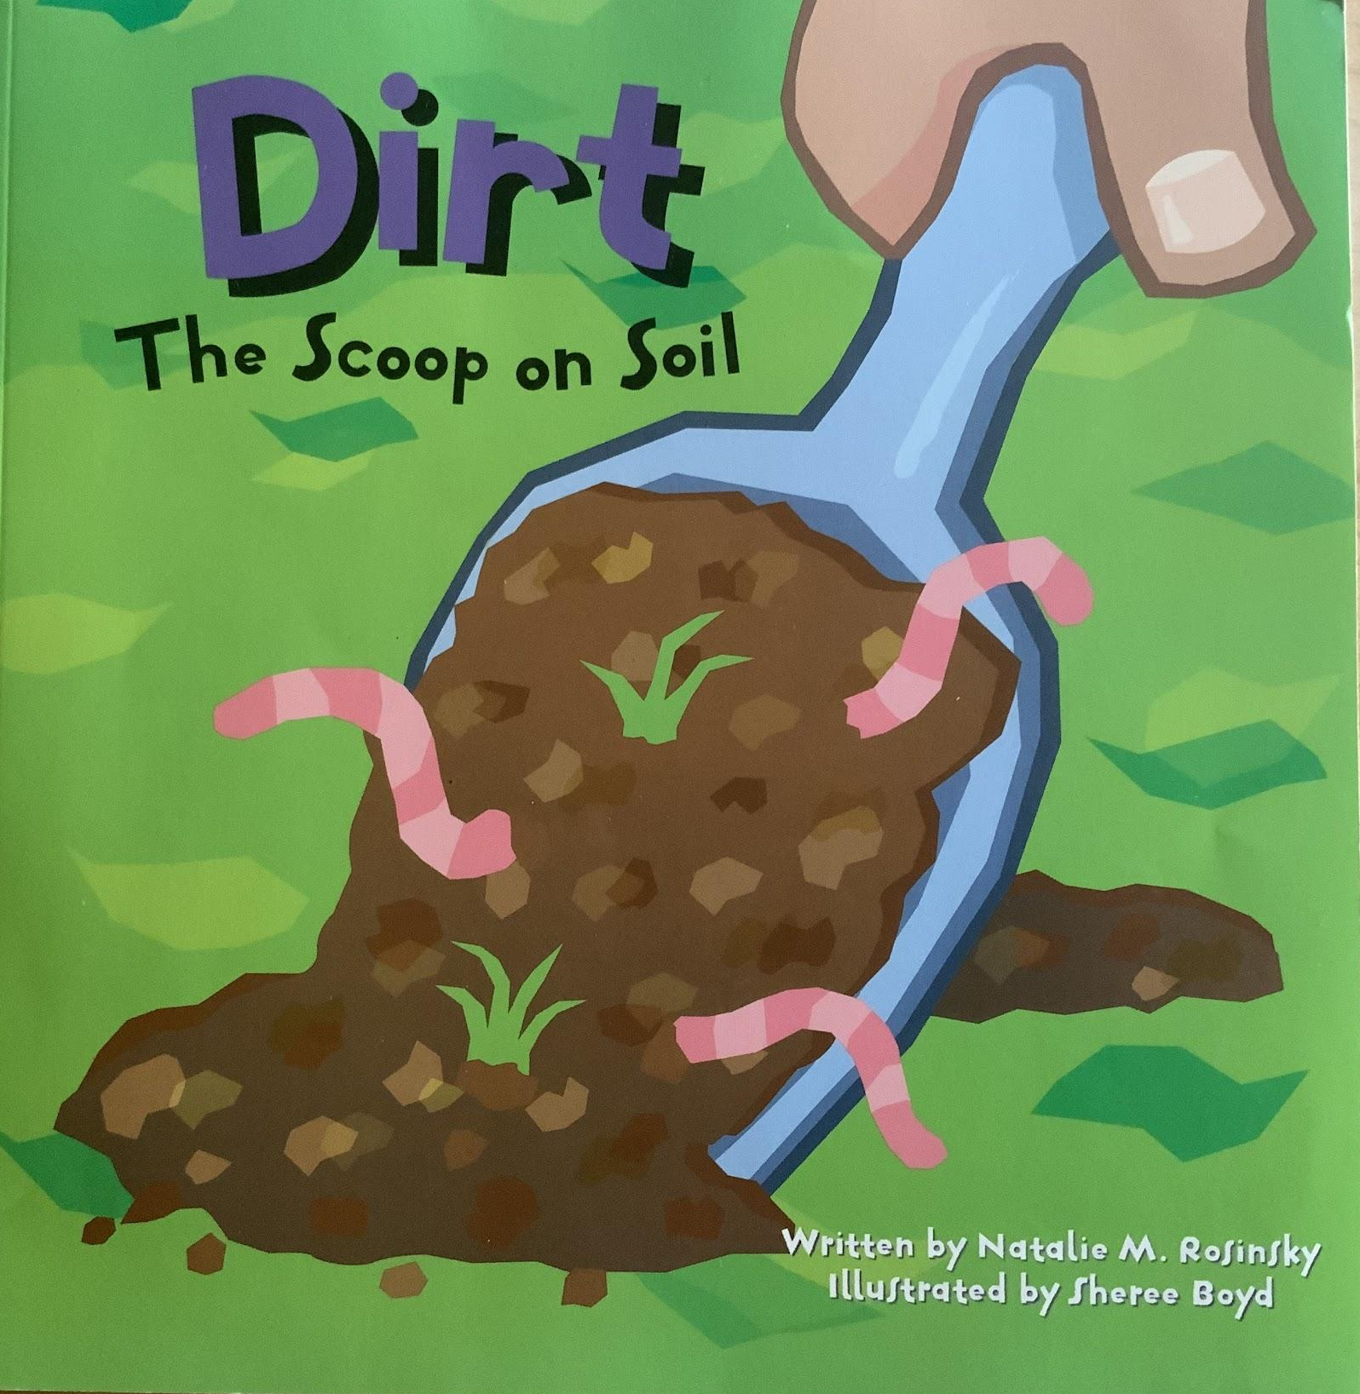
Notes:
decompose: to break down into smaller parts naturally and over a long period of time
rot: to decay
crumble: to break into small pieces
grain: the smallest part of something

Slide 2
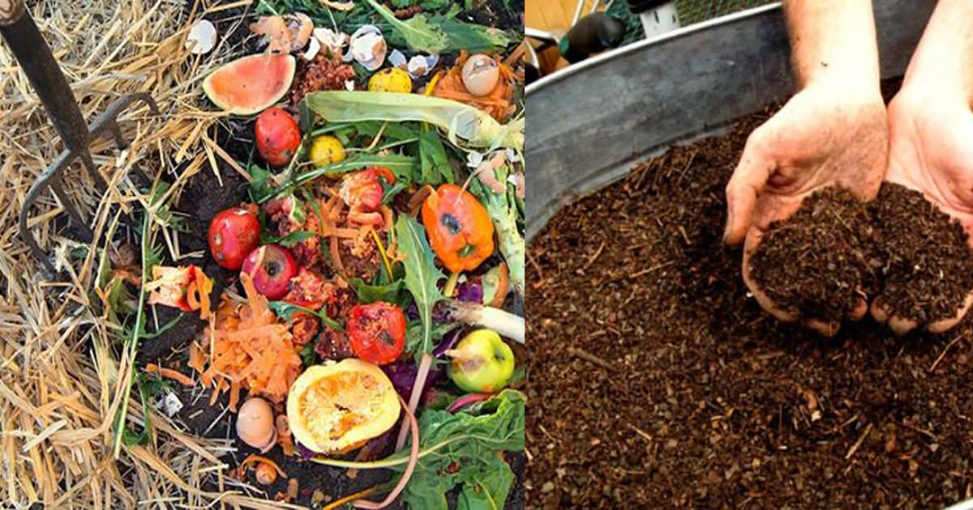
decompose
https://worldperspectives.org/cutting-down-on-waste/
Notes:
A word in the story is decompose.
In Spanish it is descomponerse (dehs-kohm-poh-nehr-seh) como en pudrirse(poo-dreer-seh).
Decompose describes when something breaks down into smaller parts naturally and over a long period of time.
Let’s say the word decompose together. Ready?
“Decompose.” When you say decompose, I hear a /d/ sound at the beginning of the word.
Look, decompose begins with the letter d.
Here is a picture that shows decompose. The person put the food waste in a compost bin. Over time, it decomposed, it broke up into very small pieces and became dirt.

Slide 3
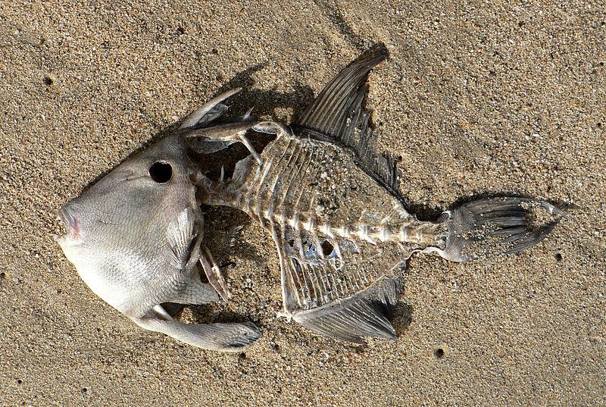
decompose
https://commons.wikimedia.org/wiki/File:Dead_fish_on_the_beach.jpg
Notes:
Here is another picture of decompose.
How does this picture show the meaning of decompose? Turn and talk to your partner.
The fish is decomposing on the beach. The tide brought this dead fish to shore, and over time it decomposes, turning into very tiny pieces and becoming part of the sand.
How many syllables are in the word decompose? Let’s find out by clapping. Ready?
“De-com-pose.” 3 syllables.
Now, let’s say decompose three times while clapping the syllables. Ready?
“De-com-pose, de-com-pose, de-com-pose.”

Slide 4
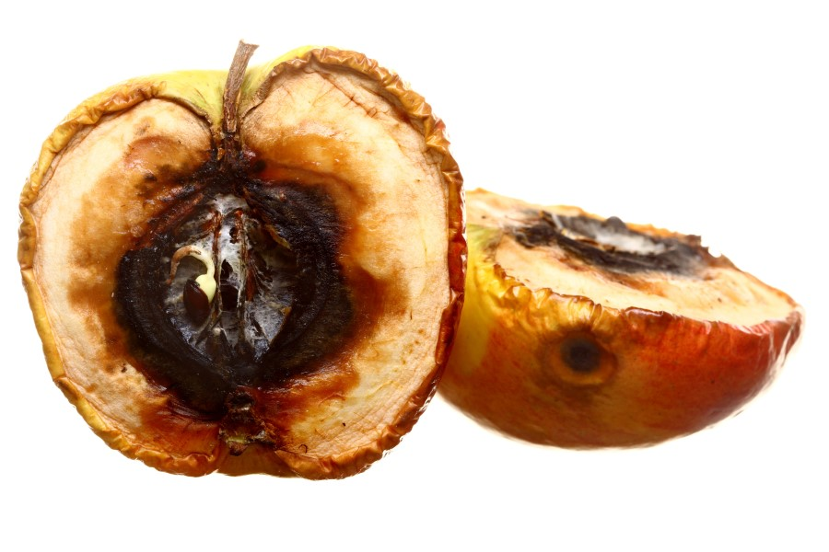
rot
https://wonderopolis.org/wonder/why-does-food-rot
Notes:
Another word in the story is rot.
In Spanish it is pudrirse (poo-dreer-seh).
Rot means to decay.
Let’s say the word rot together. Ready?
”Rot.” When you say rot, I hear the /r/ sound at the beginning of the word.
Look, rot begins with the letter r.
Here is a picture that shows rot. This apple is rotting. It is decaying; it is no longer fresh.

Slide 5
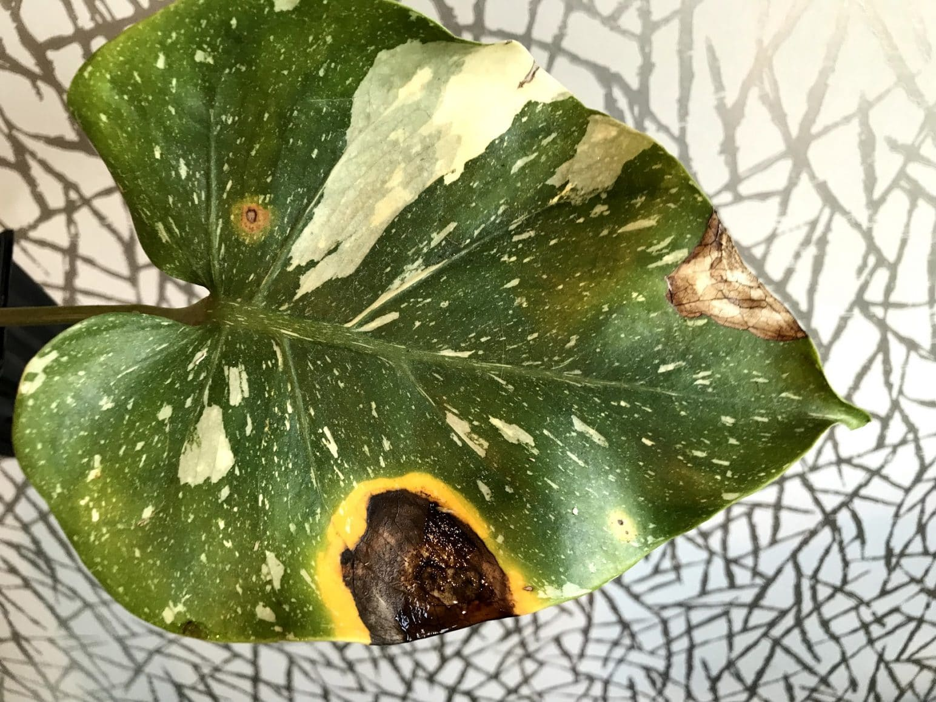
rot
https://plantophiles.com/plant-diseases/root-rot-symptoms/
Notes:
Here is another picture of rot.
How does this picture show the meaning of rot? Turn and talk to your partner.
The leaf is rotting. It has some brown spots that show that it is decaying. It is no longer growing and healthy.
How many syllables are in the word rot? Let’s find out by clapping. Ready?
“Rot.” 1 syllable.
Now, let’s say rot three times by clapping the syllables. Ready?
“Rot, rot, rot.”

Slide 6
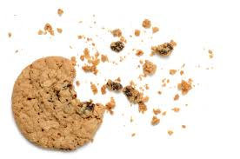
crumble
https://www.mercurynews.com/2016/09/14/kitchen-help-for-crumbly-cookies/
Notes:
A word in the story is crumble.
In Spanish it is desmenuzar (dehs-meh-noo-sahr).
Crumble is to break into small pieces, called crumbs.
Let’s say the word crumble together. Ready?
”Crumble.” When you say crumble I hear the /c/ sound at the beginning of the word.
Look, crumble begins with the letter c.
Here is a picture that shows crumble. The cookie has broken and crumbled into smaller pieces. You can still eat the crumbs, of course, instead of biting into one whole cookie.

Slide 7
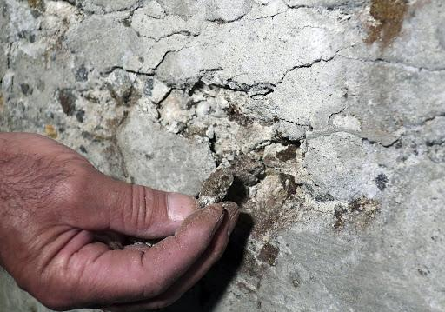
crumble
https://www.masslive.com/news/2020/01/massachusetts-estimates-350m-needed-to-fix-2000-homes-with-crumbling-foundations.html
Notes:
Here is another picture of the word crumble.
How does this picture show the meaning of crumble? Turn and talk to your partner.
This section of the wall is crumbling, it is breaking into smaller pieces.
How many syllables are in the word crumble? Let’s find out by clapping. Ready?
“Crum-ble.” 2 syllables.
Now, let’s say crumble three times by clapping the syllables. Ready?
“Crum-ble, crum-ble, crum-ble.”

Slide 8
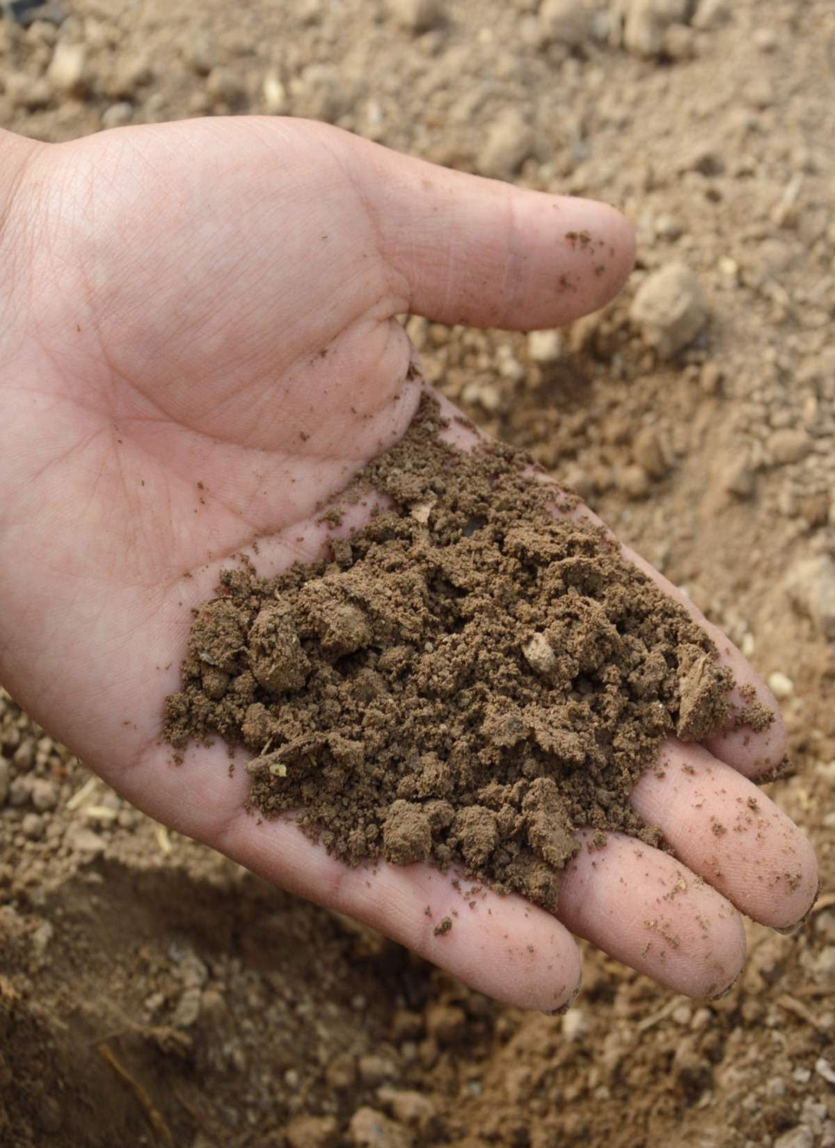
grain
https://www.nature-and-garden.com/gardening/identifying-garden-soil-type.html
Notes:
A word in the story is grain.
In Spanish it is grano (grah-noh).
Grain is the smallest part of something.
Let’s say the word grain together. Ready?
”Grain.” When you say grain I hear the /g/ sound at the beginning of the word.
Look, grain begins with the letter g.
Here is a picture that shows grain. These are grains of dirt or soil, the smallest pieces of rock.

Slide 9
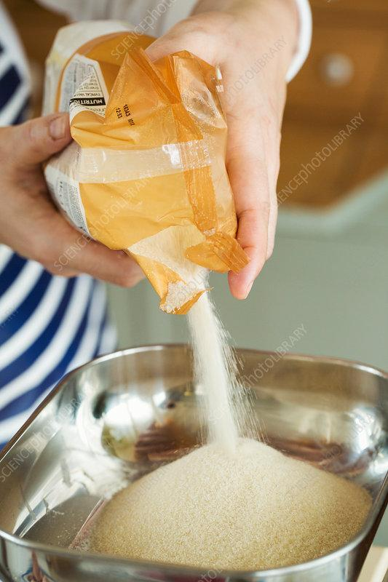
grain
https://www.sciencephoto.com/media/894689/view/baker-pouring-sugar-into-a-metal-bowl
Notes:
Here is another picture of the word grain.
How does this picture show the meaning of grain? Turn and talk to your partner.
This image shows someone baking with sugar, pour all the grains of sugar into the mixing bowl.
How many syllables are in the word grain? Let’s find out by clapping. Ready?
“Grain.” 1 syllable.
Now, let’s say grain three times by clapping the syllables. Ready?
“Grain, grain, grain.”

