Slide 1
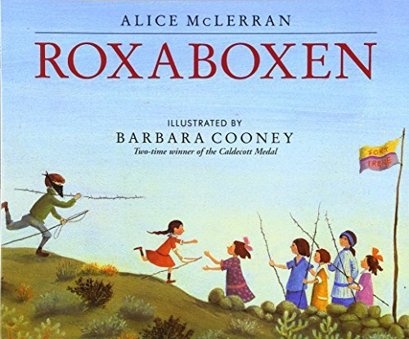
Notes:
trace: to draw around the edges (add edged as synonym)
plain: simple, not decorated
border(ing): to form an edge around something-edge

Slide 2
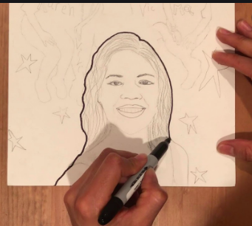
trace
https://www.youtube.com/watch?v=5DsscPtm56g
Notes:
A word in the story is traced.
In Spanish it is trazado (trah-sah-doh).
Trace is to draw over existing lines.
Let’s say the word trace together. Ready?
”Trace.” When you say trace, I hear the /t/ sound at the beginning of the word.
Look, trace begins with the letter t.
Here is a picture that shows trace. Some traces over the outline of this portrait by going over it with a dark marker.

Slide 3
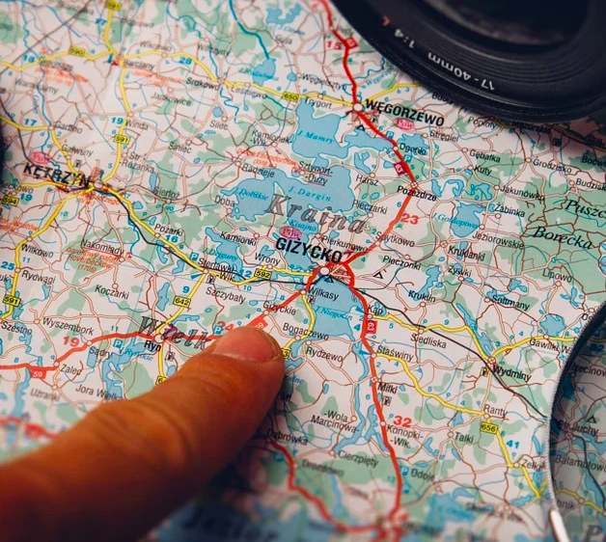
trace
Notes:
Here is another picture of trace.
How does this picture show the meaning of trace? Turn and talk to your partner.
This person is following a route for travel, using a finger to trace the road on the map.
How many syllables are in the word trace? Let’s find out by clapping. Ready?
“Trace.” 1 syllable.
Now, let’s say trace three times while clapping the syllables. Ready?
“Trace, trace, trace.”

Slide 4
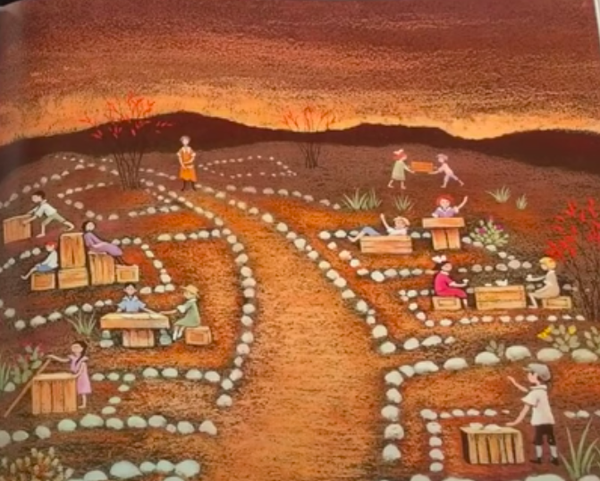
bordering
Illustration from Roxaboxen by Barbara Cooney
Notes:
Another word in the story is bordering.
In Spanish it is bordeando (bohr-deh-anh-doh).
Bordering is going along the side or edge of something.
Let’s say the word bordering together. Ready?
”Bordering.” When you say bordering, I hear the /b/ sound at the beginning of the word.
Look, bordering begins with the letter b.
Here is a picture that shows bordering. This illustration comes from the text Roxaboxen. It shows white stones bordering the main road and the places on each side of it. The author also uses the word “edged” to express this idea. The streets are edged with stones; stones are bordering the streets.

Slide 5
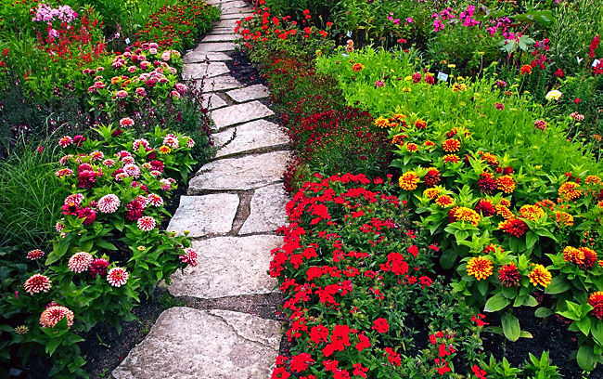
bordering
https://oneworldrising.wordpress.com/2013/07/16/choosing-a-path-and-staying-on-it/
Notes:
Here is another picture of bordering.
How does this picture show the meaning of bordering? Turn and talk to your partner.
The flowers are bordering the path. How lovely!
How many syllables are in the word bordering? Let’s find out by clapping. Ready?
“Bor-der-ing.” 3 syllables.
Now, let’s say bordering three times by clapping the syllables. Ready?
“Bor-der-ing, bor-der-ing, bor-der-ing.”

Slide 6
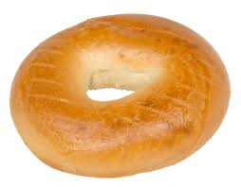
plain
https://en.wikipedia.org/wiki/Bagel
Notes:
A word in the story is plain.
In Spanish it is simple (seem-pleh).
Plain means simple, not decorated. You have probably heard the word “plane” as in “airplane.” These two words sound the same, but they are spelled differently, and they have different meanings. So when we hear “plain,” we have to pay close attention to the text to understand which meaning makes sense.
Let’s say the word plain together. Ready?
”Plain.” When you say plain I hear the /p/ sound at the beginning of the word.
Look, plain begins with the letter p.
Here is a picture that shows plain. This is a plain bagel. Is the most simple bagel we can have. It doesn’t have any seeds on top or any cream cheese inside.

Slide 7
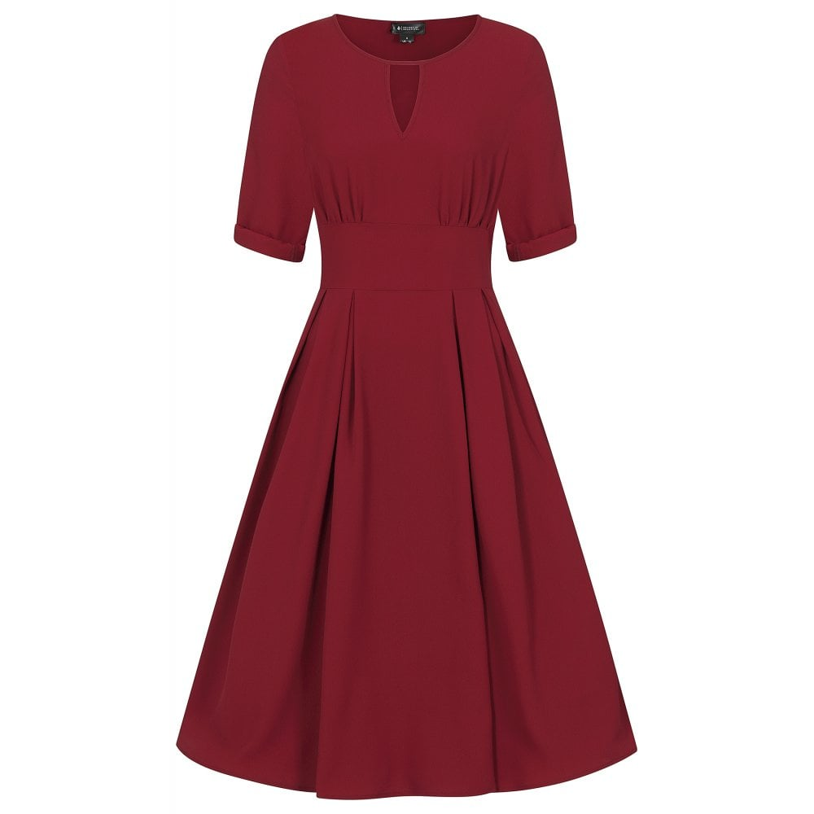
plain
https://www.collectif.co.uk/clothes-c1/flared-dresses-c3/clementine-plain-dress-p14551
Notes:
Here is another picture of the word plain.
How does this picture show the meaning of plain? Turn and talk to your partner.
This is a plain dress, it is very simple. It is all red and doesn’t have any decorations.
How many syllables are in the word plain? Let’s find out by clapping. Ready?
“Plain.” 1 syllable.
Now, let’s say plain three times by clapping the syllables. Ready?
“Plain, plain, plain.”

