Slide 1
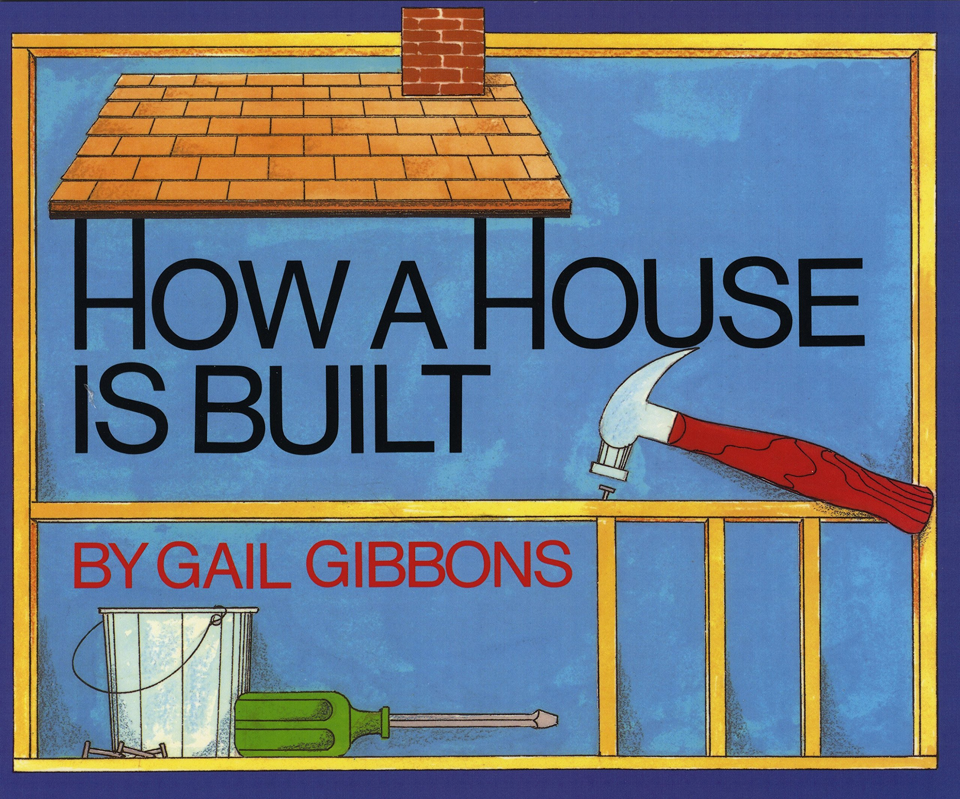
Notes:
foundation: the bottom part of a building or structure
concrete: a material used for building that begins in liquid form and dries into a heavy solid
frame: a solid structure that surrounds something
support: to hold up
install: to put in
interior: the inside of a structure or building

Slide 2
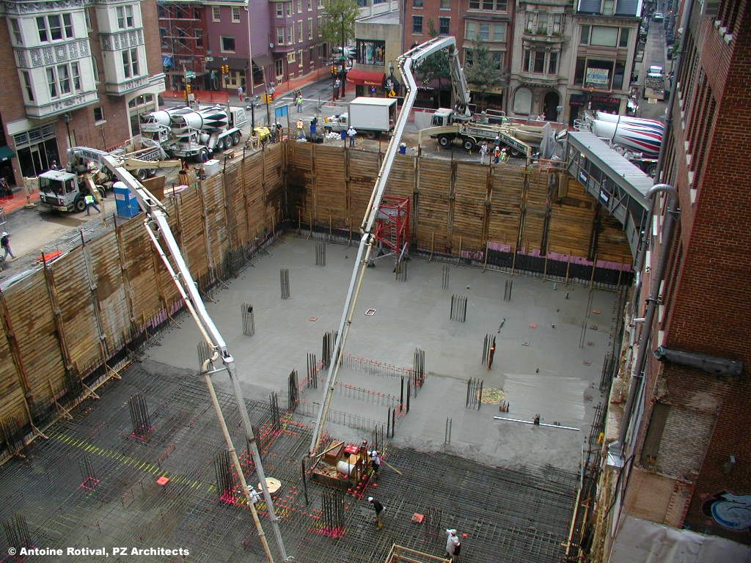
foundation
https://www.pinterest.co.uk/pin/328129522825689421/
Notes:
A word in the text is foundation.
In Spanish it is fundación (foon-dah-syohn).
A foundation is the bottom part of a building or structure.
Let’s say the word foundation together. Ready?
”Foundation.” When you say foundation, I hear the /f/ sound at the beginning of the word.
Look, foundation begins with the letter f.
Here is a picture that shows foundation. We see the foundation for a skyscraper. Skyscrapers are very tall buildings. Notice how deep the workers dug the foundation to make sure the structure will be stable.

Slide 3
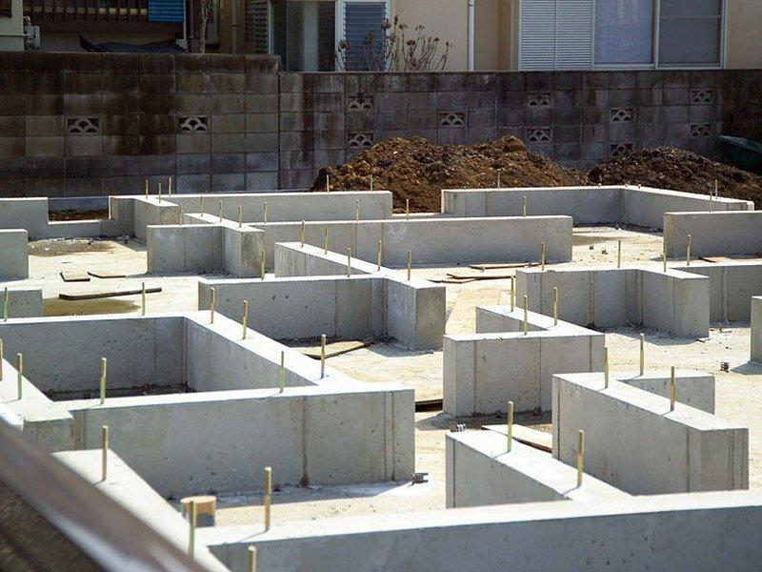
foundation
https://stonehillbuilders.com/5-steps-to-building-a-house-foundation/
Notes:
Here is another picture of foundation.
How does this picture show the meaning of foundation? Turn and talk to your partner.
The image shows the foundation for the different rooms in a house.
How many syllables are in the word foundation? Let’s find out by clapping. Ready?
“Foun-da-tion.” 3 syllables.
Now, let’s say foundation three times while clapping the syllables. Ready?
“Foun-da-tion, foun-da-tion, foun-da-tion.”

Slide 4
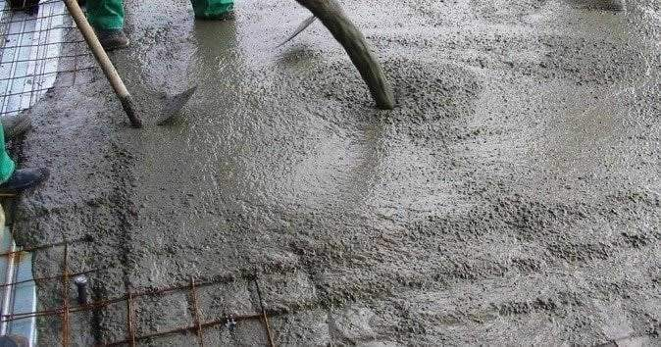
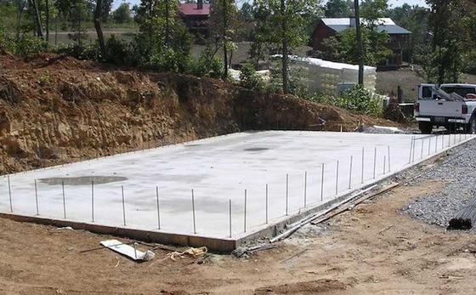
concrete
https://www.justdial.com/Chennai/Rcc-Concrete-Near-More-Market-Medavakkam/044PXX44-XX44-190830161853-R5L6_BZDET/https://www.bobvila.com/articles/442-concrete-block-and-slab-foundations/
Notes:
A word in the book is concrete.
In Spanish it is hormigón (ohr-mee-gohn).
Concrete is a material used for building that begins in liquid form and dries into a heavy solid.
.
Let’s say the word above together. Ready?
”Concrete.” When you say concrete, I hear the /c/ sound at the beginning of the word.
Look, concrete begins with the letter c.
These are two pictures that show concrete. The first shows construction workers pouring the liquid concrete to make the foundation. The second shows the concrete hardened into a hard, sturdy solid.

Slide 5
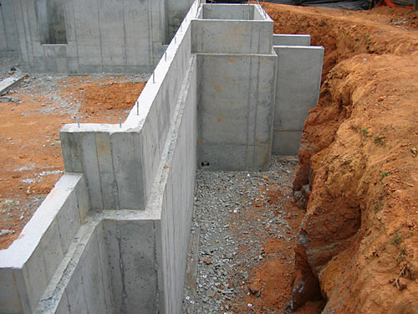
concrete
https://www.premiumhi.net/sample-blog/concrete-vs-wood-foundations
Notes:
Here is another picture of concrete.
How does this picture show the meaning of concrete? Turn and talk to your partner.
These walls are made of concrete.
How many syllables are in the word concrete? Let’s find out by clapping. Ready?
“Con-crete.” 2 syllables.
Now, let’s say concrete three times by clapping the syllables. Ready?
“Con-crete, con-crete, con-crete.”

Slide 6
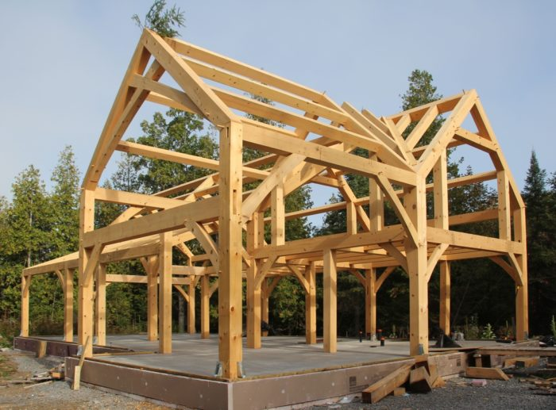
frame
https://www.greenbuildingadvisor.com/article/a-timber-frame-house-for-a-cold-climate-part-1
Notes:
A word in the book is frame.
In Spanish it is capa (kah-pah).
A frame is a solid structure that surrounds or encloses something.
We can think of a frame like an outline of a three-dimensional structure. You make outlines when you are drawing, and then put color inside. The frame is like the outline of a building, and then builders put walls, doors, and windows inside the frame.
Let’s say the word frame together. Ready?
“Frame.” When you say frame, I hear the /f/ sound at the beginning of the word.
Look, frame begins with the letter f.
Here is a picture that shows frame. This frame is the structure that encloses the different rooms in the building.

Slide 7
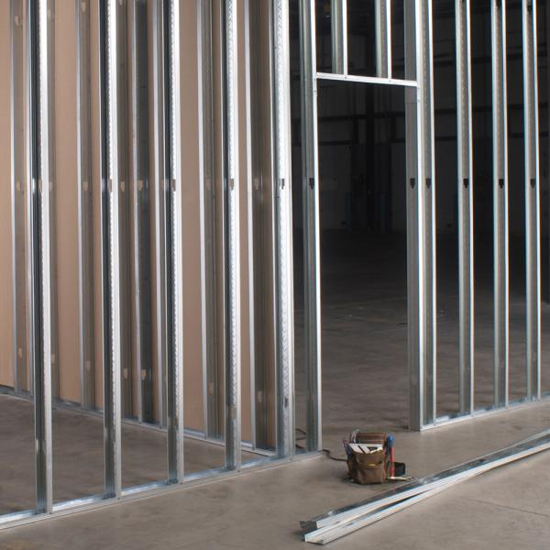
frame
https://www.kamcoboston.com/category/Products/Steel-Framing-Systems/Steel-Framing/Interior-Framing
Notes:
Here is another picture of frame.
How does this picture show the meaning of frame? Turn and talk to your partner.
This frame shows the place where the door and the walls facing the hallway will go. The door frame is surrounding the space where the door will go.
How many syllables are in the word frame? Let’s find out by clapping. Ready?
“Frame.” 1 syllable.
Now, let’s say frame three times by clapping the syllables. Ready?
“Frame, frame, frame.”

Slide 8
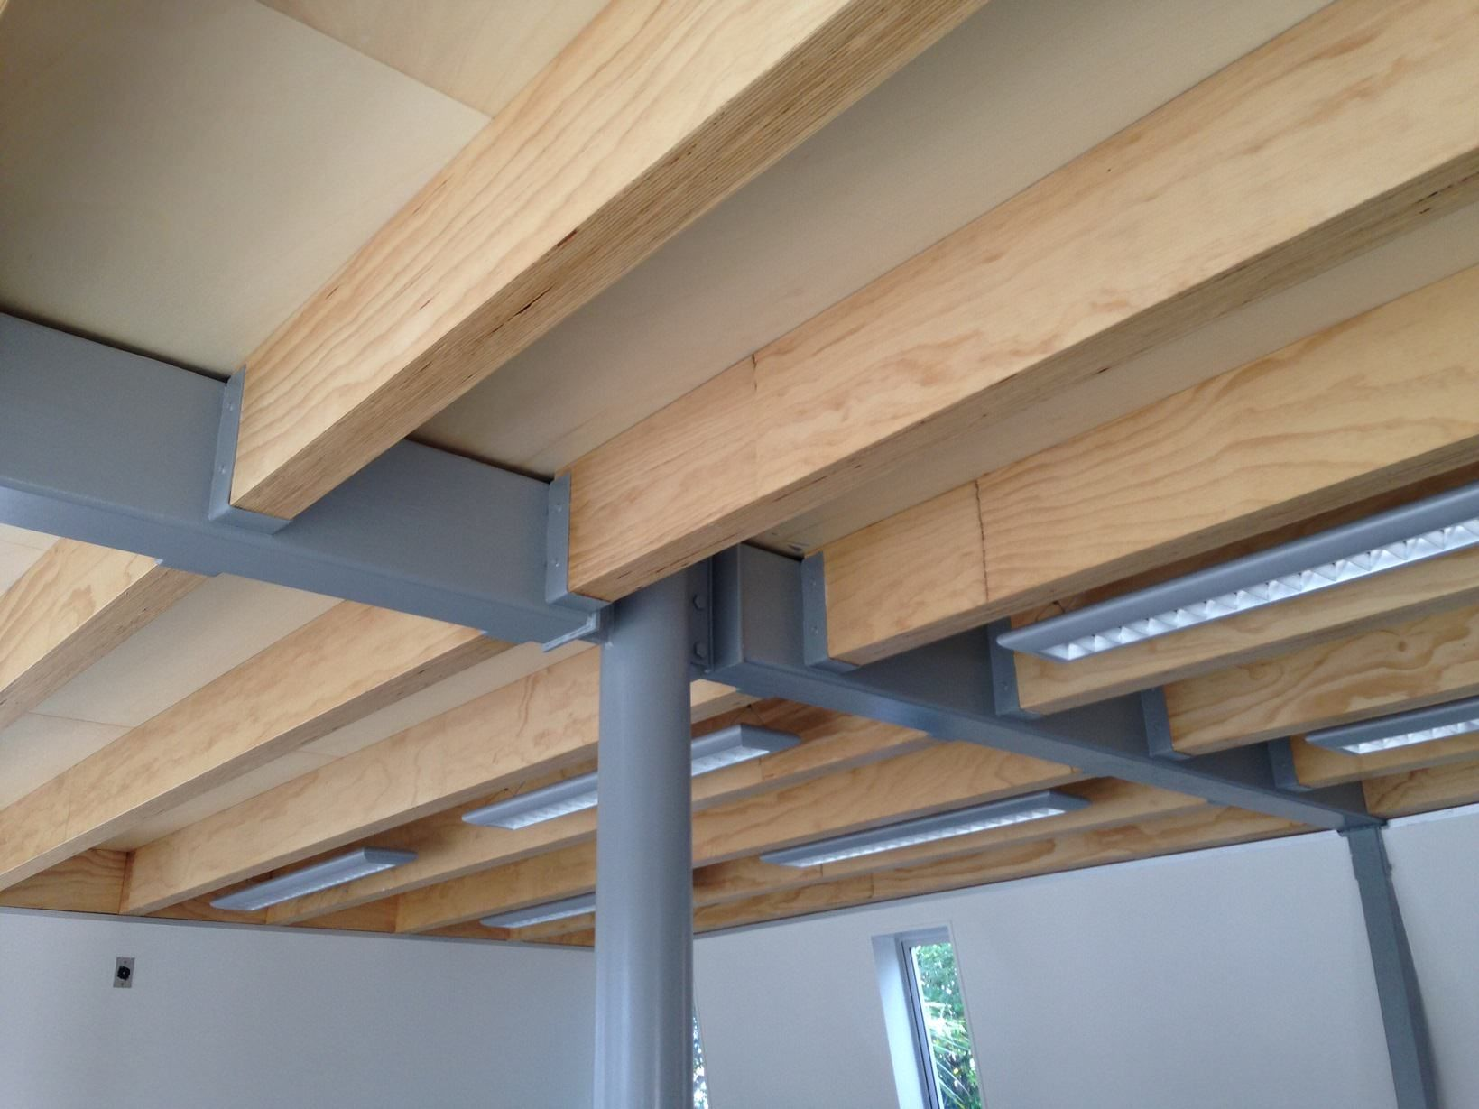
support
https://www.pinterest.com/pin/524880531575852389/
Notes:
A word in the book is support.
In Spanish it is sostener (sohs-teh-nehr).
Support means to hold up.
Let’s say the word support together. Ready?
”Support.” When you say support, I hear the /s/ sound at the beginning of the word.
Look, support begins with the letter s.
Here is a picture that shows support. The wooden beams hold up or support the walls so that they don’t fall in. We also see a gray, metal pole. It holds up the ceiling and the beam so they stay in place. The pole supports the ceiling and the beam.

Slide 9
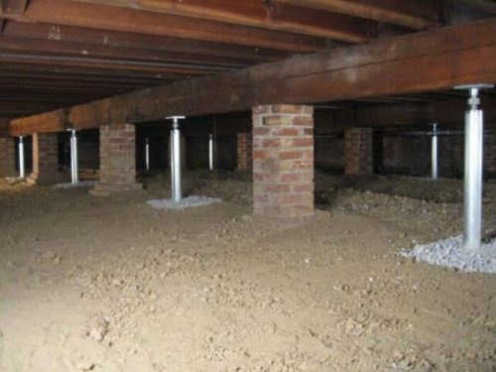
support
new-san-antonio-san-marcos-foundation-repair-guide-house-leveling-pier-beam/303755
Notes:
Here is another picture of support.
How does this picture show the meaning of support? Turn and talk to your partner.
The columns and posts in this foundation support the entire building!
How many syllables are in the word support? Let’s find out by clapping. Ready?
“Sup-port.” 2 syllables.
Now, let’s say support three times by clapping the syllables. Ready?
“Sup-port, sup-port, sup-port.”

Slide 10
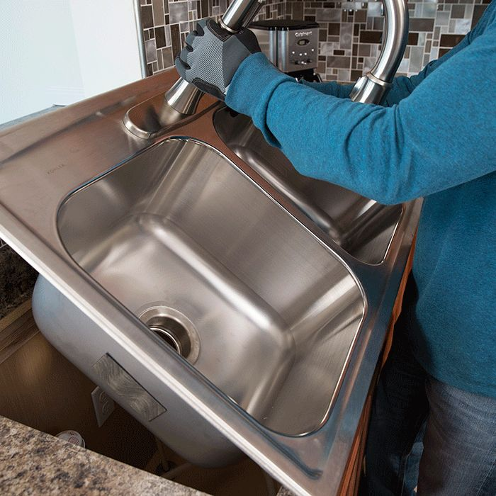
install
https://www.hagerandsonsplumbing.com/services.html
Notes:
A word in the book is install.
In Spanish it is instalar (eens-tah-lahr).
Install means to put in.
Let’s say the word install together. Ready?
”Install.” When you say install, I hear the /i/ sound at the beginning of the word.
Look, install begins with the letter i.
Here is a picture that shows install. The person is installing a kitchen sink.

Slide 11
install
https://www.reviews.org/home-security/motion-sensors-light-guide/
Notes:
Here is another picture of install.
How does this picture show the meaning of install? Turn and talk to your partner.
This person is installing a light fixture in her home.
How many syllables are in the word install? Let’s find out by clapping. Ready?
“In-stall.” 2 syllables.
Now, let’s say install three times by clapping the syllables. Ready?
“In-stall, in-stall, in-stall.”

Slide 12
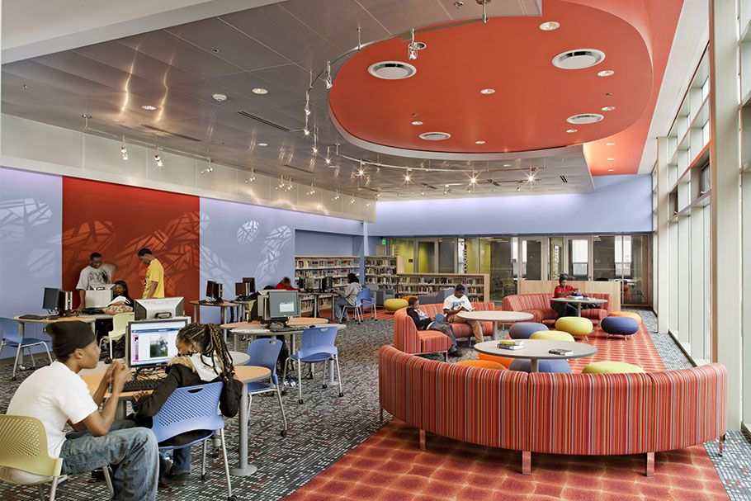
interior
https://www.pinterest.com/pin/111956740712695897/
Notes:
A word in the story is interior.
In Spanish it is interior (een-teh-ryohr).
Interior is the inside of a structure or building (and exterior is the outside of a building).
Let’s say the word interior together. Ready?
”Interior.” When you say interior, I hear the /i/ sound at the beginning of the word.
Look, interior begins with the letter i.
Here is a picture that shows interior. This is the interior of the Mattapan Public Library.

Slide 13
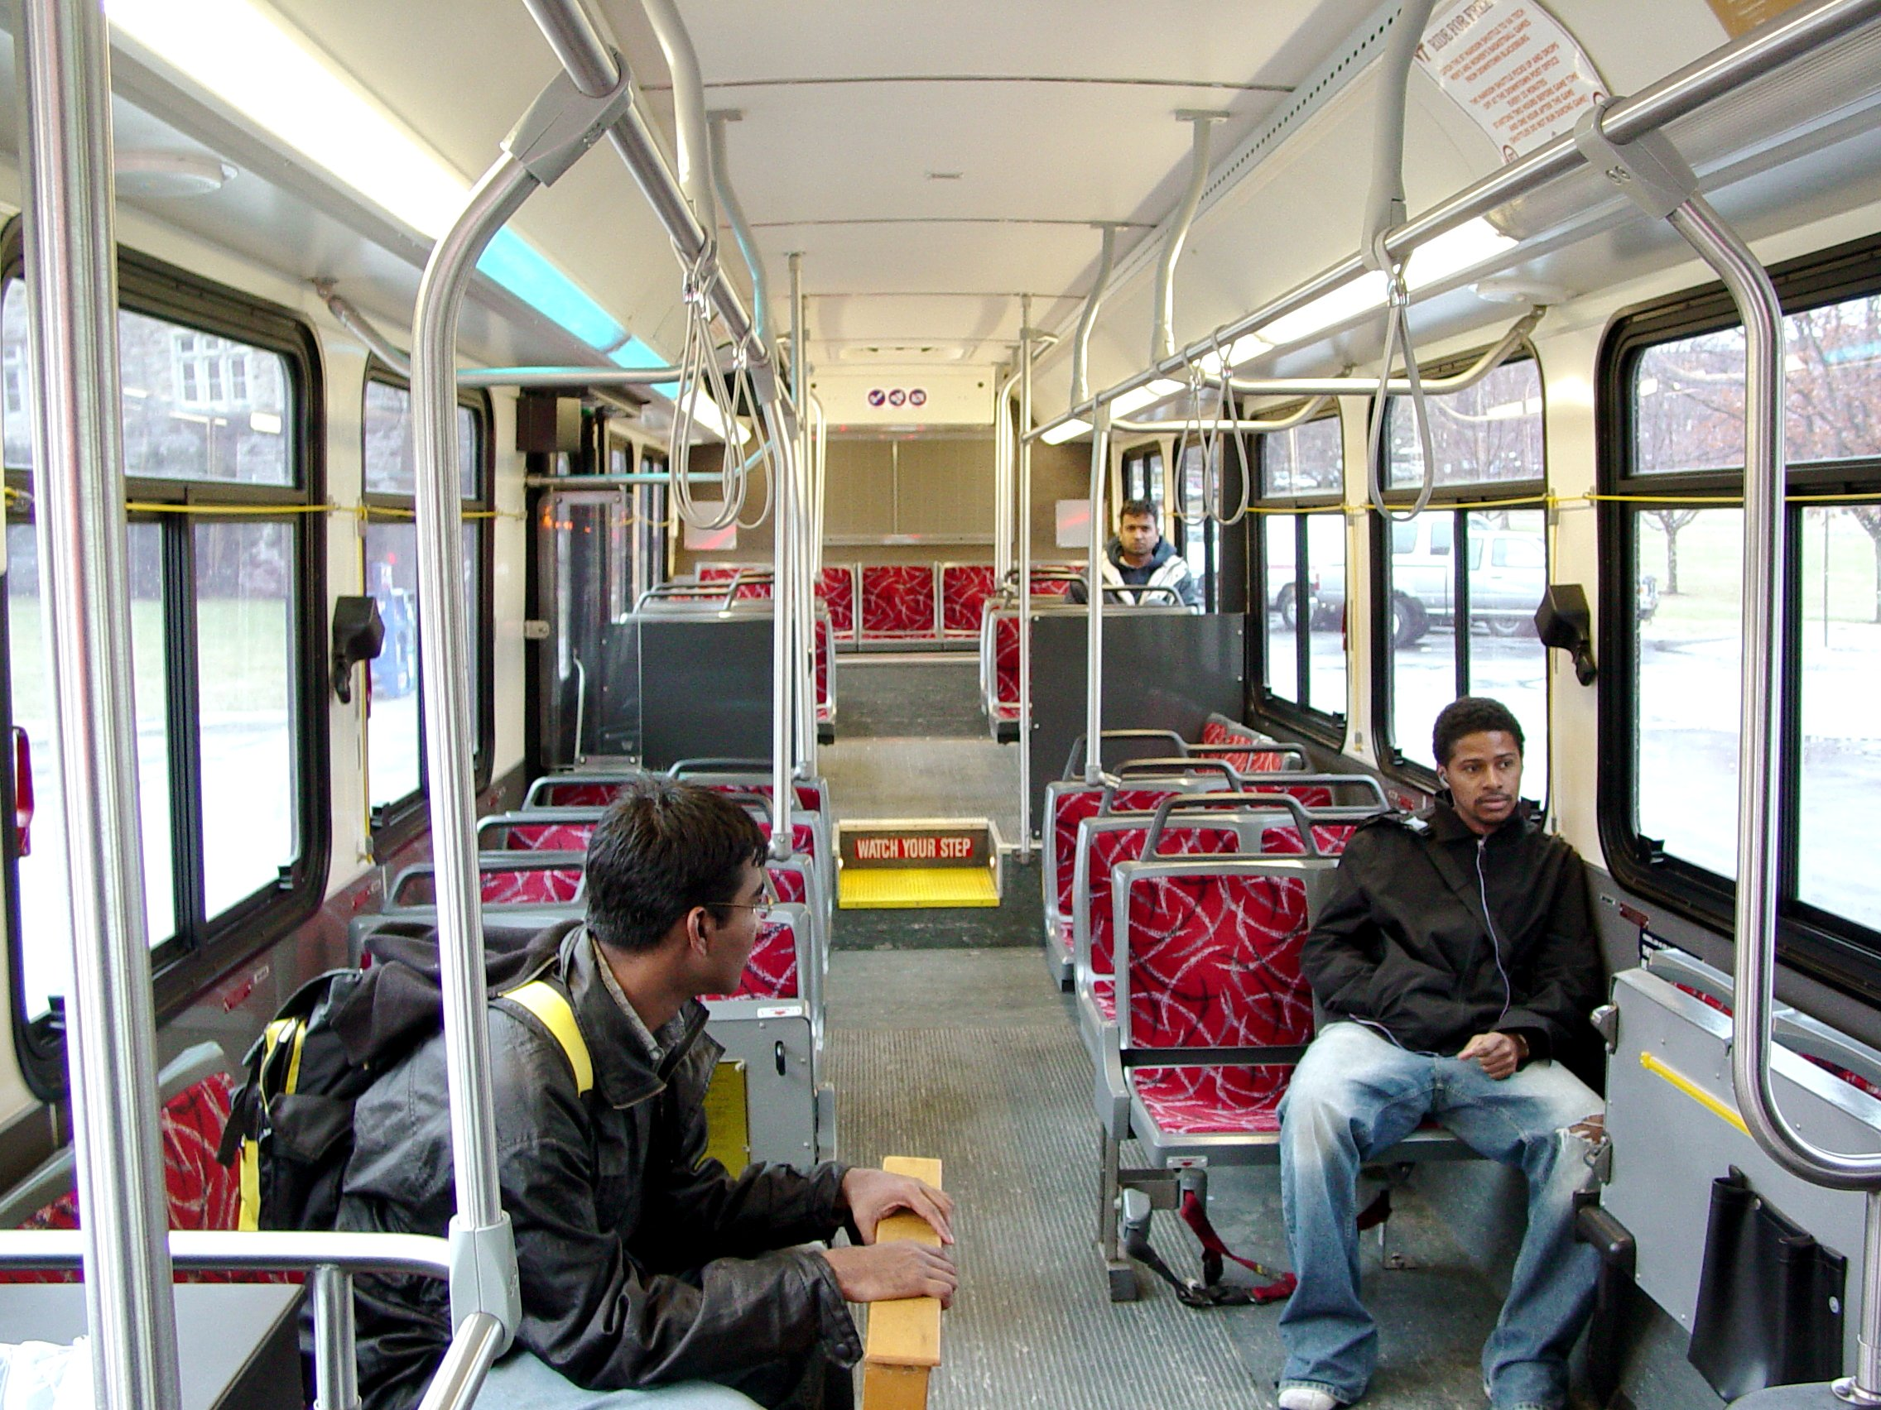
interior
https://en.wikipedia.org/wiki/File:Blacksburg_Transit_New_Flyer_low_floor_bus_interior.jpg
Notes:
Here is another picture of interior.
How does this picture show the meaning of interior? Turn and talk to your partner.
This picture shows the interior of a bus.
How many syllables are in the word interior? Let’s find out by clapping. Ready?
“In-te-ri-or.” 4 syllables.
Now, let’s say interior three times by clapping the syllables. Ready?
“In-te-ri-or, in-te-ri-or, in-te-ri-or.”

