Slide 2
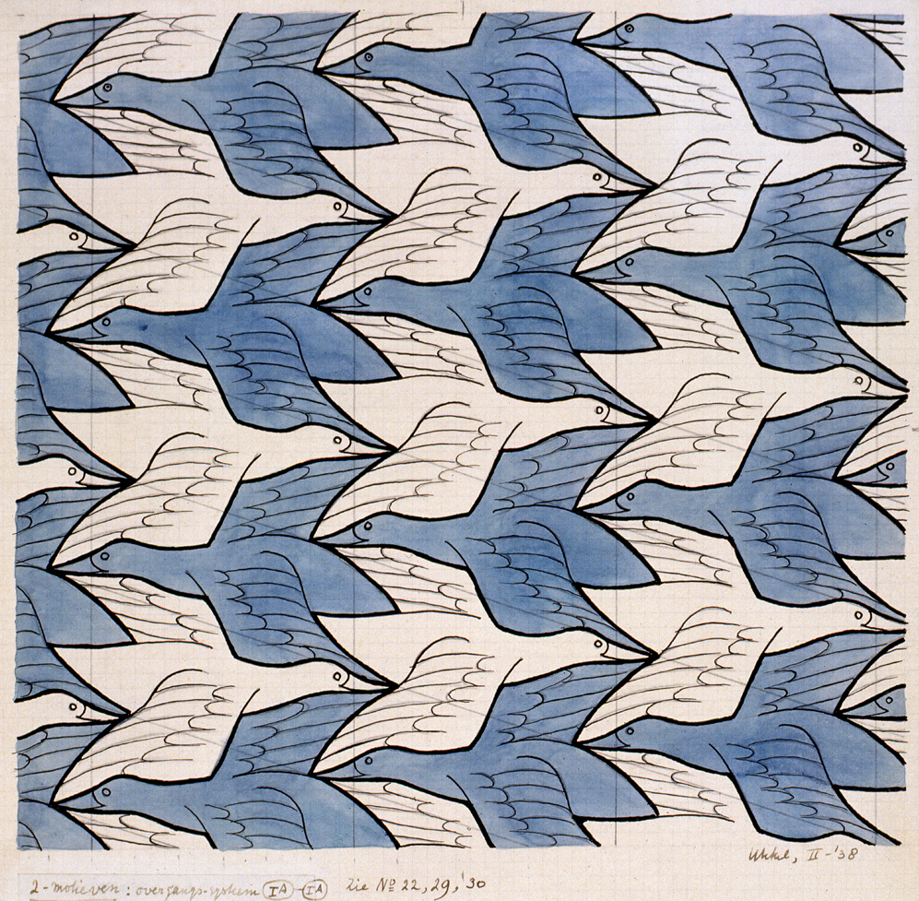
perspective
https://www.pinterest.com/pin/268456827763595642/
Notes:
A word in the story is perspective.
In Spanish it is perspectiva (pehrs-pehk-tee-bah).
Perspective is a way to see or think about things.
Let’s say the word perspective together. Ready?
”Perspective.” When you say perspective, I hear the /p/ sound at the beginning of the word.
Look, perspective begins with the letter p.
Here is a picture that shows perspective. When people look at this work of art, they have different perspectives: some see white geese, others see blue geese, and others see both.

Slide 3
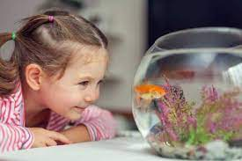
perspective
https://fluffyplanet.com/do-fish-recognize-their-owners/
Notes:
Here is another picture of perspective.
How does this picture show the meaning of perspective? Turn and talk to your partner.
How do you think the two people feel about this sunny day? Based on their expressions, they have two different perspectives. The child looks very happy that it is sunny. Kids can play in the park! The adult doesn’t seem to like it. Maybe because it is too hot. They have different perspectives on this sunny day.
How many syllables are in the word perspective? Let’s find out by clapping. Ready?
“Per-spec-tive.” 3 syllables.
Now, let’s say perspective three times by clapping the syllables. Ready?
“Per-spec-tive, per-spec-tive, per-spec-tive.”

Slide 4
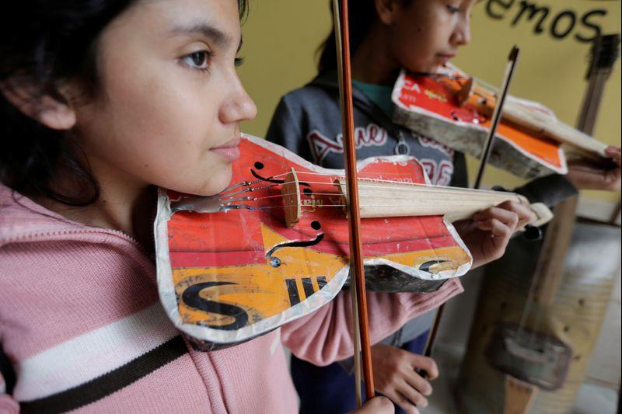
bright
https://www.nydailynews.com/life-style/orchestra-practice-recycled-orchestra-cateura-gallery-1.3414434
Notes:
Another word in the story is bright.
In Spanish it is brillante (bree-yahn-teh).
Bright means very smart. We also say that something is bright when it is shiny. In this story, it is used to mean smart.
Let’s say the word bright together. Ready?
”Bright.” When you say bright, I hear the /b/ sound at the beginning of the word.
Look, bright begins with the letter b.
Here is a picture that shows bright. These two girls are very bright. They figured out a way to build violins out of paint cans and pots, and they probably sound great!

Slide 5
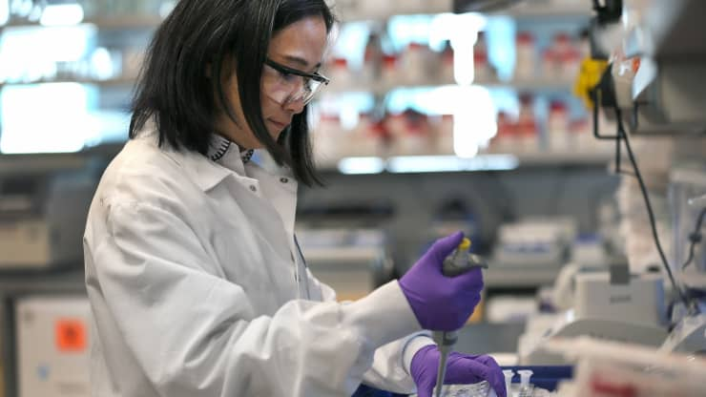
bright
https://www.cnbc.com/2020/03/16/first-human-trial-for-coronavirus-vaccine-begins-monday-in-the-us.html
Notes:
Here is another picture of bright.
How does this picture show the meaning of bright? Turn and talk to your partner.
This scientist is bright. She is doing a lot of thinking and experimenting to create medicine to protect us from illnesses.
How many syllables are in the word bright? Let’s find out by clapping. Ready?
“Bright.” 1 syllable.
Now, let’s say bright three times while clapping the syllables. Ready?
“Bright, bright, bright.”

Slide 6
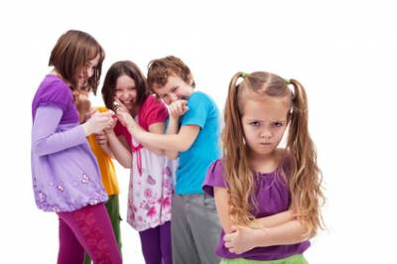
rude
https://antibullyingsoftware.com/blog/bullying-advice-for-teachers/teasing-and-bullying-how-to-know-when-teasing-crosses-the-line-and-becomes-hurtful/
Notes:
A word in the story is rude.
In Spanish it is maleducado (mahl-eh-doo-kah-doh).
Rude means impolite or offensive.
Let’s say the word rude together. Ready?
”Rude.” When you say rude, I hear the /r/ sound at the beginning of the word.
Look, rude begins with the letter r.
Here is a picture that shows rude. The older children are making fun of the younger child. They are being rude to her.

Slide 7
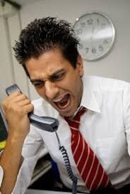
rude
https://www.siliconindia.com/shownews/rude-behaviour-among-employees-turns-off-customers-nid-70010-cid-29.html
Notes:
Here is another picture of rude.
How does this picture show the meaning of rude? Turn and talk to your partner.
The man is rude because he is yelling at someone on the phone.
How many syllables are in the word rude? Let’s find out by clapping. Ready?
“Rude.” 1 syllable.
Now, let’s say rude three times by clapping the syllables. Ready?
“Rude, rude, rude.”

Slide 8
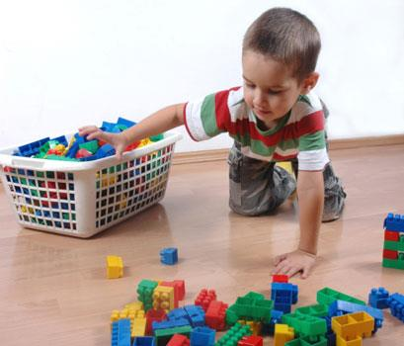
clear
https://www.4abetterspace.com/blog/view/757/the_benefits_of_raising_an_organized_child
Notes:
Another word in the story is clear.
In Spanish it is despejar (dehs-peh-hahr).
Clear is to remove things that are blocking a place.
Let’s say the word clear together. Ready?
”Clear.” When you say clear, I hear the /c/ sound at the beginning of the word.
Look, clear begins with the letter c.
Here is a picture that shows clear. This child is clearing the Legos from the floor. Now his family will be able to walk by without tripping on them.

Slide 9
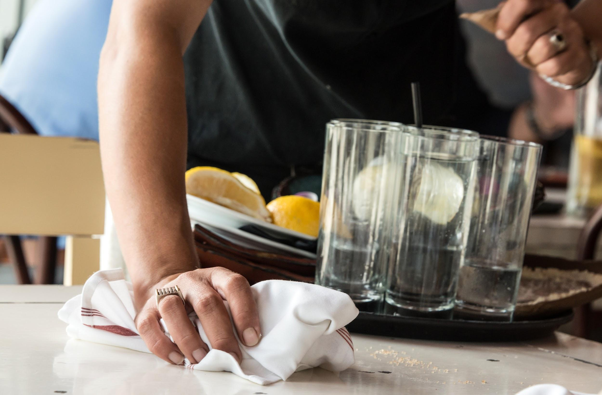
clear
https://careertrend.com/how-2266482-clear-table-as-waiter.html
Notes:
Here is another picture of clear.
How does this picture show the meaning of clear? Turn and talk to your partner.
The waiter is clearing the table so other customers can sit and enjoy a meal.
How many syllables are in the word clear? Let’s find out by clapping. Ready?
“Clear.” 1 syllable.
Now, let’s say clear three times by clapping the syllables. Ready?
“Clear, clear, clear.”

