Slide 1
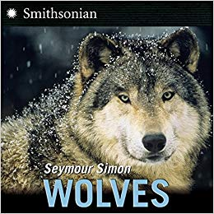

Slide 2
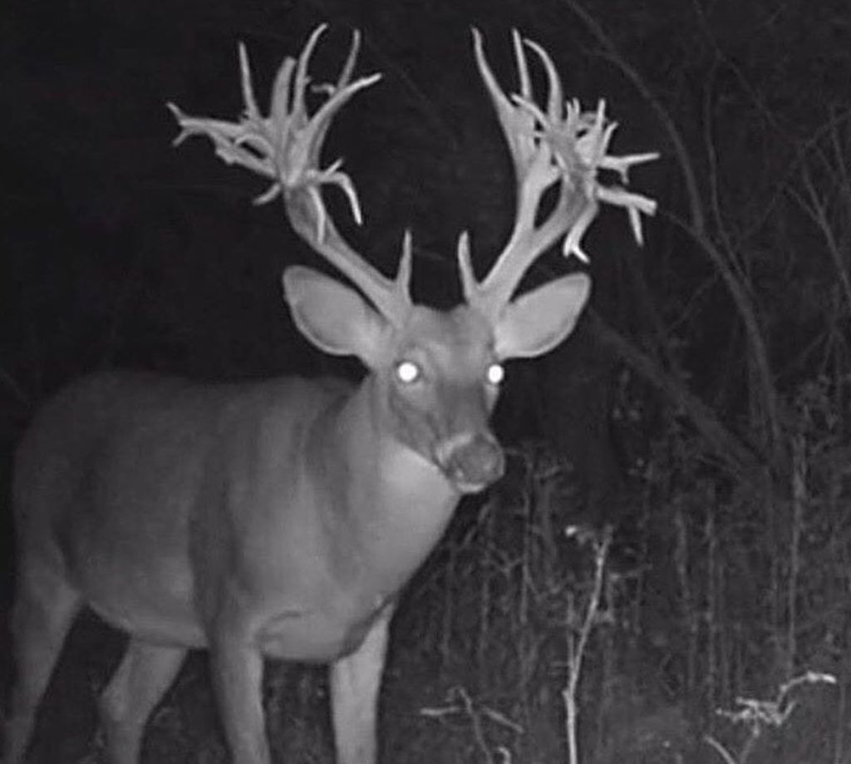
eerie
https://www.pinterest.com/pin/242279654934350274/?autologin=true&nic_v2=1a18YqhJw
Notes:
A word in the story is eerie.
In Spanish it is espeluznante (ehs-peh-loos-nahn-teh).
Eerie means scary or spooky.
Let’s say the word eerie together. Ready?
“Eerie.” When you say eerie, I hear an /e/ sound at the beginning of the word.
Look, eerie begins with the letter e.
Here is a picture that shows eerie. This deer looks eerie, or kind of strange and scary, to me. The way his eyes and antlers are lit in the photo make him look a bit eerie.

Slide 3
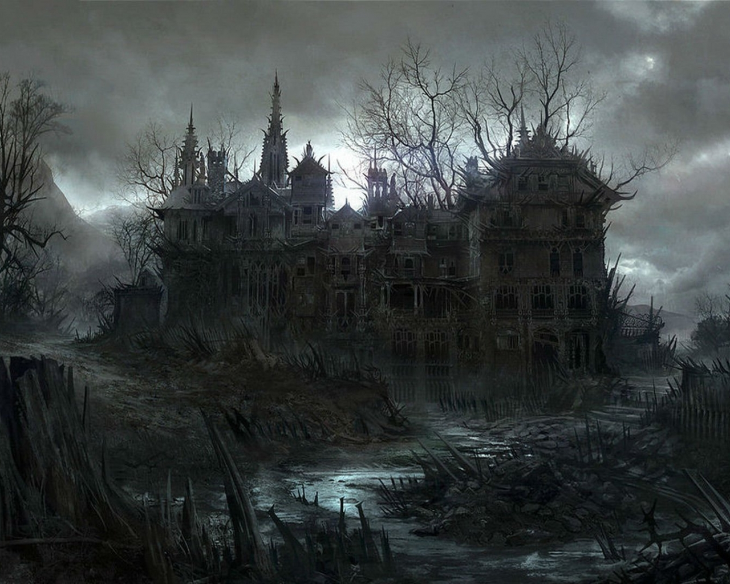
eerie
https://wallpapersafari.com/w/19yprx
Notes:
Here is another picture of eerie.
How does this picture show the meaning of eerie? Turn and talk to your partner.
This house looks eerie or scary because of the branches growing out of it.
How many syllables are in the word eerie? Let’s find out by clapping. Ready?
“Ee-rie.” Two syllables.
Now, let’s say eerie three times by clapping the syllables. Ready?
“Ee-rie, ee-rie, ee-rie.”

Slide 4
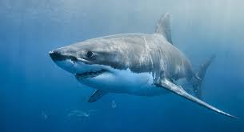
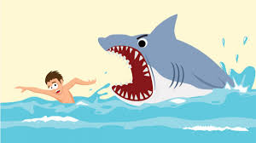
misunderstood
https://www.bostonmagazine.com/news/2019/05/21/great-white-shark-connecticut/https://www.gograph.com/vector-clip-art/shark-attack.html
Notes:
A word in the story is misunderstood.
In Spanish it is incomprendido (een-kohm-prehn-dee-doh).
Misunderstood means not known or not understood correctly. When we see “mis” at the beginning of a word, it usually means “not”—not understood.
Let’s say the word misunderstood together. Ready?
“Misunderstood.” When you say misunderstood, I hear a /m/ sound at the beginning of the word.
Look, misunderstood begins with the letter m.
Sharks, like wolves, are animals that are often misunderstood. Many people don’t know the facts about sharks; they believe that sharks want to attack people. In fact, sharks don’t like to eat people; they like to eat seals. Sometimes sharks bite people because they think they are seals. In many images and movies, sharks are portrayed as scary animals that like to eat people. So we can say that sharks are misunderstood.

Slide 5
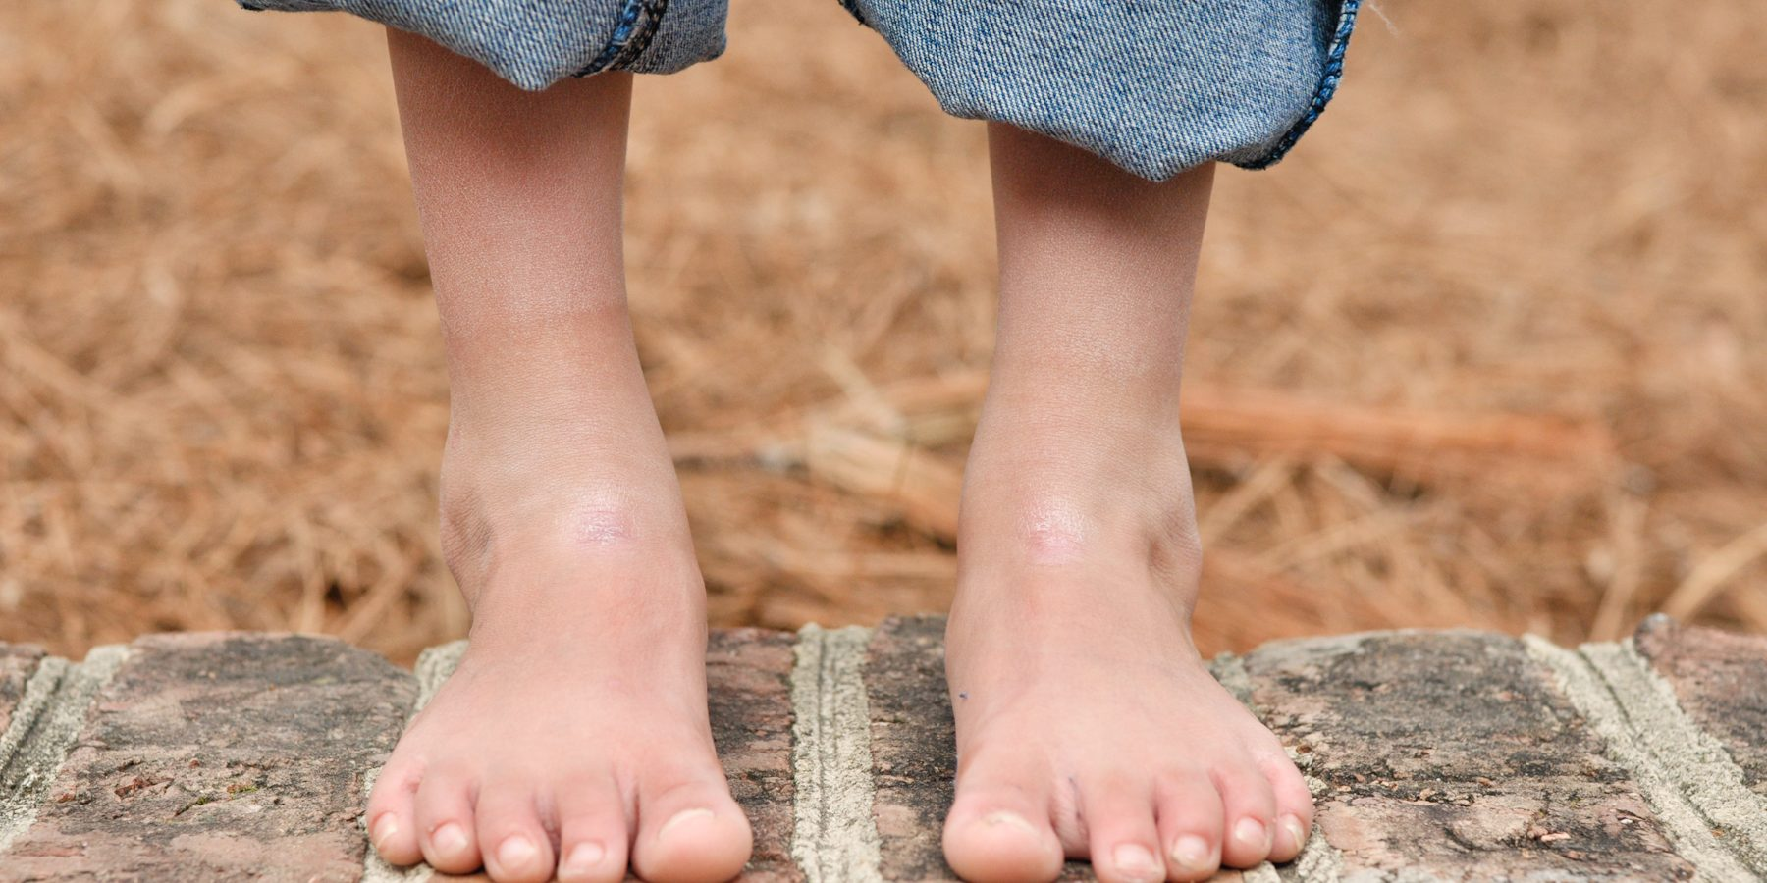
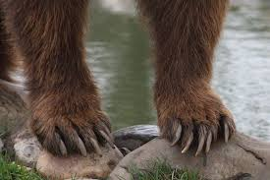
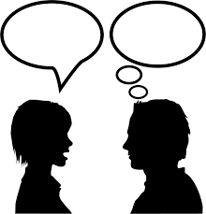
misunderstood
https://www.raepica.com/2017/09/barefoot-benefits-brain-development-2018/, https://www.pinterest.co.uk/pin/90705379975403029/?nic_v2=1a18YqhJw, http://clipart-library.com/free/talk-clipart-black-and-white.html
Notes:
Here is another picture of misunderstood.
How do these pictures show the meaning of misunderstood? Turn and talk to your partner.
One person said, “I saw a child with bare feet!” The child had no shoes on.
The other person thought she said “Bear feet”—the feet of the animal, bear.
The second person misunderstood what the first person was saying! The words sound the same but they have different meanings.
How many syllables are in the word misunderstood? Let’s find out by clapping. Ready?
“Mis-un-der-stood.” Four syllables.
Now, let’s say misunderstood three times by clapping the syllables. Ready?
“Mis-un-der-stood, mis-un-der-stood, mis-un-der-stood.”

Slide 6
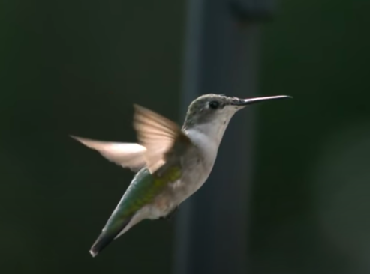
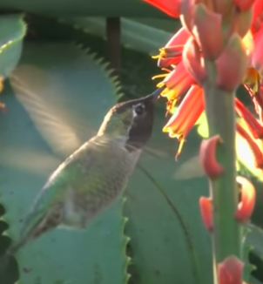
trait
https://www.youtube.com/watch?v=XVsIes8mfBQ
Notes:
A word in the story is trait.
In Spanish it is característica (kah-rahk-teh-rees-tee-kah).
Trait means characteristic, something typical of a place, thing, or person.
Let’s say the word trait together. Ready?
“Trait.” When you say trait, I hear a /t/ sound at the beginning of the word.
Look, trait begins with the letter t.
Here is a picture that shows trait. One trait of hummingbirds is that they flap their wings very, very fast. This allows them to hover next to flowers for feeding.

Slide 7
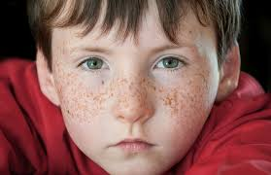
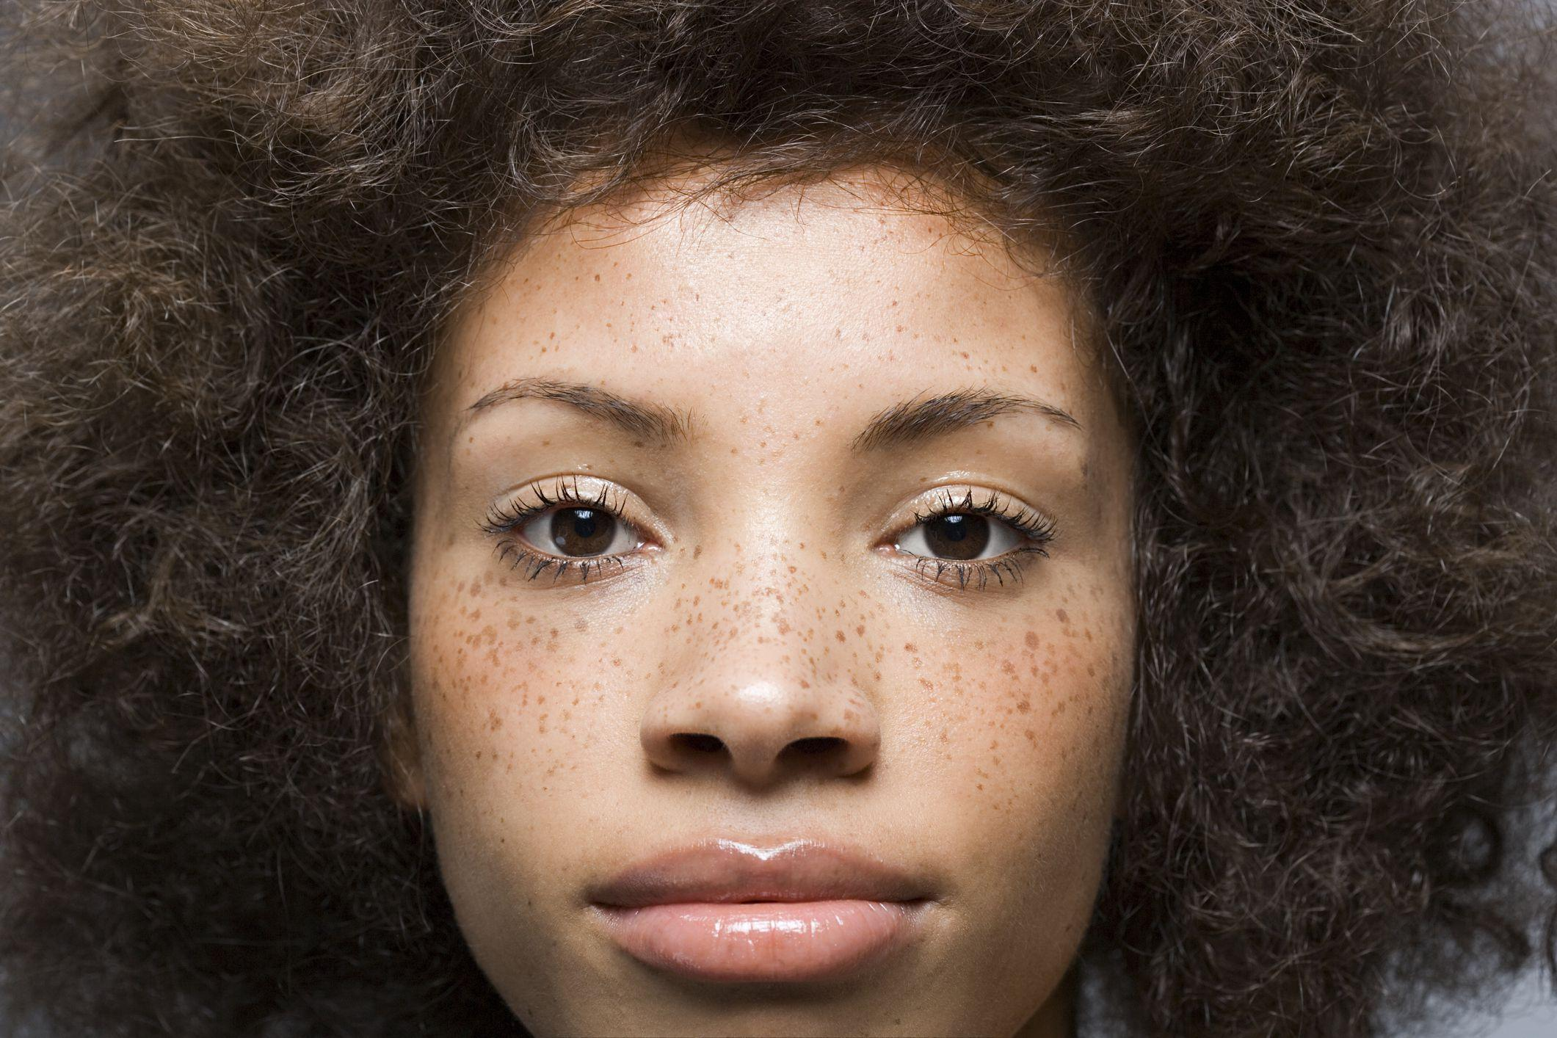
trait
https://kidsdiscover.com/quick-reads/what-causes-fabulous-freckles/, , https://www.byrdie.com/freckles-sun-damage-4690451
Notes:
Here is another picture of trait.
How do these pictures show the meaning of trait? Turn and talk to your partner.
What trait do these two people have in common? They both have freckles on their faces—that’s the trait they have in common.
How many syllables are in the word trait? Let’s find out by clapping. Ready?
“Trait.” One syllable.
Now, let’s say trait three times by clapping the syllables. Ready?
“Trait, trait, trait.”

Slide 8
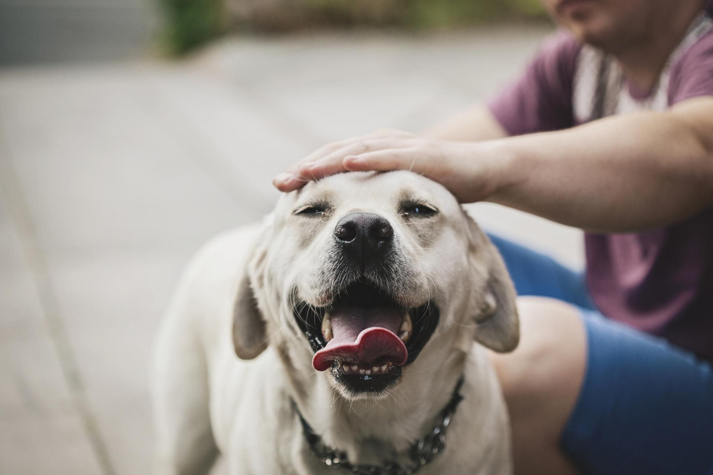
domesticated
https://time.com/4459684/national-dog-day-history-domestic-dogs-wolves/
Notes:
A word in the story is domesticated.
In Spanish it is domesticado (doh-mehs-tee-kah-doh).
Domesticated means tamed, kept by humans.
.
Let’s say the word domesticated together. Ready?
“Domesticated.” When you say domesticated, I hear a /d/ sound at the beginning of the word.
Look, domesticated begins with the letter d.
Here is a picture that shows domesticated. Dogs have been domesticated, and many people have them as pets. They are not wild animals.

Slide 9
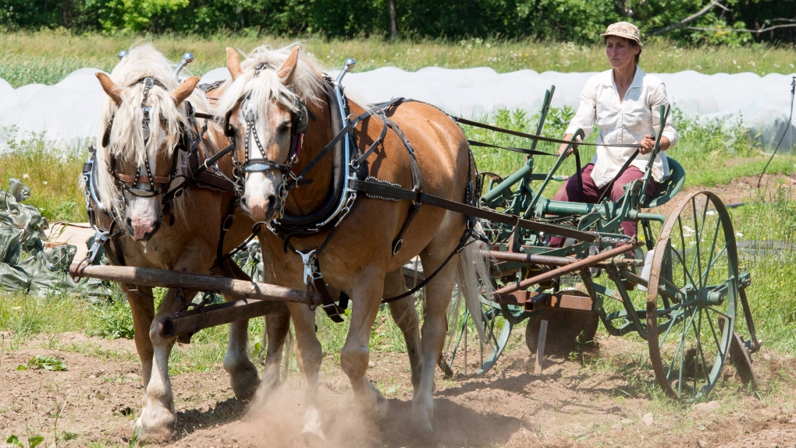
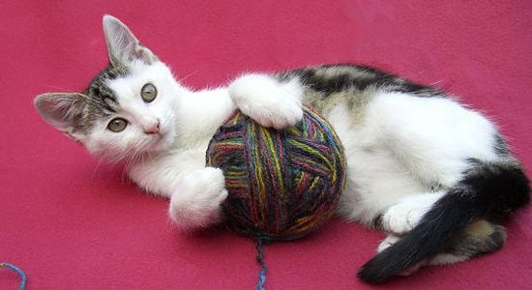
domesticated
https://www.smithsonianmag.com/history/a-brief-history-of-house-cats-158390681/, https://www.ctvnews.ca/lifestyle/why-some-canadian-farmers-are-still-choosing-horses-over-tractors-1.3997102
Notes:
Here are two more pictures of domesticated.
How do these pictures show the meaning of domesticated? Turn and talk to your partner.
This are domesticated animals. Some domesticated animals are pets, and others are working animals, such as on a farm. Domesticated animals depend on people for food and shelter, and people depend on them for companionship, work, and food.
How many syllables are in the word domesticated? Let’s find out by clapping. Ready?
“Do-mes-ti-cated.: Four syllables.
Now, let’s say domesticated three times by clapping the syllables. Ready?
“Do-mes-ti-cated, do-mes-ti-cated, do-mes-ti-cated.”

